Slide 1
Welcome to Section!
Week 1 • Code in Place 2026
Stanford University • Section Leader Edition
Cameras on · Questions welcome · Let's code together 🚀

Slide 2

A Little About Me
👤 Name: Haresh
📸
Your Photo Here
🌍 From: Pakistan
🎓 : Software Engineering Graduate
🎯 Hobby / Fun Fact: Teaching, helping, competing, and sport.
I'm your Section Leader — let's learn together! 🎉

Slide 3
What About You?
📛
🌐
❤️
Your name
Where you're tuning in from
Favorite object on your desk
💬 Shy? Drop your intro in the chat — I'll read it out for you. No pressure!

Slide 4
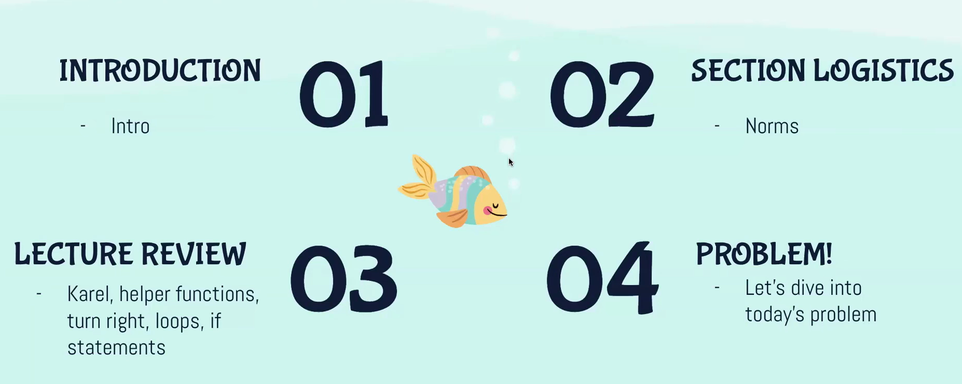
Week One Section

Slide 5
SECTION NORMS
Wait until your turn to speak, don't cut each other off
Raise hand if you want to speak
Be respectful and understanding towards each other
Show up and be willing to participate! Try our best to finish the work and respect each other's time.

Slide 6
🤖 Karel Overview
🤖
⬆️
move()
●
turn_left()
pick_beeper()
put_beeper()
Karel knows only these 4 commands — but with your code, it can do anything!
Karel's World

Slide 7
🔧 Functions Overview
Break big problems into smaller, named, reusable steps — like a recipe!
🍝 make_pasta():
Python Syntax:
make_dough()
def function_name():
# code goes here
shape_pasta()
def turn_right():
cook_pasta()
turn_left()
turn_left()
turn_left()

Slide 8
🔄 Control Flow Overview
for-loop
while-loop
if-statement
Definite Loop
Indefinite Loop
Conditional
Repeats a block a specific number of times.
Keeps repeating until the condition is false.
Runs a block only when condition is true.
def turn_right():
for i in range(3):
turn_left()
def move_to_wall():
while front_is_clear():
move()
def safe_move():
if front_is_clear():
move()

Slide 9
⚡ CONCEPT CHECK
Which loop would you use when you DON'T know how many times to repeat?
A
for-loop
C
if-statement
Definite — we know the count
Not a loop — it's a condition check
B
while-loop
D
Not sure yet!
Indefinite — runs until false
That's okay — let's find out!
💬 Use Zoom Reactions to vote! 👍 = A ❤️ = B 🎉 = C 🤔 = D

Slide 10
✅ Answer: B — while-loop!
Why while-loop?
🧹 Real World
Use for-loop when you know the count. Use while-loop when you keep going until something changes. Hospital Karel example: We don't know how long the row is — so we use while front_is_clear()
Sweeping a floor:
"Keep sweeping until the floor is clean"
Not: sweep exactly 10 times!
Any questions before we dive into Hospital Karel? 🏥

Slide 11
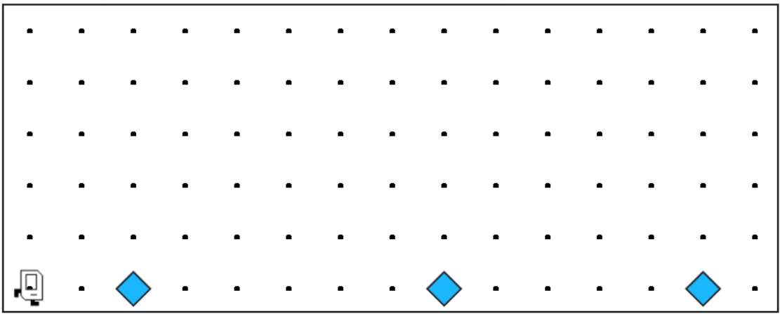
Each beeper in the figure represents a pile of supplies.

Slide 12
Karel’s job is to walk along the row and build a new hospital in the places marked by each beeper.

Slide 13
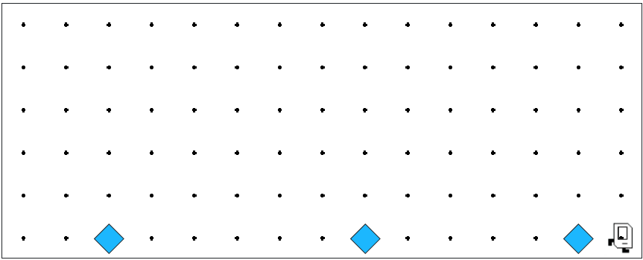

Karel’s job is to walk along the row and build a new hospital in the places marked by each beeper.

Slide 14

Hospitals look like this: a 3x2 rectangle of beepers!

Slide 15
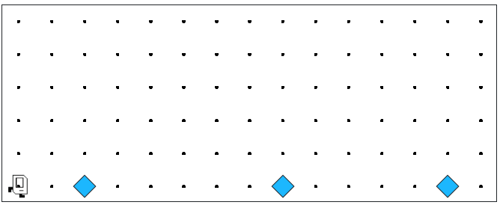
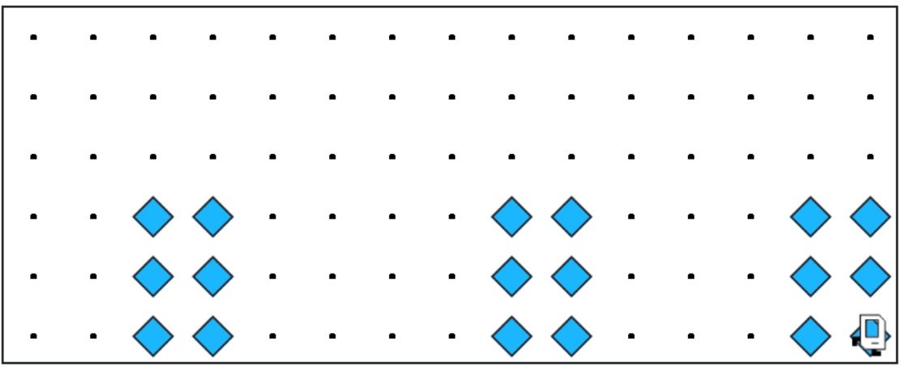
At the end of the run, Karel should be at the end of the row having created a set of hospitals. For the initial conditions shown, the result would look like this:

Slide 16
✏️
🗒️
Notes to Keep in Mind
1. Karel starts facing east at (1, 1) with an infinite number of beepers in its beeper bag.
2. The beepers indicating the positions at which hospitals should be built will be spaced so that there is room to build the hospitals without overlapping or hitting walls.
3. There will be no supplies left on the last column.
4. Karel should not run into a wall if it builds a hospital that extends into that final corner.

Slide 17
Questions Before We begin?

Slide 18
Let’s begin

