Slide 1



ROBOT
INTELLIGENT SYSTEMS

Slide 2
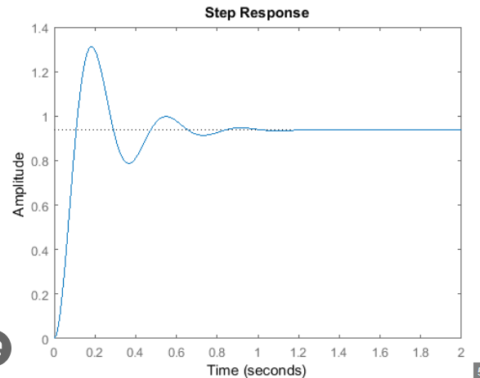
PID

Slide 3
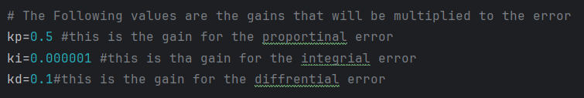
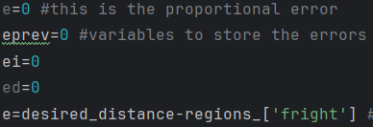
PID

Slide 4
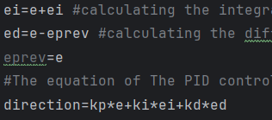

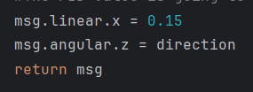
PID

Slide 5
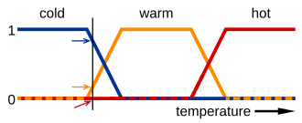
Fuzzy Logic

Slide 6
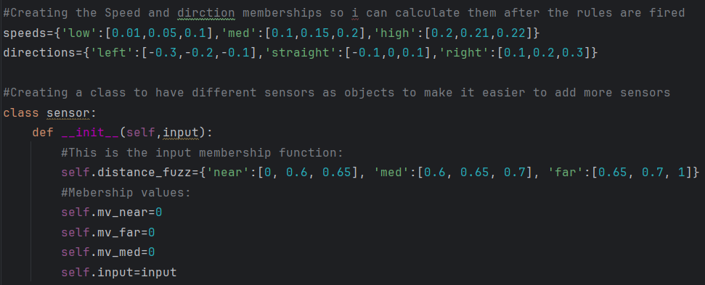
Fuzzy Logic
Memberships

Slide 7



Fuzzy Logic
Class and Sensors

Slide 8


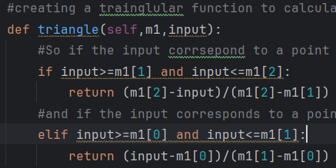
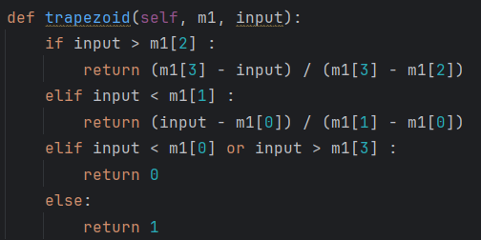
Fuzzy Logic
Membership Value Calculation

Slide 9
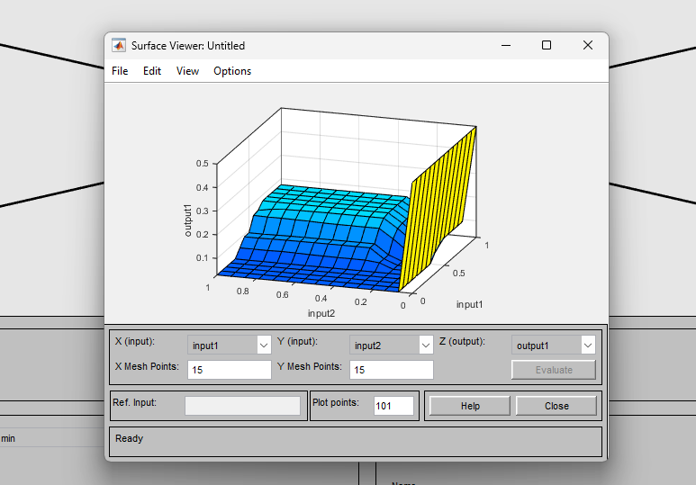
Fuzzy Logic
Membership Value Calculation

Slide 10
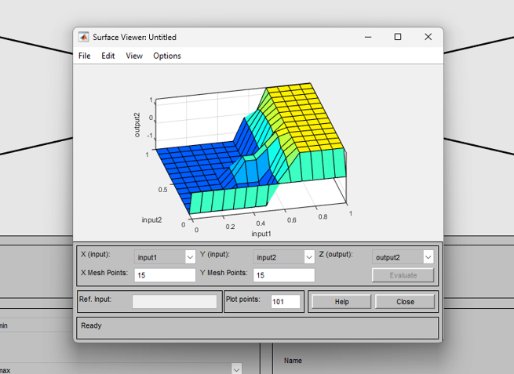
Fuzzy Logic
Membership Value Calculation

Slide 11
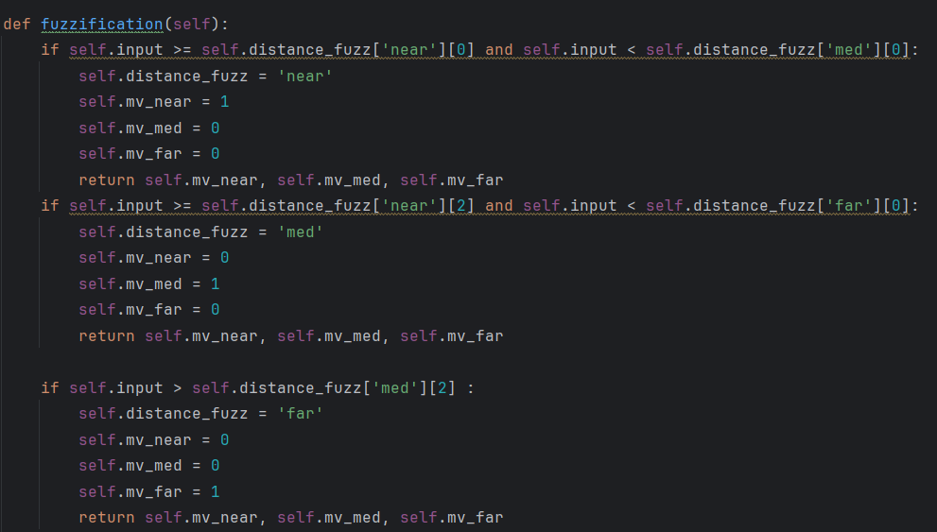
Fuzzy Logic
Membership Value Calculation

Slide 12
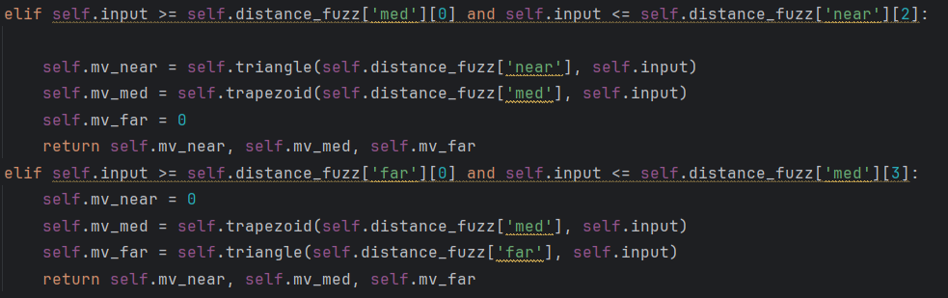
Fuzzy Logic
Membership Value Calculation

Slide 13

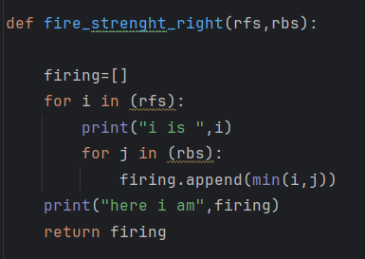
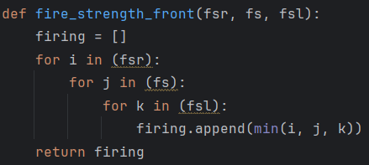
Fuzzy Logic
Firing Strength Calculation

Slide 14
Fuzzy Logic
Firing Strength Calculation

Slide 15
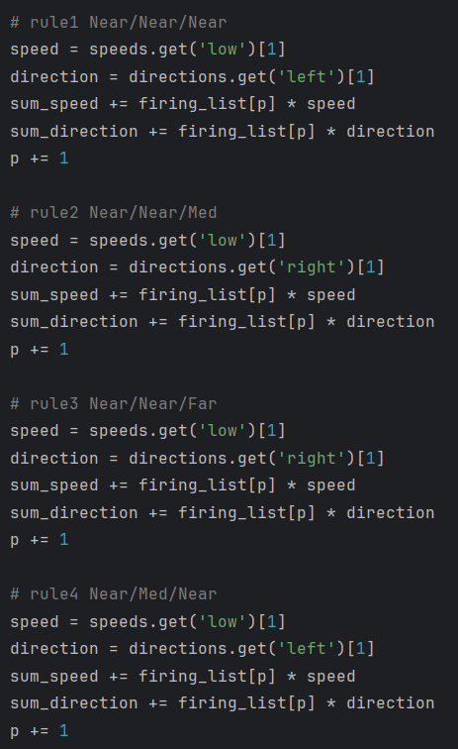
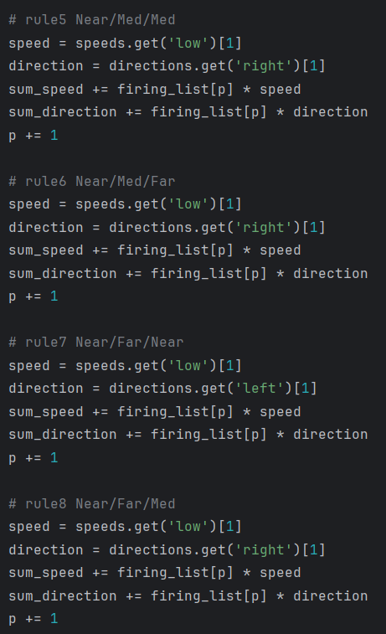
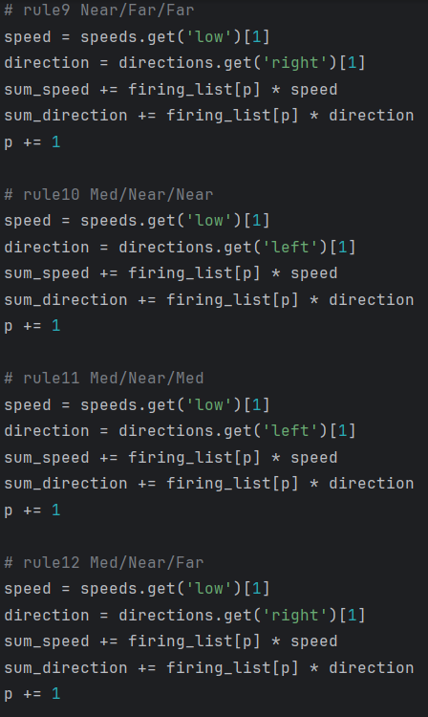
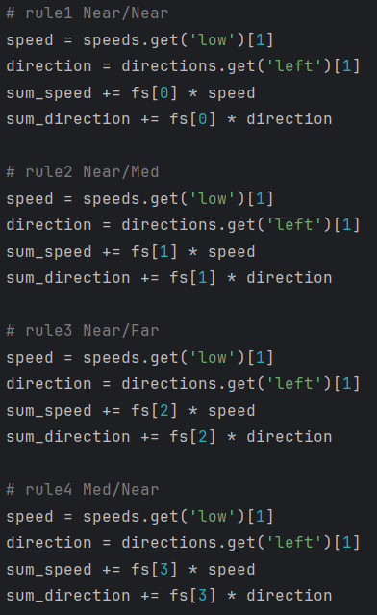
Fuzzy Logic
Rule Base

Slide 16



Fuzzy Logic
Rule Base

Slide 17
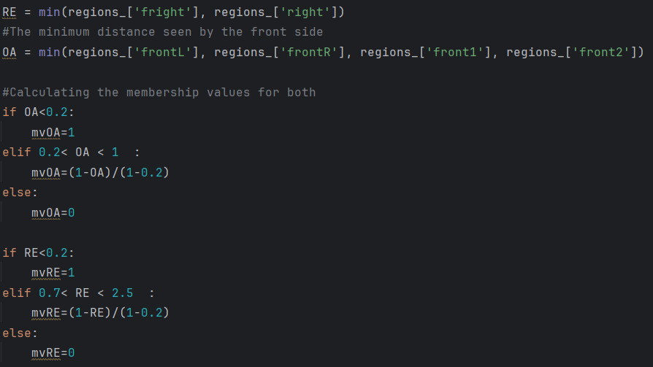
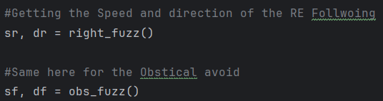
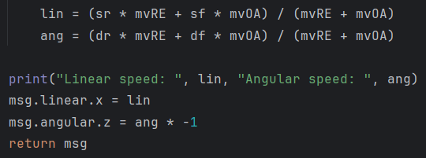
Fuzzy Logic
Context Binding

Slide 18


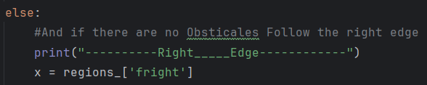

Fuzzy Logic
Subsumption

Slide 19
THANK YOU

