Slide 1

AI-Powered ADHD Diagnosis
Reducing Gender Bias in Clinical Practice. Presented by: Amer Harfoush - Registration Number: 2401810

Slide 2

Project Overview
Diagnosing ADHD, especially in females, has been challenging, causing prolonged suffering.
The project develops an AI model to accurately diagnose ADHD across genders and identify patient gender.
Creates an explainable model to assist GPs in prioritizing overlooked patients.

Slide 3

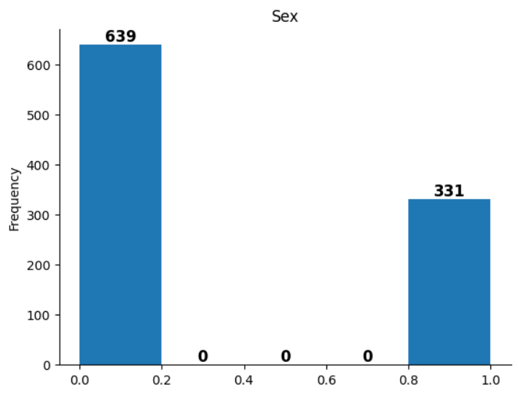

Summary of Methodology
DATA PREPROCESSING
Preprocessing involved cleaning and normalizing data collected to enhance model accuracy and response time

Slide 4
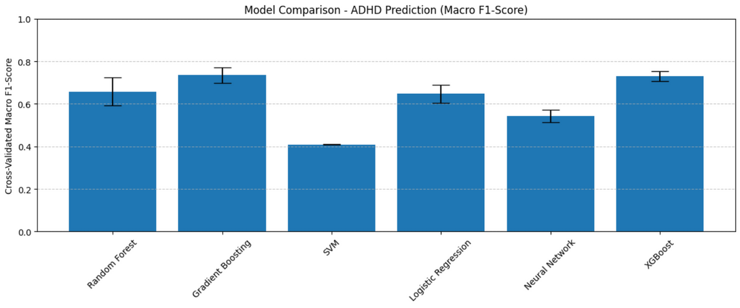
Summary of Methodology
DATA PREPROCESSING
Preprocessing involved cleaning and normalizing data collected to enhance model accuracy and response time
MODEL SELECTION
Choosing the model according to their performance in each task

Slide 5
Summary of Methodology
DATA PREPROCESSING
Preprocessing involved cleaning and normalizing data collected to enhance model accuracy and response time
MODEL SELECTION
Choosing the model according to their performance in each task
MODEL EVALUATION
Evaluation of models included metrics like precision, recall, and Confusion Matrix.

Slide 6


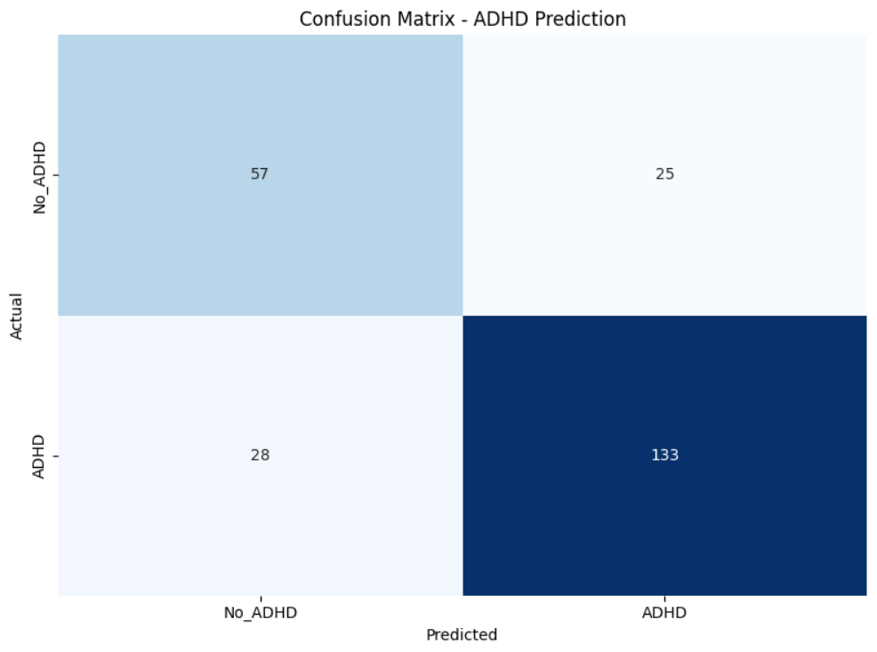

Model Performance
Evaluating the effectiveness of our ADHD support model
Strengths:
The model shows strong sensitivity (recall) for ADHD cases, which is critical in medical applications.
It is more cautious about missing ADHD diagnoses, which aligns with the goal of supporting early detection.
Consideration:
False negatives (missed ADHD diagnoses) remain a concern but are relatively low.
Overall, the model maintains a good balance, leaning slightly toward minimizing missed ADHD cases, which is appropriate for this healthcare setting.

Slide 7
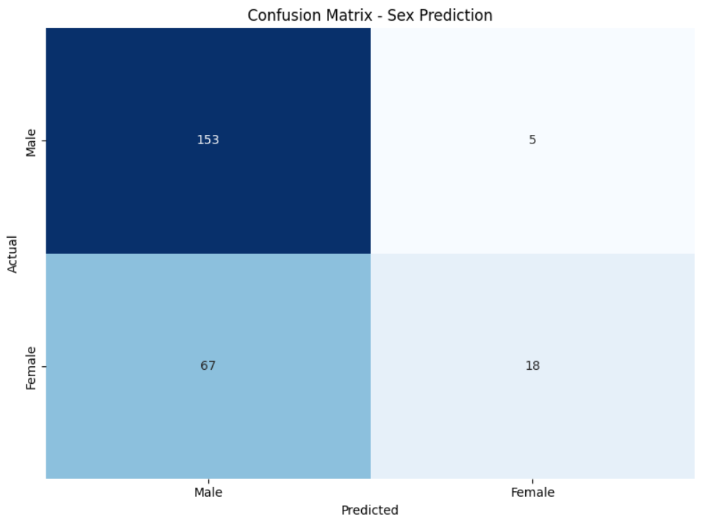
Bias Impact
Understanding the influence of sex prediction on ADHD diagnosis accuracy
96.8%
ACCURACY RATE
For Male patients
21.2%
ACCURACY RATE
For Female patients

Slide 8
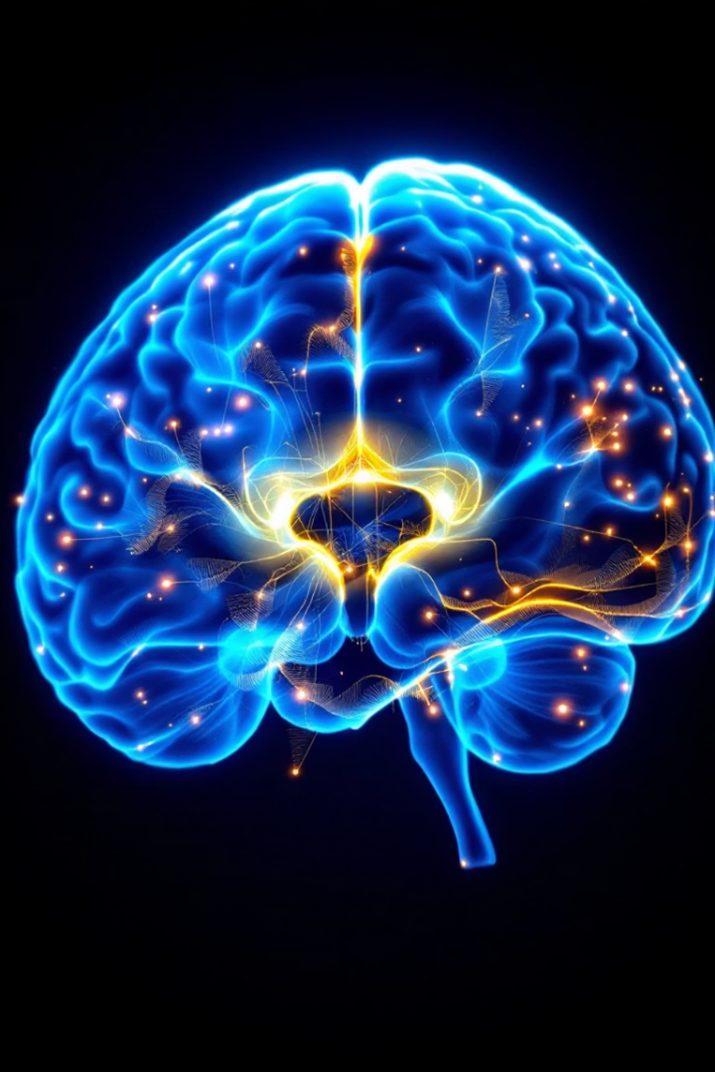
Insights & Recommendations
MODEL SUPPORT
The ADHD model provides valuable insights for clinicians in diagnosis.
LIMITATIONS
Sex model limitations warrant careful consideration for interpretation of results.
BIAS AWARENESS
There is a difference in accuracy in diagnosing ADHD patients between males and females (4.5%) in favor of male patients
MODEL ACCURACY
The Model provides an overall accuracy of 78.2%

Slide 9
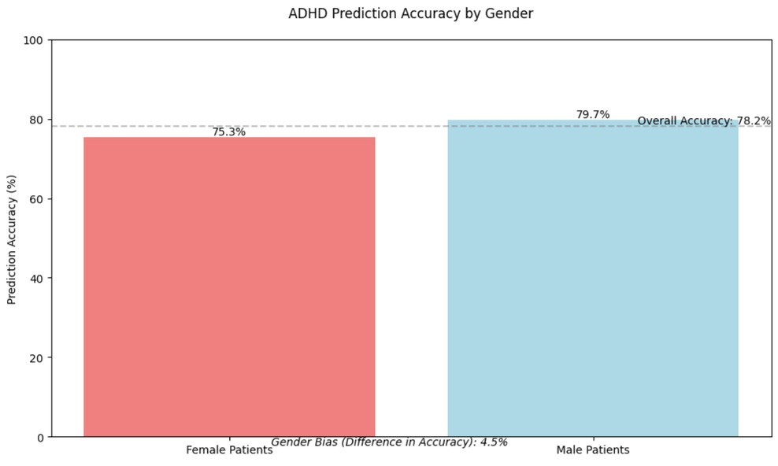
Insights & Recommendations
BIAS AWARENESS
There is a difference in accuracy in diagnosing ADHD patients between males and females (4.5%) in favor of male patients
MODEL ACCURACY
The Model provides an overall accuracy of 78.2%

Slide 10
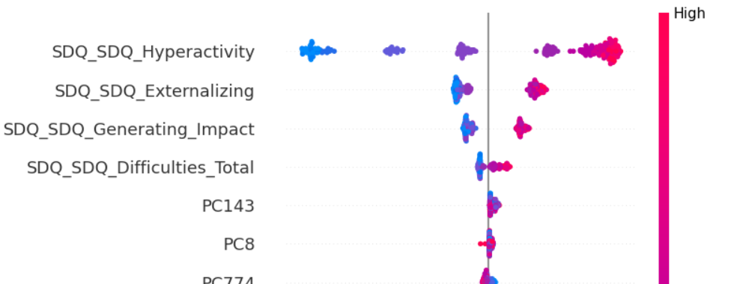
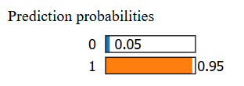
Insights & Recommendations
MODEL EXAPLINABILITY
GPs can understand why the model diagnosed the patient that way and with what % is the model sure of that

Slide 11

Conclusion
ADHD MODEL
The ADHD model fulfils the requirements However, not ready for deployment yet
SEX MODEL
The Sex identifier model is irrelevant to the prediction of ADHD to female patients
BIAS AWARENESS
The model is providing high accuracy but still a 4.5% bias in the medical field is not acceptable
There seems to be lack of data for female patients which increase the difficulty of reaching good results in any future work
FUTURE FIXES

Slide 12


Future Opportunities
Exploring innovative applications of NHS data for ADHD insights
Early Risk Prediction
Correlation Studies
GP Dashboards
Identifying potential ADHD risks in patients
Analyzing relationships between various factors and ADHD
Creating user-friendly tools for general practitioners

Slide 13


