Slide 1
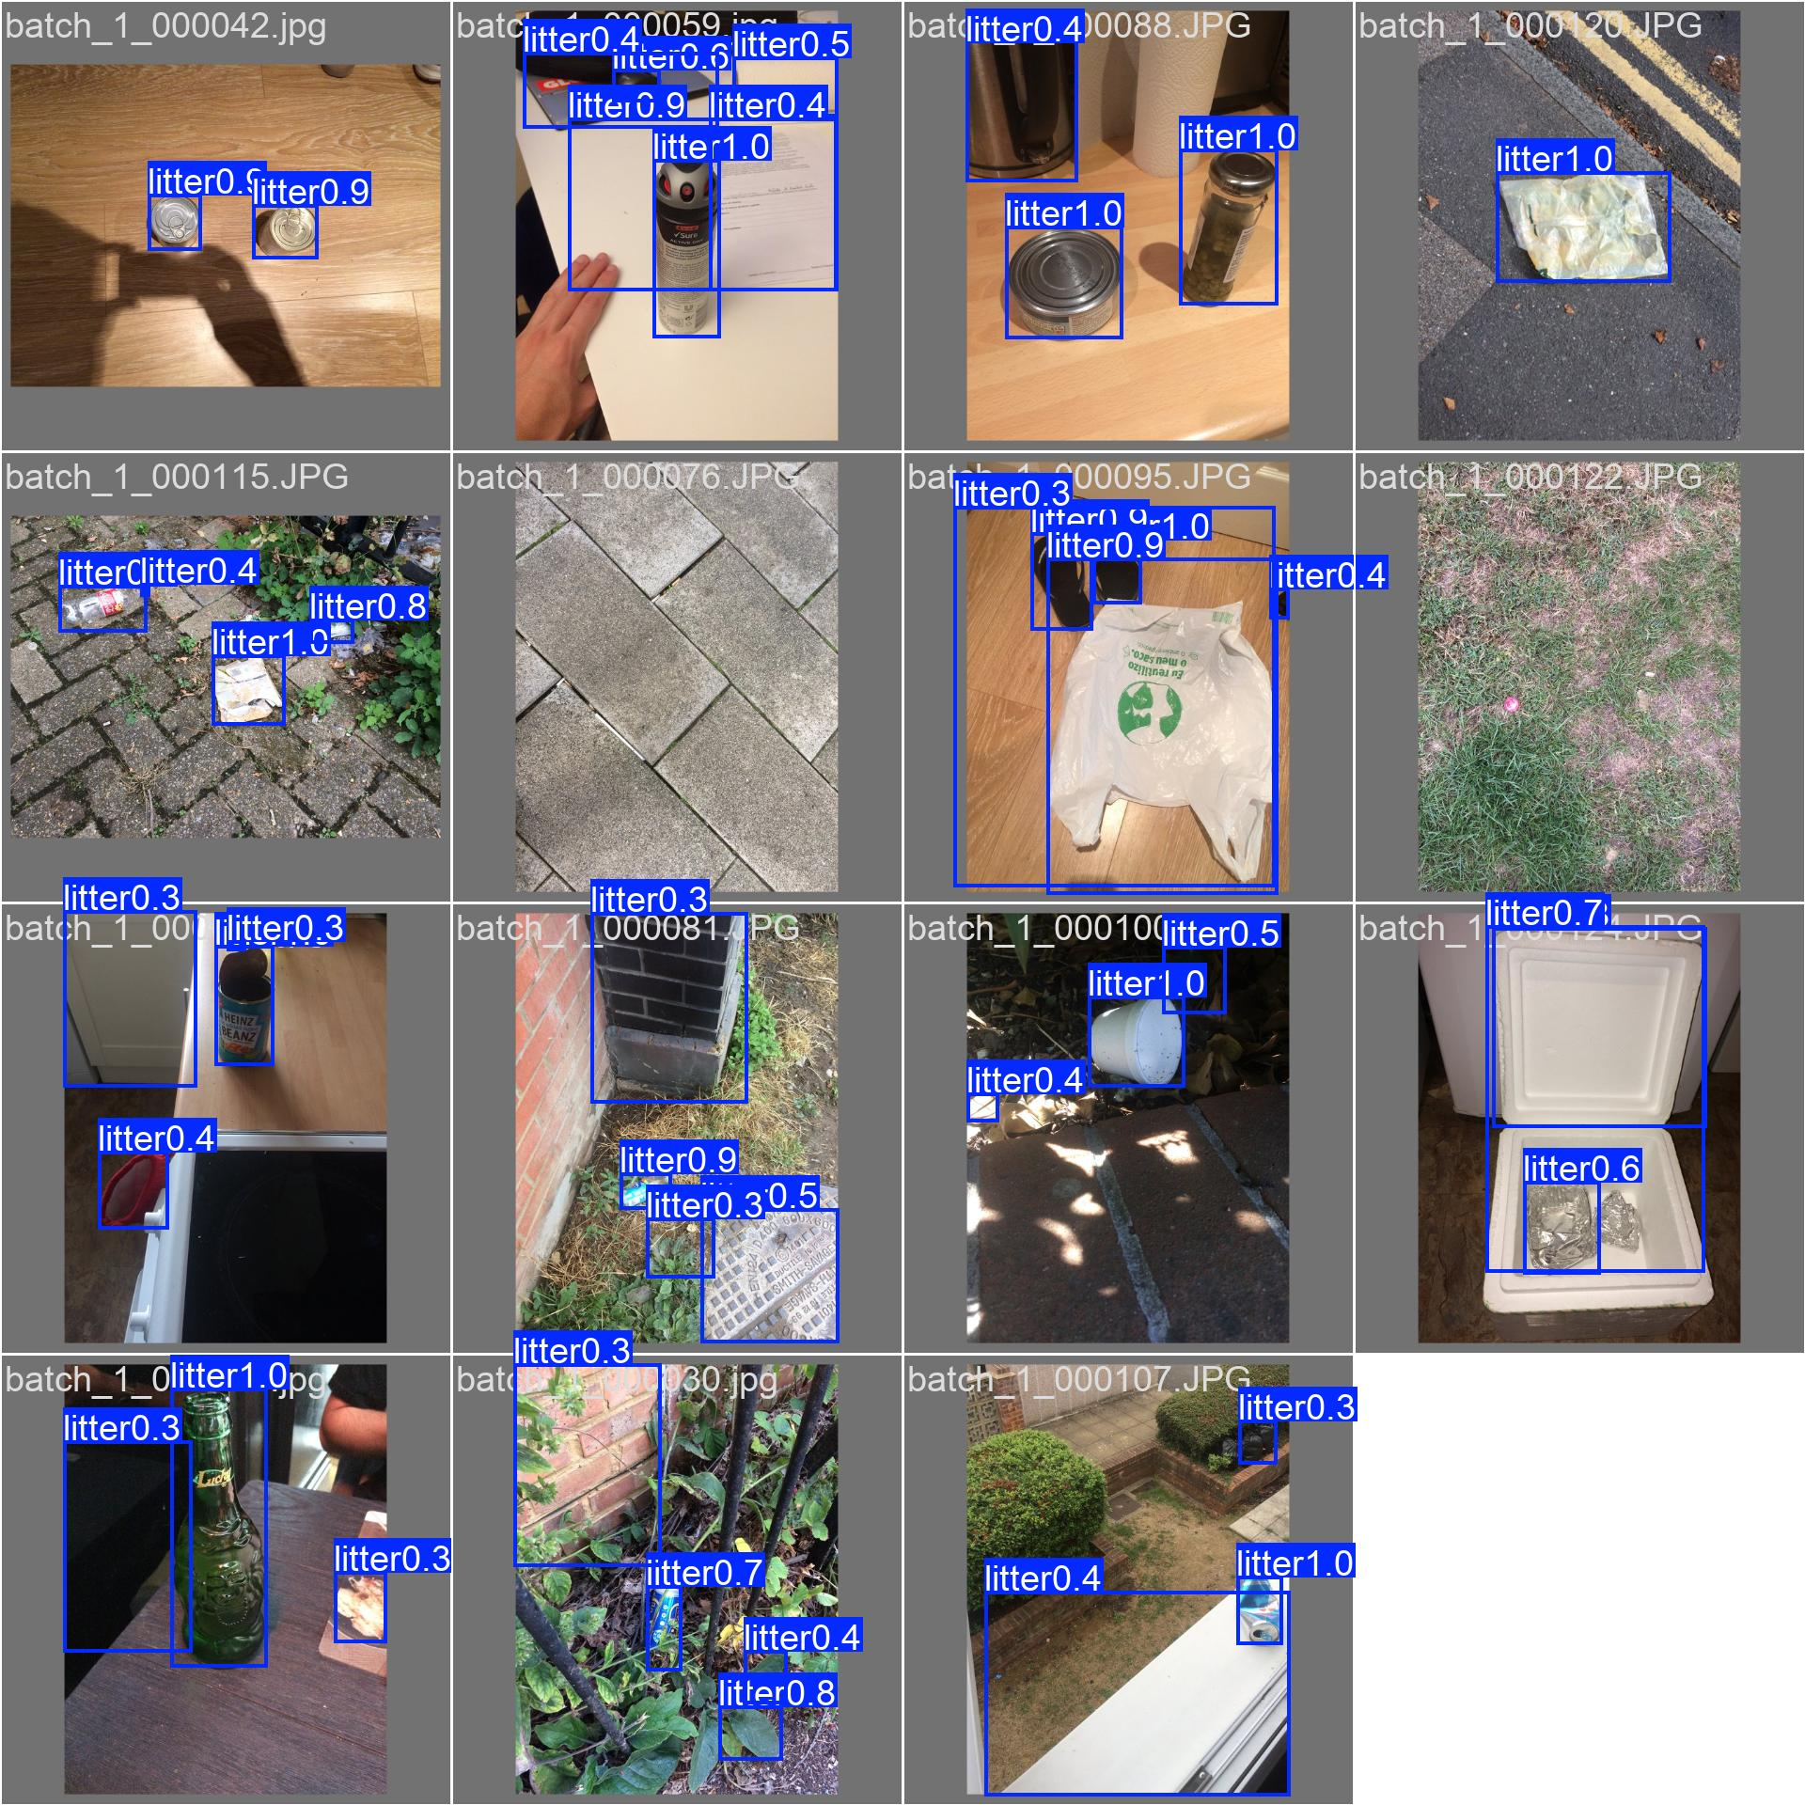
DEEP LEARNING LAB | CAPSTONE 2026–27
A cleaner campus,
one image at a time.
Campus Cleanliness Scoring System
Computer vision that detects visible litter, explains a cleanliness score,
and turns a photograph into practical inspection evidence.
Model validation-batch example
YOLOv8n + explainable scoring + web gallery
Ramdeobaba University, Nagpur • Electronics Engineering
Supervisor: Prof. V. R. Gupta
Arya Mohod • Darsh Kadu • Hargun Singh Jaggi • Ayaan Ahmed
01
Notes:
Introduce the project as an end-to-end campus cleanliness decision-support prototype. It accepts a campus image, detects visible litter, computes a transparent score, and presents the evidence in a web app. The image shown is an example prediction batch from the model's validation data, not a live campus scene.

Slide 2
01 / WHY THIS PROJECT
From subjective rounds to repeatable evidence
Manual inspections are valuable—but difficult to compare consistently across locations and time.
THE CHALLENGE
THE IDEA
THE OUTPUT
Visual checks can be subjective, intermittent and hard to prioritize when many locations need attention.
Use one photograph to localize visible litter, estimate its footprint, and produce a repeatable 0–100 indicator.
A human-readable score, detection boxes and an image record that can be inspected and shared.
A decision-support tool—not a replacement for campus staff or a certified cleanliness audit.
CAMPUS CLEANLINESS SCORING SYSTEM
02
Notes:
The project is designed to add consistency and evidence, not to make final operational decisions. Human inspectors still need to interpret images, confirm ambiguous detections, and decide what action is appropriate.

Slide 3
02 / USER JOURNEY
One photograph becomes an actionable report
A single pipeline connects validation, detection, scoring, visualization and sharing.
01
02
03
04
05
CAPTURE
VALIDATE
DETECT
SCORE
REVIEW
Campus photo
or gallery post
Allowed image type
and readable bytes
YOLOv8n boxes,
class and confidence
Count penalty +
area penalty
Score, inventory,
annotated image
The user can inspect both the original image and the model's annotated result.
CAMPUS CLEANLINESS SCORING SYSTEM
03
Notes:
Walk the teacher through the end-to-end flow. The browser validates the upload server-side as well as client-side; inference produces detection boxes; scoring converts count and footprint into a score; the report preserves the visual evidence so the output is inspectable.

Slide 4
03 / DATASET AND PREPARATION
The model learns one clear target: litter
A reproducible single-class dataset pipeline turns COCO annotations into YOLO-ready labels.
PROJECT WORKING SUBSET
70% TRAIN
15% VALIDATION
100
70 images • 204 boxes
15 images • 54 boxes
images
15% TEST
SPLIT SEED
302
15 images • 44 boxes
42 for reproducibility
annotated litter boxes
TACO SOURCE DATASET
Convert COCO boxes → clip & normalize → split → validate labels
The source dataset contains many litter categories; this project maps valid categories to one class: litter.
CAMPUS CLEANLINESS SCORING SYSTEM
04
Notes:
The TACO dataset has a broad taxonomy; for this prototype, valid litter annotations are unified into a single class. The working project subset is 100 images, not the whole TACO collection. Splits are 70/15/15 with seed 42. Data tools convert bounding boxes, clip them to image boundaries, preserve empty negative labels and validate the resulting YOLO format.

Slide 5
04 / MODEL AND TRAINING
A lightweight detector, specialized for litter
Transfer learning adapts pretrained visual features to a single campus-cleanliness class.
IMAGE
YOLOv8n
LITTER DETECTIONS
640 × 640
pretrained → fine-tuned
box • confidence • footprint
OPTIMIZER
Adam • learning rate 0.001
TRAINING RUN
10 epochs • batch size 8
TRANSFER STRATEGY
Freeze first 10 layers
INFERENCE
confidence 0.25 • IoU 0.45
Checkpoint: models/best.pt • CPU inference supported; GPU can accelerate training.
CAMPUS CLEANLINESS SCORING SYSTEM
05
Notes:
Explain that YOLOv8n is selected as a compact detector. The pretrained COCO backbone provides general visual features, while fine-tuning adapts it to a single litter class. The training settings shown are from the project configuration/run. Inference thresholds are adjustable in the web interface.

Slide 6
05 / INFERENCE EXAMPLE
What the detector actually sees
Validation-batch predictions show boxes and confidence; the application exposes this evidence to the user.
LOCALIZE
Bounding boxes locate candidate objects in image coordinates.
CONFIDENCE
Each predicted litter box includes a confidence value.
HUMAN REVIEW
False positives and misses remain possible; inspect the original image.
Example output from the saved YOLO validation-batch prediction image.
CAMPUS CLEANLINESS SCORING SYSTEM
06
Notes:
The figure is from the project's validation-batch prediction artifact. Point out that boxes are not the final score: they are intermediate measurements. A reviewer can see what drove the count and approximate area. Some detections can be wrong, so the system should not be treated as infallible.

Slide 7
06 / EXPLAINABLE SCORING
A score that accounts for both count and size
Many small items and one large object are not the same cleanup burden.
COUNT PENALTY
AREA PENALTY
BALANCED WEIGHTS
1 − e^(−0.35 × N)
min(1, area ratio ÷ 0.15)
50% item count
50% union footprint area
Score is bounded: 0–100
Score = round[100 × (1 − (0.5 × count penalty + 0.5 × area penalty))]
ONE DETECTION • SAME COUNT
Small footprint → higher score
Large footprint → stronger area penalty
Overlapping boxes use union area to avoid counting the same pixels twice.
CAMPUS CLEANLINESS SCORING SYSTEM
07
Notes:
Walk through the formula. N is the number of detected litter items. Area ratio is union box area divided by total image area. Alpha is 0.35; area saturation scale is 0.15; the count and area contributions each have weight 0.50. As an illustrative example, with one detection and a small footprint near 1%, the score is around 82; if the same single detection covers about 20% of the image, the area term saturates and the score is about 35. This is a heuristic, not a human-certified cleanliness grade.

Slide 8
07 / QUANTITATIVE RESULTS
Measured performance on the held-out test split
Current report values: evaluation_metrics_test.json • 15 test images • confidence 0.25 • IoU 0.45
Precision
78.40%
How often predicted litter is correct
Recall
63.64%
How much actual litter is found
F1 score
70.25%
Balance of precision and recall
mAP@0.50
61.49%
Detection quality at IoU 0.50
mAP@0.50:0.95
43.85%
Stricter average localization quality
Compared with the unadapted COCO checkpoint, the fine-tuned model is specialized for the project's litter class.
CAMPUS CLEANLINESS SCORING SYSTEM
08
Notes:
These numbers come from the repository's held-out test metrics JSON, not the training chart. Precision is 0.784, recall 0.6364, F1 0.7025, mAP50 0.6149, and mAP50-95 0.4385. The comparison report shows zero baseline mAP50 because the off-the-shelf COCO checkpoint is not adapted to this single-class evaluation; this is a class/domain mismatch and should not be presented as a general benchmark against YOLOv8.

Slide 9
08 / REAL-WORLD CHECK
A small campus pilot—and a useful warning
The project report contains four campus-test examples; this is promising prototype evidence, not a large field study.
100 / 100
35 / 100
74.25
corridor_clean
0 detections
canteen_clean
1 detection • 41.16% area
mean score across
4 reported campus images
WHAT WE LEARNED
A single false positive with a very large box can sharply lower the score. That is why the annotated image and human review matter.
Reported files: corridor_clean 100 • canteen_clean 35 • garden_littered 81 • pathway_bottles 81
CAMPUS CLEANLINESS SCORING SYSTEM
09
Notes:
Be transparent about the campus pilot. The committed report currently lists four images and a mean score of 74.25. One file named canteen_clean has a single detection with area ratio 0.4116 and score 35, which is an apparent false positive or overlarge localization. Use it to explain the need for more campus data, manual confirmation, and score calibration. The README contains older campus figures; this deck follows the current JSON report.

Slide 10
09 / PRODUCT EXPERIENCE
A working web app closes the loop
From a browser upload to a reviewable detection report—and now a persistent community gallery.
ANALYZE
SHARE
Campus Cleanliness AI
Upload, choose a confidence threshold, view results.
Post a public campus photo to the gallery.
UPLOAD + CONFIDENCE SLIDER
Score • count • annotated result
REVIEW
RETRY
Inspect score, count and annotated preview.
Analyze Photo / Analyze Again from each post.
Community photos are saved with SQLite records and can be analyzed or retried from the gallery.
Local-network demo: HOST=0.0.0.0 • persistent local files
CAMPUS CLEANLINESS SCORING SYSTEM
10
Notes:
Describe the user-facing capabilities: drag-and-drop/upload, confidence threshold, result page with original and annotated image, score, metrics and detection inventory, metrics API and health endpoint. Community posts persist to local image files and SQLite. A post may be analyzed automatically; each card also supports Analyze Photo or Analyze Again. For a classroom LAN demo, the server must remain running and use the host machine's LAN address.

Slide 11
10 / SOFTWARE ARCHITECTURE
A modular pipeline keeps the project explainable
Each layer has a focused responsibility—from reproducible dataset tools to a deployable Flask interface.
DATA
MODEL
SCORING
WEB
download_dataset.py
train.py
cleanliness_score.py
app.py + Flask routes
convert_annotations.py
predict.py
score_config.py
upload validation
split_dataset.py
evaluate.py
count + area formula
templates + static
validate_dataset.py
compare_models.py
SQLite community gallery
Evidence travels through the system: image → boxes → score → annotated result → review
CAMPUS CLEANLINESS SCORING SYSTEM
11
Notes:
Point out the separation of concerns. Data scripts prepare and validate labels; model scripts train, predict and evaluate; scoring is a separate deterministic module; Flask routes/services connect the model and UI. This makes changes easier to test and explain.

Slide 12
11 / VERIFICATION
We tested the transformations, the score and the web flow
The full repository suite passes in the current environment.
Dataset
32
COCO → YOLO math, clipping, malformed labels
TESTS PASSED
Scoring
Bounds, zero-detection case, monotonicity, config
Web
Routes, invalid uploads, public gallery, analyze/retry
Also verified a real community upload through model inference, score persistence and annotated-image output.
Test command: python -m pytest tests/ -q
CAMPUS CLEANLINESS SCORING SYSTEM
12
Notes:
The full test suite was run while preparing this presentation: 32 passed. Tests cover COCO-to-YOLO coordinate transforms, clipping and validation, scoring limits and monotonic behavior, and Flask routes including the new community gallery. Separately, a real model smoke test confirmed that a photo submission produces and persists score output and an annotated image.

Slide 13
12 / LIMITATIONS AND ROADMAP
Honest limits point to the next experiment
The prototype establishes a pipeline; better calibration and broader validation are the next research steps.
SMALL / OCCLUDED ITEMS
NEXT STEPS
Tiny litter and partly hidden objects may be missed.
01
Collect more diverse campus images
02
Label hard examples and review false positives
SCENE VARIATION
Lighting, shadows and textured backgrounds can trigger errors.
03
Ask multiple reviewers for human cleanliness ratings
04
Calibrate score; report MAE and uncertainty
SCORE VALIDATION
Human cleanliness ratings have not yet been collected.
05
Then consider categories, heatmaps or CCTV
Score = heuristic indicator; verify before acting.
CAMPUS CLEANLINESS SCORING SYSTEM
13
Notes:
The report explicitly says human cleanliness ground truth is unavailable. The score therefore should be presented as a transparent heuristic rather than as an objectively calibrated measure. Next, gather representative campus images, label failure cases, collect independent human ratings, and measure agreement/MAE before expanding scope.

Slide 14
THE LIVE DEMO
From one campus image
to an explainable result.
1
Open the web app
http://127.0.0.1:5000
2
Upload or choose a campus image
Adjust confidence if useful
3
Inspect the result
Score, count, boxes and annotated image
4
Share a photo
Post to gallery, then Analyze / Analyze Again
DETECT • EXPLAIN • REVIEW • IMPROVE
Thank you
Arya Mohod • Darsh Kadu • Hargun Singh Jaggi • Ayaan Ahmed
14
Notes:
End by demonstrating the running app. If presenting on a local network, start the app with HOST=0.0.0.0 and share the host computer's LAN IP; keep the server running. For the demo, choose an image, show the annotated result and score, and then show the community gallery's Analyze action. Invite questions about false positives, score calibration and next experiments.

