Slide 1
Dedication…
Hargun Pal Singh Jassal
GRDN 2200-19F
8671597
Notes:
Welcome to view my project of a book over a topic-”Dedication”.

Slide 2
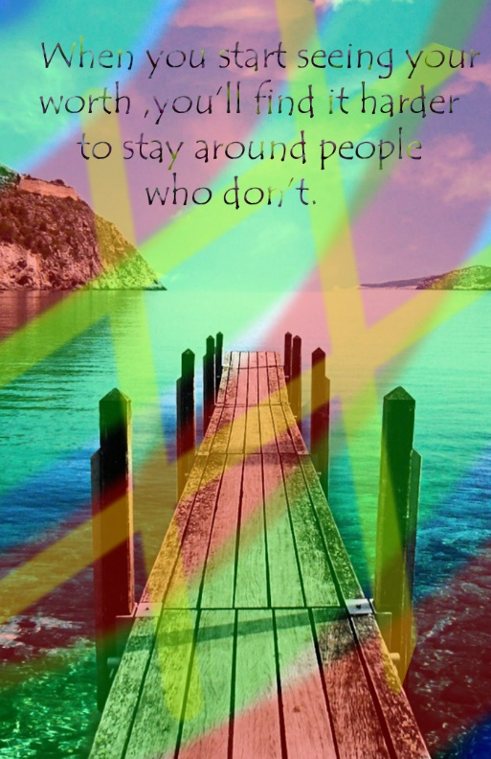
Colorful
Adding a couple of layers with different colors.
Appling distinctive techniques like, opacity.
Notes:
Colorful, this particular slide presents the chief motive of colorfulness, representing joy.
However Brush stokes and opacity played a significant role, while creating this image.

Slide 3
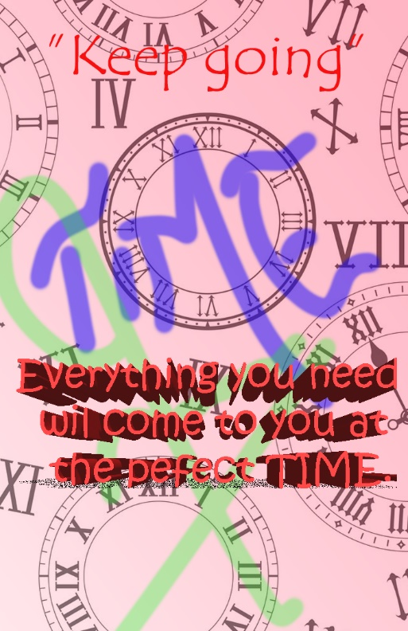
Attractive.
Using 3D Text.
Gradient to the background.
Notes:
In order to make it look attractive, 3D Text had been used. Also the use of manual filter using opacity on several layers, result out to be quite fascinating.
On top of it the Free hand style “TIME” is enhancing the looks.

Slide 4
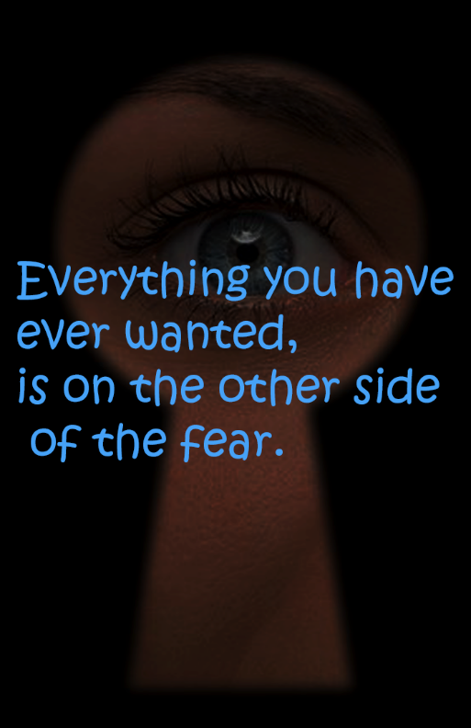
Altering the mood
Saturation.
Hue.
Bright text over image.
Notes:
Over here, the viewer is forced a bit to view the background which even symbolizes with the quote mentioned.
However, having a brighter text over it enhanced the picture.

Slide 5
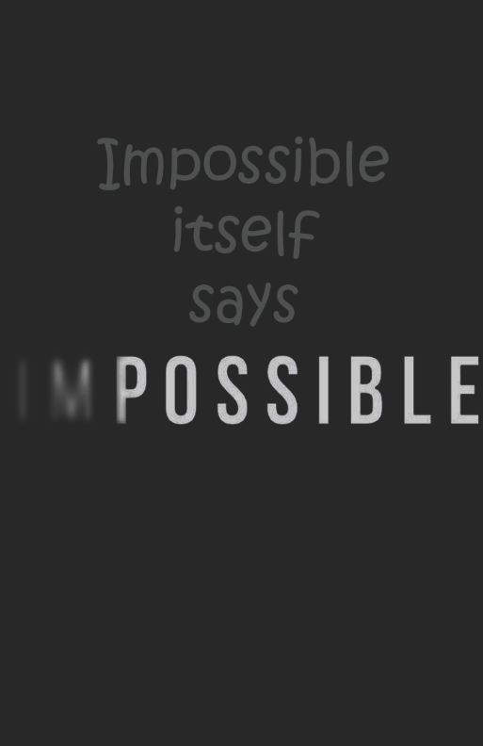
Simplicity
Faded expression.
Using several effects like Dissolve, Difference, and so on.
Notes:
Simplicity has always been a way out to a particular situation. Like here there is not much colors involved in the picture, still it looks complete.
However, using the fade technique matched up with the theme of nothing is “impossible”.

Slide 6
Thank You…

