Slide 1
World Development Clusters
Cluster analysis of global development indicators, deployed as a Streamlit app
Notes:
Welcome. This project groups 208 countries by development indicators using unsupervised learning, and ships the result as a Streamlit app.

Slide 2
Team Members
MENTOR
TEAM MEMBERS
Pranitha K
1
Thodeti Venu
2
Chintapalli Hari Krishna
3
Vadlamudi Krishnaveni
4
Tellagorla Hemalatha
5
Gogineni Chaitanya Krishna

Slide 3
Agenda
1
2
3
Business objective & data
Project plan
EDA & preparation
4
5
6
Models & evaluation
Cluster results & insights
Deployment & conclusion

Slide 4
Business objective
1
Objective
2
Acceptance criteria
Create clusters on a global development measurement dataset, grouping countries with similar economic and development profiles.
Build several clustering models, compare them, and deploy the clustering application on Streamlit.

Slide 5
The dataset
208
4
4
countries
clusters found
themes: economy, health, population, technology
Example indicators
Birth Rate
CO2 emissions
GDP
Infant Mortality
Internet Usage
Life Expectancy Female
Health Exp/Capita
Lending Rate
Days to Start Business
Ease of Business

Slide 6
Project plan
DataSet
EDA
Modelling & evaluation
Deployment
Final presentation

Slide 7
EDA and data cleaning
1
Convert text to numbers
2
One row per country
Currency and percentage strings become numeric values.
Duplicates removed so every country appears once.
3
Handle skewed indicators
4
Review missing values
Heavily skewed columns are log-transformed.
Gaps are filled in the preparation step.

Slide 8
Preparation pipeline
Fill missing
Log transform
Scale
PCA
>
>
>
median values
skewed columns
standardise features
keep 95% of variance
The same four steps run inside the app for every new input, so predictions match the notebook.

Slide 9
Four clustering models compared
1
K-Means
2
DBSCAN
Centroid-based; needs the number of clusters up front.
Density-based; finds outliers but needs eps and min samples.
3
Gaussian Mixture
4
Hierarchical
Probabilistic; soft, elliptical clusters.
Builds a dendrogram by merging similar countries.

Slide 10
How the models were evaluated
Silhouette
Davies-Bouldin
Calinski-Harabasz
Higher is better
Lower is better
Higher is better
How well each country fits its own cluster versus the nearest other one.
Average similarity between each cluster and its closest neighbour.
Ratio of between-cluster to within-cluster spread.
K-Means and Gaussian Mixture gave the most interpretable groups and were selected for deployment.
Notes:
Insert your actual metric scores for each model here if you want a numeric comparison table.

Slide 11
K-Means: four country groups
Cluster 0
Cluster 1
Cluster 2
Cluster 3
Small mid-income states
Developed countries
Large emerging economies
Least developed countries
Cluster numbers differ between models, so the app maps each number to a readable name.

Slide 12
Gaussian Mixture: four country groups
Cluster 0
Cluster 1
Cluster 2
Cluster 3
Least developed countries
Developed countries
Small island states
Middle-income countries
Gaussian Mixture separates small island states, which K-Means merges with other groups.

Slide 13
What separates the clusters
Health
Life expectancy and health spending per person are highest in developed countries and lowest in least developed ones.
Demographics
Birth rate and infant mortality fall as development rises; the share of people aged 65+ rises.
Technology
Internet usage climbs steeply from least developed to developed countries.
The app shows this as a cluster-profile heatmap (red = high, blue = low).

Slide 14
Deployment architecture
Saved files
Input
Transform
Prediction
scaler, pca, kmeans, gmm, app_info (.pkl) and country_results.csv
Sliders and number boxes for the indicators, or a starting country
log, scale and PCA exactly as in the notebook
K-Means or Gaussian Mixture returns the cluster
>
>
>
Built with Streamlit, scikit-learn, joblib and Plotly.

Slide 15
The Streamlit app
1
Predict
2
World Map
Set indicators, get the cluster, see the 5 most similar countries and a PCA plot.
Choropleth of all countries coloured by cluster, with a cluster browser.
3
Cluster Profiles
4
About
Cluster sizes and a heatmap of typical values per cluster.
Plain-language summary of data, preparation and models.
A sidebar switches between K-Means and Gaussian Mixture.

Slide 16
Where this can be used
1
Policy and aid
2
Investment
Group countries with similar needs to target programmes.
Compare emerging markets with peers at a similar stage.
3
Research
4
What-if analysis
Benchmark a country against its closest neighbours in the data.
Change indicators in the app to see when a country moves cluster.

Slide 17
Limitations and next steps
Limitations
Next steps
One snapshot in time, no trends
Missing values filled with typical values
Cluster names are interpretations, not model output
Add multi-year data to track movement
Test more indicators and cluster counts
Host the app publicly

Slide 18
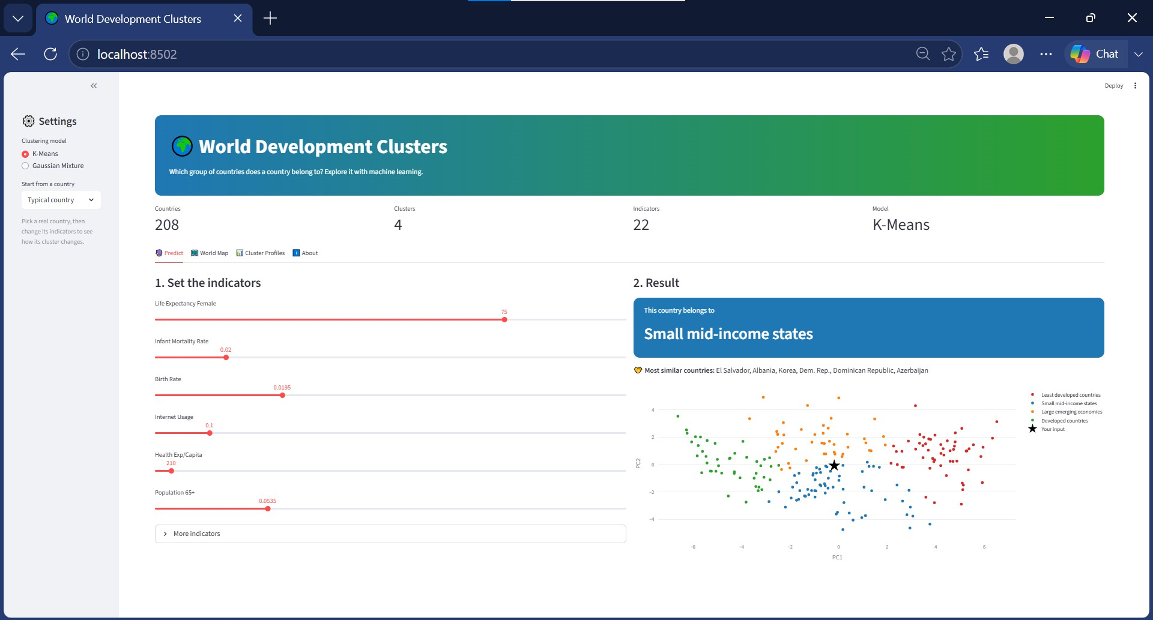
OUTPUT

Slide 19
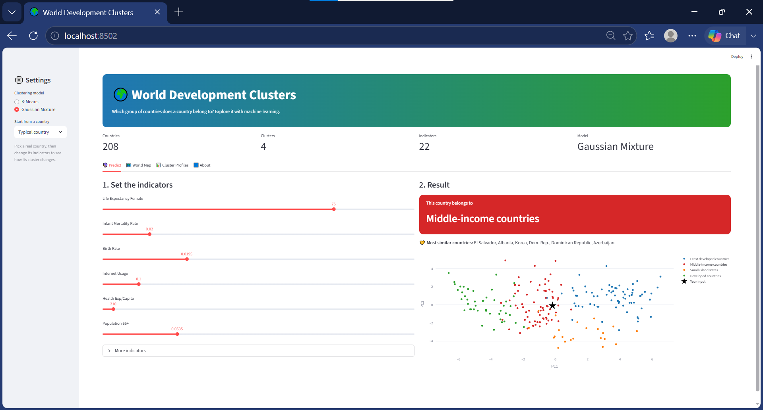
OUTPUT

Slide 20
Challenges faced during the project
1
Messy raw data
Currency and percentage text had to become numbers, with one clean row per country.
2
Gaps in indicators
Many countries lacked values, so missing data was filled to avoid losing them.
3
Uneven scales and skew
GDP-type indicators dwarfed others until log, scaling and PCA levelled them.
4
Comparing four models
Metrics alone were not enough; clusters also had to make sense and be named.
5
Matching app to notebook
The app had to repeat every preparation step exactly to predict new inputs.

Slide 21
Conclusions
208 countries grouped into four clear development tiers
Four models compared; K-Means and Gaussian Mixture deployed
Deployed as an interactive Streamlit app with map, profiles and prediction

Slide 22
Thank you

