Slide 1

Brain Tumor Detection Using U-Net for Semantic Segmentation on MRI Images Project Category: RESEARCH
Guide :
Dr. Om Prakash P.G,
Computational Intelligence,
SRM Institute of Science and Technology.
Made by :
Harinarayanan R (RA2111026010424),
Manikanta Sai Patel (RA2111026010433),
Computational Intelligence,
SRM Institute of Science and Technology.

Slide 2
Introduction
The project aims to enhance brain tumor detection by developing a tool that utilizes the U-Net architecture for semantic segmentation of MRI images. Brain tumors are challenging to detect manually due to their varied characteristics and the complexity of MRI scans. To address this, the project employs a deep learning approach where the U-Net model automatically segments tumor regions from MRI images, providing precise tumor boundaries. The U-Net architecture, known for its effectiveness in image segmentation, employs an encoder-decoder structure with skip connections to preserve spatial information while segmenting images at multiple scales.
The process begins with the input of MRI images into the U-Net model, which then performs feature extraction through its encoder, processes this information through a bottleneck, and reconstructs the segmented output in the decoder phase. The final output is a segmented mask highlighting tumor regions, which is then used to assist medical professionals in diagnosing and planning treatment. This automated approach aims to improve diagnostic accuracy, reduce manual effort, and support better patient care.

Slide 3
Objectives
Develop an Automated Segmentation Tool: To create a deep learning-based tool utilizing the U-Net architecture for segmentation of brain tumors in MRI images, aiming to improve diagnostic accuracy and efficiency.
Enhance Tumor Detection Accuracy: To achieve high precision in distinguishing tumor regions from non-tumor areas, thereby providing clear delineation of tumor boundaries for more effective treatment planning.
Streamline Diagnostic Process: To reduce the time and effort required for manual tumor detection by automating the segmentation process, enabling quicker and more reliable diagnosis for medical professionals.
Validate Model Performance: To rigorously evaluate the performance of the U-Net model using relevant metrics such as accuracy, precision, recall, and F1-score, ensuring its reliability and effectiveness in clinical settings.
Integrate Visualization and Reporting Features: To develop interactive visualization tools and reporting features that allow users to view and analyze segmented results.
Address Technical Challenges: To identify and mitigate potential challenges related to data preprocessing, model training, and integration.

Slide 4
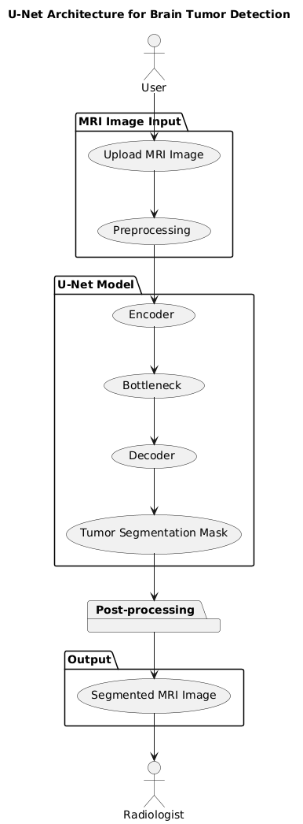
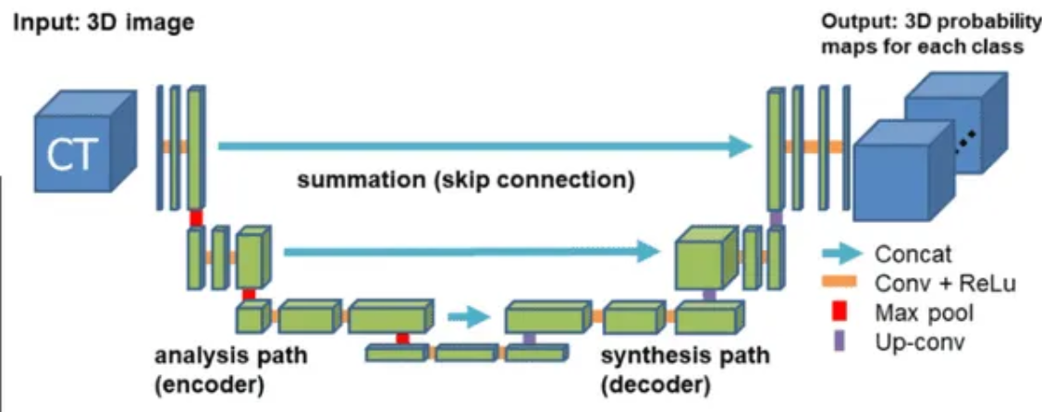
Architecture
U-Net Architecture : A convolutional neural network architecture designed for precise image segmentation, featuring a symmetric encoder-decoder structure with skip connections to capture both local and global features

Slide 5
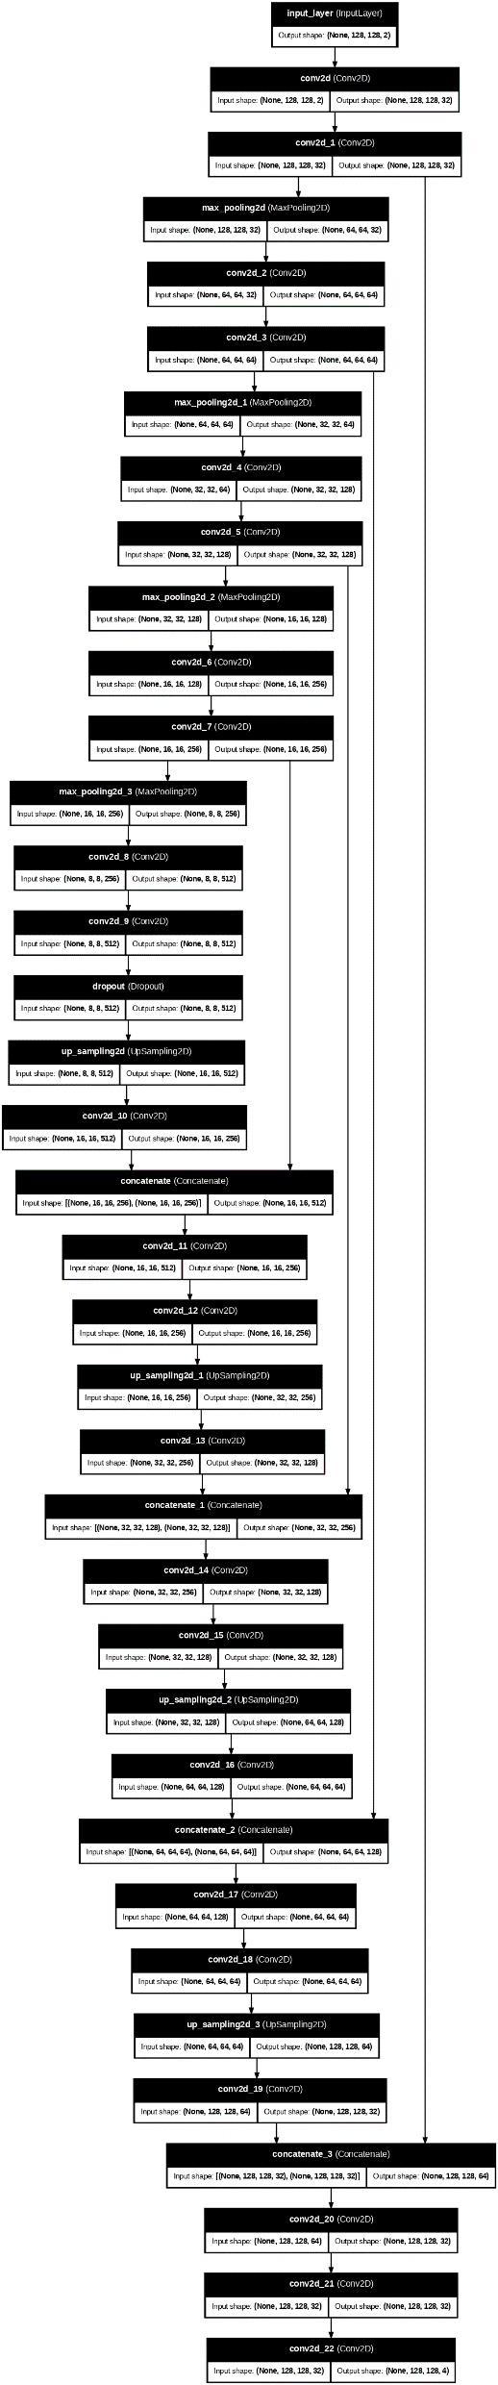
U-NET Architecture

Slide 6
Functional Document
Product Goal:
The goal of this project is to create a reliable tool that improves the accuracy and efficiency of brain tumor detection in MRI images. By automating the segmentation process, the tool aims to assist medical professionals in quickly identifying and delineating tumor regions, thereby enhancing diagnostic accuracy and supporting better treatment planning for patients.
Demography (Users, Location):
Target Users: Radiologists, Neurosurgeons, Medical researchers, Data scientists in medical imaging.
Location: Hospitals, medical research institutions, and healthcare facilities globally, especially those with access to MRI imaging technology and a need for advanced diagnostic tools.
User Characteristics:
Radiologists and Neurosurgeons: Medical professionals with expertise in interpreting MRI scans. They require tools that enhance the accuracy and speed of their work, aiding in precise tumor detection and treatment planning.

Slide 7
Medical Researchers: Individuals engaged in developing and improving diagnostic methods, who need access to advanced tools for analyzing medical images and validating research findings.
Data Scientists in Medical Imaging: Professionals focused on developing and refining algorithms for medical image analysis, who seek reliable datasets and tools for training and testing deep learning models.
Business Processes:
Data Acquisition: Collection of MRI scans from medical institutions or publicly available datasets like the BraTS dataset.
Data Preprocessing: Preparing the MRI images by normalizing, augmenting, and segmenting them into training and testing datasets.
Model Training: Training the U-Net model on the pre-processed MRI images to classify pixels as either tumor or non-tumor.
Model Validation: Validating the model’s performance using the testing dataset to ensure high accuracy and reliability.
Deployment and Feedback: Deploying the trained model in a clinical setting or research environment where it can be used to analyze new MRI scans. Gather Feedback to refine and improve the model

Slide 8
Features:
Automatic Tumor Segmentation: Automatically segments tumor regions in MRI scans by classifying each pixel as either tumor or non-tumor, providing a clear and accurate delineation of tumor boundaries. User Story: As a radiologist, I want to upload an MRI scan and receive an automatically generated tumor segmentation map, so I can quickly assess the tumor's size, shape, and location for diagnosis.
Interactive Visualization: Allows users to visualize the segmented tumor regions overlaid on the original MRI scan, with options to adjust transparency, zoom, and highlight specific areas of interest. User Story: As a neurosurgeon, I want to visualize the segmented tumor in detail and adjust the overlay to better understand its relation to surrounding brain structures, aiding in surgical planning.
Authorization Matrix:
Role | Access Level
Radiologist | Full Access (Can upload MRI scans, view segmentation results & export data)
Neurosurgeon | View Access (Can view and interpret segmentation for surgical planning)
Researcher | Limited Access (Can access anonymized data for research purposes)
Administrator | Full Access (Can manage the model, parameter settings, and data access)

Slide 9
Assumptions
The development environment and infrastructure will remain stable throughout the sprint.
The MRI images used are of high quality and have been pre-processed appropriately.
The deployment environment has the necessary computational resources to run the U-Net model efficiently.
Team members possess the necessary skills and resources to complete the assigned tasks.
Feature | Test Case | Steps to execute test case | Expected Output | Actual Output | Status | More Info
Clear Visualization | Ensure that the model visualization feature is proper and highlighting the region of tumor. | 1. Load the MRI scan and segmented output. 2. Use visualization techniques 3. Verify whether region is highlighted clearly | The visualization is clearly showing the segmented part of the tumor in MRI images | The data is loaded successfully and the segmented images can be viewed properly | Pass | No error messages
Model Performance Metrics | Ensure that the systems performance metrics is accurate and efficient for the U-Net model. | 1. Display the performance metrics. 2. Review metrics displayed (accuracy, precision, recall, F1-score). | The model's performance on datasets should be sufficiently high to be deemed suitable for research purposes. | Performance metrics like accuracy, loss, precision, sensitivity, val and loss is displayed for training data | Pass | No error messages

Slide 10
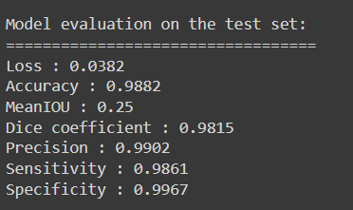
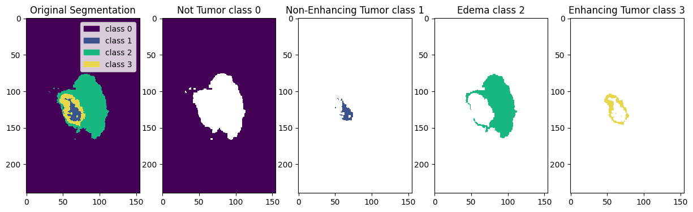
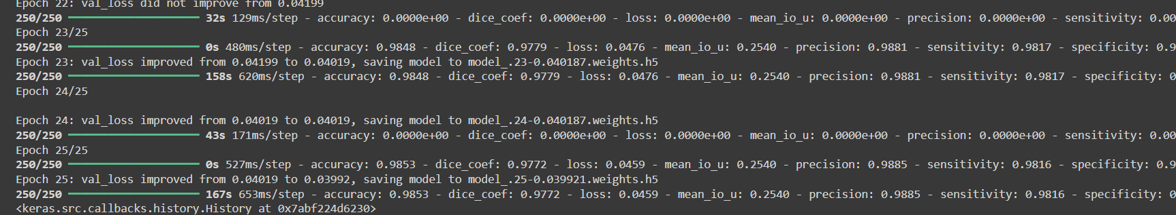
Result

Slide 11
Result Analysis
Define the Project Scope and Goals: Clearly outlined the goal of developing an automated U-Net-based tool for brain tumor segmentation, improving diagnostic accuracy and efficiency.
Summarize Existing Research and Relevance of U-Net Provided a thorough literature review, demonstrating the shift from conventional methods to deep learning, and justified the use of U-Net for its superior segmentation capabilities.
Present the Project Plan, Key Milestones, and Timeline: Detailed the project plan with clear milestones and a timeline, covering data collection, model training, and evaluation.
Describe the Technical Methodology: Explained the technical approach, including data preprocessing and U-Net model specifics, with a rationale for its selection.
Present the Initial System Architecture and Design: Presented the system architecture and design, ensuring alignment with project goals and scalability.
Assess Feasibility and Identify Risks: Evaluated project feasibility, identified potential risks, and proposed mitigation strategies.
Data acquisition & Preprocessing: Data collection and preprocessing has been carried out, acquisition of MRI images and the steps for preparing data for model training.

