Slide 1

Predictive Analytics for Loan Defaults: A Deep Learning Approach Project Category: RESEARCH
Guide :
Dr. Om Prakash P.G,
Computational Intelligence,
SRM Institute of Science and Technology.
Made by :
Harinarayanan R (RA2111026010424),
Manikanta Sai Patel (RA2111026010433),
Computational Intelligence,
SRM Institute of Science and Technology.

Slide 2
Introduction
Loan defaults are a significant challenge in the financial industry, leading to substantial credit losses and operational inefficiencies for lenders. Accurate prediction of loan defaults is critical for minimizing risks and improving financial decision-making. Our project, focuses on building an advanced predictive model to assess and manage loan default risks effectively.
Leveraging a comprehensive dataset from LendingClub and other relevant sources, this project integrates exploratory data analysis (EDA) and deep learning techniques to extract meaningful patterns from historical data. The analysis includes identifying borrower characteristics, loan attributes, and repayment behavior that contribute to defaults. Deep learning models, known for their ability to handle complex data and uncover non-linear relationships, are employed to predict the likelihood of default with high accuracy.
The insights generated from this project aim to empower lending institutions with a data-driven framework for risk assessment. This includes optimizing loan approval processes, tailoring lending strategies, and mitigating credit losses. By adopting a predictive approach, lenders can enhance operational efficiency, safeguard financial stability, and maintain customer satisfaction while addressing the challenges of a dynamic lending environment.

Slide 3
Objectives
Build a Predictive Model: Develop a robust deep learning-based model capable of accurately predicting loan default probabilities, ensuring reliable results even for complex data patterns.
Identify Key Drivers: Perform exploratory data analysis (EDA) to uncover borrower characteristics and loan attributes that strongly influence default risks.
Optimize Risk Management: Enable risk-adjusted lending strategies, such as dynamic interest rates or reduced loan amounts for high-risk borrowers.
Reduce Credit Losses: Minimize financial losses by proactively identifying borrowers with a high likelihood of defaulting and implementing preventive measures to mitigate risks.
Enhance Decision-Making: Equip lending institutions with actionable insights derived from the model to improve decision-making during loan approval and portfolio management.
Improve Operational Efficiency: Streamline lending workflows by automating risk assessments, reducing manual intervention, and ensuring faster, data-driven loan approval processes.

Slide 4
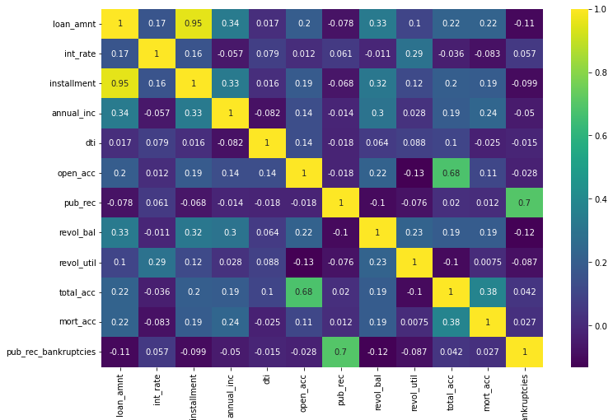
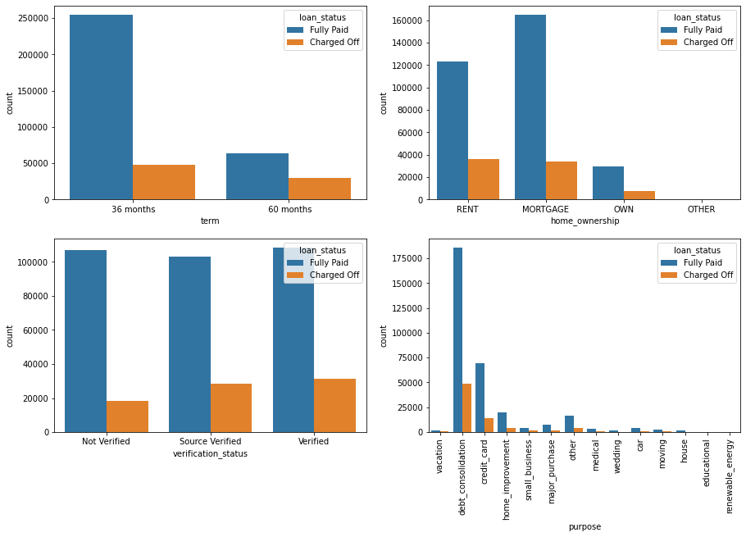
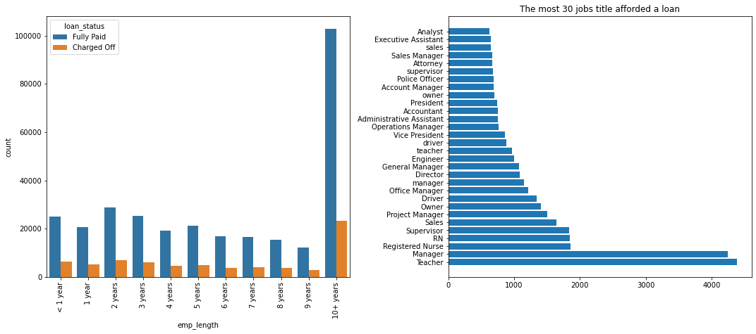
Exploratory Data Analysis

Slide 5
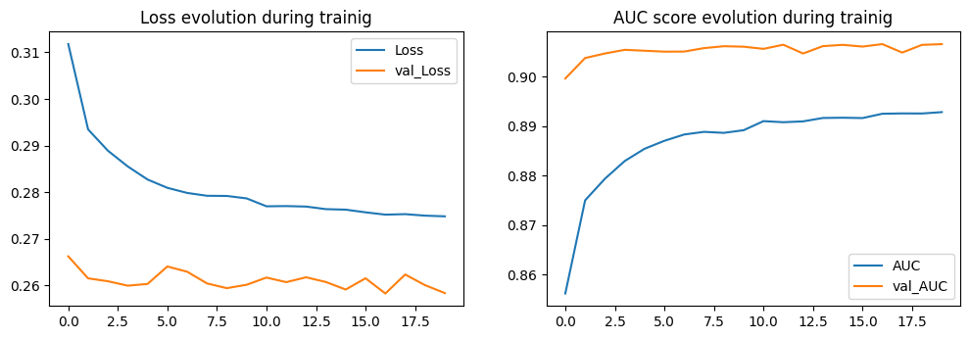
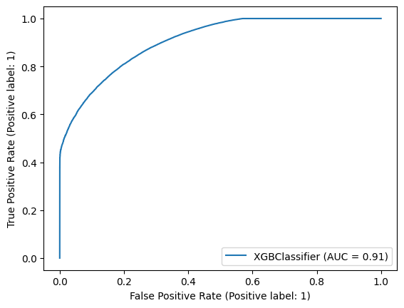
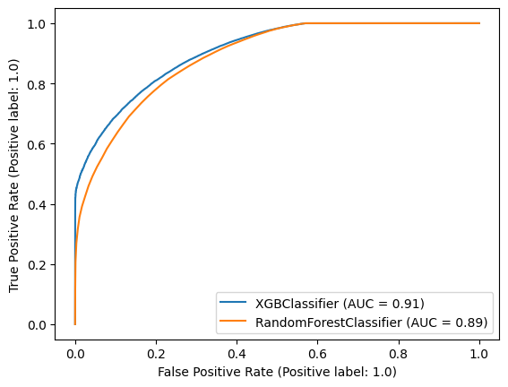
AUC and ROC Graphs
ANN
XGB
RF & XGB
ANN

Slide 6
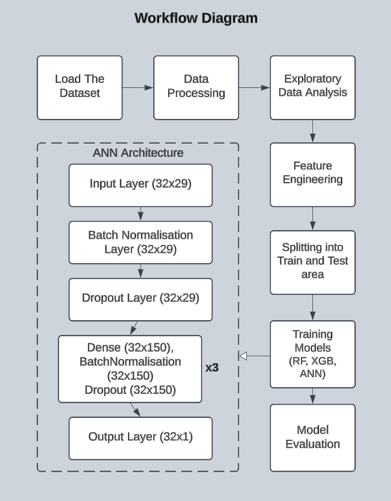
Architecture
The workflow begins with loading and processing the dataset, followed by exploratory data analysis (EDA) to understand patterns and relationships. Feature engineering is then applied to refine the dataset before splitting it into training and testing sets.
For model training, multiple approaches are used: Random Forest (RF), XGBoost (XGB), and an Artificial Neural Network (ANN). Traditional machine learning models like RF and XGB handle structured data efficiently, while the ANN is designed for deeper pattern recognition using multiple layers, including batch normalization and dropout for improved generalization. After training, model evaluation is performed to compare performance using appropriate metrics. The final model is selected based on accuracy and robustness, ensuring the best predictive capability for the given problem.

Slide 7
Literature Survey
S/NO | Title (Name of the journal, author and publication details) | Methodology (Provide a Summary of key studies and their findings) | Identification of gaps and limitations. (Identify the limitations of the Research Paper)
1 | Alejandrino, Jovanne & Bolacoy Jr, Jovito & Murcia, John Vianne. (2023). Supervised and unsupervised data mining approaches in loan default prediction. International Journal of Electrical and Computer Engineering (IJECE). | Among ml techniques. K nearest neighbour perform well in detection Naïve Bayes method also performs well for the loan dataset | Only explained machine learning approaches Performance was bad on actual dataset
2 | Xu Zhu, Qingyong Chu, Xinchang Song, Ping Hu, Lu Peng, Explainable prediction of loan default based on machine learning models, Data Science and Management, Volume 6, Issue 3, 2023. | Use of Light BGM and XG boost Explaining using local interpretable models | Some models acts as Blackbox failing to explain the work
3 | Li, Baodong, [Retracted] Online Loan Default Prediction Model Based on Deep Learning Neural Network, Computational Intelligence and Neuroscience, 2022, 4276253, 9 pages, 2022. https://doi.org/10.1155/2022/4276253 | Use of deep Learning techniques Explaining P2P loan platforms | Use of only basic neural networks.

Slide 8
S/NO | Title (Name of the journal, author and publication details) | Methodology (Provide a Summary of key studies and their findings) | Identification of gaps and limitations. (Identify the limitations of the Research Paper)
4 | LLin Zhu, Dafeng Qiu, Daji Ergu, Cai Ying, Kuiyi Liu, A study on predicting loan default based on the random forest algorithm, Procedia Computer Science, Volume 162, 2019. | Model Generalization Comparison with other ML models shows random forest is better for the particular dataset | Small dataset and further tuning of model required to understand optimal performance
5 | T. Deng, "Study of the Prediction of Micro-Loan Default Based on Logit Model," 2019 International Conference on Economic Management and Model Engineering (ICEMME), Malacca, Malaysia, 2019, pp. 260-264, doi: 10.1109/ICEMME49371.2019.00058. | Details on different techniques used on different micro loan dataset | Fails to use/tune deep learning model for better outcome
6 | RHZIOUAL BERRADA, I., BARRAMOU, F. and BACHIR ALAMI, O., 2024. Towards a Machine Learning-based Model for Corporate Loan Default Prediction. International Journal of Advanced Computer Science & Applications, 15(3). | Detailed Machine Learning approach for High training accuracy Loan default prediction. | Model fails to generalize to new data

Slide 9
S/NO | Title (Name of the journal, author and publication details) | Methodology (Provide a Summary of key studies and their findings) | Identification of gaps and limitations. (Identify the limitations of the Research Paper)
8 | M. V. Rajesh et al., "An Efficient Machine Learning Classification model for Credit Approval", International Conference on Artificial Intelligence and Smart Energy (ICAIS) Coimbatore India, pp. 499-503, 2023. | Comparison with other ML models shows random forest is better for the particular dataset | Only explained machine learning approaches
9 | K Gomathy et al., "The Loan Prediction Using Machine Learning", International Research Journal of Engineering and Technology, vol. 08, no. 10, Oct | Use of Light BGM and XG boost Explaining P2P loan platforms | Fails to use/tune deep learning model for better outcome
10 | Feng Shen, Xingchao Zhao, Gang Kou, et al. A new deep learning ensemble credit risk evaluation model with an improved synthetic minority oversampling technique,Applied Soft Computing, Volume 98, 2021, 106852, ISSN 1568-4946, https://doi.org/10.1016/j.asoc.2020.106852. | Simple Neural networks used to train to the data | Model fails to generalize to new data

Slide 10
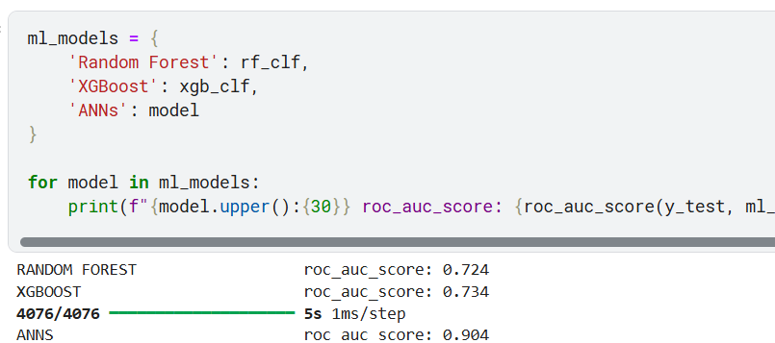
Result Analysis
The results from the predictive models indicate significant differences in their performance when evaluated using the ROC-AUC score, which measures the ability of the model to distinguish between defaulters and non-defaulters. The Random Forest model achieved an ROC-AUC score of 0.725, reflecting a moderate performance in capturing the underlying patterns of loan defaults.
The XGBoost model performed slightly better, with an ROC-AUC score of 0.734, showcasing its strength in handling complex datasets and uncovering intricate relationships. However, the Artificial Neural Networks (ANN) model significantly outperformed both, achieving an impressive ROC-AUC score of 0.905.
This highlights the superiority of deep learning in handling large and complex datasets, as it can effectively model non-linear relationships and interactions between variables. The results demonstrate that ANNs are the most suitable approach for this project, offering high accuracy and robust predictive capabilities for assessing loan default risks. The insights generated from this analysis help refine risk management strategies and align them with the institution’s business objectives.

