Slide 1
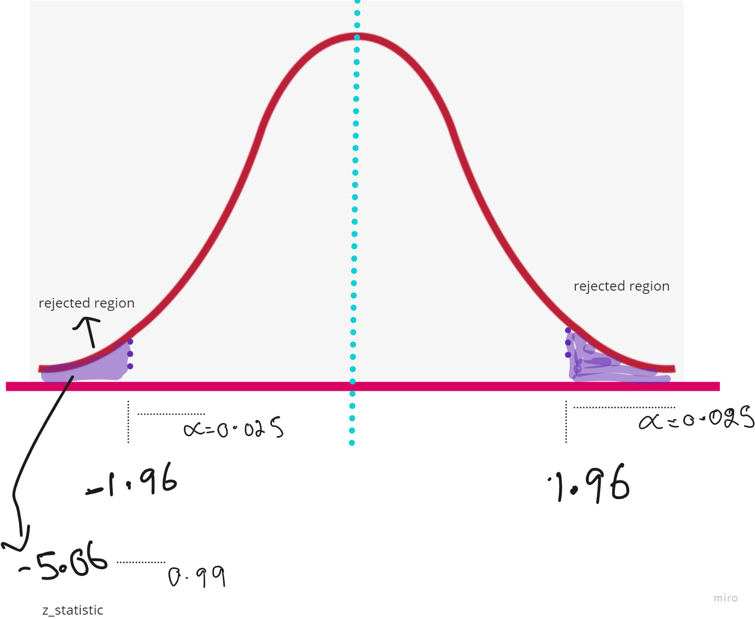
Z-Test for Single Mean(two tail test)
A factory has a machine that dispenses 80 mL of fluid in a bottle. An employee believes the average amount of fluid is not 80 mL. Using 40 samples, he measures the average amount dispensed by the machine to be 78 mL with a standard deviation of 2.5. (a) State the null and alternative hypotheses. (b) At a 95% confidence level, is there enough evidence to support the idea that the machine is not working properly
# Given data
sample_mean = 78, population_mean = 80, population_std_dev = 2.5, sample_size = 40
# Z-test calculation
z_statistic = (sample_mean - population_mean) / (population_std_dev / np.sqrt(sample_size)) # z_statistic -> -5.059
# Two-tailed test at 95% confidence level
p_value = 2 * (1 - stats.norm.cdf(np.abs(z_statistic))) # p_value ->4.200393977082939e-07
# Compare p-value with significance level (e.g., 0.05)
alpha = 0.05
if p_value < alpha:
print("Reject the null hypothesis: There is enough evidence to support the idea that the machine is not working properly.")
else:
print("Fail to reject the null hypothesis: There is not enough evide

Slide 2
Z-Test for Single Mean(one tail test)
Null Hypothesis (H0): The true mean (μ) weight is equal to 80.
Alternative Hypothesis (H1): The true mean (μ) weight is less than 80.
# Given data
sample_mean = 78,population_mean = 80, population_std_dev = 2.5, sample_size = 40
# Z-test calculation
z_statistic = (sample_mean - population_mean) / (population_std_dev / np.sqrt(sample_size))
# One-tailed test at 95% confidence level
p_value = stats.norm.cdf(z_statistic) # p_valu - >2.1001969880109995e-07
# Compare p-value with significance level (e.g., 0.05)
alpha = 0.05
if p_value < alpha:
print("Reject the null hypothesis: There is enough evidence to support the idea that the machine dispenses less fluid.")
else:
print("Fail to reject the null hypothesis: There is not enough evidence to conclude that the machine dispenses less fluid.")

Slide 3
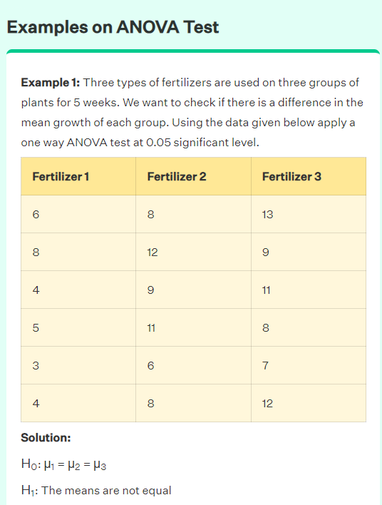
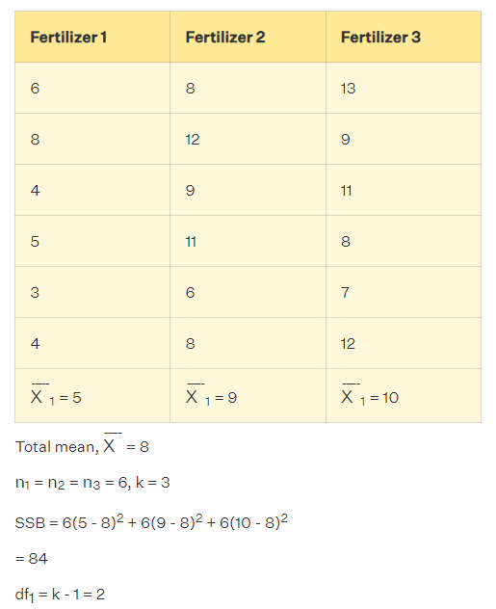
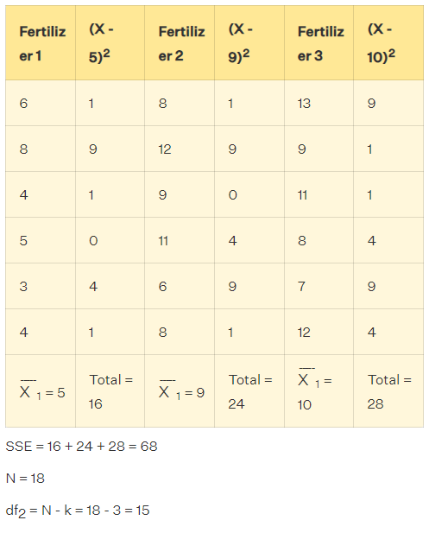
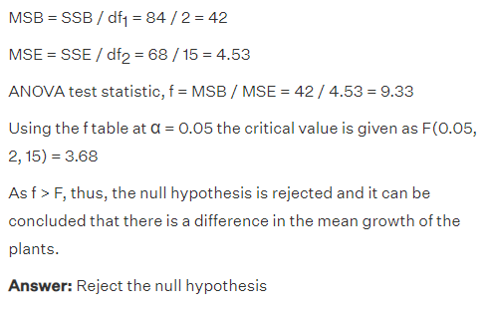
ref: https://www.cuemath.com/anova-formula/

Slide 4
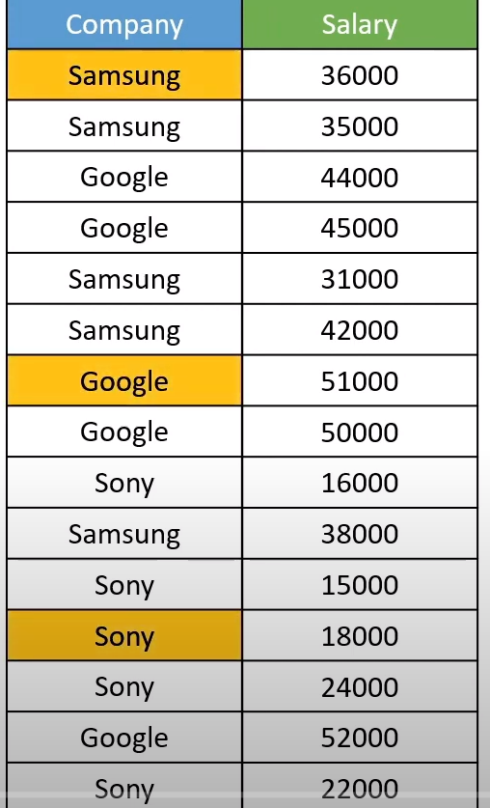
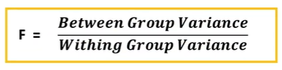
Dataset
if the f-score is high thenthat feature is important
if the F is less then that feature is notimportant
Null Hypothesis ​: There is no significant difference between the group means.
Alternative Hypothesis : There is a significant difference between at least two group means.

Slide 5
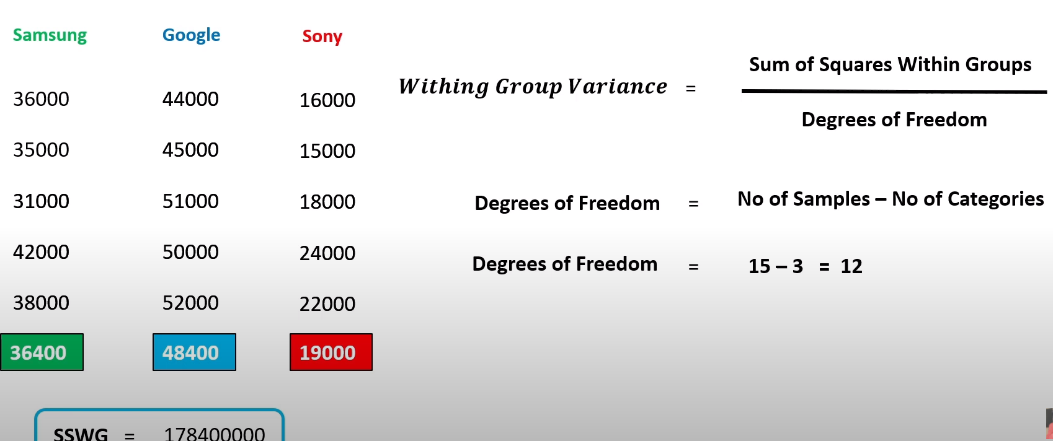
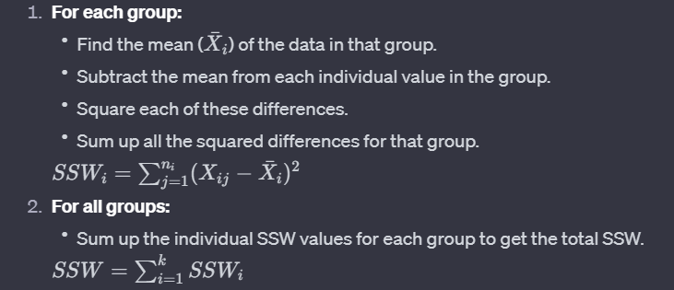

calculate within group variance

Slide 6
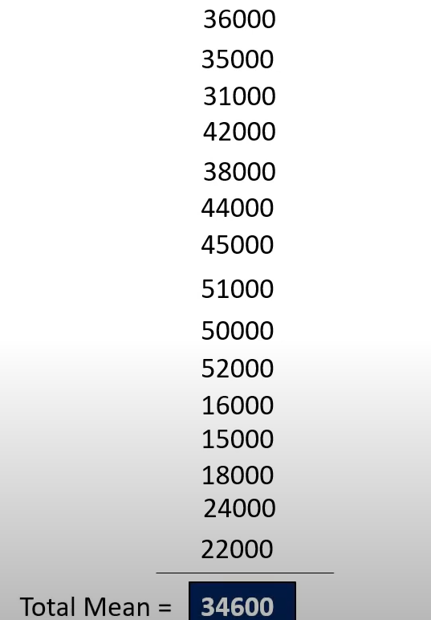
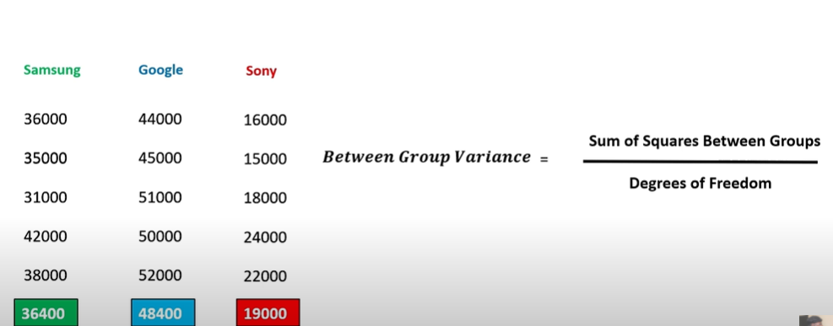
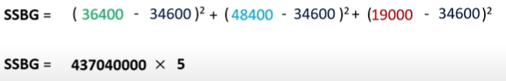

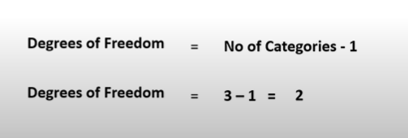
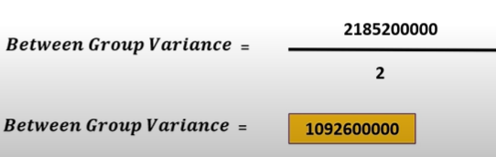

Slide 7
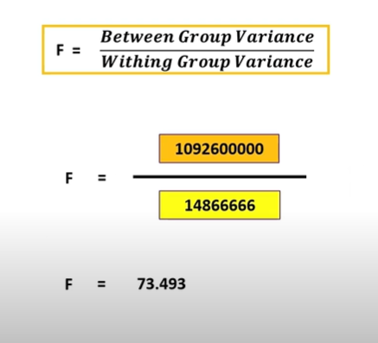
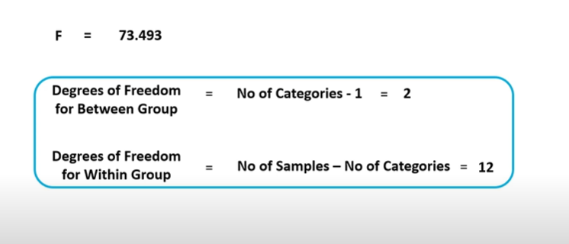
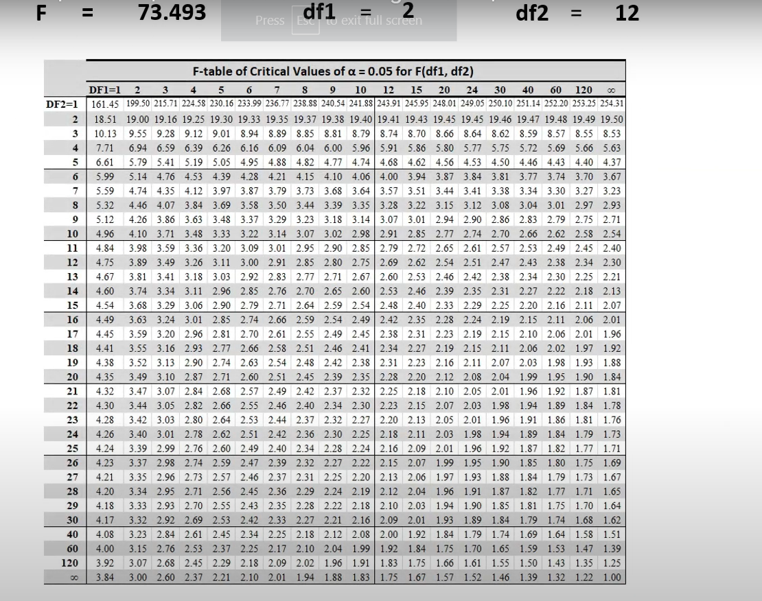

Slide 8
