Slide 1
COURSE NOTES: DESCRIPTIVE STATISTICS

Slide 2
Types of data
Types of data
Categorical
Numerical
Categorical data represents groups or categories.
Examples:
Car brands: Audi, BMW and Mercedes.
Answers to yes/no questions: yes and no
Discrete
Continuous
Numerical data represents numbers. It is divided into two groups: discrete and continuous. Discrete data can be usually counted in a finite matter, while continuous is infinite and impossible to count.
Examples:
Discrete: # children you want to have, SAT score Continuous: weight, height

Slide 3
Levels of measurement
Levels of measurement
Qualitative
Quantitative
Nominal
Ordinal
Interval
Ratio
There are two qualitative levels: nominal and ordinal. The nominal level represents categories that cannot be put in any order, while ordinal represents categories that can be ordered.
Examples:
Nominal: four seasons (winter, spring, summer, autumn) Ordinal: rating your meal (disgusting, unappetizing, neutral, tasty, and delicious)
There are two quantitative levels: interval and ratio. They both represent “numbers”, however, ratios have a true zero, while intervals don’t.
Examples:
Interval: degrees Celsius and Fahrenheit Ratio: degrees Kelvin, length

Slide 4







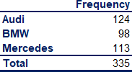
Graphs and tables that represent categorical variables
Frequency
distribution tables
Bar charts
Pie charts
Pareto diagrams
Sales
150
Sales
Merced es 34%
150
100%
80%
60%
40%
20%
0%
Frequency
124
Audi 37%
100
98
113
Frequency
100
124
113
50
50
0
Audi
BMW Mercedes
BMW
98
29%
0
Audi Mercedes BMW
Frequency distribution tables show the category and its corresponding absolute frequency.
Bar charts are very common. Each bar represents a category. On the y-axis we have the absolute frequency.
Pie charts are used when we want to see the share of an item as a part of the total. Market share is almost always represented with a pie chart.
The Pareto diagram is a special type of bar chart where the categories are shown in descending order of frequency, and a separate curve shows the cumulative frequency.

Slide 5
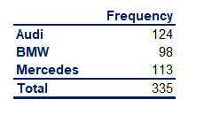

Graphs and tables that represent categorical variables. Excel formulas
Frequency
distribution tables
Bar charts
Pie charts
Pareto diagrams
Sales
150
Sales
Merced es 34%
150
100%
80%
60%
40%
20%
0%
Frequency
124
Audi 37%
100
98
113
Frequency
100
124
113
50
50
0
Audi BMW
Mercedes
BMW
98
29%
0
Audi
Mercedes BMW
In Excel, we can either hard code the frequencies or count them with a count function. This will come up later on.
Total formula: =SUM()
Bar charts are also called
Pie charts are created in the following way:
Choose your data, Insert -> Charts -> Pie chart
Next slide.
clustered column charts in
Excel. Choose your data, Insert
-> Charts -> Clustered column or Bar chart.

Slide 6
Pareto diagrams in Excel
Creating Pareto diagrams in Excel:
Order the data in your frequency distribution table in
descending order.
Create a bar chart.
Add a column in your frequency distribution table that measures the cumulative frequency.
Select the plot area of the chart in Excel and Right click.
Choose Select series.
Click Add
Series name doesn’t matter. You can put ‘Line’
For Series values choose the cells that refer to the cumulative frequency.
Click OK. You should see two side-by-side bars.
Select the plot area of the chart and Right click.
Choose Change Chart Type.
Select Combo.
Choose the type of representation from the dropdown list. Your initial categories should be ‘Clustered Column’. Change the second series, that you called ‘Line’, to ‘Line’.
Done.
Sales
150
100%
90%
80%
100
70%
Frequency
60%
50%
40%
50
30%
20%
10%
0
124
113
98
0%
Audi
Mercedes
BMW

Slide 7
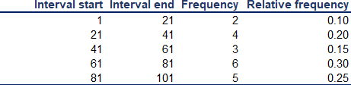
Numerical variables. Frequency distribution table and histogram
Frequency distribution tables for numerical variables are different than the ones for categorical. Usually, they are divided into intervals of equal (or unequal) length. The tables show the interval, the absolute frequency and sometimes it is useful to also include the relative (and cumulative) frequencies.
The interval width is calculated using the following formula:
𝐼𝑛𝑡𝑒𝑟𝑎𝑙 𝑤𝑖𝑑𝑡ℎ =
𝐿𝑎𝑟𝑔𝑒𝑠𝑡 𝑛𝑢𝑚𝑏𝑒𝑟 − 𝑠𝑚𝑎𝑙𝑙𝑒𝑠𝑡 𝑛𝑢𝑚𝑏𝑒𝑟
𝑁𝑢𝑚𝑏𝑒𝑟 𝑜𝑓 𝑑𝑒𝑠𝑖𝑟𝑒𝑑 𝑖𝑛𝑡𝑒𝑟𝑣𝑎𝑙𝑠
Creating the frequency distribution table in Excel:
Decide on the number of intervals you would like to use.
Find the interval width (using a the formula above).
Start your 1st interval at the lowest value in your dataset.
Finish your 1st interval at the lowest value + the interval width. ( = start_interval_cell + interval_width_cell )
Start your 2nd interval where the 1st stops (that's a formula as well - just make the starting cell of interval 2 = the ending of interval 1)
Continue in this way until you have created the desired number of intervals.
Count the absolute frequencies using the following COUNTIF formula:
=COUNTIF(dataset_range,">=“&interval start) -COUNTIF(dataset_range,">“&interval end).
In order to calculate the relative frequencies, use the following formula: = absolute_frequency_cell / number_of_observations
In order to calculate the cumulative frequencies:
The first cumulative frequency is equal to the relative frequency
Each consequitive cumulative frequency = previous cumulative frequency + the respective relative frequency
Note that all formulas could be found in the lesson Excel files and the solutions of the exercises provided with each lesson.

Slide 8
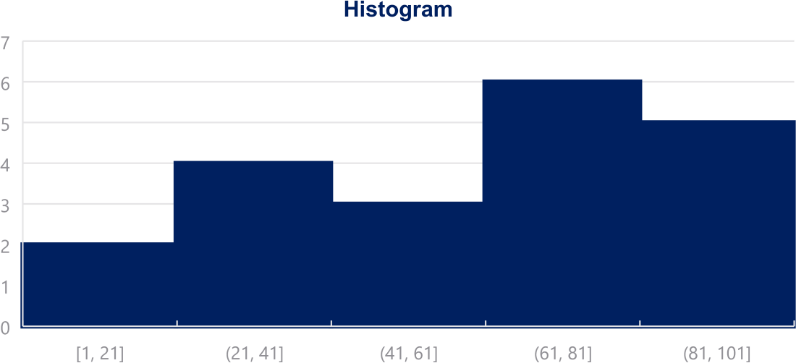
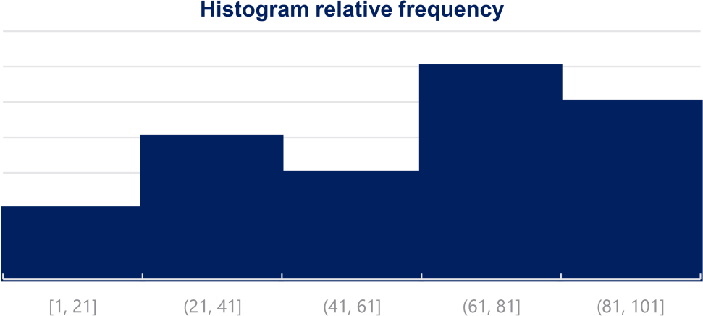
Numerical variables. Frequency distribution table and histogram
Histograms are the one of the most common ways to represent numerical data. Each bar has width equal to the width of the interval. The bars are touching as there is continuation between intervals: where one ends -> the other begins.
Creating a histogram in Excel:
Choose your data
Insert -> Charts -> Histogram
To change the number of bins (intervals):
Select the x-axis
Click Chart Tools -> Format -> Axis options
You can select the bin width (interval width), number of bins, etc.
0.30
0.25
0.20
0.15
0.10

Slide 9
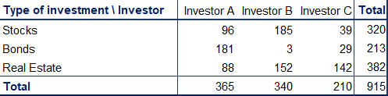
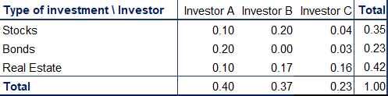
Graphs and tables for relationships between variables. Cross tables
Cross tables (or contingency tables) are used to represent categorical variables. One set of categories is labeling the rows and another is labeling the columns. We then fill in the table with the applicable data. It is a good idea to calculate the totals. Sometimes, these tables are constructed with the relative frequencies as shown in the table below.
Side-by-side bar chart
200
A common way to represent the data from a cross table is by using a side-by-side bar chart.
180
160
140
120
100
80
60
40
20
0
Creating a side-by-side chart in Excel:
1. Choose your data
2. Insert -> Charts -> Clustered Column
Selecting more than one series ( groups of data ) will automatically prompt Excel to create a side-by-side bar (column) chart.
Investor A
Investor B
Stocks Bonds Real Estate
Investor C

Slide 10



Graphs and tables for relationships between variables. Scatter plots
800
When we want to represent two numerical variables on the same graph, we usually use a scatter plot. Scatter plots are useful especially later on, when we talk about regression analysis, as they help us detect patterns (linearity, homoscedasticity).
Scatter plots usually represent lots and lots of data. Typically, we are not interested in single observations, but rather in the structure of the dataset.
700
600
500
400
300
Creating a scatter plot in Excel:
Choose the two datasets you want to plot.
Insert -> Charts -> Scatter
200
100
0
0
100
200
300
400
500
600
700
800
26
25.5
25
A scatter plot that looks in the following way (down) represents data that doesn’t have a pattern. Completely vertical ‘forms’ show no association.
Conversely, the plot above shows a linear pattern, meaning that the observations move
together.
24.5
24
23.5
23
22.5
22
21.5
0
20
40
60
80
100
120
140
160
180

Slide 11
Mean, median, mode
Mean
Median
Mode
The mean is the most widely spread measure of central tendency. It is the simple average of the dataset.
Note: easily affected by outliers
The formula to calculate the mean is:
The median is the midpoint of the ordered dataset. It is not as popular as the mean, but is often used in academia and data science. That is since it is not affected by outliers.
In an ordered dataset, the median is
The mode is the value that occurs most often. A dataset can have 0 modes, 1 mode or multiple modes.
The mode is calculated simply by finding the value with the highest frequency.
In Excel, the mode is calculated by:
=MODE.SNGL() -> returns one mode
=MODE.MULT() -> returns an array with the modes. It is used when we have more than 1 mode.
the number at position ^{n+1} .
_{σ}𝑁
𝑥_{𝑖}
2
If this position is not a whole number, it, the median is the simple average of the two numbers at positions closest to the calculated value.
In Excel, the median is calculated by:
=MEDIAN()
𝑖=1
𝑁
or
𝑥₁ + 𝑥₂ + 𝑥₃ + ⋯ + 𝑥_{𝑁−1} + 𝑥_{𝑁}
𝑁
In Excel, the mean is calculated by:
=AVERAGE()

Slide 12
Skewness
Skewness is a measure of asymmetry that indicates whether the observations in a dataset are concentrated on one side.
Right (positive) skewness looks like the one in the graph. It means that the outliers are to the right (long tail to the right).
Left (negative) skewness means that the outliers are to the left.
Usually, you will use software to calculate skewness.
Median Mean Mode
1 _{σ𝑛}
(𝑥 − 𝑥ҧ)³
Calculating skewness in Excel:
=SKEW()
Formula to calculate skewness:
𝑛
𝑖=1
𝑖
1
_{σ}𝑛
3
(𝑥 − 𝑥ҧ)²
𝑛 − 1
𝑖=1
𝑖

Slide 13

Variance and standard deviation
Variance and standard deviation measure the dispersion of a
set of data points around its mean value.
There are different formulas for population and sample variance & standard deviation. This is due to the fact that the sample formulas are the unbiased estimators of the population formulas. More on the mathematics behind it.
Point 1
Point 4
Point 2
Mean
Point 5
_{σ}𝑛
(𝑥_{𝑖}−𝑥ҧ)²
Sample variance formula:
𝑠² =
𝑖=1
𝑛−1
Point 3
Point 6
_{σ}𝑁
σ² =
𝑖=1
(𝑥_{𝑖}−𝜇)²
Population variance formula:
𝑁
_{σ}𝑛
(𝑥_{𝑖}−𝑥ҧ)²
Calculating variance in Excel:
Sample standard deviation formula:
𝑠 =
𝑖=1
𝑛−1
Sample variance: =VAR.S()
Population variance: =VAR.P()
Sample standard deviation: = STDEV.S() Population standard deviation: =STDEV.P()
_{σ}𝑁
(𝑥_{𝑖}−𝜇)²
Population standard deviation formula: σ =
𝑖=1
𝑁

Slide 14
Covariance and correlation
Covariance
Correlation
Covariance is a measure of the joint variability of two variables.
A positive covariance means that the two variables move together.
A covariance of 0 means that the two variables are
independent.
A negative covariance means that the two variables move in opposite directions.
Covariance can take on values from -∞ to +∞ . This is a problem as it is very hard to put such numbers into perspective.
Correlation is a measure of the joint variability of two variables. Unlike covariance, correlation could be thought of as a standardized measure. It takes on values between -1 and 1, thus it is easy for us to interpret the result.
A correlation of 1, known as perfect positive correlation, means that one variable is perfectly explained by the other.
A correlation of 0 means that the variables are independent.
A correlation of -1, known as perfect negative correlation, means that one variable is explaining the other one perfectly, but they move in opposite directions.
_{σ}𝑛
𝑥_{𝑖}−𝑥ҧ ∗(𝑦_{𝑖}−𝑦ത)
^{𝑠}𝑥𝑦
Sample covariance formula:
𝑠_{𝑥𝑦} =
𝑖=1
Sample correlation formula: r =
𝑛−1
𝑠_{𝑥}𝑠_{𝑦}
_{σ}𝑁
𝑥_{𝑖}−𝜇_{𝑥} ∗(𝑦_{𝑖}−𝜇_{𝑦})
^{𝜎}𝑥𝑦
Population covariance formula:
𝜎_{𝑥𝑦} =
𝑖=1
Population correlation formula: ρ =
𝑁
𝜎_{𝑥}𝜎_{𝑦}
In Excel, the covariance is calculated by:
In Excel, correlation is calculated by:
=CORREL()
Sample covariance: =COVARIANCE.S() Population covariance: =COVARIANCE.P()

