Slide 1
COURSE NOTES: HYPOTHESIS TESTING

Slide 2
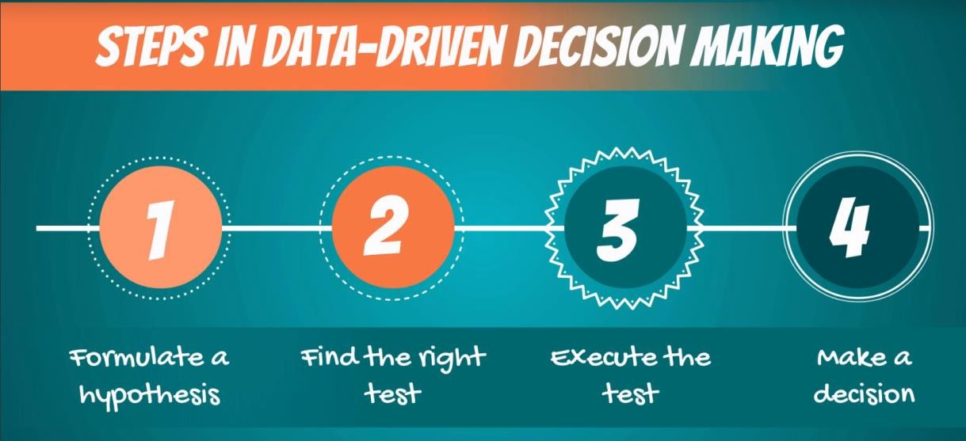
Scientific method
The ‘scientific method’ is a procedure that has characterized natural science since the 17th century. It consists in systematic observation, measurement, experiment, and the formulation, testing and modification of hypotheses.
Since then we’ve evolved to the point where most people and especially professionals realize that pure observation can be deceiving. Therefore, business decisions are increasingly driven by data. That’s also the purpose of data science.
While we don’t ‘name’ the scientific method in the videos, that’s the underlying idea. There are several steps you would follow to reach a data-driven decision (pictured).

Slide 3

Hypotheses
A hypothesis is “an idea that can be tested”
It is a supposition or proposed explanation made on the basis of
limited evidence as a starting point for further investigation.
Null hypothesis (H₀)
Alternative hypothesis (H₁ or H_{A})
The null hypothesis is the hypothesis to be tested.
It is the status-quo. Everything which was believed until now
that we are contesting with our test.
The concept of the null is similar to: innocent until proven guilty. We assume innocence until we have enough evidence to prove that a suspect is guilty.
The alternative hypothesis is the change or innovation that is contesting the status-quo.
Usually the alternative is our own opinion. The idea is the
following:
If the null is the status-quo (i.e., what is generally believed), then the act of performing a test, shows we have doubts about the truthfulness of the null. More often than not the researcher’s opinion is contained in the alternative hypothesis.

Slide 4
Question 1:
You want to check if your height is above average, compared to your classmates. State the null and alternative hypotheses of this test.
H0: My height is lower or equal to the average height in the class.
H1: My height is higher than the average height in the class.
The null is the status quo (you are 'shorter'), while the alternative is the 'change or innovation' (you are looking for this answer). Therefore, the null hypothesis of the test is ‘lower or equal’. You have to include ‘equal’ in the null hypothesis, as conventionally, the equality sign is always included in the null.

Slide 5
Question 2:
You want to test if the Obama administration issued fewer executive orders than the Bush administration. State the null and alternative hypotheses of this test.
H0: The Obama administration issued at least as many executive orders as the Bush administration.
H1: The Obama administration issued fewer executive orders than the Bush administration.
We want to test if the Obama administration issued fewer executive orders than the Bush administration. Therefore, the null hypothesis is: ‘The Obama administration issued at least as many executive orders as the Bush administration.’ The alternative hypothesis encompasses everything else; therefore, the alternative is: The Obama administration issued fewer executive orders than the Bush administration.

Slide 6
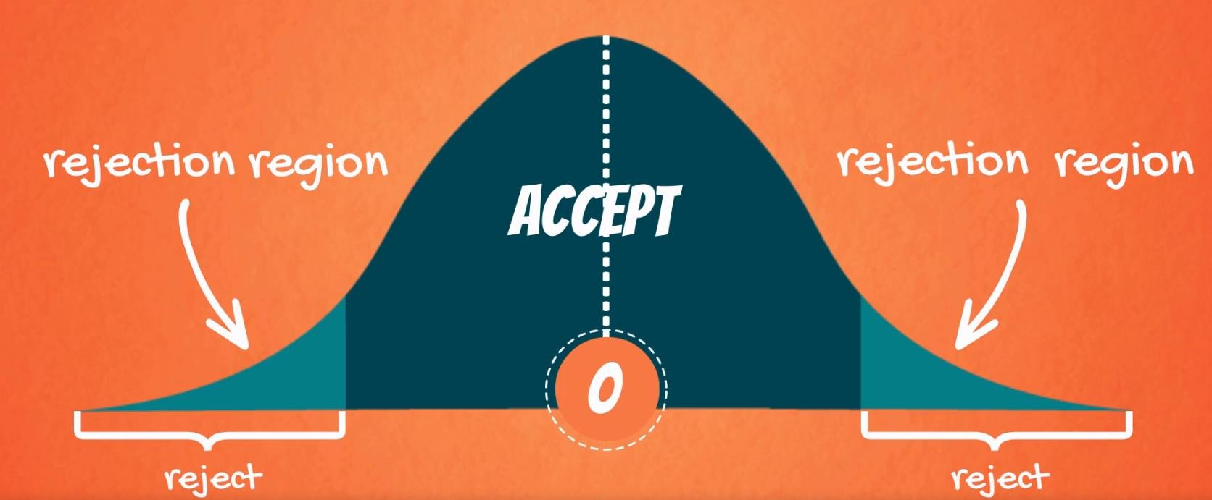
Decisions you can take
When testing, there are two decisions that can be made: to accept the null hypothesis or to reject the null hypothesis.
To accept the null means that there isn’t enough data to support the change or the innovation brought by the alternative. To reject the null means that there is enough statistical evidence that the status-quo is not representative of the truth.
Given a two-tailed test:
Graphically, the tails of the distribution show when we reject the null hypothesis (‘rejection region’).
Everything which remains in the middle is the ‘acceptance
region’.
The rationale is: if the observed statistic is too far away from 0 (depending on the significance level), we reject the null. Otherwise, we accept it.
Different ways of reporting the result:
Accept
At x% significance, we accept the null hypothesis
At x% significance, A is not significantly different from B
At x% significance, there is not enough statistical evidence that… At x% significance, we cannot reject the null hypothesis
Reject
At x% significance, we reject the null hypothesis
At x% significance, A is significantly different from B
At x% significance, there is enough statistical evidence… At x% significance, we cannot say that *restate the null*

Slide 7
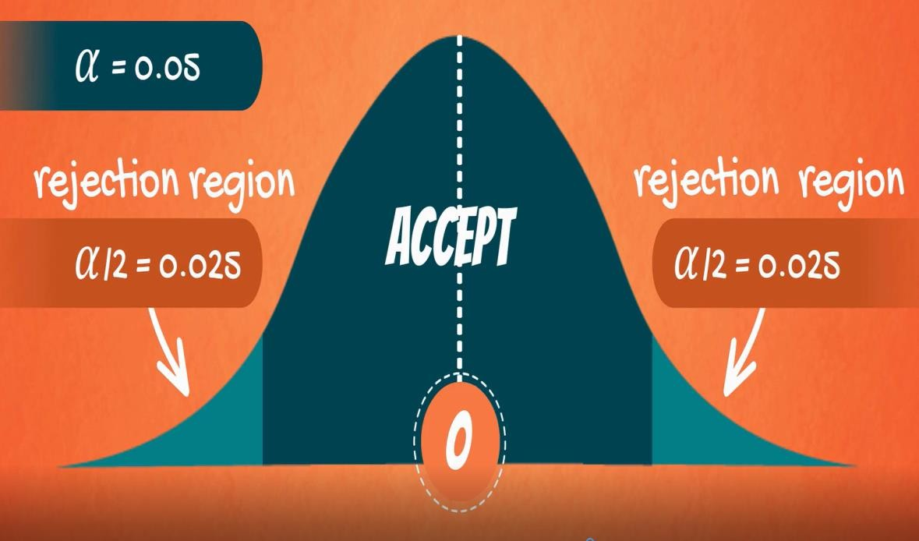
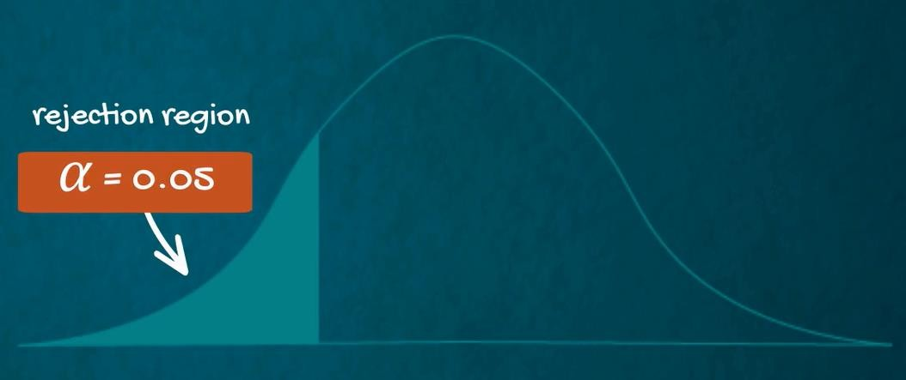
Level of significance and types of tests
Level of significance (α)
The probability of rejecting a null hypothesis that is true; the probability of making this error.
Common significance levels
0.10 0.05 0.01
One-sided (one-tailed) test
Used when the null doesn’t contain equality or inequality sign (<,>,≤,≥)
Two-sided (two-tailed) test
Used when the null contains an equality (=) or an inequality sign (≠)

Slide 8
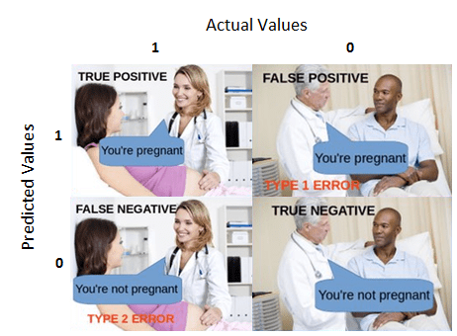
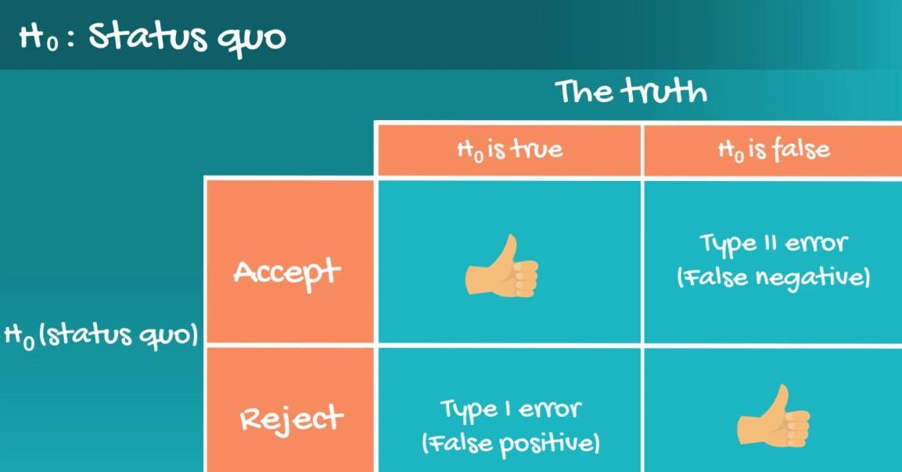
Statistical errors (Type I Error and Type II Error)
In general, there are two types of errors we can make while testing: Type I error (False positive) and Type II Error (False negative).
Statisticians summarize the errors in the following table: Here’s the table with the example from the lesson:
The probability of committing Type I error (False positive) is the probability of making this error is alpha (α).
The probability of committing Type II error (False negative) is the probability of making this error is denoted by beta (β) and is called ‘power of the test.
If you want to find out more about statistical errors, just follow this link for an article written by your instructor.

Slide 9
P-value
p-value
The p-value is the smallest level of significance at which we can still reject the null hypothesis,
given the observed sample statistic
0.000
When we are testing a hypothesis, we always strive for those ‘three zeros after the dot’. This indicates that we reject the null at all significance levels.
Notable p-values
0.05
0.05 is often the ‘cut-off line’. If our p-value is higher than 0.05 we would normally accept the null hypothesis (equivalent to testing at 5% significance level). If the p-value is lower than 0.05 we would reject the null.
Where and how are p-values used?
Most statistical software calculates p-values for each test
The researcher can decide the significance level post-factum
p-values are usually found with 3 digits after the dot (x.xxx)
The closer to 0.000 the p-value, the better
Should you need to calculate a p-value ‘manually’, we suggest using an online p-value calculator, e.g. this one.

Slide 10



Formulae for Hypothesis Testing
# populations | Population variance | Samples | Statistic | Variance |  | Formula for test statistic |  | Decision rule
One | known | - | z | _{𝜎}2 |  | 𝑥ҧ − 𝜇₀ 𝑍 = _{𝜎} ൗ _{n} |  | There are several ways to phrase the decision rule and they all have the same meaning. Reject the null if: |test statistic| > |critical value| The absolute value of the test statistic is bigger than the absolute critical value p-value < some significance level most often 0.05 Usually, you will be using the p-value to make a decision.
One | unknown | - | t | _{𝑠}2 |  | 𝑥ҧ − 𝜇₀ 𝑇 = _{𝑠} ൗ _{n}
Two | - | dependent | t | _{𝑠}2 𝑑𝑖𝑓𝑓𝑒𝑟𝑒𝑛𝑐𝑒 |  | 𝑑^{ҧ} − 𝜇₀ 𝑇 = _{𝑠𝑑ൗ} n
Two | Known | independent | z | σ² , σ² 𝑥 𝑦 |  | 𝑍 = | (𝑥ҧ − 𝑦ത) − 𝜇₀ _{σ2 σ}2 _{𝑥 +} 𝑦 𝑛_{𝑥} 𝑛_{𝑦}
Two | unknown, assumed equal | independent | t | 𝑠² = 𝑝 | 𝑛_{𝑥} − 1 𝑠² + 𝑛 − 1 𝑠² 𝑥 𝑦 𝑦 𝑛_{𝑥} + 𝑛_{𝑦} − 2 | 𝑇 = | (𝑥ҧ − 𝑦ത) − 𝜇₀ _{𝑠}2 _{𝑠}2 𝑝 ₊ 𝑝 𝑛_{𝑥} 𝑛_{𝑦}
𝝈
^{𝒛}𝑎/𝟐 ∗ _{𝒏}
𝒔
𝒕 ∗
𝒅.𝒇.,𝑎/𝟐 _{𝒏}

Slide 11
To calculate the confidence interval for a population mean with a known standard deviation, you can use the following formula:
Sample Size = 30
Sample Standard Deviation = 100
Sample Mean = 500
Confidence Level = 95%
To calculate the confidence interval for a population mean with a known standard deviation, use the formula:
Confidence Interval = (X̄ - Z(σ/√n), X̄ + Z(σ/√n))
For a 95% confidence level:
- Z ≈ 1.96 (corresponding to a cumulative probability of 0.975)
Substitute the values:
Confidence Interval ≈ (500 - 1.96(100/√30), 500 + 1.96(100/√30))
Calculating:
Confidence Interval ≈ (500 - 35.764, 500 + 35.764)
Result:
Confidence Interval ≈ (464.236, 535.764)
Therefore, the 95% confidence interval for the population mean is approximately (464.236, 535.764).

Slide 12
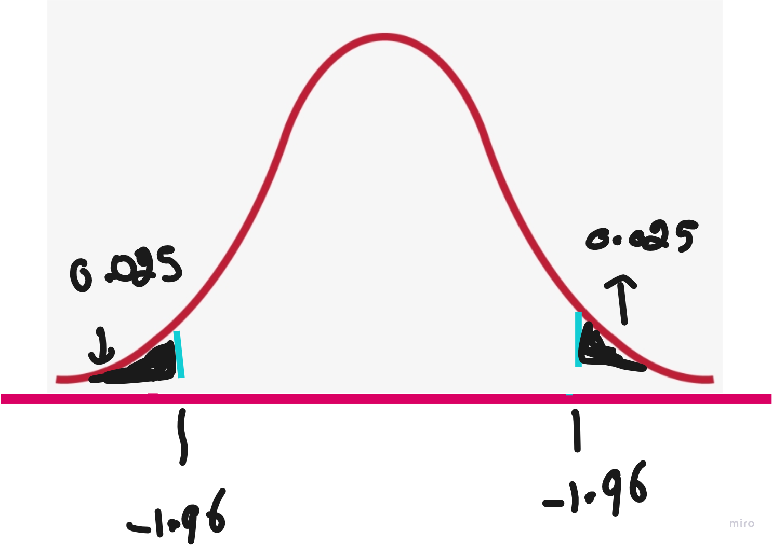
The average weight of all residents in town XYZ is 168 lbs. A nutritionist believes the true mean to be different. She measured the weight of 36 individuals and found the mean to be 169.5 lbs with a standard deviation of 3.9. (a) State the null and alternative hypotheses. (b) At a 95% confidence level, is there enough evidence to discard the null hypothesis? (Use the p-value method)
One-Sample T-Test
(a) Null and Alternative Hypotheses:
H0: μ = 168 # μ represents the population mean
H1: μ ≠ 168
(b) Given values:
- Sample mean (x̄): 169.5 lbs
- Sample size (n): 36
- Standard deviation (s): 3.9 lbs
Calculating the t-statistic:
t = (169.5 - 168) / (3.9 / √36)
t ≈ 1.5 / (3.9 / 6) ≈ 2.3077
The p-value associated with a t-statistic of 2.3077 with 35 degrees of freedom is approximately 0.027.
Results:
The p-value is 0.027. Since this p-value is less than the common significance level of 0.05, we reject the null hypothesis.
Conclusion:
At a 95% confidence level, there is enough evidence to suggest that the true mean weight of residents in town XYZ is different from 168 lbs.

Slide 13
t-Test
T-Test:
A t-test is a statistical test used to determine if there is a significant difference between the means of two groups. It is particularly useful when comparing the means of small sample sizes. The t-test is based on the t-distribution and is commonly used in hypothesis testing.
Types of T-Tests:
There are several types of t-tests, but the two most common ones are:
Independent Samples T-Test:
This test is used when comparing the means of two independent groups to determine if they are significantly different from each other.
Paired Samples T-Test:
Also known as a dependent samples t-test, this is used when comparing the means of two related groups, such as repeated measurements on the same individuals.

Slide 14
When to Use T-Test:
T-tests are appropriate in various scenarios, including:
Comparing means: To determine if there is a significant difference between the means of two groups.
Before and after studies: To assess if there is a significant change in a variable before and after an intervention.
Paired observations: When dealing with paired observations, like measurements on the same subjects over time.
Limitations of T-Tests:
While t-tests are widely used and valuable in many situations, they have limitations:
Sample Size: T-tests are sensitive to sample size. With very small sample sizes, the results may not be reliable.
Normal Distribution Assumption: T-tests assume that the data follow a normal distribution. If this assumption is violated, the results may not be accurate.
Equal Variance Assumption: The standard t-test assumes that the variances of the two groups being compared are equal. If this assumption is not met, alternative versions of the t-test (such as Welch's t-test) should be considered.
Sensitivity to Outliers: T-tests can be sensitive to outliers, which may unduly influence the results.
Multiple Comparisons: Conducting multiple t-tests increases the chance of making a Type I error (false positive). In such cases, corrections like the Bonferroni correction may be applied.

Slide 15
Data:
Layout A: [3, 4, 2, 5, 3]
Layout B: [6, 5, 7, 4, 6]
Algorithm Formulas:
1. Calculate Means and Variances:
- Mean for Layout A (𝑋̅): 3.4
- Mean for Layout B (𝑌̅): 5.6
- Variance for Layout A (s²ₓ): ~1.3
- Variance for Layout B (s²ᵧ): ~0.7
Algorithm Formulas:
2. Calculate the T-Statistic:
- T-Statistic (t): t = (𝑋̅ - 𝑌̅) / √((s²ₓ/nₓ) + (s²ᵧ/nᵧ))
- Substituting values: ~-2.13
3. Degrees of Freedom:
- Degrees of Freedom (df): 8
4. Find Critical Value or P-Value:
- Assuming α = 0.05, Critical t-Value (t_critical): ±2.31
5. Make a Decision:
- Since |t| < t_critical and the p-value is less than 0.05, we reject the null hypothesis.
Conclusion:
There is enough evidence to suggest that the mean time spent on the site with layout A is significantly different from the mean time spent with layout B.

Slide 16
One-Sample T-Test Results
Sample Data:
Completion times (minutes): {25, 28, 32, 30, 27}
Claimed Average Completion Time: 30 minutes
----------------------------------------
1. Calculate Sample Mean (𝑋̅):
𝑋̅ = (25 + 28 + 32 + 30 + 27) / 5 = 28.4
2. Calculate Sample Standard Deviation (𝑠):
Differences from mean: {-3.4, -0.4, 3.6, 1.6, -1.4}
Squared differences: {11.56, 0.16, 12.96, 2.56, 1.96}
Variance = (11.56 + 0.16 + 12.96 + 2.56 + 1.96) / (5 - 1) = 7.3
𝑠 = √7.3 ≈ 2.70
3. Calculate t-Statistic:
𝑡 = (28.4 - 30) / (2.70 / √5) ≈ -1.49
----------------------------------------
Conclusion:
The calculated t-value of -1.49 does not fall within the critical region at a 95% confidence level with 4 degrees of freedom. Therefore, we fail to reject the null hypothesis.
There is not enough evidence to suggest that the average completion time significantly differs from the claimed average of 30 minutes based on this sample data.
To make a conclusion, we would compare this calculated t-value to a critical value from the t-distribution table with
n−1 degrees of freedom (in this case, 5-1= 4) at a certain confidence level (e.g., 95%).

