Slide 1
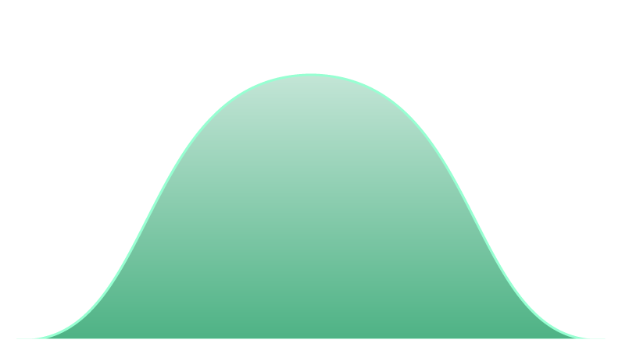

An overview of Distributions
A distribution shows the possible values a random variable can take and how frequently they occur.
Important Notation for Distributions:
Y actual outcome
y one of the possible outcomes
𝑃(𝑌 = 𝑦) is equivalent to p(𝑦).
We call a function that assigns a probability to each distinct outcome in the sample space, a probability function.
 | Population | Sample
Mean | 𝜇 | 𝑥ҧ
Variance | _{𝜎}2 | _{𝑠}2
Standard Deviation | 𝜎 | 𝑠
𝜇 − 𝜎
𝜇
𝜇 + 𝜎

Slide 2
Types of Distributions
Certain distributions share characteristics, so we separate them into types. The well-defined types of distributions we often deal with have elegant statistics. We distinguish between two big types of distributions based on the type of the possible values for the variable – discrete and continuous.
Discrete
Continuous
Have a finite number of outcomes.
Use formulas we already talked about.
Can add up individual values to determine probability of an interval.
Can be expressed with a table, graph or a piece-wise function.
Expected Values might be unattainable.
Graph consists of bars lined up one after the other.
Have infinitely many consecutive possible
values.
Use new formulas for attaining the probability of specific values and intervals.
Cannot add up the individual values that make up an interval because there are infinitely many of them.
Can be expressed with a graph or a
continuous function.
Graph consists of a smooth curve.

Slide 3


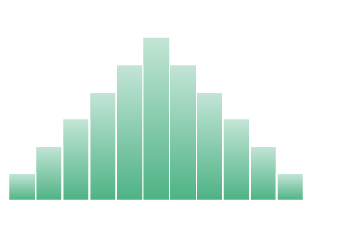
Discrete Distributions
Discrete Distributions have finitely many different possible outcomes. They possess several key characteristics which separate them from continuous ones.
Key characteristics of discrete distribution
Have a finite number of outcomes.
Use formulas we already talked about.
Can add up individual values to
determine
probability of an interval.
Can be expressed with a table, graph or a piece-wise function.
Expected Values might be unattainable.
Graph consists of bars lined up one after the other.
𝑷 𝒀 ≤ 𝒚 = 𝑷 𝒀 < 𝒚 + 𝟏
Examples of Discrete Distributions:
Discrete Uniform Distribution
Bernoulli Distribution
Binomial Distribution
Poisson Distribution

Slide 4
Uniform Distribution
A distribution where all the outcomes are equally likely is called a Uniform Distribution.
Notation:
𝒀~ 𝑼(𝒂, 𝒃)
* alternatively, if the values are categorical, we simply indicate the number of categories, like so: 𝒀~ 𝑼(𝒂)
Key characteristics
All outcomes are equally likely.
All the bars on the graph are equally tall.
The expected value and variance have no predictive power.
Example and uses:
Outcomes of rolling a single die.
Often used in shuffling algorithms due to its fairness.

Slide 5
Bernoulli Distribution
A distribution consisting of a single trial and only two possible outcomes – success or failure is called a Bernoulli Distribution.
Notation:
𝒀~ 𝑩𝒆𝒓𝒏(𝒑)
Key characteristics
One trial.
Two possible outcomes.
𝑬 𝒀 = 𝒑
𝑽𝒂𝒓 𝒀 = 𝒑 × (𝟏 − 𝒑)
Example and uses:
Guessing a single True/False question.
Often used in when trying to determine what we
expect to get out a single trial of an experiment.

Slide 6
Binomial Distribution
A sequence of identical Bernoulli events is called Binomial and follows a Binomial Distribution.
Notation:
𝒀~ 𝑩(𝒏, 𝒑)
Key characteristics
Measures the frequency of occurrence of one of the possible outcomes over the n trials.
𝑷 𝒀 = 𝒚 = 𝑪 𝒚, 𝒏 × 𝒑^{𝒚} ×
𝑬 𝒀 = 𝒏 × 𝒑
𝑽𝒂𝒓 𝒀 = 𝒏 × 𝒑 × (𝟏 − 𝒑)
_{𝟏 − 𝒑} 𝒏−𝒚
Example and uses:
Determining how many times we expect to get a
heads if we flip a coin 10 times.
Often used when trying to predict how likely an event is to occur over a series of trials.

Slide 7

Poisson Distribution
When we want to know the likelihood of a certain event occurring over a given interval of time or distance
we use a Poisson Distribution.
Notation:
𝒀~ 𝑷𝒐(λ)
Key characteristics
Measures the frequency over an interval of time or distance. (Only non-negative values.)
𝑷 𝒀 = 𝒚 =
𝑬 𝒀 = λ
𝑽𝒂𝒓 𝒀 = λ
_{λ}𝒚
y!𝒆^{−λ}
Example and uses:
Used to determine how likely a specific outcome is,
knowing how often the event usually occurs.
Often incorporated in marketing analysis to determine whether above average visits are out of the ordinary or not.

Slide 8

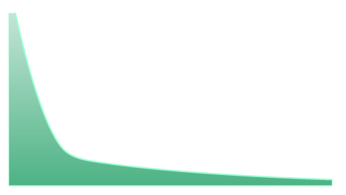

Continuous Distributions
If the possible values a random variable can take are a sequence of infinitely many consecutive values, we are dealing with a continuous distribution.
Key characteristics
Have infinitely many consecutive possible values.
Cannot add up the individual values that make up an interval because there are infinitely many of them.
Can be expressed with a graph or a continuous function. Cannot use a table, be
Graph consists of a smooth curve.
To calculate the likelihood of an interval, we need integrals.
They have important CDFs.
𝑷 𝒀 = 𝒚 = 0 for any individual value y.
𝑷 𝒀 < 𝒚 = 𝑷 𝒀 ≤ 𝒚

Slide 9
Normal Distribution
A Normal Distribution represents a distribution that most natural events follow.
Notation:
𝒀~ 𝑵(μ, σ^{𝟐})
Key characteristics
Its graph is bell-shaped curve, symmetric and has thin tails.
𝑬 𝒀 = μ
𝑽𝒂𝒓 𝒀 = σ^{𝟐}
68% of all its values should fall in the interval:
(μ − 𝝈, 𝝁 + 𝝈)
Example and uses:
Often observed in the size of animals in the
wilderness.
Could be standardized to use the Z-table.

Slide 10
Standardizing a Normal Distribution
To standardize any normal distribution we need to transform it so that the mean is 0 and the variance and standard deviation are 1.
Ensures mean is 0.
Using a transformation to create a new random variable z.
𝑦 − 𝜇
z =
𝜎
Ensures standard deviation is 1.
Importance of the Standard Normal Distribution.
The new variable z, represents how many standard deviations away from the mean, each corresponding value is.
We can transform any Normal Distribution into a Standard Normal Distribution using the transformation shown above.
Convenient to use because of a table of known values for its CDF, called the Z-score table, or simply the Z-table.

Slide 11
Students’ T Distribution
A Normal Distribution represents a small sample size approximation of a Normal Distribution.
Notation:
𝒀~ 𝒕 (𝒌)
Key characteristics
A small sample size approximation of a Normal Distribution.
Its graph is bell-shaped curve, symmetric, but has fat tails.
Accounts for extreme values better than the Normal Distribution.
If k>1: 𝑬 𝒀 = μ and 𝑽𝒂𝒓 𝒀 = 𝒔^{𝟐} ×
Example and uses:
𝒌
𝒌−𝟐
Often used in analysis when examining a small sample of data that usually follows a Normal Distribution.

Slide 12
Chi-Squared Distribution
A Chi-Squared distribution is often used.
Notation:
𝒀~ 𝝌^{𝟐}(𝒌)
Key characteristics
Its graph is asymmetric and skewed to the right.
𝑬 𝒀 = 𝒌
𝑽𝒂𝒓 𝒀 = 𝟐𝒌
The Chi-Squared distribution is the square of the t- distribution.
Example and uses:
Often used to test goodness of fit.
Contains a table of known values for its CDF called
the 𝝌^{𝟐}-table. The only difference is the table shows what part of the table

Slide 13
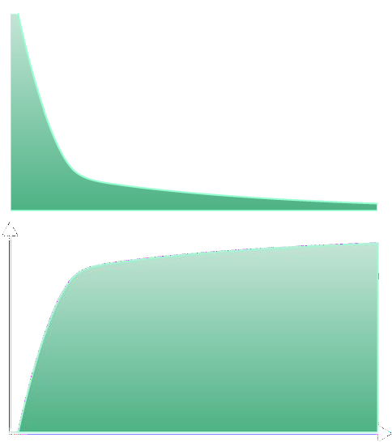
Exponential Distribution
The Exponential Distribution is usually observed in events which significantly change early on.
Notation:
𝒀~ 𝑬𝒙𝒑 (𝝀)
Key characteristics
PDF
Both the PDF and the CDF plateau after a certain point.
₌ 𝟏
𝑬 𝒀
𝑽𝒂𝒓 𝒀 =
We often use the natural logarithm to transform the values of such distributions since we do not have a table of known values like the Normal or Chi- Squared.
𝝀
𝟏
_{𝝀}𝟐
CDF
Example and uses:
Often used with dynamically changing variables, like online website traffic or radioactive decay.

Slide 14
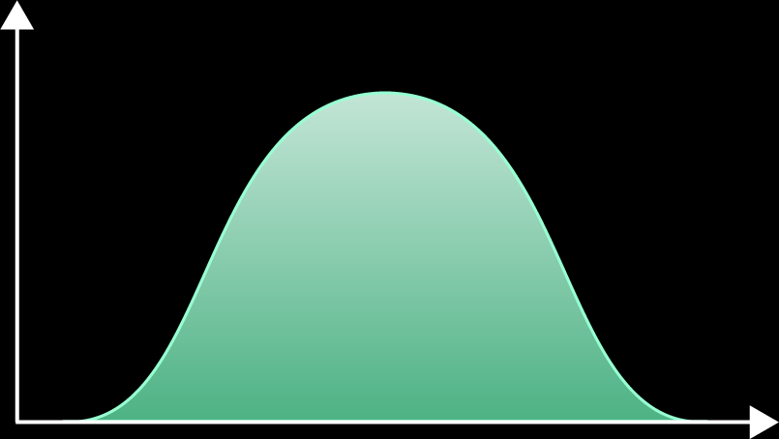

Logistic Distribution
The Continuous Logistic Distribution is observed when trying to determine how continuous variable inputs
can affect the probability of a binary outcome.
Notation:
𝒀~ 𝑳𝒐𝒈𝒊𝒔𝒕𝒊𝒄 (𝝁, 𝒔)
PDF
Key characteristics.
𝑬 𝒀 = 𝝁
𝑽𝒂𝒓 𝒀
The CDF picks up when we reach values near the
mean.
The smaller the scale parameter, the quicker it reaches values close to 1.
𝟐 𝟐
₌ 𝒔 ×𝝅
𝟑
Example and uses:
Often used in sports to anticipate how a player’s or team’s performance can determine the outcome of the match.
CDF

