Slide 1
PYTHON

Slide 2
What is Python
Python is a general purpose programming language that is often applied in scripting roles
So, Python is a programming language as well a scripting language
Python is also called as Interpreted language

Slide 3
Program vs Scripting language
Program
Scripting
A program is executed
( the source is first compiled and the result of that compilation is expected)
A “program” in general, is a sequence of instructions written so that a computer can perform certain task.
A script is interpreted
A “script” is code written in a scripting language. A scripting language is nothing but a type of programming which we can write code to control another software application.

Slide 4
History of python:
Invented in the Netherlands, early 90s by Guido van Rossum
Open sourced from the beginning, managed by Python Software Foundation
Considered a scripting language, but is much more
Scalable, object oriented and functional from the beginning
Used by Google from the beginning

Slide 5
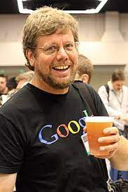
“Python is an experiment in how much freedom programmers need. Too much freedom and nobody can read another's code; too little and expressiveness is endangered.” - Guido van Rossum

Slide 6
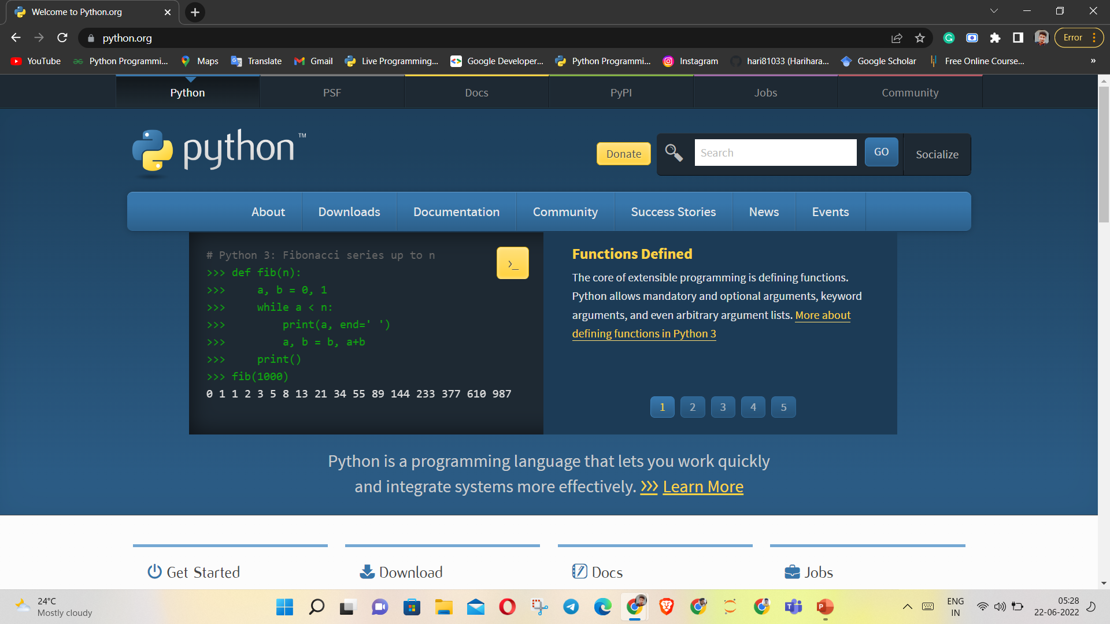
https://www.python.org/

Slide 7
Why Python? (why do people use Python)
Python is Object-Oriented
Structure of python supports concepts such as polymorphism, operation overloading, and multiple inheritance
Indentation
Indentation is one of the greatest future in python
Open Source
Downloading and installing Python is free and easy. Source code is easily accessible

Slide 8
It’s Powerful
Dynamic Typing
Built-in types and tools
Library utilities
Automatic memory management
Portable
Python runs virtually every major platform used today
Python programs will run in exactly the same manner, irrespective of platform.

Slide 9
Easy to use
No intermediate compile and link steps as in C / C++
Python programs are compiled automatically to an intermediate form called bytecode, which the interpreter than reads
This gives Python the development speed of an interpreter without the performance loss inherent in purely interpreted languages
Easy to learn
Structure and syntax are pretty intuitive and easy to grasp

Slide 10
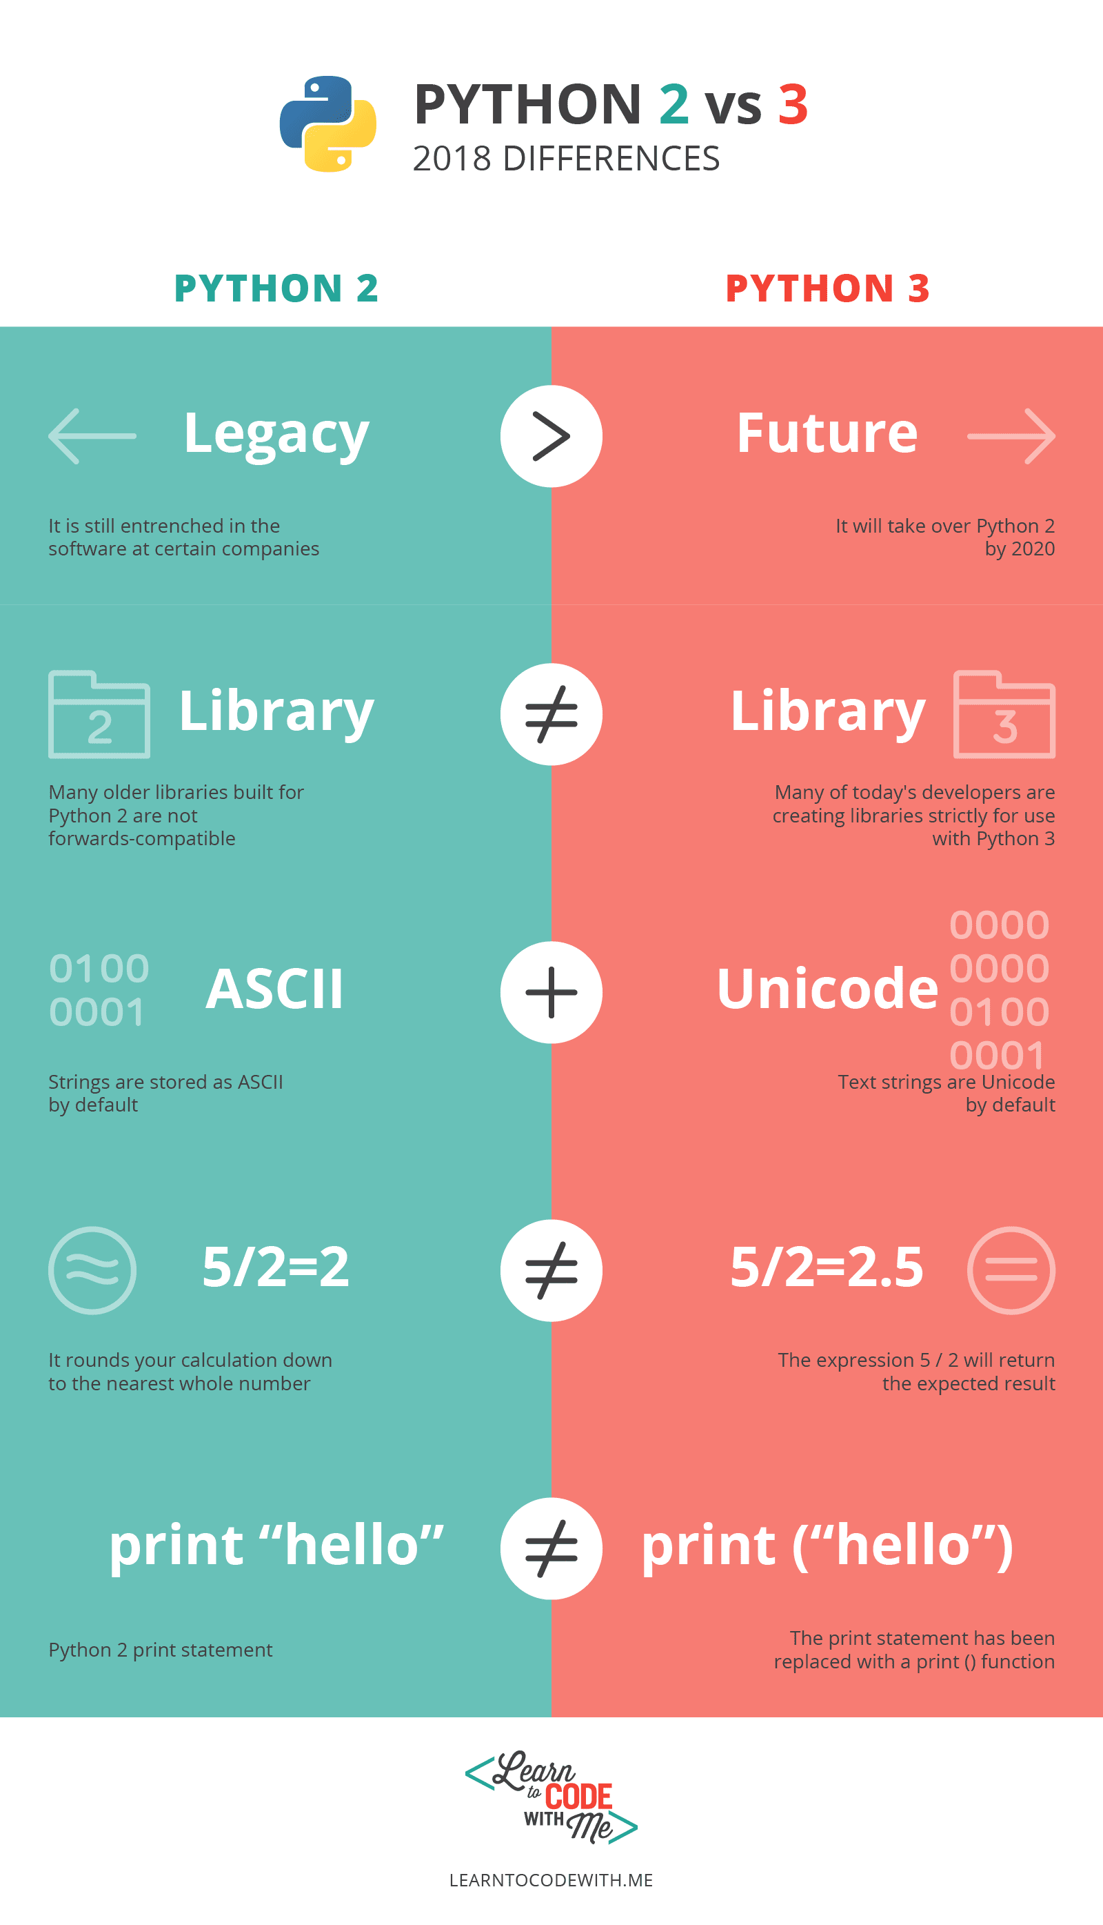

Slide 11
Cpython, Jython, PyPy, IronPython
CPython is the original implementation, written in C. (The "C" part in "CPython" refers to the language that was used to write Python interpreter itself.) CPython compiles Python to intermediate bytecode that is then interpreted by a virtual machine
Jython is the same language (Python), but implemented using Java. Jython compiles your Python code to Java bytecode, so your Python code can run on the JVM.
IronPython interpreter was written in C#.
There's also PyPy - a Python interpreter written in Python. The PyPy implementation is 16 times faster than the CPython implementation. PyPy uses just-in-time (JIT) compilation to translate Python code into machine-native assembly language
C# and RPython (a subset of Python), respectively.

Slide 12
Python Features and Advantages
Easy to Code. Python is a very high-level programming language, yet it is effortless to learn. ...
Easy to Read. Python code looks like simple English words. ...
Free and Open-Source. ...
Robust Standard Library. ...
Interpreted. ...
Portable. ...
Object-Oriented and Procedure-Oriented. ...
Extensible.

Slide 13
Diff of Python from other languages
Python code does not declare the types of variables –just assign to them and go
Python raises a runtime error if the code tries to read from a variable that has not been given a value
Like C++ and Java, python is case sensitive so “a” and “A” are different variables
The end of a line marks the end of a statement, so unlike C++ and java, Python does not require a semicolon at the end of each statement. You can include semicolons at the end of python statements, but it’s not the best practice.

Slide 14
Real-world Applications of Python
Web Development.
Game Development.
Scientific and Numeric Applications.
Artificial Intelligence and Machine Learning.
Software Development.
Enterprise-level/Business Applications.
Education programs and training courses.
Etc...

Slide 15
Interactive mode
Interactive mode is a command line shell which gives immediate feedback for each statement, while running previously fed statements in active memory. As new lines are fed into the interpreter, the fed program is evaluated both in part and in whole.[.ipynb]
Script mode
Script etymologically means a system of writing. In the script mode, a python program can be written in a file. This file can then be saved and executed using the command prompt.
We can view the code at any time by opening the file and editing becomes quite easy as we can open and view the entire code as many times as we want. Script mode is very suitable for writing long pieces of code. It is much preferred over interactive mode by experts in the program. The file made in the script made is by default saved in the Python installation folder and the extension to save a python file is “.py”.

Slide 16
Why do we need to learn Python?
Python is highly versatile. You can use it for both small and complex tasks, and it is used across many different industries from its more common applications in data science and software engineering to environments like mobile app development, artificial intelligence, and machine learning.
The major fields include Machine Learning and AI, Web Development, Data Analytics, Game Development, IoT, Application Development, and Game Development. Many sectors including the healthcare sector, finance sector, aerospace sector, and banking sector rely heavily on Python.

Slide 17
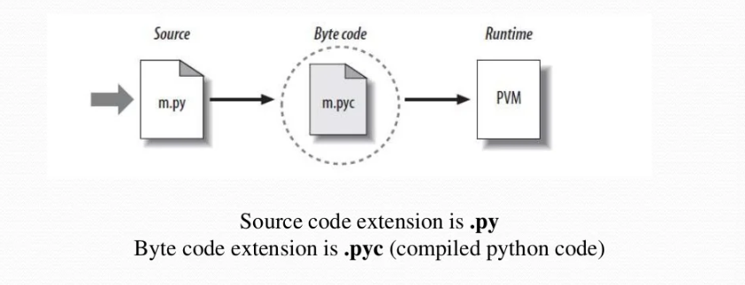
Python Code Execution
Python’s traditional execution mode:
Source code is translated to byte code, which is then run by the Python Virtual Machine. Code is automatically compiled, then it is interpreted.

Slide 18
Download Python - https://www.python.org/downloads/
Download VS Code - https://code.visualstudio.com/download

