Slide 1
Project-67(P67)
E-commerce Business
Mentor VINOD sir & DEEPIKA mam
Group-2
Team Members
MUSKAN
SHIVANI
SURAJ
GOVIND
ROSHAN
HARISHANKAR

Slide 2
PROBLEM STATEMENT
E-COMMERCE COMPANY OPERATES IN VARIOUS STATES OF USA, BUT THE CUSTOMER DATA IS ONLY SPECIFIC TO ONE STATE IN THE USA.
THE WAREHOUSE IS LOCATED ON THE EASTERN PART WHEREAS, THE STATE TO WHICH SHIPMENTS ARE DELIVERED IS AT THE WESTERN PART OF USA.

Slide 3
OBJECTIVE OF THE BUSINESS
The main objective of the project is build a module to predict if the shipments are reach on time or not
We have to use various Logit/Probabilistic techniques with the most accurate model.

Slide 4
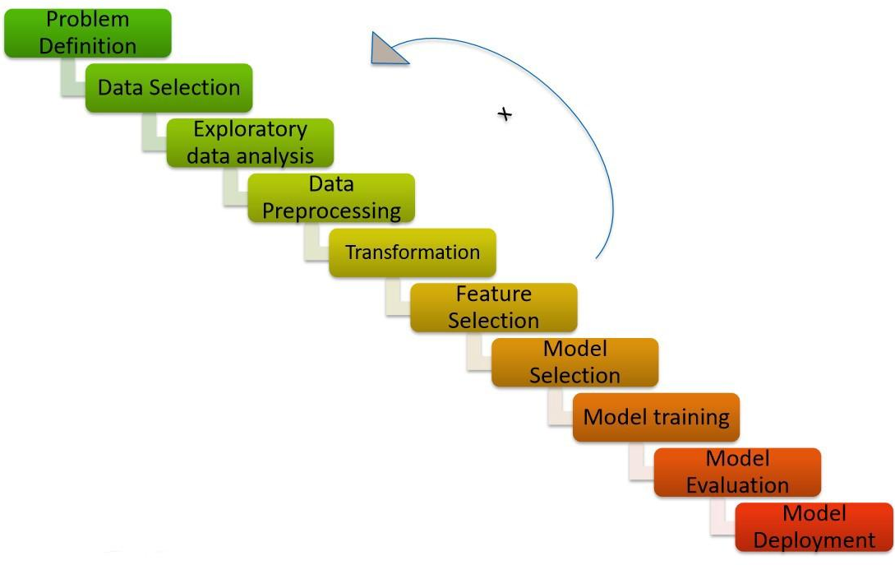
PROJECT FLOW

Slide 5
This is the Dataset what we have
No. of Rows : 10999 Rows
No. of Columns:12 Columns
Data Type: Object and Integer
Missing Values: No Missing values

Slide 6
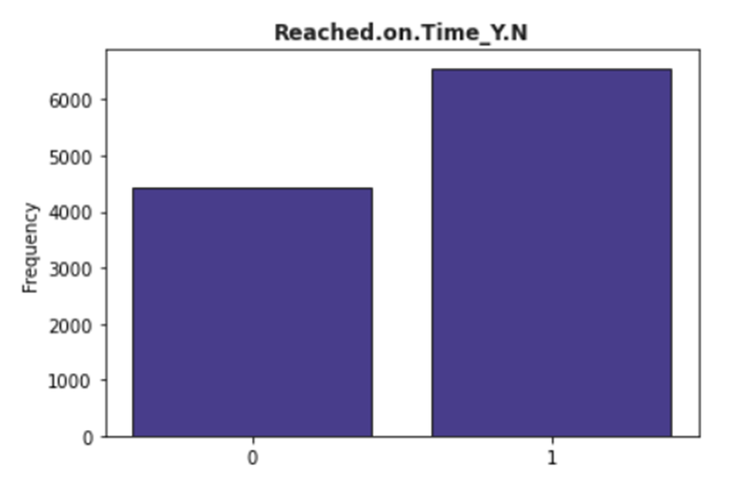

4436 : Products delivered on time
6563 : Products not delivered on time
No. of product undelivered are more than no. of products delivered

Slide 7
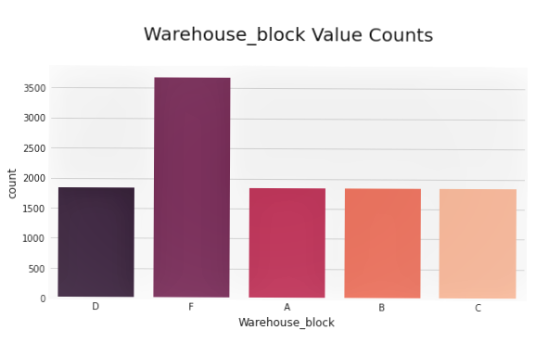
Warehouse block ‘F’ has more values than all other Warehouse blocks.

Slide 8
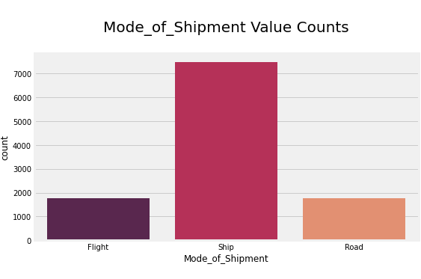
In mode of shipment columns we can clearly see that ship delivers the most of products to the customers.

Slide 9
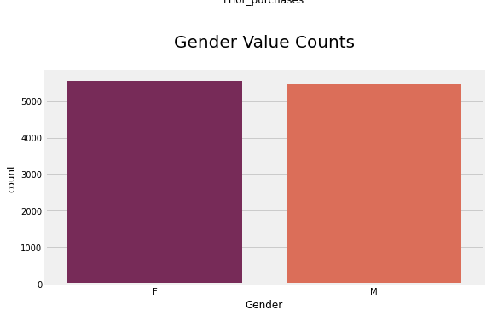
Gender Column doesn't have much variance.

Slide 10
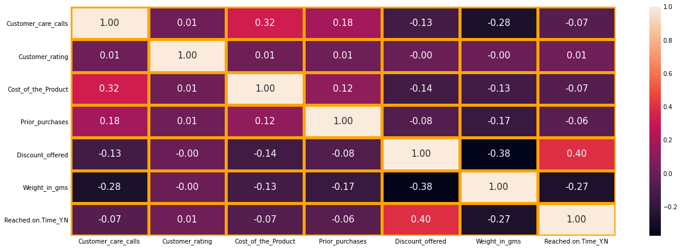

Slide 11
Correlation between Variables
Cost of product and customer care calls have more strong relationship compared to other relationships. That means if our costumer pays more money for product, they have tendency to have more customer care calls.
Weight, and Cost are positively.
amount of Discount is negatively correlated with the target variable.

Slide 12
ML Models used for Problem Solving
XGBoost

Slide 13
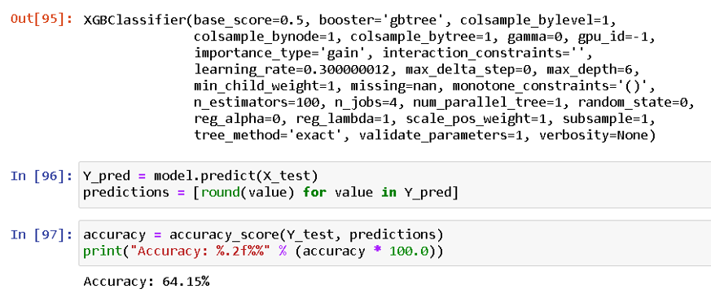

Slide 14
RANDOM FOREST

Slide 15
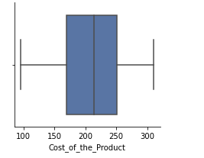
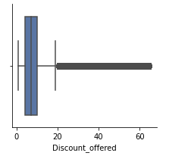
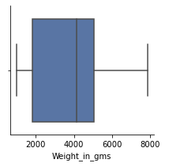
Outlier Detection
It seems like we have a lot of outliers for discount offered but we might have some outliers for other features as well. Let's find them with z_score.

Slide 16
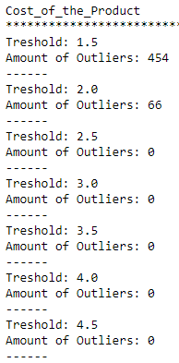
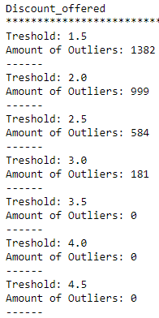
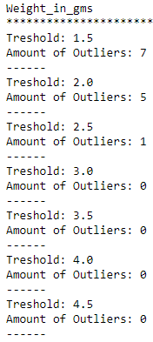
Outlier Detection with Z_Score
We have most number of outliers in "discount_offered" column. We can’t drop them considering the number of data, winsorization technique is the solution on it.

Slide 17
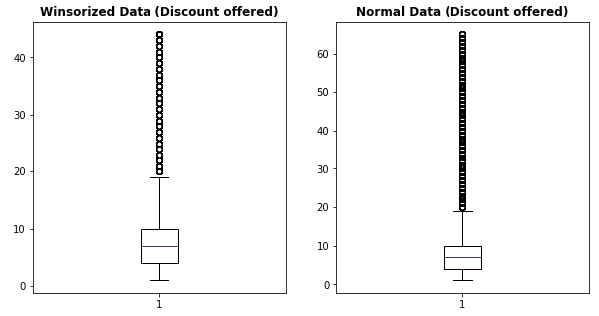
Now outliers have visibly decreased after winsorization.
We use winsorized method which helps to replace outliers by smallest and largest values of data set with the observation closest to them.
So now outliers have visibly decreased after winsorization.

Slide 18
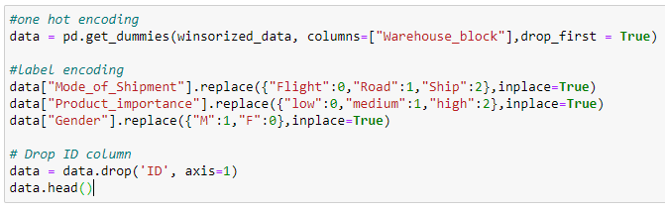
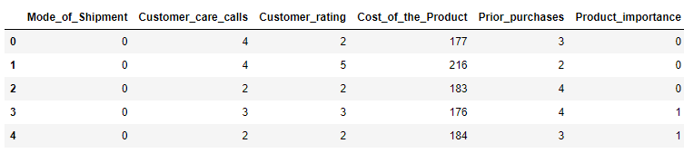
Making data ready for model training

Slide 19
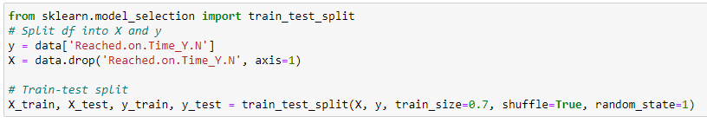
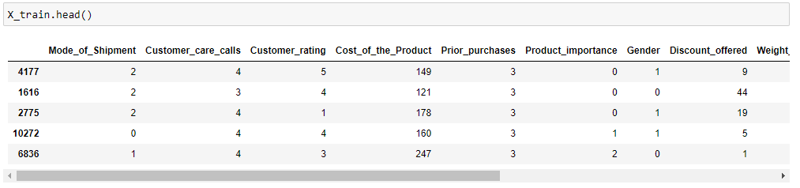
Train-Test split

Slide 20
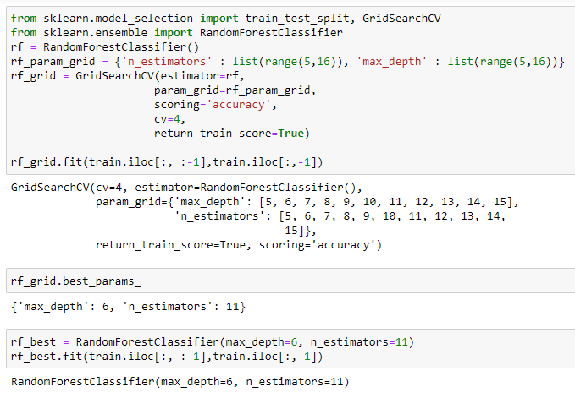
Hyper tuning with Grid Search CV

Slide 21
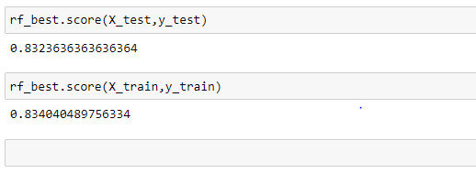
Test and Train Accuracy: Random Forest

Slide 22
SUPPORT VECTOR MACHINE

Slide 23
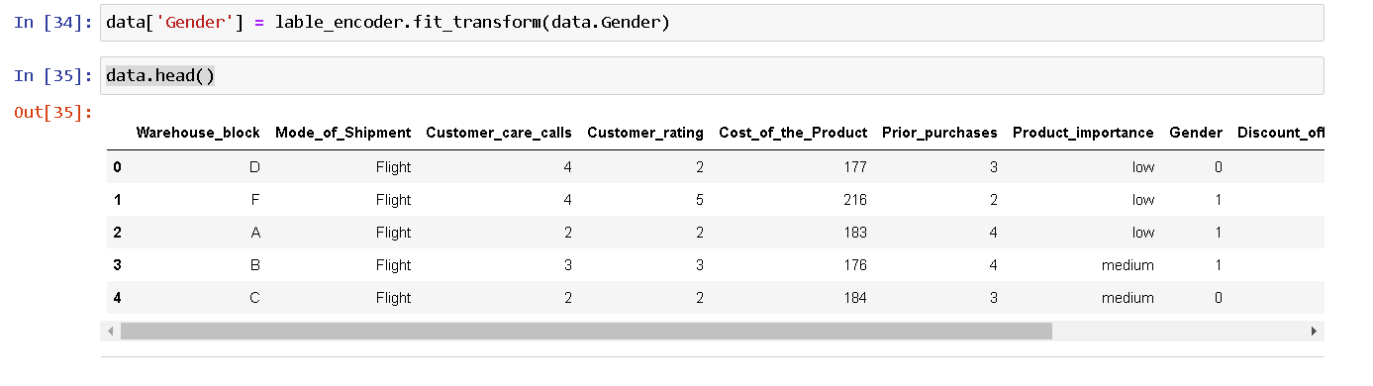
Model Building
We apply lable encoding on gender variable which is one of categorical feature i.e. 0= Female and 1= Male.

Slide 24
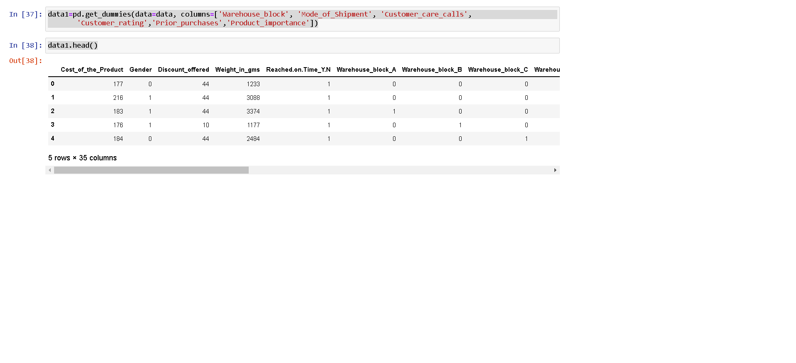
Here we create dummy data for other categorical variables for better understanding

Slide 25
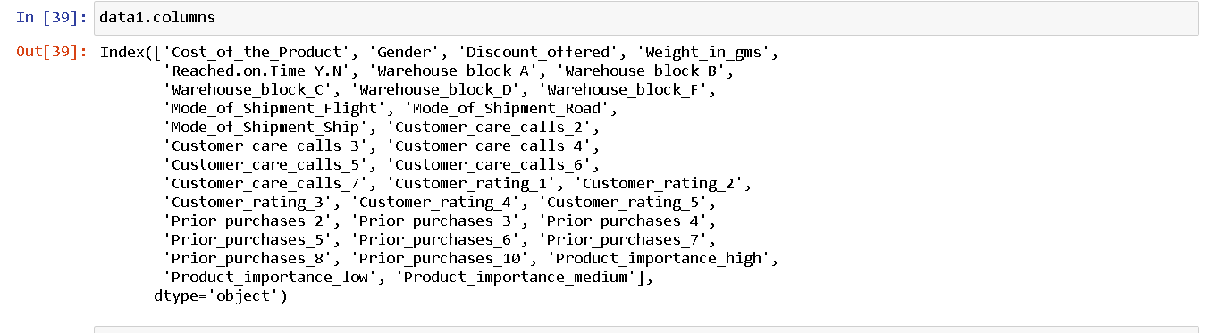
We get new columns after using dummy dataset in the dataset.

Slide 26
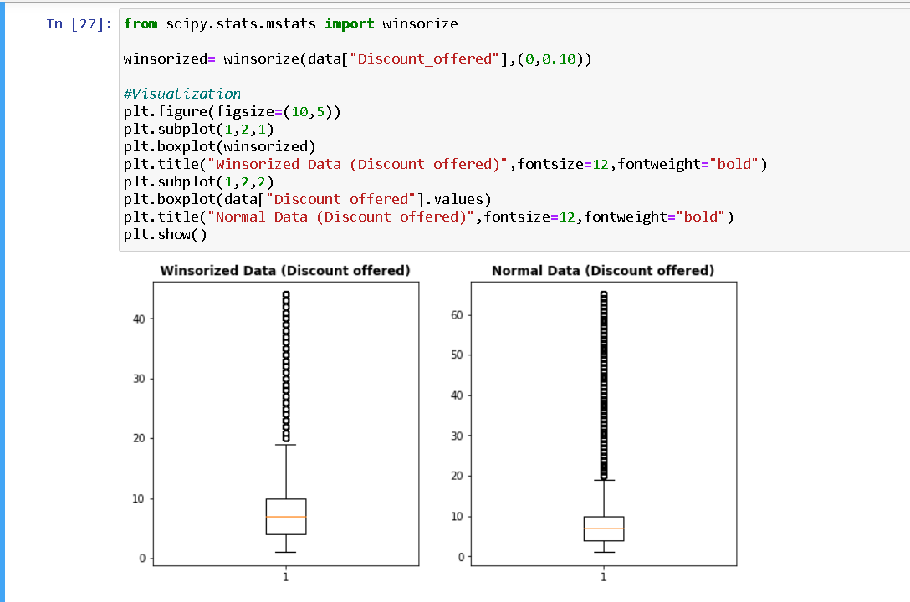
We use winsorized method which helps to replace outliers by smallest and largest values of data set with the observation closest to them.

Slide 27
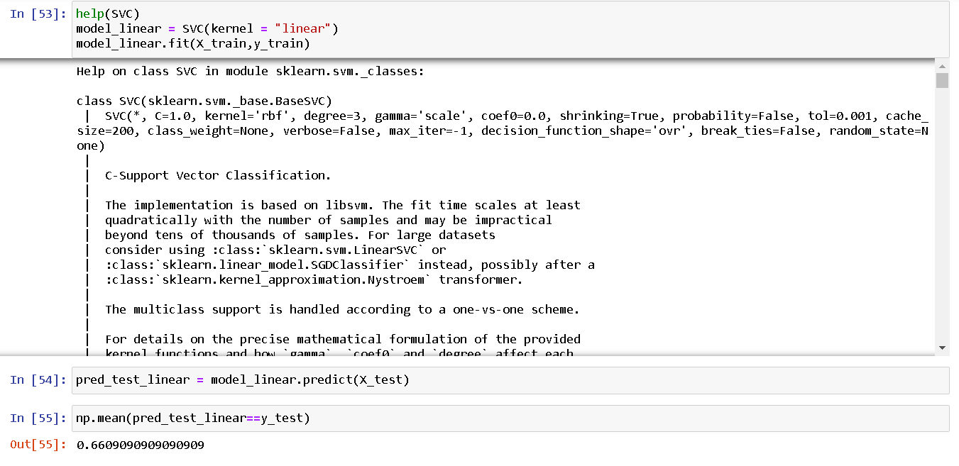
By applying linear kernel model we get 66% accuracy.

Slide 28
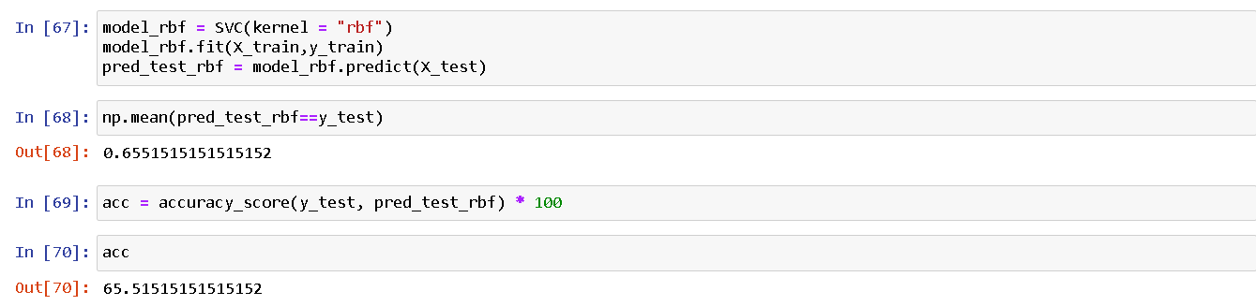
In Support Vector Machine by using rbf (Radial Base Kernel) accuracy is getting 65.51%.

Slide 29
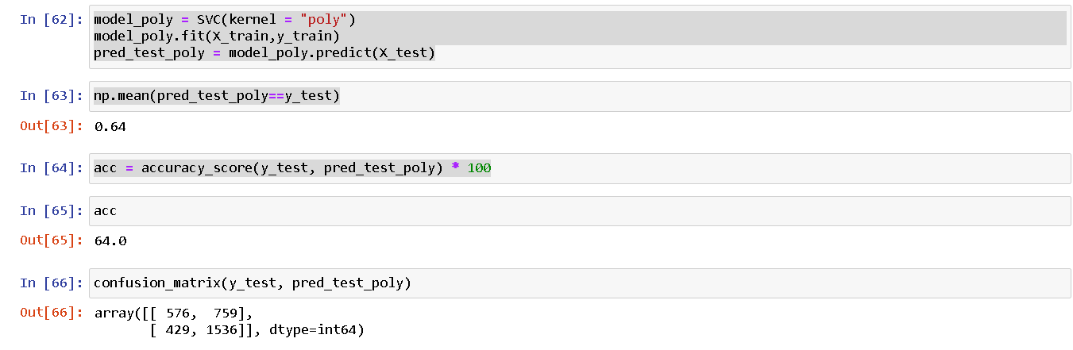
In Support Vector Machine by using polynomial accuracy is getting 65.51%.

Slide 30
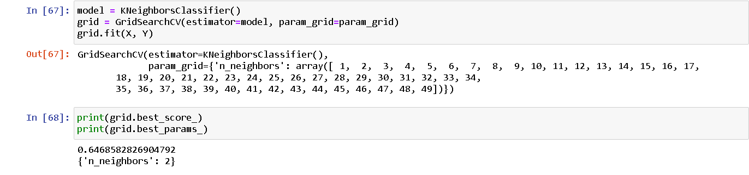
From KNN model we get 64%accuracy.

Slide 31
LOGISTIC REGRESSION

Slide 32
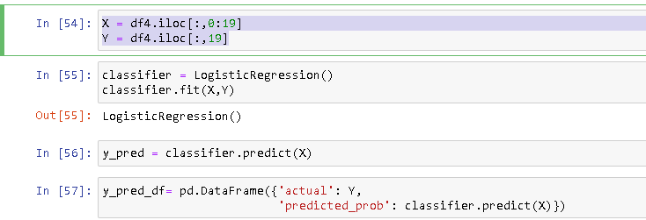
Regression Process After removal of Outliers
Here X is The 0 To 18 column and Y is 19 column which is our target column

Slide 33
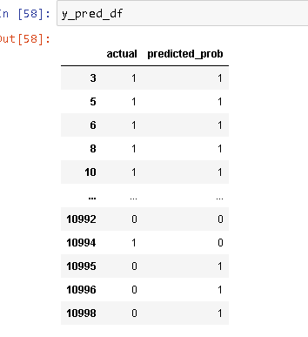
Comparison of Actual vs Predicted value
In this box we can notice the Actual And Predicted Probability is almost same but At some rows it is different

Slide 34
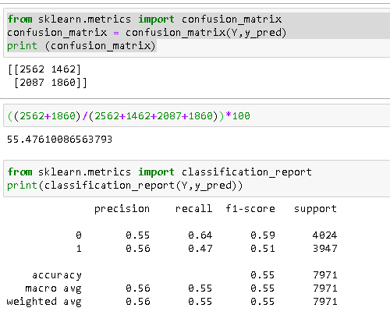
We got the Final Accuracy From Confusion Matrix is 59%

Slide 35
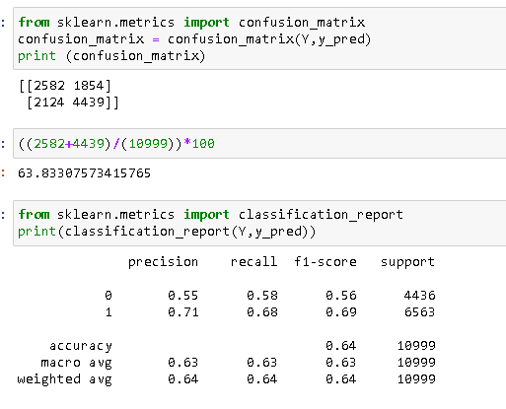
By Assuming the outlier as important we got the accuracy as 63% which is almost 64%

Slide 36
Models Comparison
ML Model | Accuracy
Logistic Regression | 63%
Support Vector Machine | 66%
Random Forest | 83%
XGBoost | 64%
KNN | 64%

Slide 37
Recommendation for Project
The parcel should not be centralized in the warehouse block F, so that the handling is not too crowded which can cause the late shipment.
The operation team should add more manpower when there is a sale program, especially for the discount more than 10% and the parcel weight is 1 - 4 Kg.

Slide 38
Thank you

