Slide 1

Team Members:-
MUSKAN
SHIVANI
SURAJ
GOVIND
ROSHAN
HARISHANKAR

Slide 2
OBJECTIVE OF THE BUSINESS
An International E-Commerce company wants to use some of the most advanced machine learning techniques to analyse their customers with respect to their services and some important customer success matrix. They also have future expansion plans to India.
The company operates in various states of USA, but the customer data is only specific to one state in the USA. The warehouse is located on the eastern part whereas, the state to which shipments are delivered is at the western part of USA.
The main objective of the project is build model to predict if the shipments are reach on time or not.

Slide 3
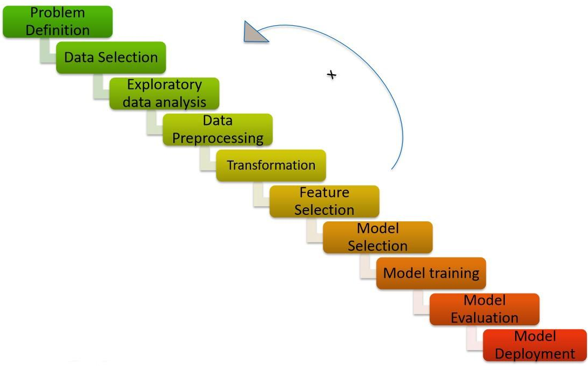
PROJECT FLOW

Slide 4
This is the Dataset what we have
No. of Rows : 10999 Rows
No. of Columns:12 Columns
Data Type: Object and Integer
Missing Values: No Missing values

Slide 5
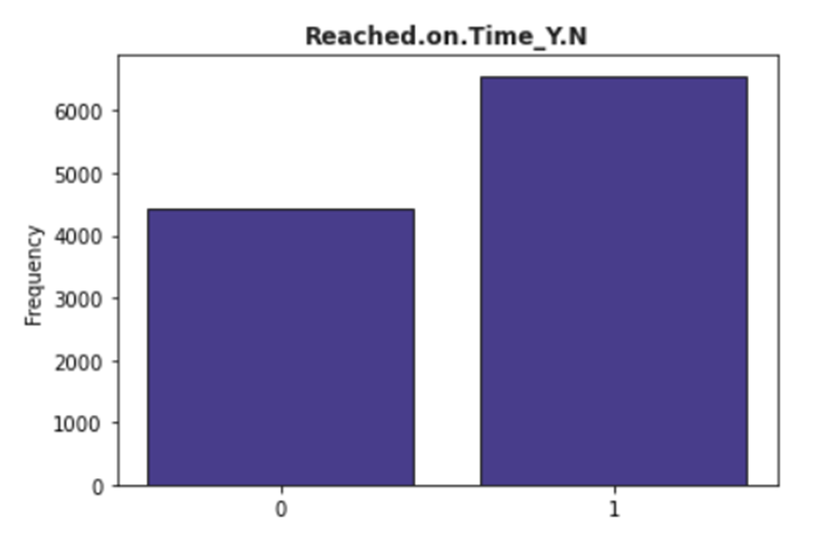

4436 : Products delivered on time
6563 : Products not delivered on time
No. of product undelivered are more than no. of products delivered

Slide 6
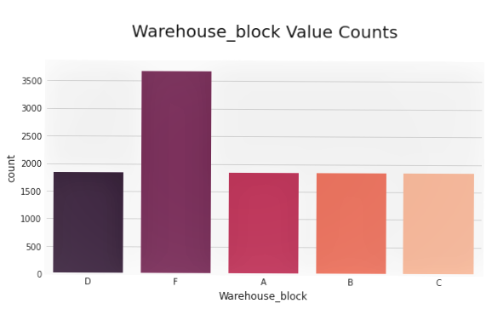
Warehouse block ‘F’ has more values than all other Warehouse blocks.

Slide 7
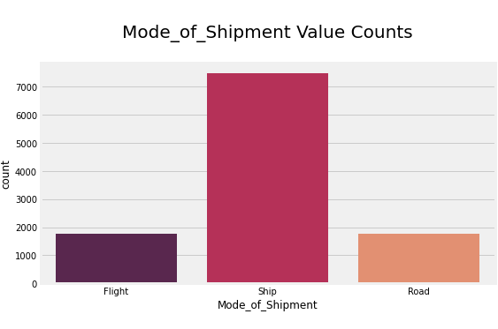
In mode of shipment columns we can clearly see that ship delivers the most of products to the customers.

Slide 8
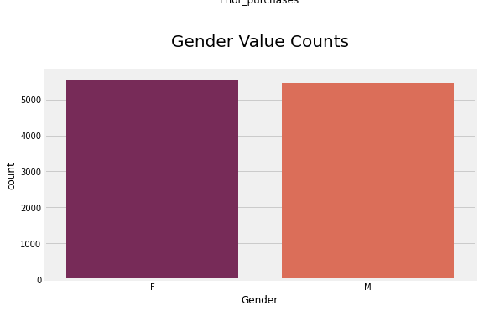
Gender Column doesn't have much variance.

Slide 9
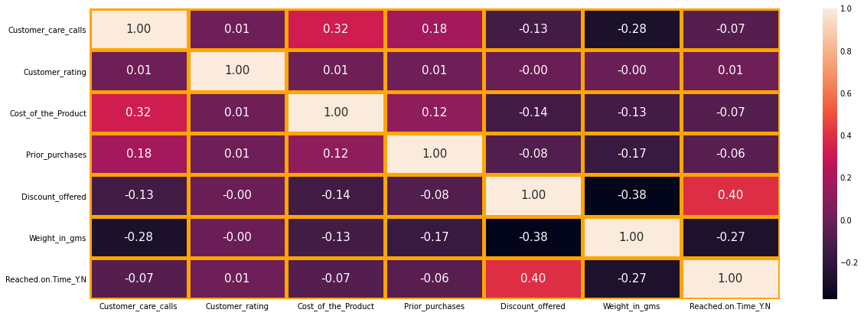

Slide 10
Correlation between Variables
Cost of product and customer care calls have more strong relationship compared to other relationships. That means if our costumer pays more money for product, they have tendency to have more customer care calls.
Weight, and Cost are positively.
amount of Discount is negatively correlated with the target variable.

Slide 11
RANDOM FOREST

Slide 12
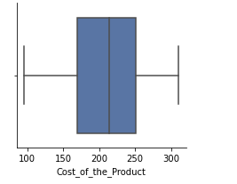
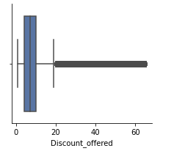
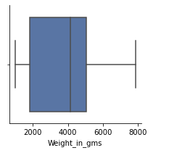
Outlier Detection
It seems like we have a lot of outliers for discount offered but we might have some outliers for other features as well. Let's find them with z_score.

Slide 13
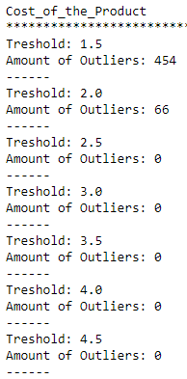
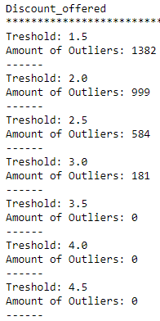
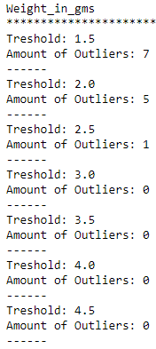
Outlier Detection with Z_Score
We have most number of outliers in "discount_offered" column. We can’t drop them considering the number of data, winsorization technique is the solution on it.

Slide 14
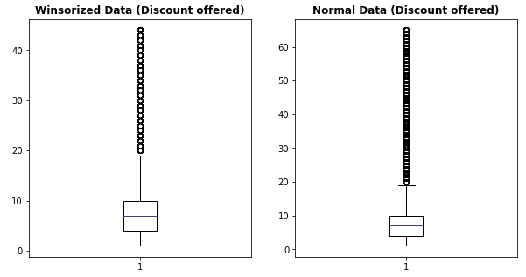
Now outliers have visibly decreased after winsorization.
We use winsorized method which helps to replace outliers by smallest and largest values of data set with the observation closest to them.
So now outliers have visibly decreased after winsorization.

Slide 15
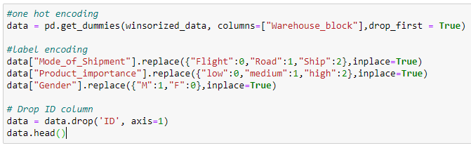
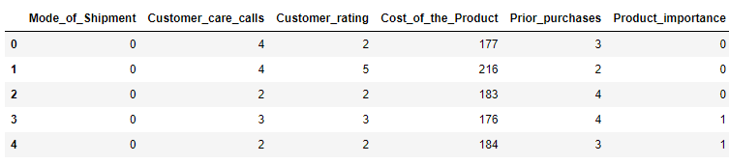
Making data ready for model training

Slide 16
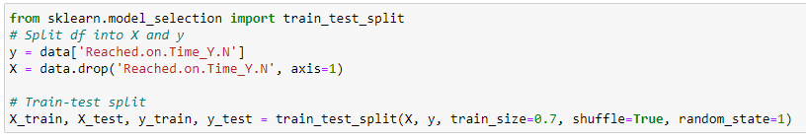
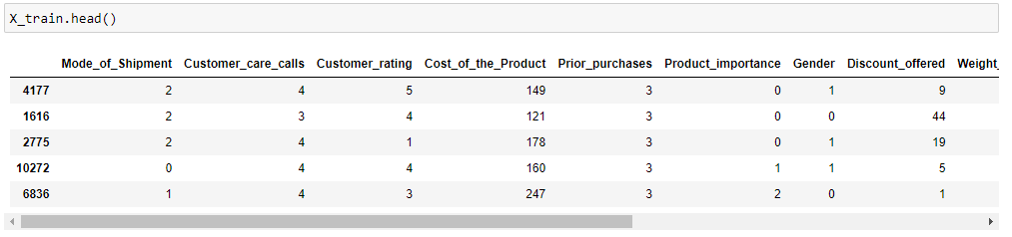
Train-Test split

Slide 17
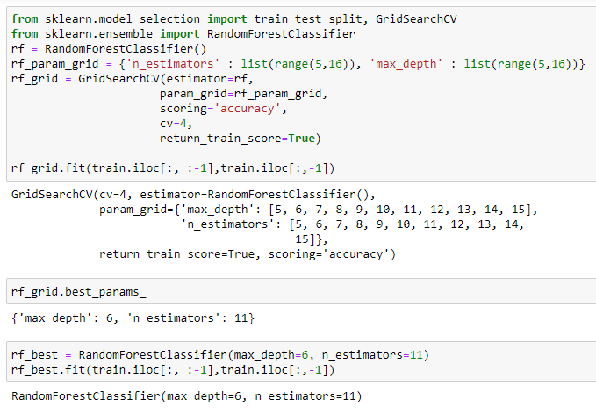
Hyper tuning with Grid Search CV

Slide 18
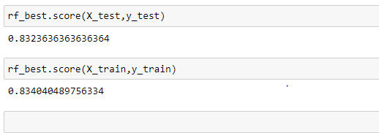
Test and Train Accuracy: Random Forest

Slide 19
SUPPORT VECTOR MACHINE

Slide 20
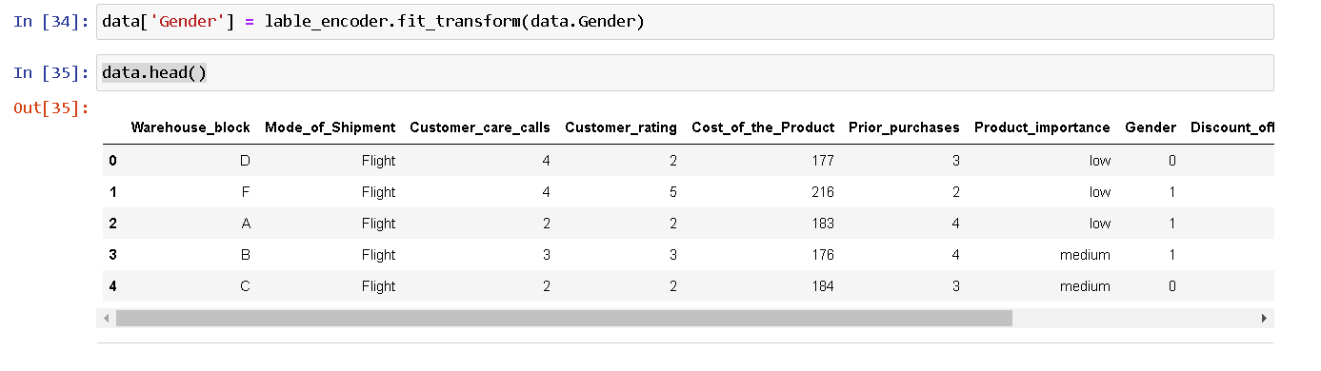
Model Building
We apply lable encoding on gender variable which is one of categorical feature i.e. 0= Female and 1= Male.

Slide 21
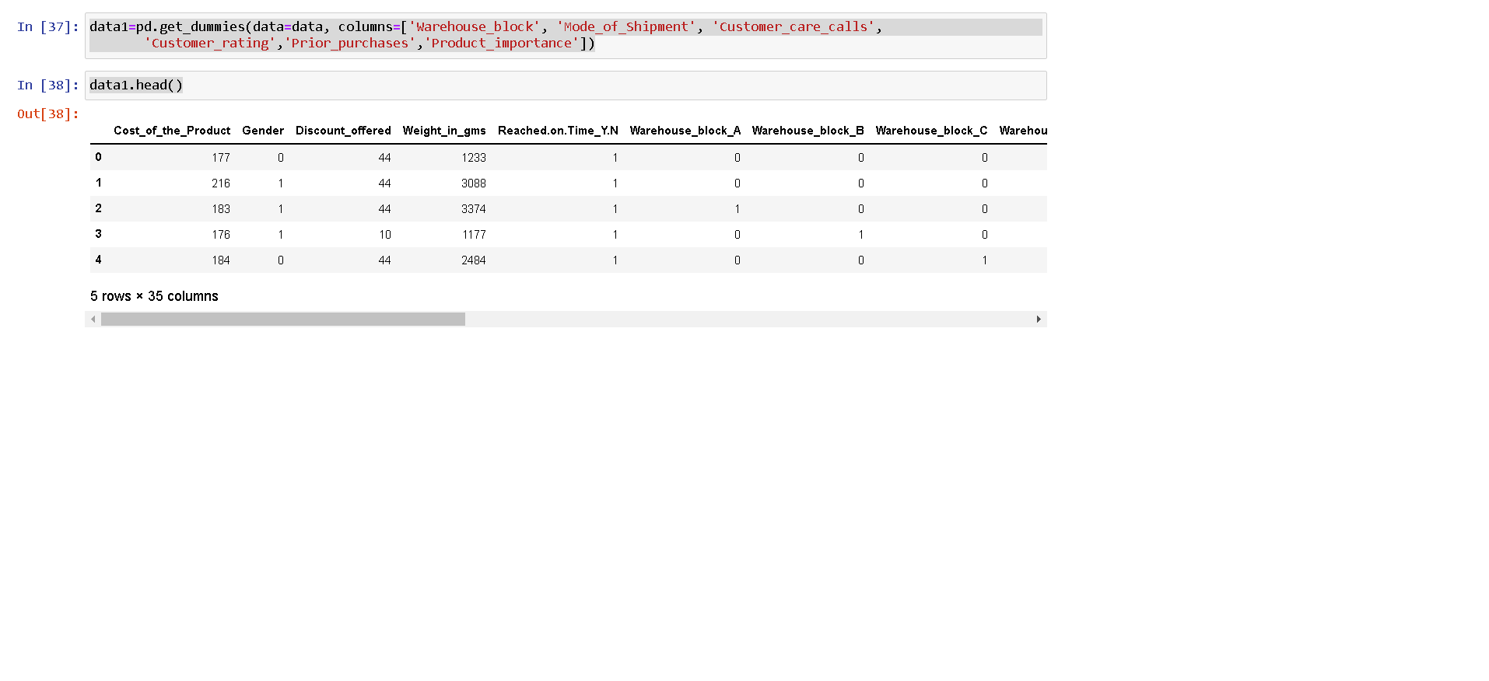
Here we create dummy data for other categorical variables for better understanding

Slide 22
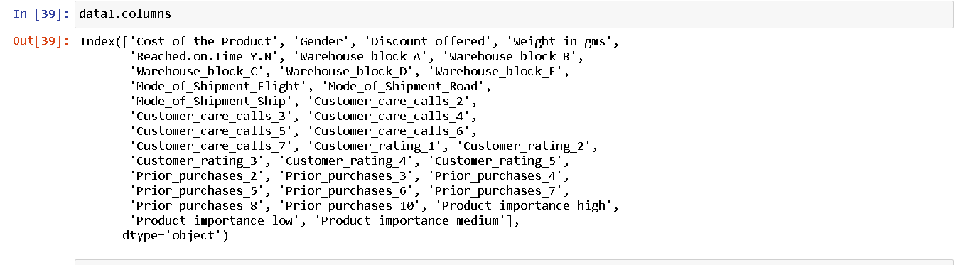
We get new columns after using dummy dataset in the dataset.

Slide 23
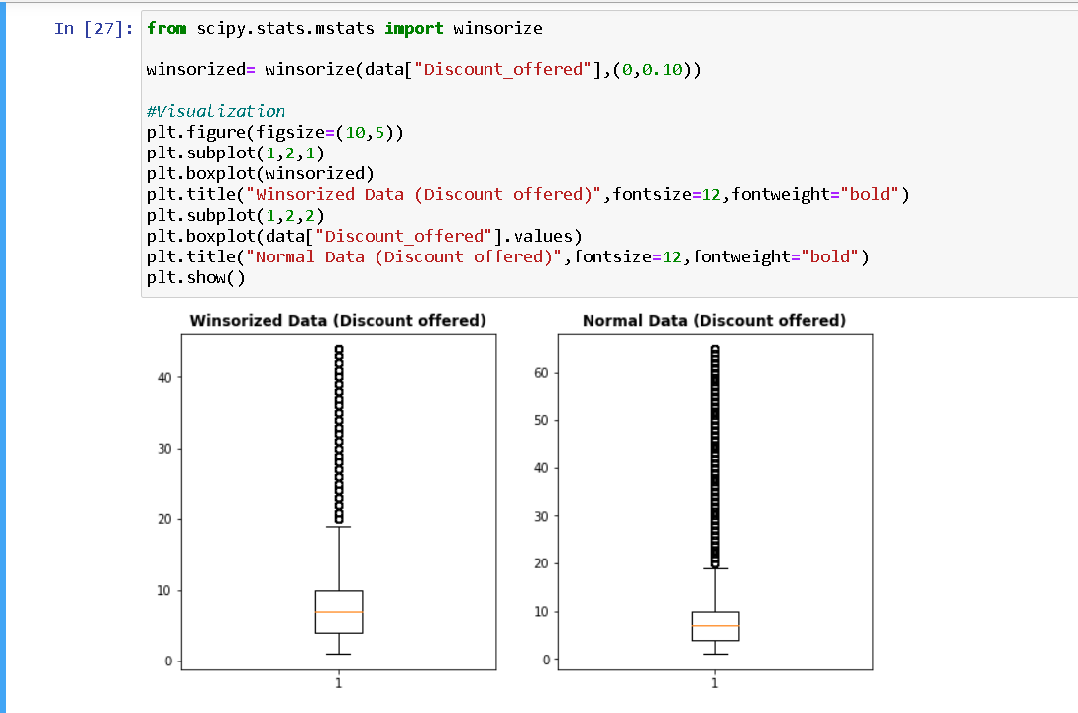
We use winsorized method which helps to replace outliers by smallest and largest values of data set with the observation closest to them.

Slide 24
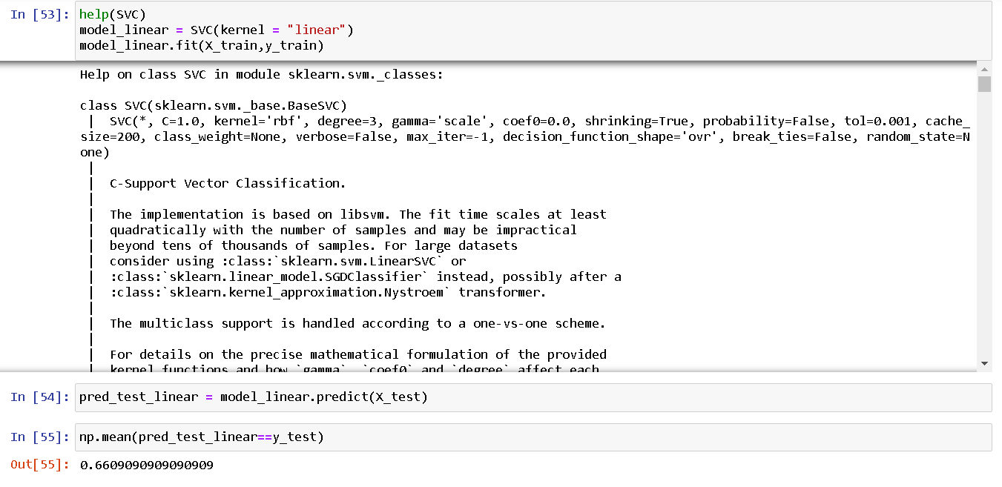
By applying linear kernel model we get 66% accuracy.

Slide 25
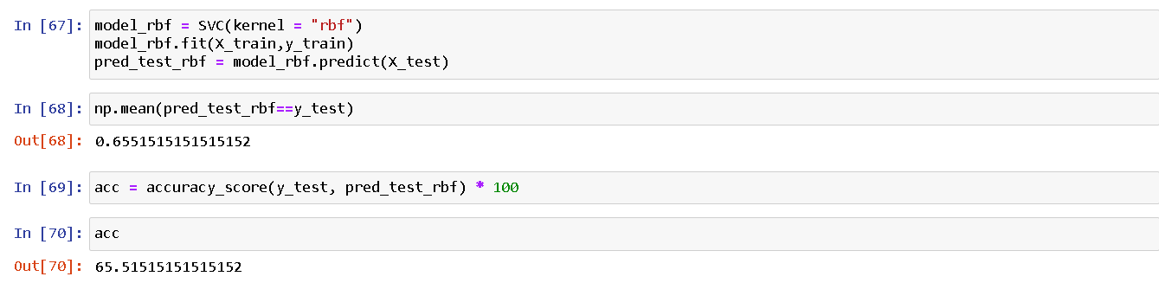
In Support Vector Machine by using rbf (Radial Base Kernel) accuracy is getting 65.51%.

Slide 26
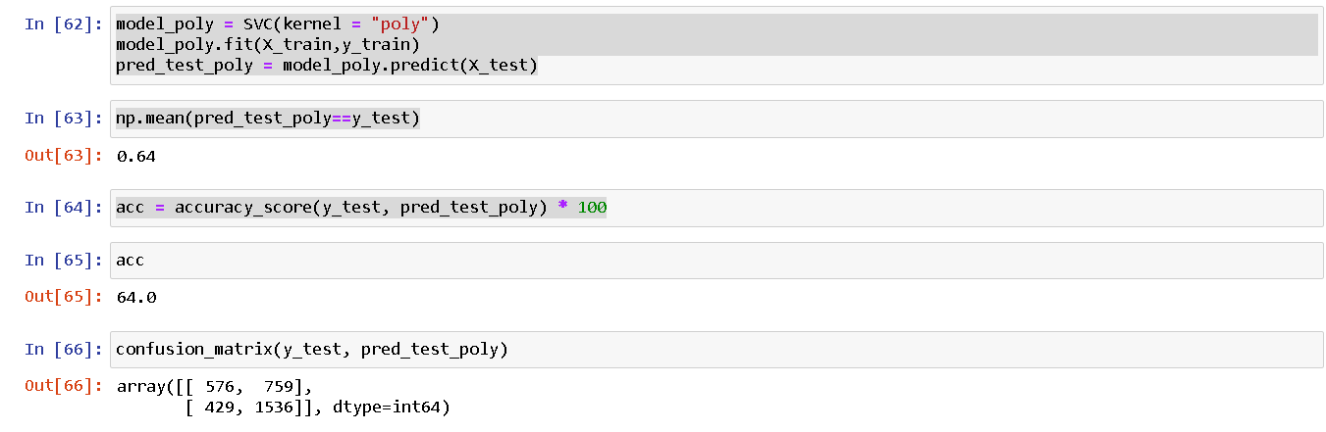
In Support Vector Machine by using polynomial accuracy is getting 65.51%.

Slide 27
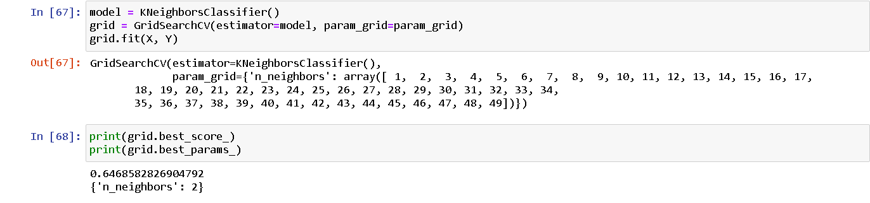
From KNN model we get 64%accuracy.

Slide 28
LOGISTIC REGRESSION

Slide 29
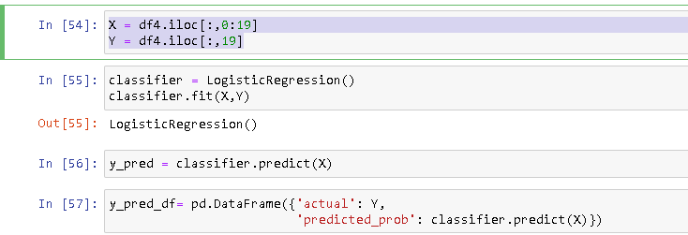
Regression Process After removal of Outliers
Here X is The 0 To 18 column and Y is 19 column which is our target column

Slide 30
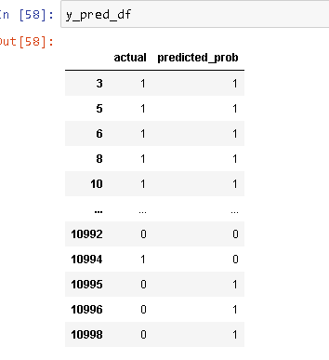
Comparison of Actual vs Predicted value
In this box we can notice the Actual And Predicted Probability is almost same but At some rows it is different

Slide 31
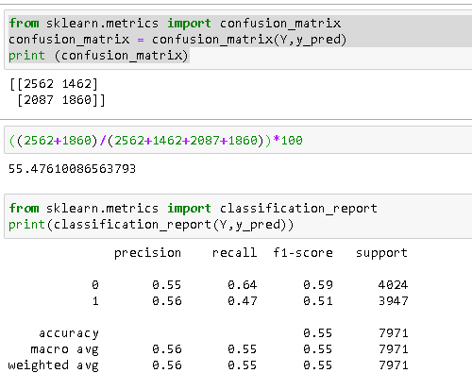
We got the Final Accuracy From Confusion Matrix is 59%

Slide 32
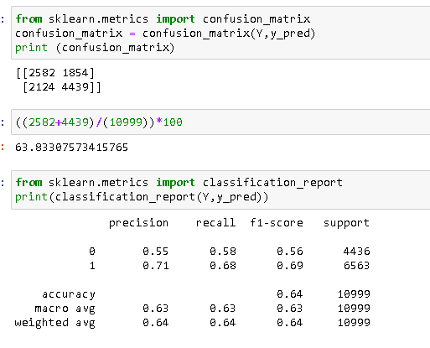
By Assuming the outlier as important we got the accuracy as 63% which is almost 64%

Slide 33
Models Comparison
ML Model | Accuracy
Logistic Regression | 63%
Support Vector Machine | 66%
Random Forest | 83%
XGBoost | 66%
KNN | 64%
Decision Tree | 65%

Slide 34
DEPLOYMENT
After the Model building and Evaluation process, we have deployed the code using “Streamlit”.
• We have selected the best model and used in our deployment
phase.

Slide 35
Recommendation for Project
The parcel should not be centralized in the warehouse block F, so that the handling is not too crowded which can cause the late shipment.
The operation team should add more manpower when there is a sale program, especially for the discount more than 10% and the parcel weight is 1 - 4 Kg.

Slide 36
Thank you

