Slide 1
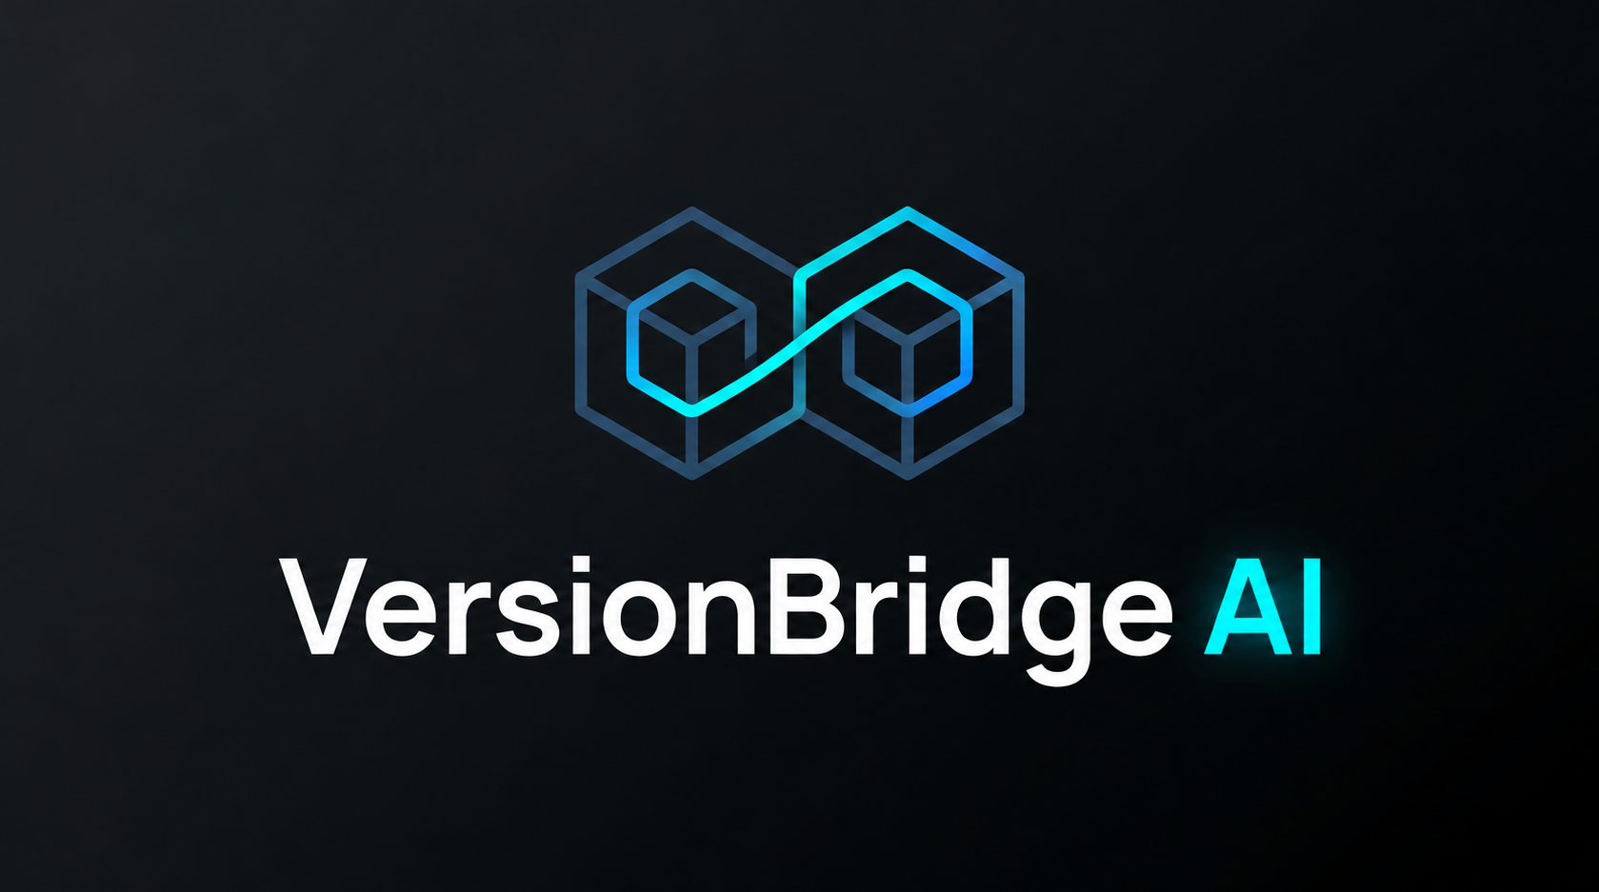
Vultr Agent Rush · Blast Radius Zero
VersionBridge AI
Reproduce a code failure.
Verify the patch against the original tests.
Live Vultr app, source and evidence on GitHub
Notes:
Introduce VersionBridge as a repair and verification tool. The public Vultr deployment is live. GLM 5.3 Flash supplies the judged repair proposals.
https://github.com/Hari-Aditya-003/versionbridge-ai
https://lablab.ai/ai-hackathons/vultr-hackathon/

Slide 2
Repair workflow
01 Reproduce
02 Propose
03 Verify
Resolve the Git commit and capture the failure in a fresh container.
Give the model the relevant source and failure output. Validate the proposed edit.
Run the same tests in a second container. Export the diff and evidence.
If verification fails, one more model attempt can use the new test output.
Notes:
A maintainer can use a pinned snapshot or a bundled case. The scoped mode targets a single return expression in a named top-level Python function.
https://github.com/Hari-Aditya-003/versionbridge-ai/blob/main/ARCHITECTURE.md

Slide 3
Separated web and execution services
Vultr web API
Execution worker
An unprivileged HTTP service queues work and serves the workspace over HTTPS.
A separate user controls Docker and calls Vultr inference. The web user holds neither privilege.
Disposable test containers
Evidence store
Each baseline or candidate gets its own container, deadline, and resource limits.
SQLite stores outcomes, execution events, test hashes, and available model receipts.
Notes:
The target public path follows LabLab rules. The Dell path is a private development profile and has no role in judging.
https://lablab.ai/ai-hackathons/vultr-hackathon/
https://github.com/Hari-Aditya-003/versionbridge-ai/blob/main/LOCAL_GPU.md

Slide 4
Measured repair and verification outcomes
GLM 5.3 Flash
13 / 13 expected outcomes
DeepSeek V4.1 Flash 1017
12 / 13 expected outcomes
Hosted Vultr verification
12 verified + 1 regression rejected
Automated release checks
23 acceptance + 20 HTTP
Controlled fixtures. Broader repository repair needs further evaluation.
Notes:
The live Vultr comparison evaluated thirteen profiles. Both candidates rejected the seeded regression. GLM 5.3 Flash was selected on observed outcomes. The hosted public API matched all thirteen expected outcomes.
https://github.com/Hari-Aditya-003/versionbridge-ai/actions/runs/42078004307
https://github.com/Hari-Aditya-003/versionbridge-ai/blob/main/EVALUATION.md

Slide 5
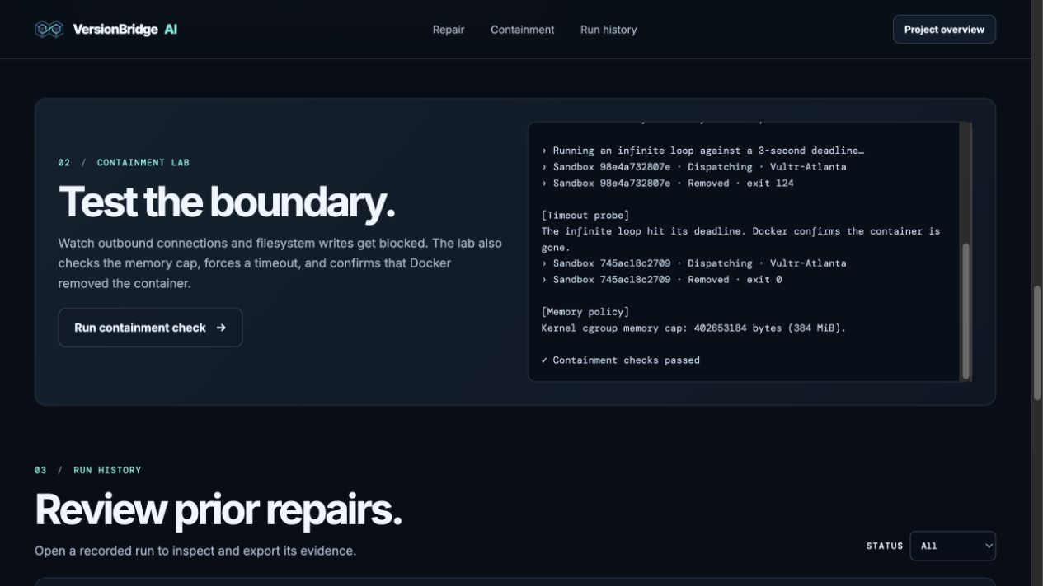
Sandbox containment checks
Blocked access
Outbound network connections and root filesystem writes failed.
Bounded execution
Docker enforced a 384 MiB memory cap. The infinite loop hit a three-second deadline.
Notes:
In the live containment walkthrough, show the loop deadline and the subsequent container removal. The recorded public run executes on the Vultr Atlanta VM.
https://github.com/Hari-Aditya-003/versionbridge-ai/blob/main/DEMO.md
https://github.com/Hari-Aditya-003/versionbridge-ai/blob/main/SECURITY.md

Slide 6
Scoped repairs across nine environments
Python and web code
SQL verification
Python migrations and arithmetic. JavaScript runtime checks and strict TypeScript compilation.
SQLite and PostgreSQL use disposable data. Tests cover missing matches, duplicates and NULLs.
Compiled languages
Private Dell option
Go, Rust, Java and C++ examples compile and execute in bounded build space.
A small quantized coding model can use fresh GPU telemetry to admit or pause local requests.
Notes:
These are curated repair profiles. The optional Dell mode remains separate from the Vultr judging path.
https://github.com/Hari-Aditya-003/versionbridge-ai/blob/main/README.md
https://github.com/Hari-Aditya-003/versionbridge-ai/blob/main/LOCAL_GPU.md

Slide 7
Live demo and next scope
Public workspace
https://versionbridge.64.177.53.254.sslip.io/demo.html
Source and evidence
github.com/Hari-Aditya-003/versionbridge-ai
Next development
Broader repository adapters, repair PRs, organizations and independent generated regression tests.
Notes:
The live URL, recorded browser session, hosted QA evidence and model comparison are published. Official LabLab submission remains a separate step. Hosting costs $12 per month with backups. A $4 hosted inference allowance is separate from a $1 local evaluation allowance. Account-wide billing requires monitoring.
https://versionbridge.64.177.53.254.sslip.io/demo.html
https://github.com/Hari-Aditya-003/versionbridge-ai/blob/main/EVALUATION.md
https://lablab.ai/ai-hackathons/vultr-hackathon/

