Slide 1
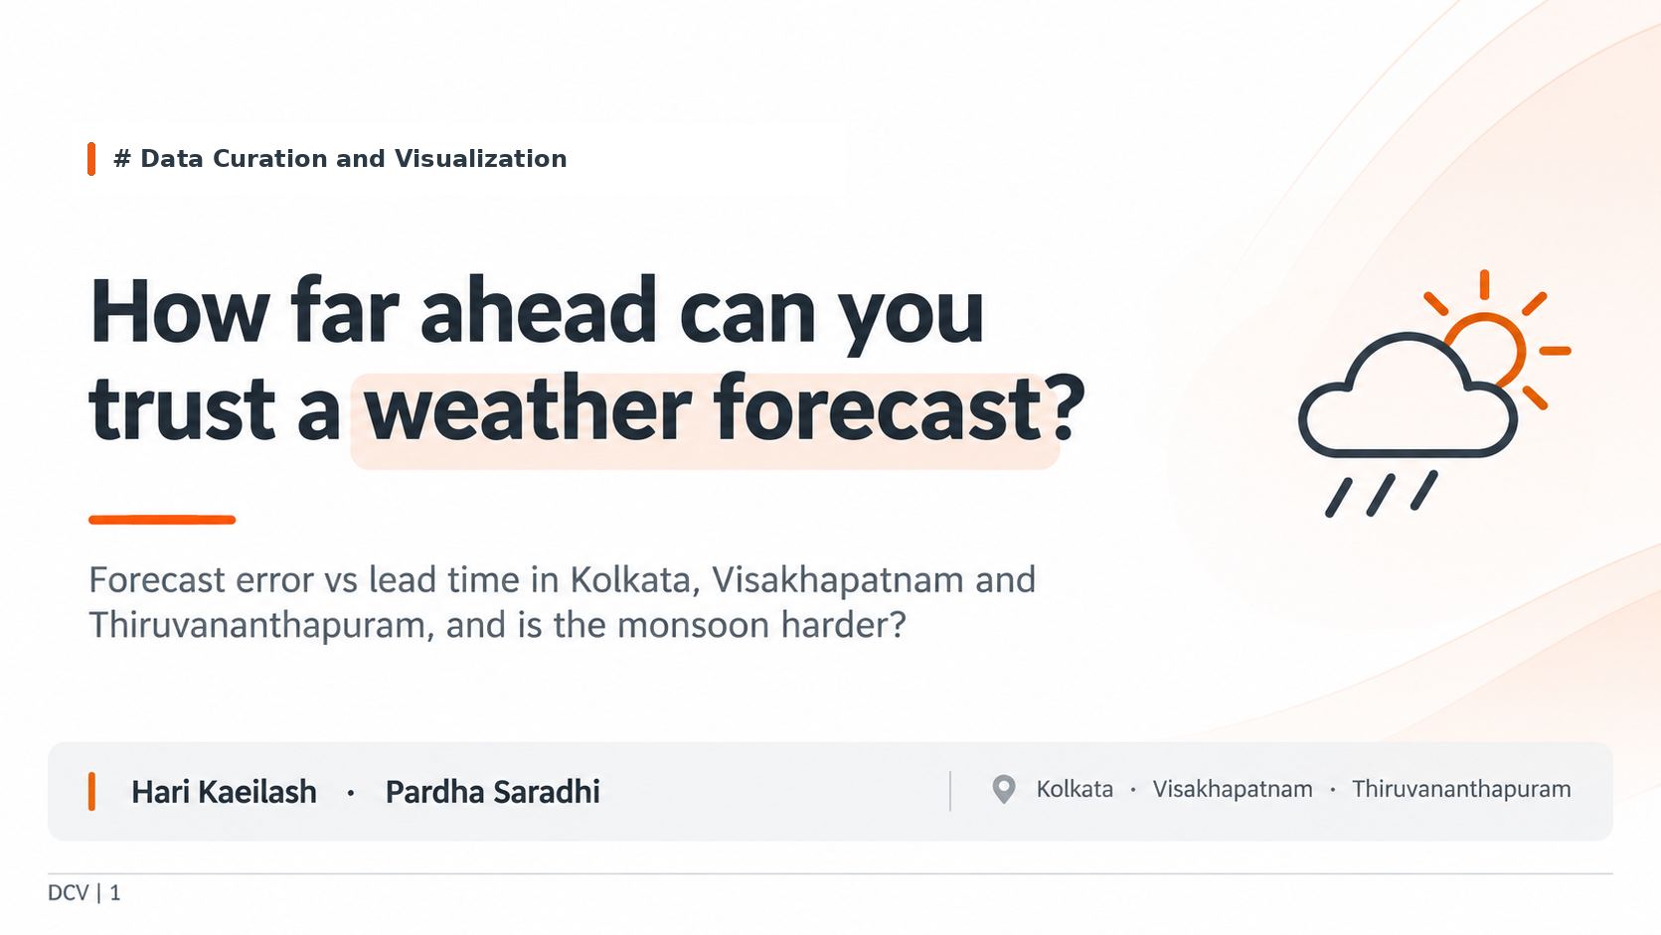
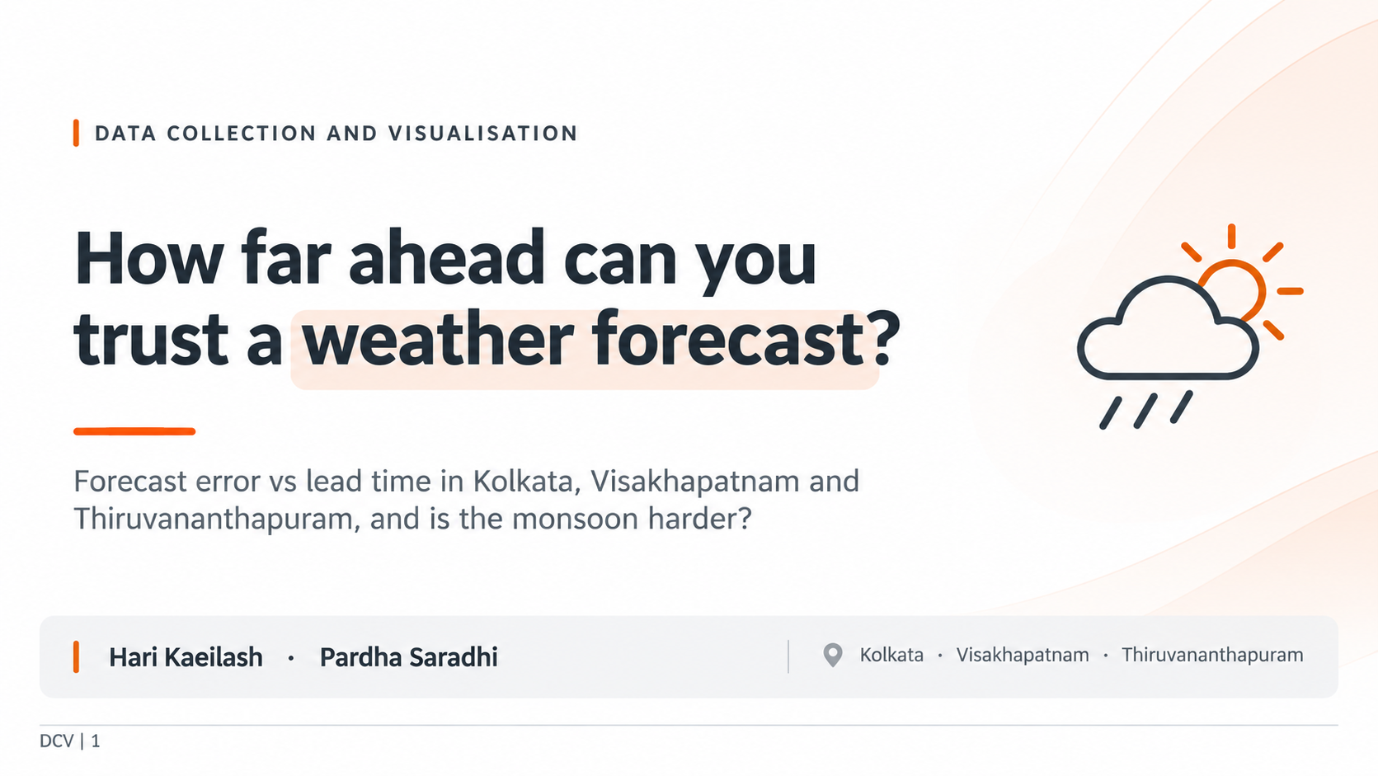

Slide 2
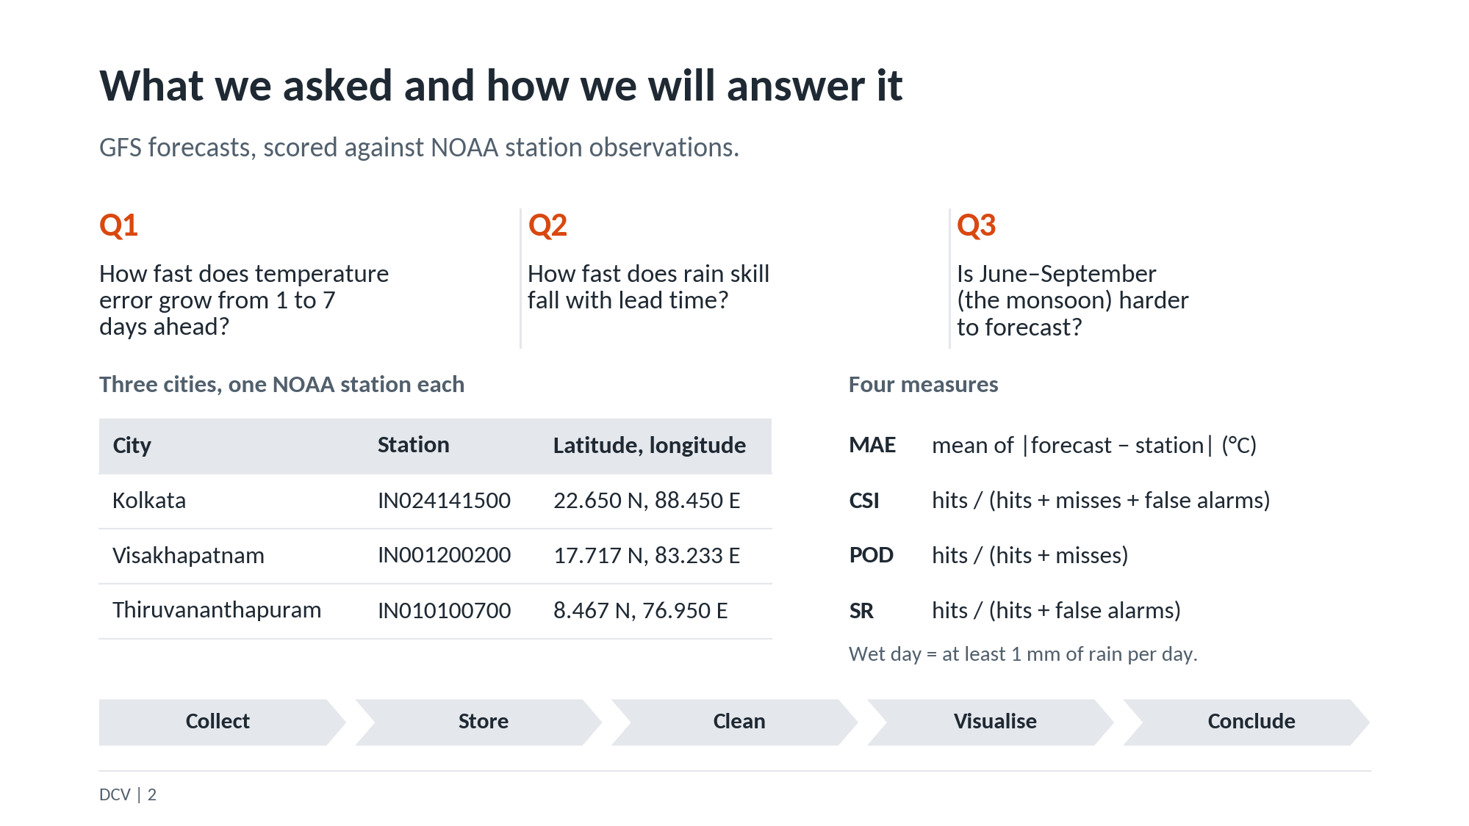

Slide 3
COLLECTION
Two sources of data
NOAA GHCN-Daily
Open-Meteo Previous Runs API
Real measurements from weather stations
Our 'truth' to compare forecasts against
137,187 rows | 3 cities, 1 station each
5 file downloads
Forecasts made 1 to 7 days before
105,192 hourly rows | 17 columns
12 requests (3 cities x 4 years)
Model: GFS
All downloaded by Python code, 27 files, never edited. Plus 6 check requests to 2 other Open-Meteo APIs (18 Open-Meteo requests in total).
DCV | 3
Notes:
We used two sources, and Python code downloaded everything; nothing by hand. NOAA gives real station measurements (137,187 rows, 3 cities). Open-Meteo gives forecasts made 1 to 7 days ahead (105,192 hourly rows). 12 requests for the main forecast data, plus 6 for a small check on two other Open-Meteo APIs: 18 in total.

Slide 4
ROBOTS.TXT AND TERMS
Are we allowed to collect this?
NOAA: allowed
Open-Meteo: blocked on paper
Blocks only /data* and /orders*
Our path /pub/data/ghcn/... is not blocked
robots.txt says: Disallow: /
Blocks all paths, including ours
Our decision: proceed, and say so openly
Terms of use allow free non-commercial use (under 10,000 calls/day). Ours is coursework.
Only 18 requests, 2-second delay, files cached, source credited.
DCV | 4
Notes:
Before collecting, we read each site's robots.txt, a file that says what bots may access. NOAA blocks only /data* and /orders*, so our path was allowed. Open-Meteo's file says Disallow: / which blocks everything. We proceeded because Open-Meteo's published terms allow free non-commercial use under 10,000 calls a day, and ours is coursework with only 18 calls. We added a 2-second delay, cached files, credited the source, and flagged this decision openly.

Slide 5
RAW DATA
Problems we found in the raw data
Tenths
Too much history
1
2
346 means 34.6 C: values stored in tenths
NOAA goes back to 1901, we need only a few years
Extra columns
Missing days
3
4
Only 4,535 of 137,187 rows are TMAX or PRCP
Many days have no station value
Time mismatch
Forecast gap
5
6
Station day is 08:30 to 08:30, forecast day is midnight to midnight
No forecast data around 30 Dec 2023
Grid offset
7
Forecast point is 3.4 to 5.5 km from the station (OK, under 10 km)
DCV | 5
Notes:
We found 7 problems. Values are stored in tenths. NOAA goes back to 1901 but we only need a few years. Only about 4,500 of 137,000 rows are TMAX or PRCP. Many days are missing. Station days run 08:30 to 08:30 while forecast days run midnight to midnight. There is a forecast gap around 30 Dec 2023. The forecast grid point is 3 to 5 km from the station, which is close enough to count as the same place.

Slide 6
STORAGE
Storing the data: raw, interim, clean
raw/
interim/
clean/
27 files exactly as downloaded.
Never edited.
Converted to Parquet.
NOAA 137,187 rows
Open-Meteo 105,192 rows
Final tables.
Temperature 2,787 days
Rain 822 days
Why Parquet, not CSV?
File naming rule
Much smaller: 6.8 MB to 0.75 MB
Keeps data types (dates stay dates)
Read back and checked: same shape
source_what_date
noaa_ghcnd_IN024141500_date.csv.gz
Date collected is always in the name
DCV | 6
Notes:
We kept three folders. raw holds the files exactly as downloaded and is never edited. interim holds the files converted to Parquet. clean holds the final tables. File names contain the source and the date collected. We chose Parquet over CSV because it is much smaller (6.8 MB became 0.75 MB for NOAA) and it remembers data types such as dates. We read the files back and checked shape and types matched.

Slide 7
CLEANING
Cleaning: 137,187 raw rows become 2,787 + 822
1
Dates: YYYYMMDD numbers to real dates
2,787
2
Units: tenths to deg C and mm
temperature days (TMAX)
3
Drop the -9999 missing code
4
Keep only TMAX (temperature) and PRCP (rain)
822
5
Keep only our date window
rain days (PRCP)
6
Drop rows that failed quality checks
7
Check duplicates: none found
DCV | 7
Notes:
Cleaning steps: convert dates from numbers to real dates, convert tenths to degrees C and mm, drop the -9999 missing code, keep only TMAX and PRCP, keep only our date window, drop rows that failed quality checks, and check duplicates, which there were none. Most of the loss comes from missing station values, not from errors.

Slide 8
MISSING VALUES
Missing days: deleted, not filled in
Why no imputation?
Days deleted (no station value)
Station value = the truth
A filled value would be another forecast
A forecast cannot be tested against another forecast
Temperature: 673 days
Kolkata 223, Thiruvananthapuram 327, Visakhapatnam 123
Rain: 900 days
Kolkata 332, Thiruvananthapuram 212, Visakhapatnam 356
The gaps are not random
Rain: a missing day is usually a dry day nobody wrote down (forecast for those days was low).
Limitation: kept rain days lean wet (54% of kept days had 1 mm or more).
DCV | 8
Notes:
This is the most important cleaning slide. We did not fill in missing values. The station value is the truth we score forecasts against. If we filled it in, we would compare a forecast against another guess. We also tested whether the gaps were random, and they were not. For rain, a missing day usually means a dry day that nobody wrote down. The cost is that our rain sample leans wet, and we state that as a limitation.

Slide 9
OUTLIERS
Outliers: real extremes or errors?
27
1
26
flagged by modified z-score
error: removed
real extremes: kept
The 1 error
The 26 real ones
Kolkata, 20 Mar 2024: 21.7 C
Typical for that month: 33.65 C
Neighbour days: 32.0 and 28.4
Example: Visakhapatnam, 10 to 17 June 2023, 44.4 to 44.6 C
Heat wave on consecutive days
Rain: max 132.1 mm is real, so kept
DCV | 9
Notes:
We used the modified z-score method to flag unusual temperatures. 27 values were flagged. Only 1 was an actual error: 21.7 C in Kolkata on 20 March 2024 against a typical 33.6 C, with normal days on both sides. The other 26 were real heat waves, for example Visakhapatnam hit 44 C in June 2023. We kept them, because deleting real extremes would hide the weather we want to study. For rain, the largest value of 132 mm was kept as a real heavy-rain day.

Slide 10
RESULT
What survived cleaning
78%
46%
of temperature days kept: 2,787 of 3,564
of rain days kept: 822 of 1,770
Lost: 673 missing station days, 81 forecast gaps, 22 after end of record, 1 error
Rain loses more because stations often do not record dry days
Most of the loss is values never recorded by the station, not quality problems.
DCV | 10
Notes:
After cleaning we keep 78 percent of temperature days and 46 percent of rain days. Rain loses more because stations often do not record dry days. Most of the loss is station values that were never recorded, not quality problems. Now my friend will take over for the analysis.

Slide 11
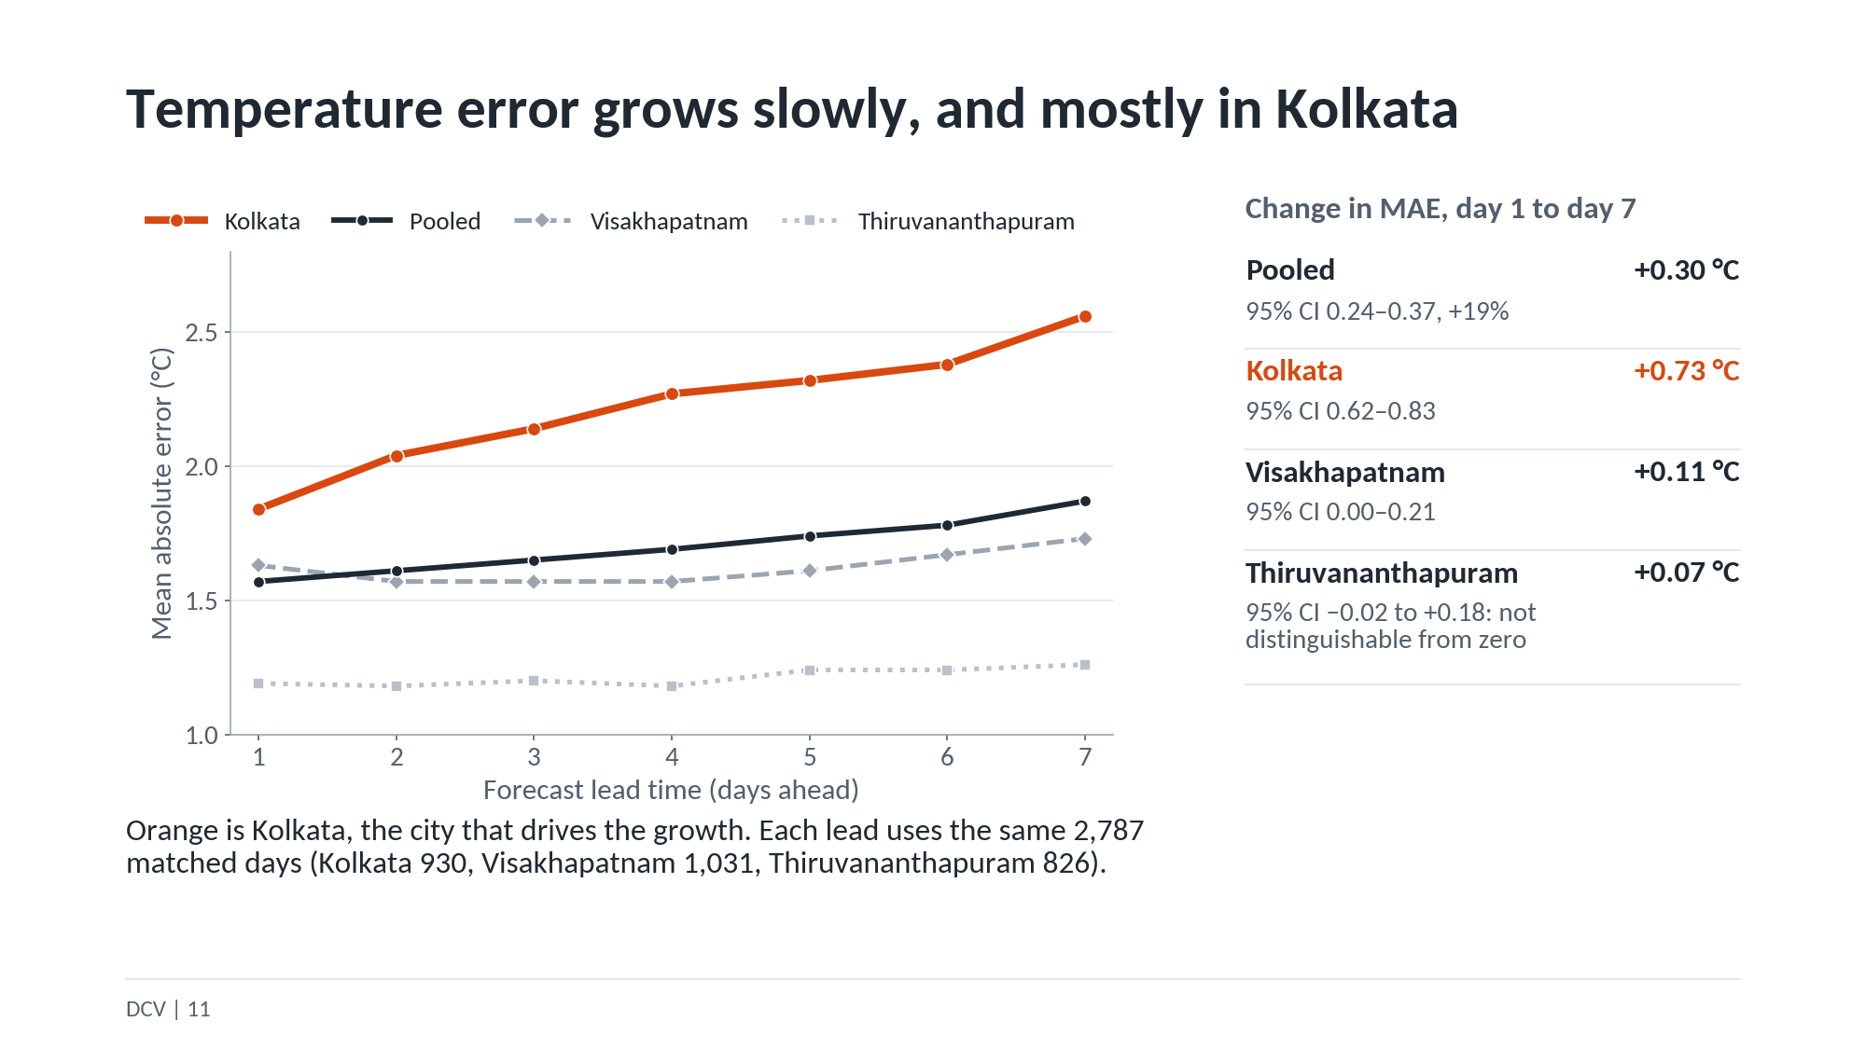

Slide 12
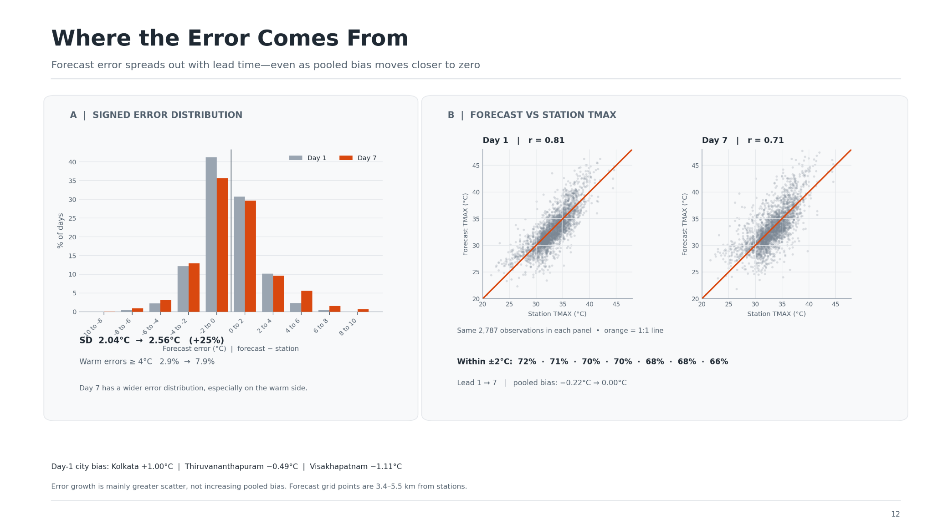

Slide 13
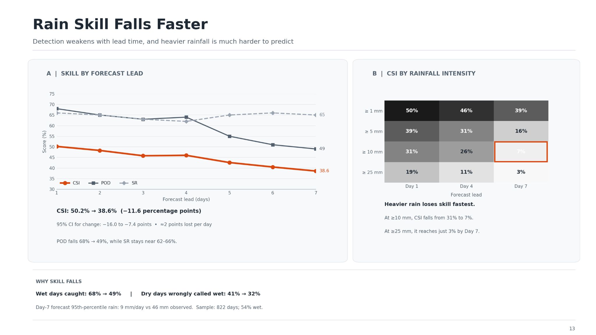

Slide 14
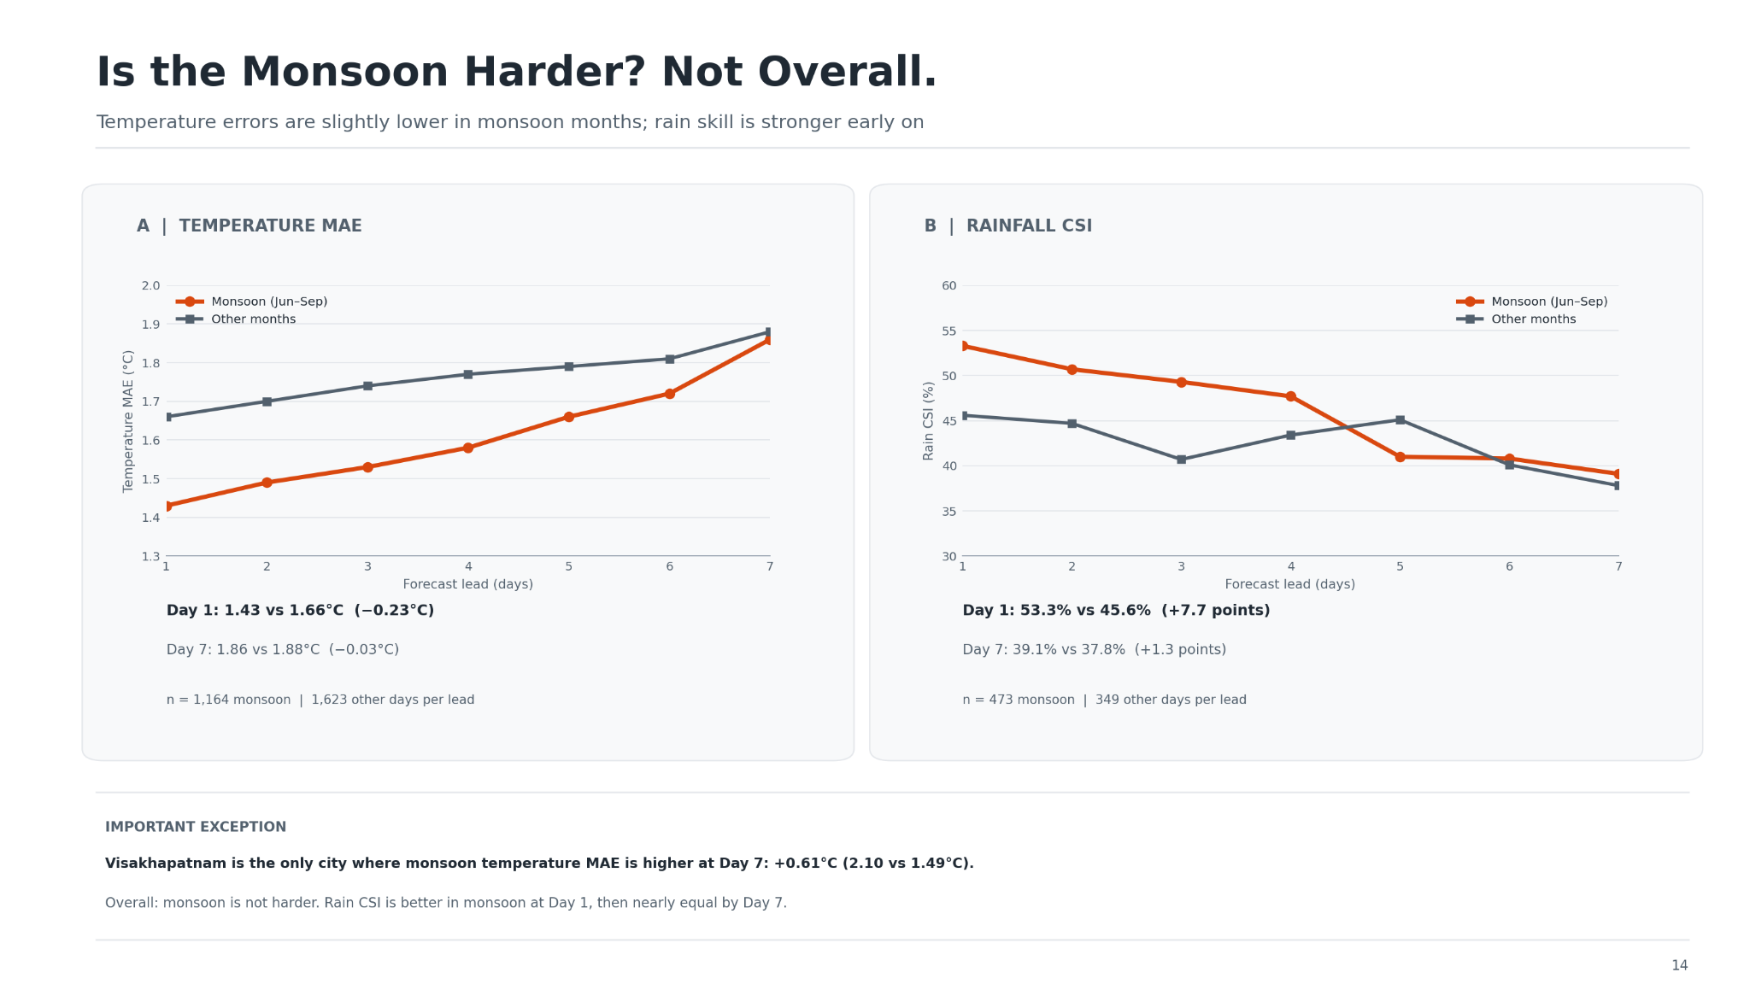

Slide 15
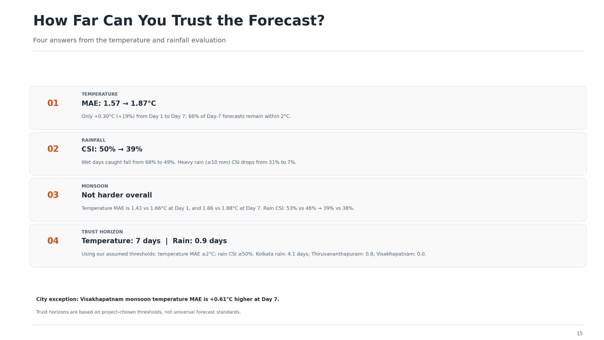

Slide 16
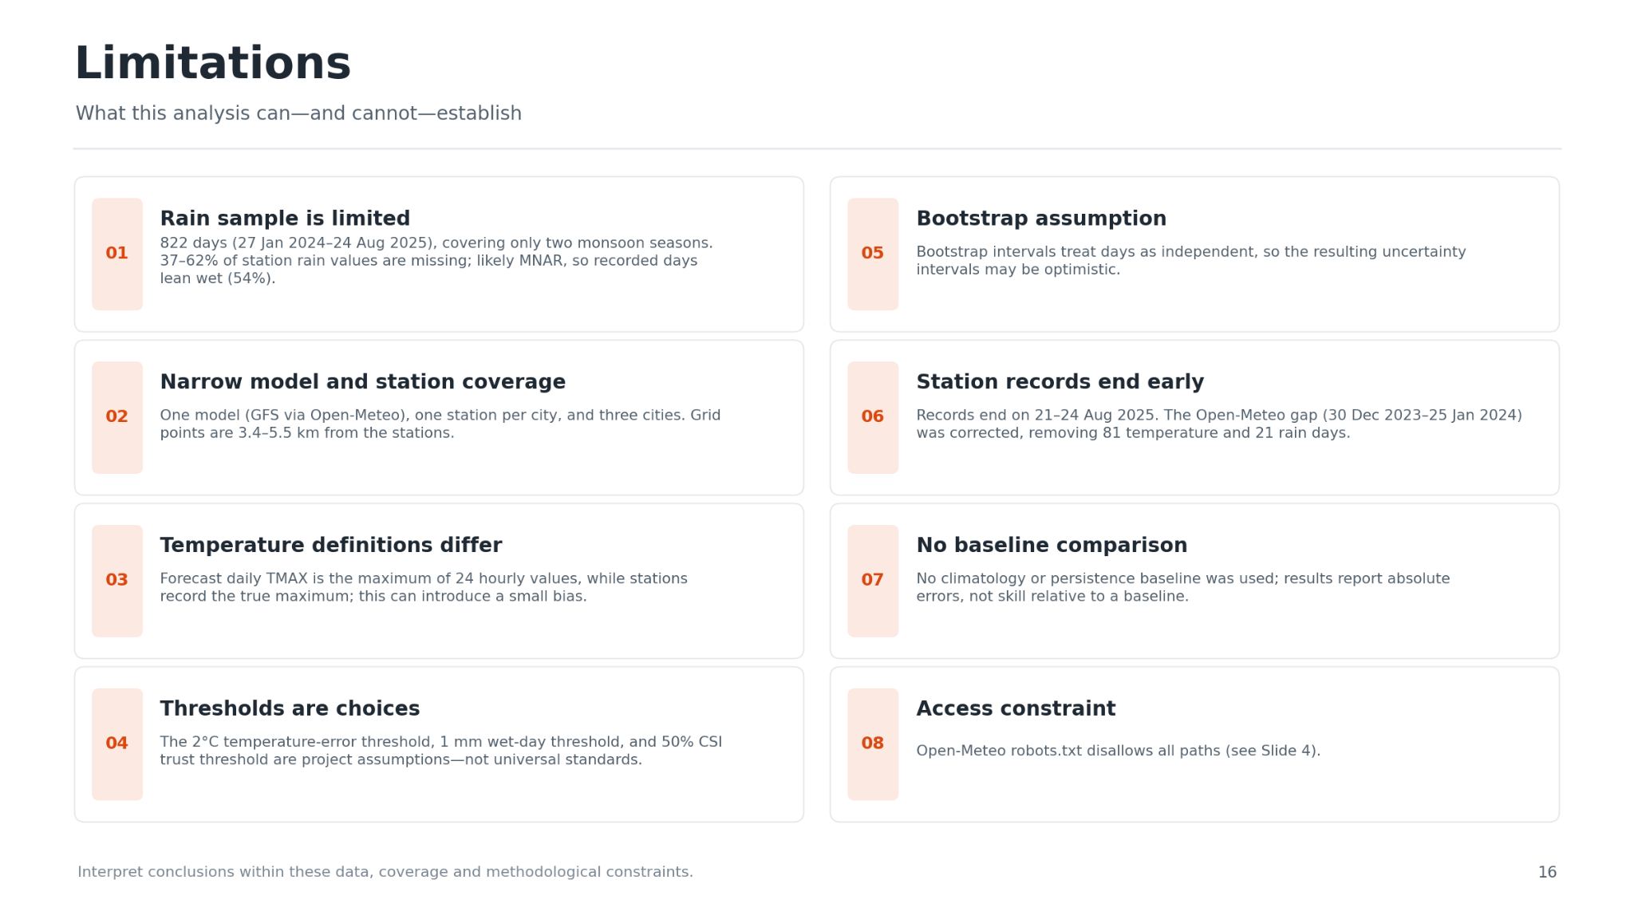

Slide 17
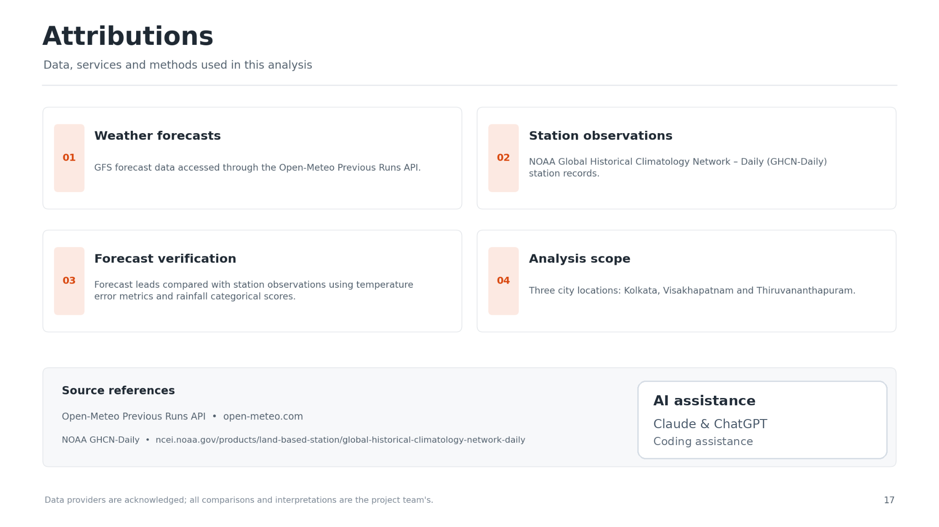
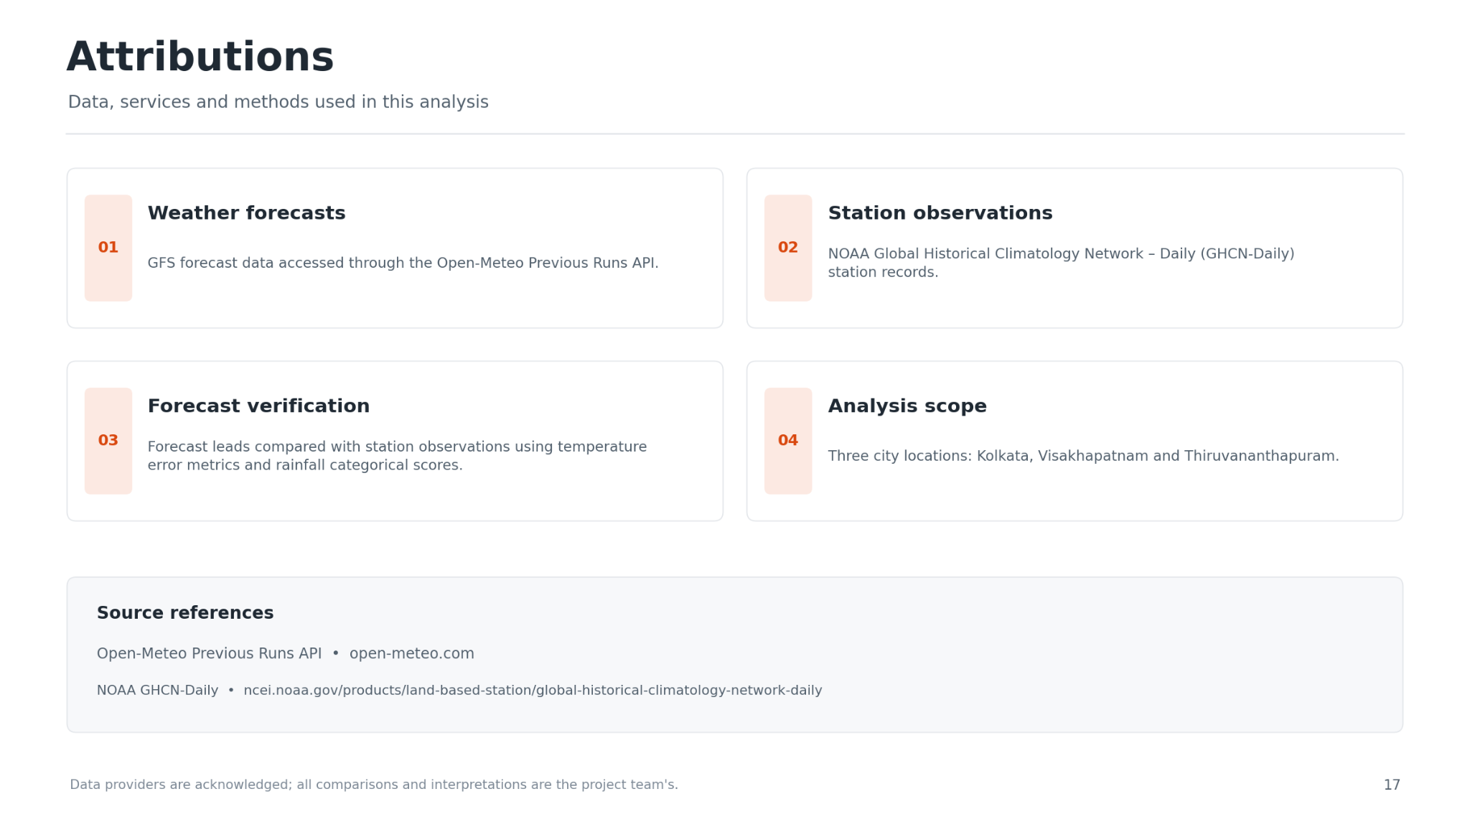

Slide 18
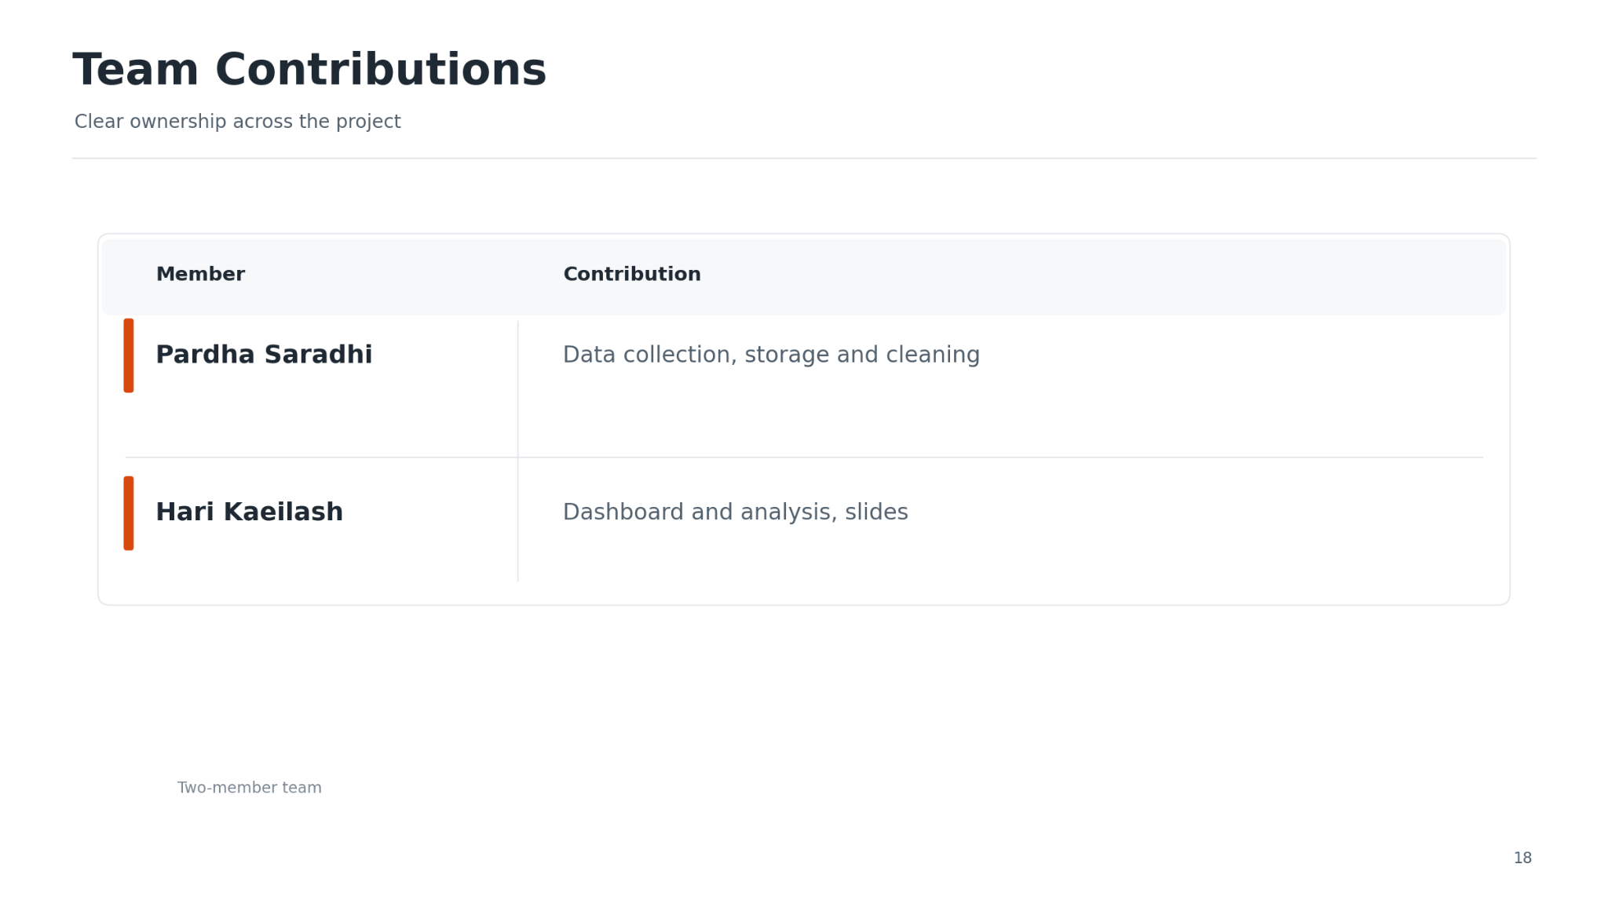

Slide 19


