Slide 1
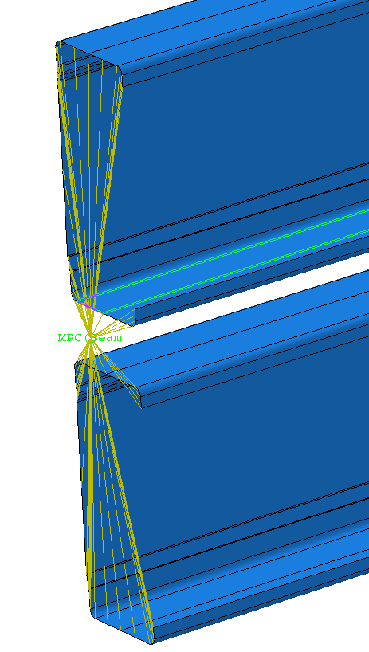
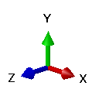
Stud
Row-1
MPC beam constraint at reference point
Stud
Row-2

Slide 2
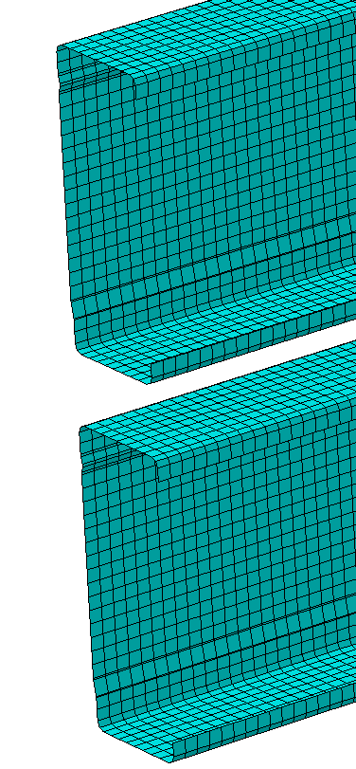
Stud
Row-1
4 mm meshes
Stud
Row-2

Slide 3
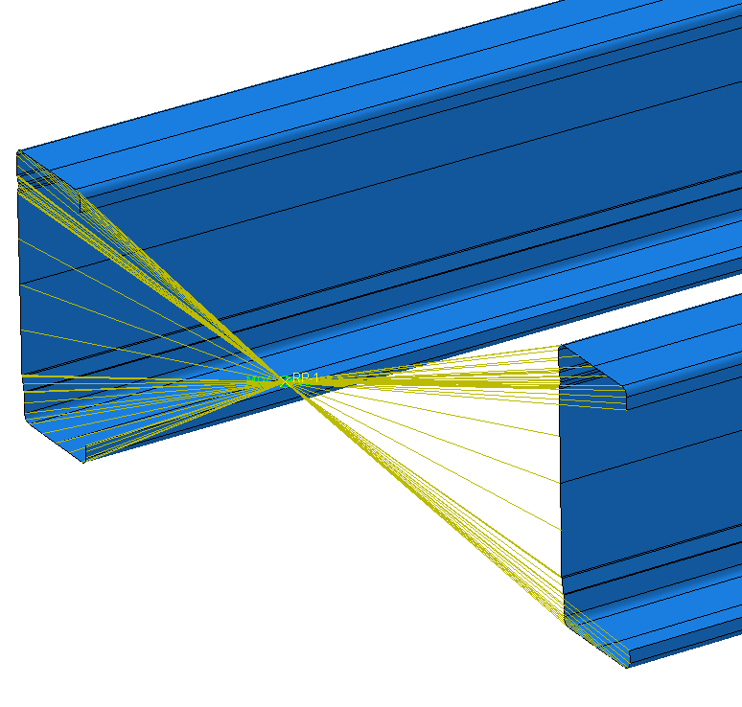
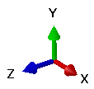
MPC beam constraint at reference point
Stud
Row-1
Stud
Row-2

Slide 4
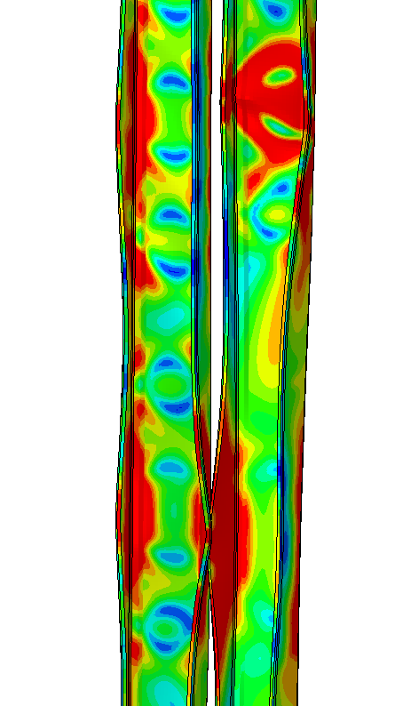
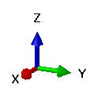
Buckling of stud flanges
Notes:
AT1-buckling-fea

Slide 5
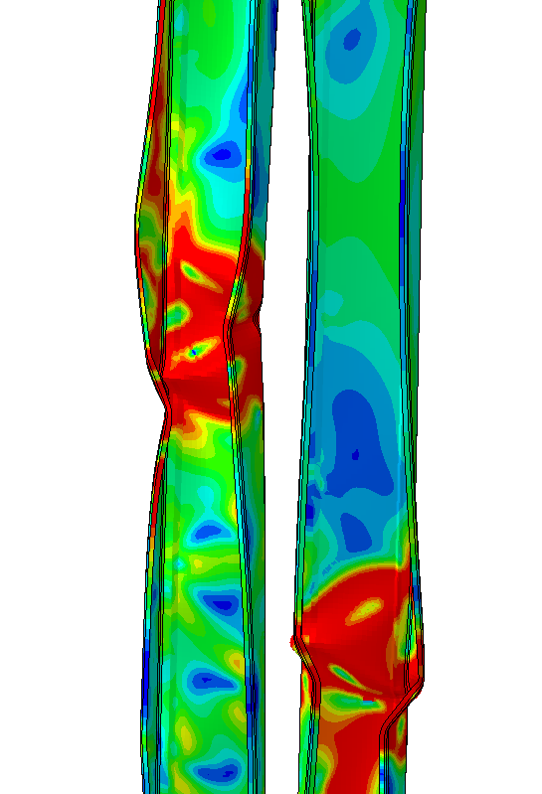
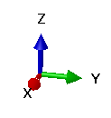
Buckling of stud
Notes:
AT2-buckling-fea

Slide 6
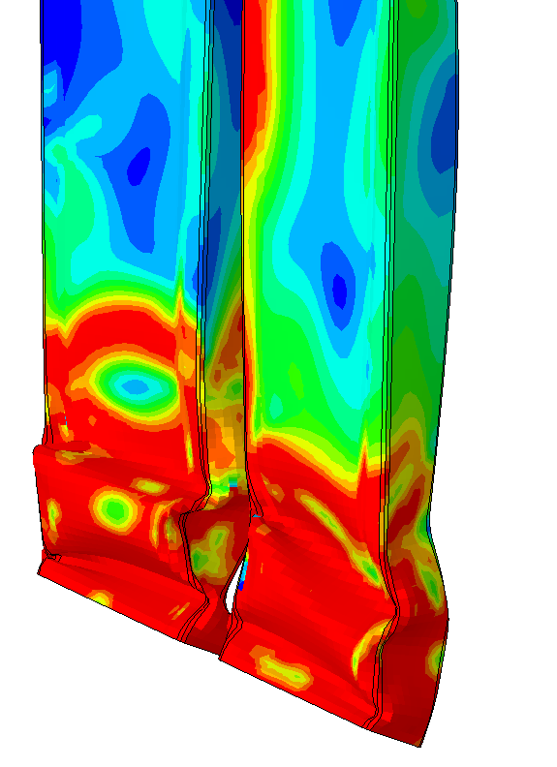
Local crushing
Notes:
AT3-buckling-fea

Slide 7
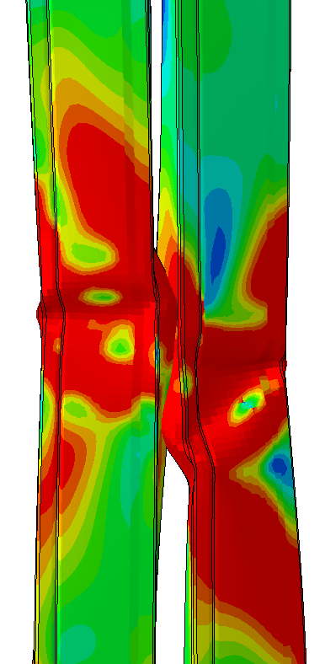

Buckling of web and flanges
Notes:
AT4-buckling-fea

Slide 8
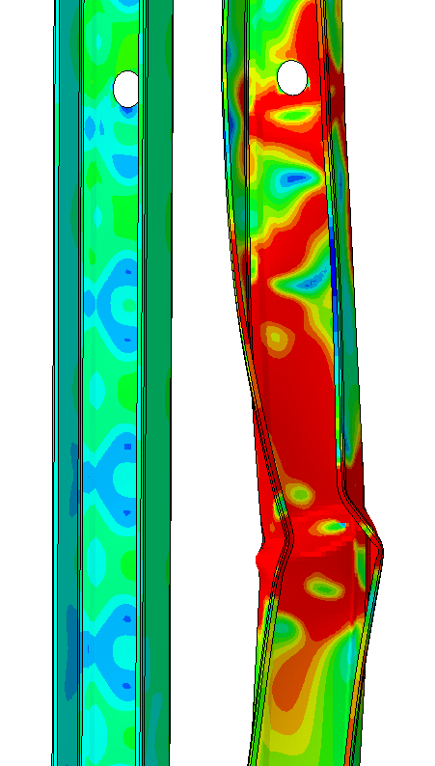
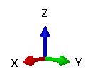
Buckling of web and flanges
Notes:
AT5-buckling-fea

Slide 9
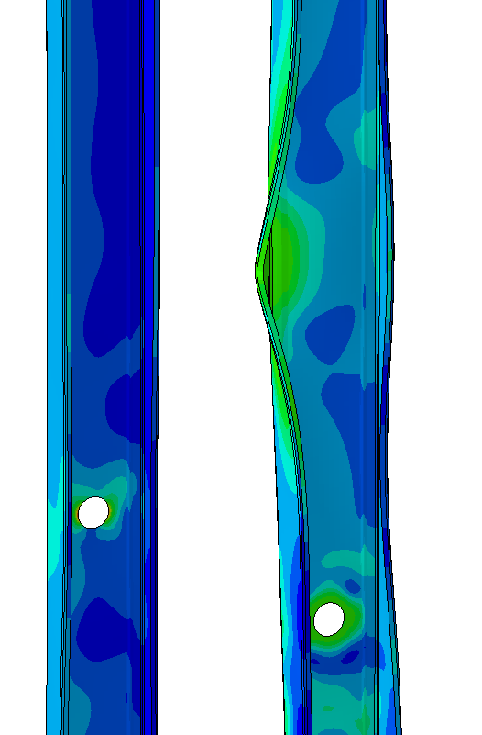
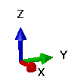
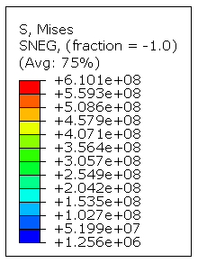
Buckling of flanges
Notes:
T10-buckling-FEA

