Slide 1
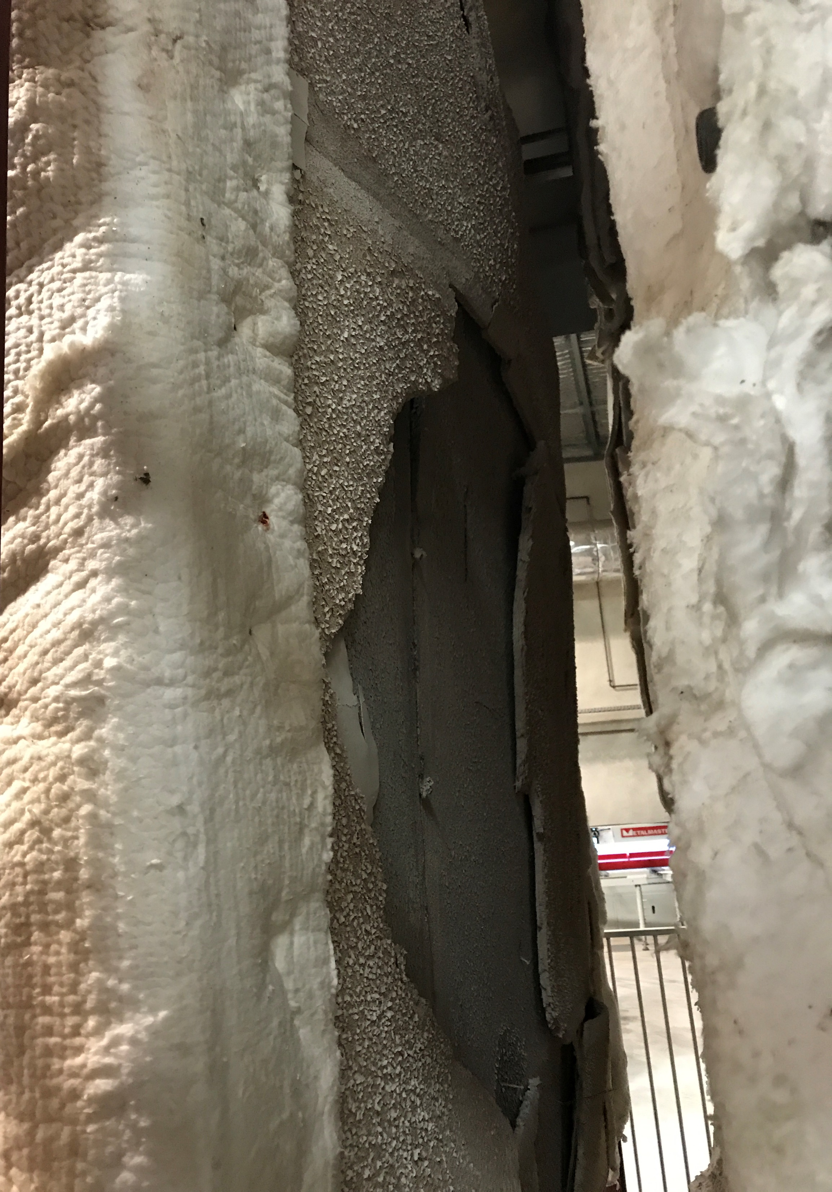
Fire Side
Plasterboard
Open Up

Slide 2
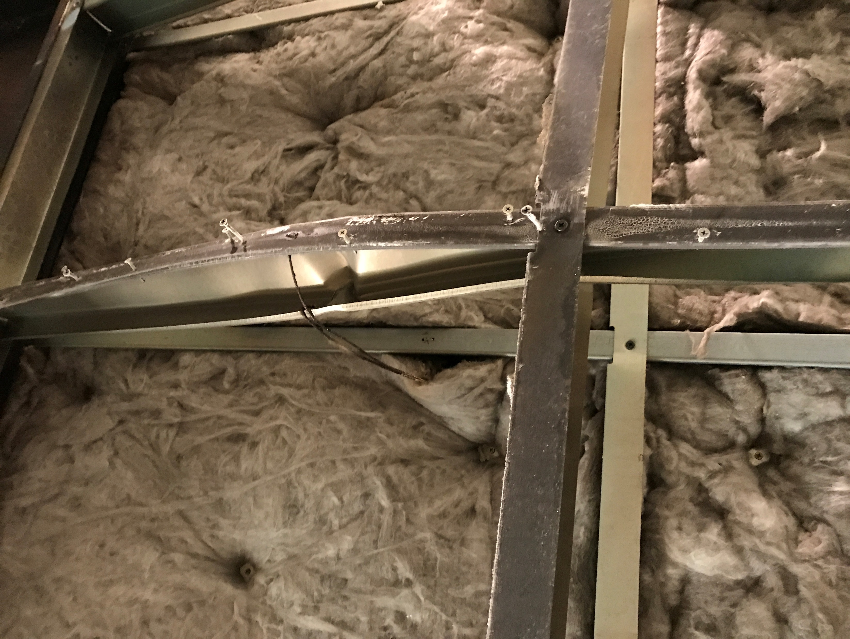
Intact Ambient Side Studs
Intact Insulation
Buckled Fire Side Studs

