Slide 1
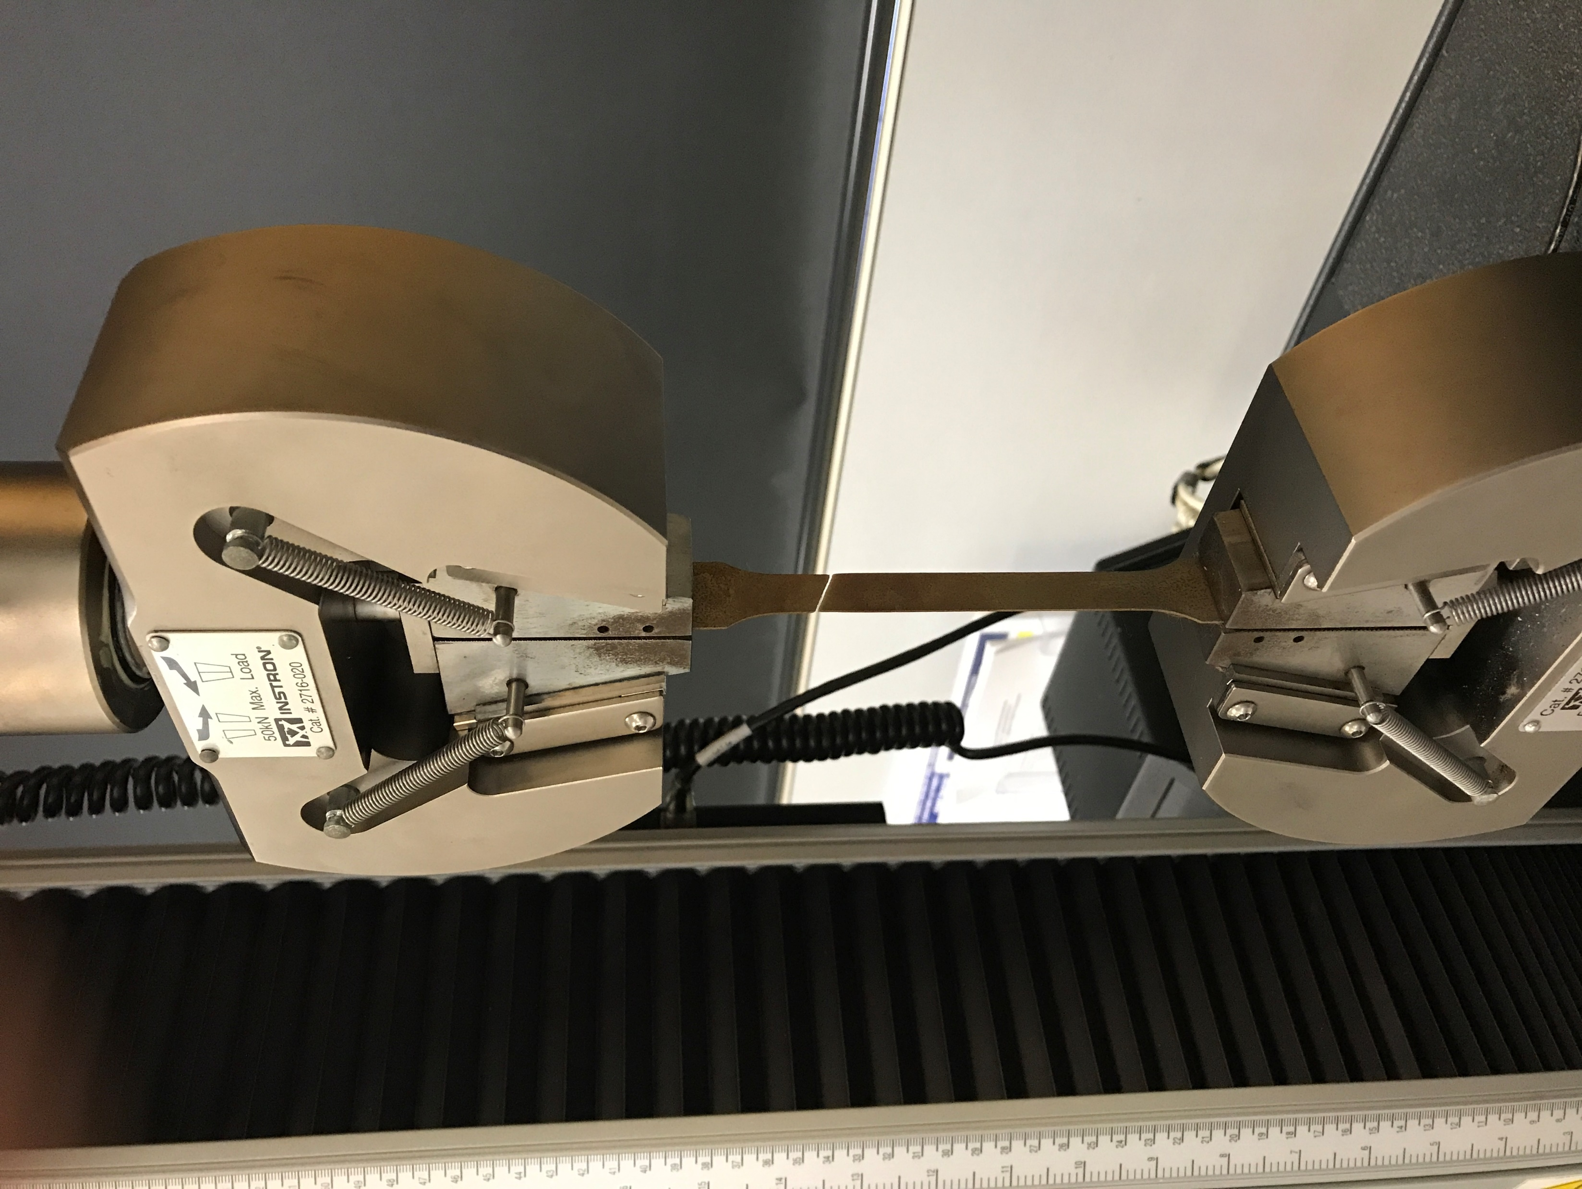
Top clamp
Fracture of specimen
Bottom clamp
Notes:
AT1

