Slide 1

Department of ECE
EMBEDDED PROTOTYPE
VOICE CONTROL HOME AUTOMATION USING ESP32.
GUIDED BY:-
Dr. N. PRABAKARAN Associate Professor Dept of ECE
PRESENTED BY:-
2300040110 – P Girish
2300040145 – G Mukhesh Kumar
2300040186 – P Mahesh

Slide 2

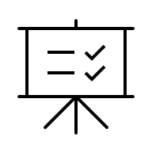
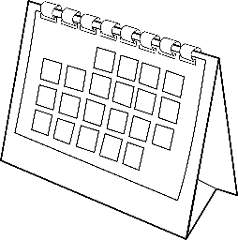
Objective
To design and implement a smart home automation system using ESP32 and IoT technology.
To remotely control home appliances like lights, fan through internet connectivity.
To enable real-time communication between devices using MQTT protocol and Wii.
To improve convenience and reduce manual effort in operating home appliances.
To develop a low-cost, energy-efficient, and secure home automation system.

Slide 3
Problem Statement
In our daily life, home appliances like lights, fans, and doors are controlled manually using switches. This can be inconvenient and may lead to energy wastage when devices are left ON unnecessarily.
So, there is a need to develop a smart system that allows users to control and monitor home appliances remotely through the internet. This project aims to create a simple, low-cost smart home automation system using ESP32 and IoT technology for easy and efficient control of home devices.

Slide 4
Hardware & Software Tools
Hardware Components:
ESP32 microcontroller
4-channel relay module
Light bulbs (bedroom and hall)
Fan / DC motor
Door lock / motor
Power supply
Jumper wires
Breadboard (optional)
WiFi router / internet connection
Software Requirements:
Arduino IDE
ESP32 Board Package
PubSubClient (MQTT library)
WiFi Library
HiveMQ Cloud (MQTT broker)
Mobile app (for control)

Slide 5
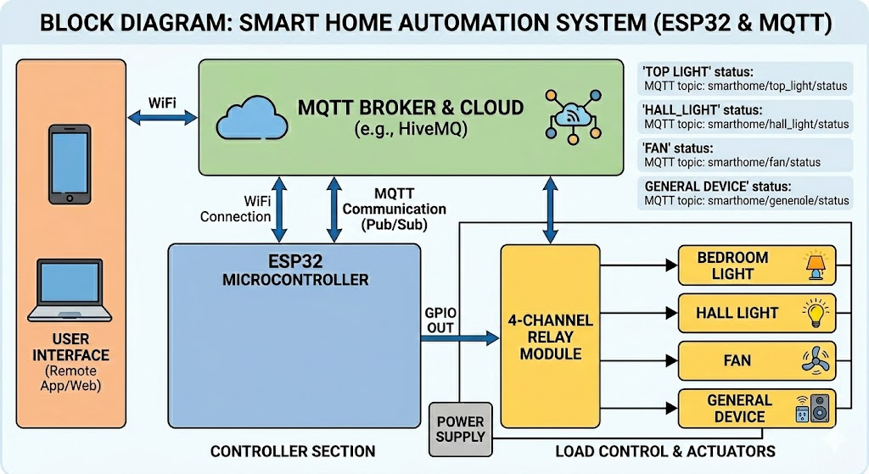
Block Diagram

Slide 6





Methodology / Working
Initialization & Connection:
The ESP32 connects to local WiFi and establishes a secure connection with the HiveMQ Cloud MQTT broker.
Command Reception:
A user publishes a command (ON/OFF) via the mobile app, which the HiveMQ broker instantly routes to the ESP32.
Signal Processing:
The ESP32 interprets the received MQTT message and triggers the corresponding GPIO output pin.
Load Switching:
The 4-channel relay module receives the low-voltage signal from the ESP32 to switch the high-voltage appliances
like lights and fans.
Status Feedback:
The system sends a real-time status update back to the MQTT cloud to confirm the device state on the user's dashboard.

Slide 7
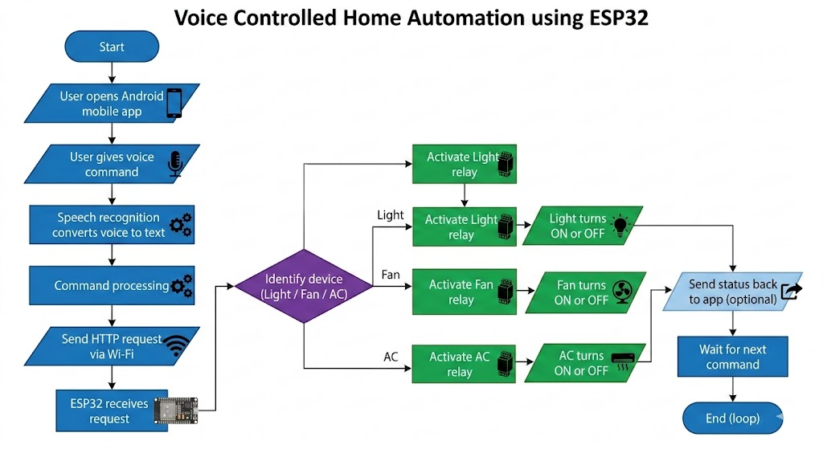
Flowchart

Slide 8
Conclusion & Future Scope
Conclusion:
This project demonstrates a smart home automation system using ESP32 and MQTT. It allows users to control lights and fan remotely through the internet. The system is low-cost, easy to use, and helps in saving energy. It also provides practical knowledge of IoT and embedded systems.
Future Scope:
Implement sensor to automatic automation system.
Add smart power consumption analytics.
Enable multi-user access control.
Integrate with smart grid technology.

Slide 9


THANK YOU
EMBEDDED PROTOTYPE

