Slide 1
PSG iTech Hackfest
Team Name- Zeus Thinkers
Team Members - R. Gokulprasath
- A. Hariguptha
- S. Ragul
- C. Vasan
Theme- Open Network for Digital Commerce

Slide 2

Problem
-User face the difficulty of making transactions while buying items from ecommerce websites like:
-Entering card details each time while making payments
-Wrong entry of card details
-Don't have card at the time of payments
-Forgot pin while making payments via UPI platforms like GPAY, PHONEPAY
-Less Security
-Ecommerce websites only sells products of big corporates

Slide 3

Solution
-Centralization of transactions (Once the user recharge within this website from his Bank account then they can buy products till their balance gets over)
-Merchant website authentication via this web-app(Users logging are handled by SHELDON)
-We generate a JWT Token for user and send it to the merchant website he visits and we would be handling the payments
-Connecting local business to ecommerce market

Slide 4

Features
-Users would buy products from any other ecommerce websites but our centralization website would handle all the transactions in backend, making a secured place for market
-This can be achieved by, the respective merchant by adding the API key we are providing in our SHELDON website in their merchant website
-Also the local merchants would expose their products in the SHELDON website

Slide 5

Technology/Tool Stack Used
HTML/CSS
JavaScript
NodeJS
MongoDB
- Github(Code Base)

Slide 6
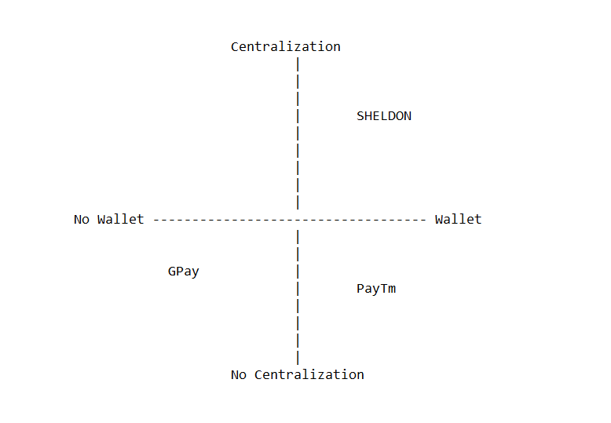
Competitor Map

Slide 7
THANK YOU

