Slide 1

AWS – Amazon Web Service
AWS originated in the early 2000s to solve Amazon's internal IT challenges of scaling its e-commerce platform. After building a structured internal infrastructure with well-documented APIs, Amazon realized this shared technology could be offered to external companies as a service.
AWS officially launched in 2006 with S3 (storage) and EC2 (compute), pioneering cloud computing and establishing itself as a leading platform by providing scalable, on-demand computing power over the internet.

Slide 2

AWS – Amazon Web Service
Cloud computing platform provided by Amazon.
Instead of buying and maintaining physical servers, companies and individuals can rent
Computing power
Storage, databases,
Networking,
Machine learning many other services from AWS

Slide 3
Computer
It is an electronic device.
It understands only machine language.
In modern computer we use programming language to do a task
Basic component of a computer is.
RAM (Random Access Memory)
ROM (Read only Memory)
CPU (Central Processing Unit)

Slide 4

Server
A device that provides service to another computer.
A server can be physical or virtual.

Slide 5
Different Types of Server
Web server
Database Server
Mail Server
File Server
Proxy Server – API request
Application Server
DNS Server
DHCP Server

Slide 6

VIRTUAL SERVER
A physical server is divided into multiple virtual servers by installing a lightweight software is
Called HYPERVISOR. This process is called virtualization.

Slide 7
Data Centre
The data center is used to store, process, and share the data and application.
Data centers provide powering of online games, e-commerce transactions, machine learning and artificial intelligence.
Intelligent
Data center maintenance cost is very high.
Data centers need uninterrupted electricity.
Data centers need high internet speed.

Slide 8



Data Centre Room

Slide 9
Cloud Computing
Delivery of computer resources through the internet
Like server, storage, database, networking, software, analytics, and intelligence.
PAY-AS-YOU-GO model
It can be accessed anywhere anytime with the help of the internet.
Cloud Computing provider are AWS, Microsoft Azure cloud, Google Cloud Platform, IBM ·Cloud, VMware.
User don’t want to build any data center.
No need to worry about the security and software update of the server and hardware.
Easily scale up and scale down.

Slide 10
SERVICE MODEL
IaaS (Infrastructure-as-a-Service)
Providers are managing the server, storage, Networking. Customers can use their own OS to deploy their application.
Customers only pay for the usage of hardware.
PaaS (Platform-as-a-Service)
Customers are only managed by their application and data; all the other things are managed by the provider.
SaaS (Software-as-a-Service)
Providers manage everything and customers don’t worry about anything.

Slide 11
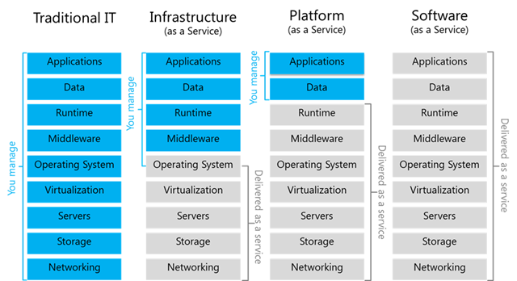
SERVICE MODEL

Slide 12
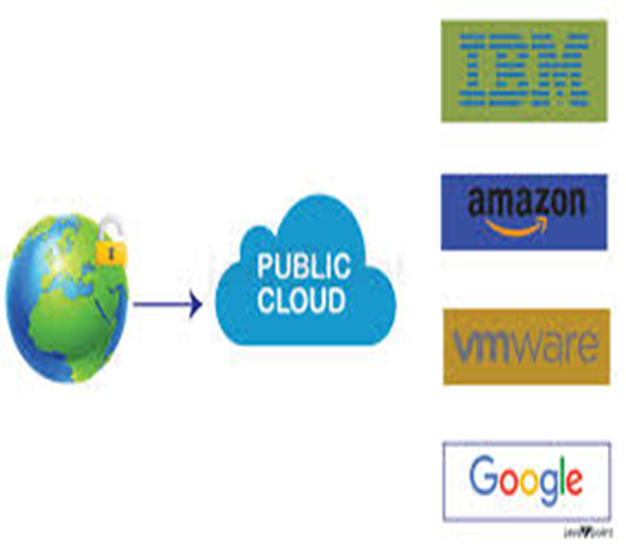
DEPLOYMENT MODEL
Public Cloud
It is fully managed by the provider.
Our data is stored in the provider data center.
It can access public using internet.

Slide 13

DEPLOYMENT MODEL
Private Cloud
It is set up by an organization.
Data are stored there on data center.
Maintenance cost is very high.

Slide 14
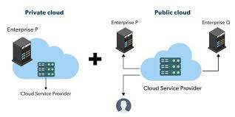
SERVICE MODEL
Hybrid cloud
Combination of private and public cloud
Reduce the pain and cost in cloud migration.

Slide 15
Different Platforms in Cloud Computing
Amazon Web Service (AWS) - 2006
Microsoft Azure - 2010
Google Cloud - 2011
IBM Cloud - 2011
Oracle Cloud (OCI) - 2012
Alibaba Cloud - 2009

Slide 16
Region, Availability Zones, AWS Global Infrastructure
Region
A Region is a physical geographical area where cloud providers host multiple data centers.
Each region is independent and isolated from others to ensure fault tolerance and data sovereignty.
AWS has multiple Regions worldwide, each identified by unique codes (e.g., us-east-1, euwest-2).
Users can select a region based on proximity, compliance, latency, and cost considerations.

Slide 17
Availability Zones (AZs)
Availability Zones (AZs) are isolated data centers within a region.
Each AWS region has multiple AZs (usually 2 or more) to ensure high availability and fault tolerance.
AZs are physically separate, with independent power, cooling, and networking.
Resources can be deployed across multiple AZs to achieve redundancy and resilience.

Slide 18
AWS Global Infrastructure
Regions: Worldwide distributed locations for deploying cloud services.
Availability Zones: Multiple data centers within a region to ensure uptime.

Slide 19
Benefits of AWS
Scalability & Flexibility
Lower computing cost
Improved performance
Advanced security
Data loss prevention
Universal access

Slide 20
Limitations
Required constant and good internet connection.
Does not work at a low speed of the internet.

