Slide 1
AUTOMATIC MULTI-SPINDLE NUT DRIVER Submitted By UNDER THE GUIDANCE OF

Slide 2
OUTLINE
ABSTRACT
INTRODUCTION
ASSEMBLY DIAGRAM
WORKING PRINCIPLE
ADVANTAGES AND APPLICATIONS
CONCLUSION
FUTURE WORK

Slide 3
ABSTRACT
Car maintenance plays a crucial role in determining the lifespan of a vehicle, and one of the essential tasks is changing the car's tires. However, the traditional method of unscrewing and tightening lug nuts using a manual lug wrench can be time-consuming and physically demanding.
In this project, our aim is to design an automated multi-spindle nut driver that can efficiently tighten and remove the lug nuts of a car's wheels in a single stroke. The automated nut driver incorporates a screwdriver gun, a multi-head spindle arrangement, and a box spanner socket for streamlined operation.
The system's working involves the rotation of the screwdriver gun, which transmits torque to the multi-head spindle arrangement. The spindles, coupled with spur gears, rotate the box spanner socket to tighten or loosen the lug nuts. The chosen components, including the spur gears, shaft, socket, and bearings, are carefully selected for their durability and functionality. The steel body structure provides stability and strength to withstand the forces encountered during operation.

Slide 4
The automated multi-spindle nut driver simplifies the process of changing car tires by significantly reducing the time and effort required to tighten or remove lug nuts.
The project's outcome is a practical solution that enhances efficiency and convenience in car maintenance tasks. Future work can focus on optimizing the design, integrating sensor technology for enhanced control and safety, and conducting real-world testing for validation.
Overall, the automated multi-spindle nut driver demonstrates the potential for automation and innovation in improving automotive maintenance processes.

Slide 5
INTRODUCTION
In this presentation, we will introduce an automated multi-spindle nut driver designed to revolutionize the way we handle wheel lug nut fastening and removal.
This innovative tool aims to enhance efficiency, save time, and reduce the physical strain associated with tire replacement. By incorporating a screwdriver gun, a multi-head spindle arrangement, and a box spanner socket, our solution offers a seamless and user-friendly experience.
we will introduce an automated multi-spindle nut driver designed to revolutionize the way we handle wheel lug nut fastening and removal. This innovative tool aims to enhance efficiency, save time, and reduce the physical strain associated with tire replacement.
Additionally, we will touch upon the validation process, including design calculations, simulations, and performance testing.

Slide 6
Objective of the study
The concept of the Automated Multi-Spindle Nut Driver: Provide a comprehensive understanding of the automated system designed to simplify wheel lug nut fastening and removal.
Highlight the need for automation in car maintenance: Discuss the limitations of traditional lug wrenches and emphasize the benefits of automated solutions in terms of time savings, efficiency, and user convenience.
Explain the working principle and components of the Automated Multi-Spindle Nut Driver: Describe the key components, such as the screwdriver gun, multi-head spindle arrangement, and box spanner socket, and their roles in achieving efficient lug nut manipulation.
Showcase the design considerations: Present the design calculations, gear ratios, and bearing selection process involved in ensuring optimal performance and reliability of the system.
Discuss the validation process: Explain the steps taken to validate the design through simulations, calculations, and performance testing, ensuring that the Automated Multi-Spindle Nut Driver meets the required standards and specifications.
Demonstrate the benefits and applications: Illustrate the advantages of using the Automated Multi-Spindle Nut Driver, including improved productivity, reduced labor, enhanced safety, and its applicability in various car maintenance settings.

Slide 7
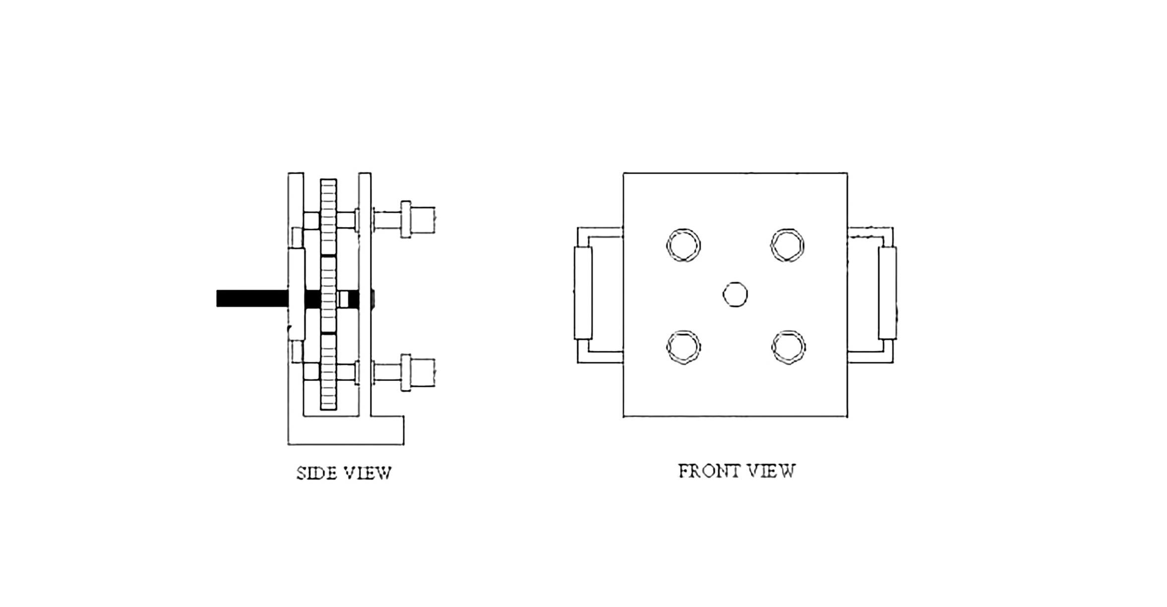
ASSEMBLY DIAGRAM

Slide 8
WORKING PRINCIPLE
Power Source:
The system utilizes a screwdriver gun as the primary power source. The rotational motion of the screwdriver gun provides the necessary torque for lug nut manipulation.
Multi-Head Spindle Arrangement:
The screwdriver gun's rotational motion is transmitted to a multi-head spindle arrangement. This arrangement consists of multiple spindles, each equipped with a gear mechanism.
Gear Mechanism:
Each spindle is connected to a gear mechanism, typically using spur gears, which convert the rotational motion from the screwdriver gun into the desired direction and speed for lug nut tightening or removal.

Slide 9
Box Spanner Socket:
The gear mechanism drives a box spanner socket, which is designed to fit various lug nut sizes commonly found in car wheels. The socket securely engages with the lug nuts, allowing for efficient manipulation.
Simultaneous Operation:
The multi-head spindle arrangement enables the simultaneous operation of multiple spindles, allowing for the tightening or removal of multiple lug nuts with a single stroke.
Ergonomic Design:
The Automated Multi-Spindle Nut Driver is designed to be compact and ergonomic, ensuring ease of use and comfortable handling for the user. The system's design promotes efficiency and minimizes physical strain during tire replacement.

Slide 10
ADVANTAGE
Time Savings: The Automated Multi-Spindle Nut Driver significantly reduces the time required for wheel lug nut fastening and removal. With its simultaneous operation of multiple spindles, it can quickly tighten or remove all the lug nuts in a single stroke, streamlining the tire replacement process.
Improved Efficiency: By automating the lug nut manipulation process, the system eliminates the need for manual effort and reduces the physical strain on the user. This improves efficiency and allows for faster completion of car maintenance tasks.
Increased Productivity: The automated nature of the Multi-Spindle Nut Driver enhances productivity in car maintenance operations. With its quick and efficient operation, mechanics or users can handle more tire replacements in less time, leading to increased overall productivity.

Slide 11
APPLICATIONS
Tire Replacement in Automotive Workshops:
The Multi-Spindle Nut Driver is ideal for automotive workshops and service centers where tire replacements are performed regularly. It simplifies the process of tightening or removing lug nuts, saving time and effort for mechanics.
Fleet Management:
Fleet management companies that handle a large number of vehicles can benefit from the efficiency of the Multi-Spindle Nut Driver. It allows for quicker tire replacements, ensuring minimal downtime for vehicles in the fleet.
Roadside Assistance:
Mobile mechanics and roadside assistance providers can utilize the Automated Multi-Spindle Nut Driver to expedite tire replacements on the roadside. Its quick and efficient operation enables them to efficiently serve customers with punctured or damaged tires.

Slide 12
APPLICATIONS
Automotive Manufacturing:
The Multi-Spindle Nut Driver can be integrated into automated assembly lines in automotive manufacturing plants. It streamlines the lug nut fastening process during vehicle assembly, improving efficiency and ensuring consistent torque application.
DIY Enthusiasts:
DIY car enthusiasts who prefer performing their own maintenance can benefit from the Multi-Spindle Nut Driver. It simplifies the tire replacement process, allowing them to efficiently tighten or remove lug nuts without the need for extensive manual effort.
Commercial Vehicle Maintenance:
The Multi-Spindle Nut Driver is applicable not only to passenger cars but also to commercial vehicles such as trucks, buses, and delivery vans. It can handle the lug nut fastening and removal requirements of these vehicles, enhancing efficiency in their maintenance.

Slide 13
CONCLUSION
In conclusion, the Automated Multi-Spindle Nut Driver presents a significant advancement in the field of car maintenance and tire replacement. By integrating a screwdriver gun, multi-head spindle arrangement, and box spanner socket, this innovative system streamlines the process of tightening and removing lug nuts from car wheels.
Throughout this presentation, we have discussed the various components, working principle, advantages, and applications of the Automated Multi-Spindle Nut Driver. It offers several key benefits, including time savings, improved efficiency, increased productivity, consistent torque application, user-friendliness, and enhanced safety. The system's design and functionality make it suitable for a range of applications, including automotive workshops, fleet management, roadside assistance, car rental agencies, manufacturing, and DIY projects.

Slide 14
FUTURE WORK
Future work for the Automated Multi-Spindle Nut Driver involves potential areas of improvement and expansion. This may include optimizing the system for better performance, integrating smart technologies for advanced features, exploring the use of advanced materials for enhanced durability, and conducting further research and development to refine and enhance the tool's capabilities.

