Slide 1
Sentimental Analysis With Bag of Words VS Naive Bayesian
Submitted By
G.Hari Krishna Reddy
148W1A1217

Slide 2
An Overview
sentimental analysis is a process of determining the opinion or feeling of a piece of text
The texts from reviews or Blogs is processed to get an accurate description of how the writer feels regarding the subject

Slide 3
INTRODUCTION
Problem statement
The problem in sentimental analysis is classifying the polarity of a given text at the document,sentence ,or feature/aspect level
Whether the expressed opinion in a document , a sentence or an entity feature /aspect is positive,negative, or neutral

Slide 4
INTRODUCTION CONTINUED…
Objectives
To implement an aotumatic classification for text into positive,negative or neutral
Sentimental analysis to determine the attitude of the mass is positive ,negative or neutral towards the subject of interest
Creating a wordcloud of high frequency words in the reviews or feedback
Making a barplot of top frequency words

Slide 5
MOTIVATION
we generally perform analysis on labelled data and generate some classififcation rules, basing on the classififcation rules we determine the nature of feedback
Just think, what if we dont have any labelled data , then how to perform analysis on data without any learning?
There is a way!
we can perform sentimental analysis on feedback or reviews by
" sentimental analysis with bag of words" without any learning from labelled
data

Slide 6
PHASES in “sentimental analysis with bag of words”
There are two phases in this
PHASE I : understanding the basic nature of data
PHASE II : counting number of positive words and negative words in the reviews consecutively.
Displaying total number of positive,negative and neutral reviews
among the whole data

Slide 7
PHASE I
load the data on which you want to perform sentimental analysis
create a corpus of the data , which you loaded
Now clean the corpus i.e, punctuations,numbers,remove stopwords and the noisy data which does not help you in making decisions
now convert the document as a stem document
make a document term matrix of stemmed data
convert the DTM into matrix
sort the columns of document term matrix from highest to lowest mean order
display the 20 top frequency words in barplot
create a word cloud of top 100 frequency words

Slide 8
PHASE I IMPLENATION CONT..,
Required libraries
library(tm) # text mining
library(wordcloud) #to genearate wordclud
library(SnowballC) #word streaming
library(caret) # partitioning,plots,etc.,
setwd("C:/Users/ghari/Desktop/newattempt")
movie<-read.csv("movie.csv",header = T,stringsAsFactors = F) # reding the file
moviec<-Corpus(VectorSource(movie$review)) #converting it into corpus
length(moviec)
moviec$review[1]

Slide 9
PHASE I IMPLENATION CONT..,
cleaning the DATA
doc<-tm_map(moviec,removeNumbers)
doc<-tm_map(doc,removeWords,stopwords("english"))
doc<-tm_map(doc,removePunctuation)
doc<-tm_map(doc,stripWhitespace)
doc<-tm_map(doc,stemDocument,language="english")
moviedtm<-DocumentTermMatrix(doc)
## a document matrix create table with distinct words in colums

Slide 10
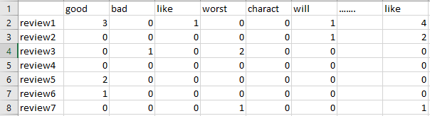
PHASE I IMPLENATION CONT..,
A document term will look like this
distinct words of reviews
A 2000 Review data set document term have a dimension of (2000,25000)
The DTM describes the frequency of distinct terms that occur in a collection of documents.

Slide 11
PHASE I IMPLENATION CONT..,
rr<-removeSparseTerms(moviedtm,0.8) # removing low frequency terms
mean_movie<-sort(colMeans(as.matrix(rr),na.rm = TRUE),decreasing = T)
mean_movie[1:20] ## top 20 frequency words
### barplot
barplot(mean_movie[1:20],xlab="top 20 words",ylab="frequency",las=3,ylim=c(0,3))
## wordcloud
wordcloud(names(mean_movie[1:100]), mean_movie[1:100], min.freq = 0,scale=c(2,1) ,max.words=200, random.order=FALSE, rot.per=0.80, colors=brewer.pal(8, "Dark2"))

Slide 12
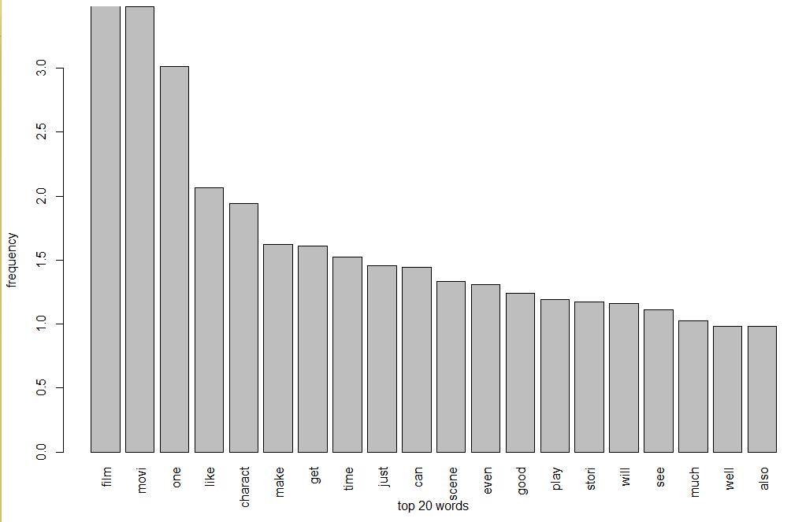

Slide 13
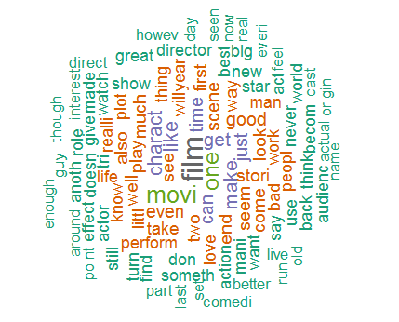

Slide 14
PHASE I IMPLENATION CONT..,
As we can see , the word cloud consists of some words which will not help us in making decision so removing that stream of unnecessary words
unwanted<-c("film","movie")
unwanted<-tm_map(tempp,removeWords,unwanted)
unwanted<-tm_map(unwanted,stemDocument,language="english")
## unwanted words must remove before stemming
moviedtm<-DocumentTermMatrix(unwanted)
mean_movie<-sort(colMeans(as.matrix(rr),na.rm = TRUE),decreasing = T)
#baarplot
barplot(mean_movie[1:20],xlab="top 20 words",ylab="frequency",las=3,ylim=c(0,3))
## wordcloud
wordcloud(names(mean_movie[1:100]), mean_movie[1:100], min.freq = 0,scale=c(2,1) ,max.words=210, random.order=FALSE, rot.per=0.80,colors=brewer.pal(8, "Dark2"))

Slide 15
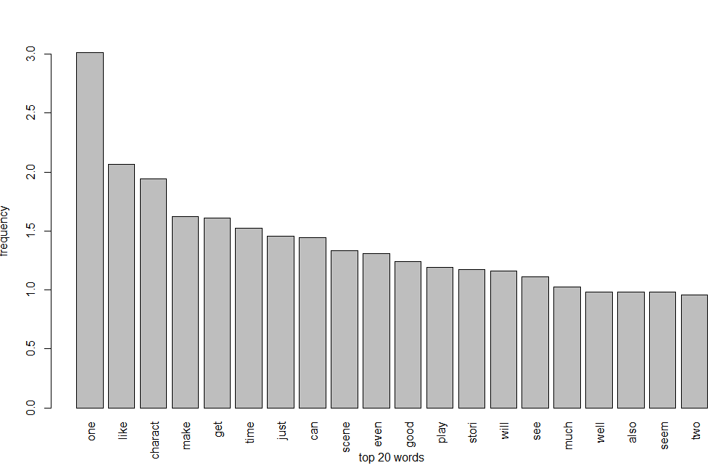

Slide 16
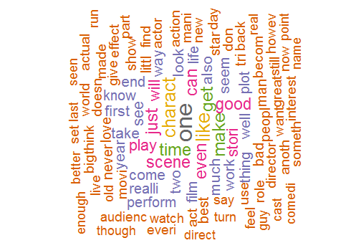

Slide 17
PHASE II
load a list of stemmed positive words
load a list of stemmed negative words
load the data and clean it
cleaning includes removing numbers, stemming, removing punctuation ,removing stop words,and the noisy data which is not helpful in making decisions
create a positive document term matrix by passing postive word list as argument to DTM
create a negative document term matrix by passing negative word list as argument to DTM
convert the negative and positive DTM into matrix form

Slide 18
PHASE II
if review[1] poswords - review[1] negwords >=1 count it as a positive review
if review[1] poswords - review[1] negwords <=1 count it as a negative review
if review[1] poswords - review[1] negwords ==0 count it as a NEUTRAL REVIEW
EXAMPLE
REVIEW :: The movie is the worst movie
Poswords=0 negwords=1
Poswords-negwords=-1 <0 so it is counted as a negative review

Slide 19
PHASE II IMPLENATION
#loading positive words
neg<-read.csv("neg.csv",header = F,stringsAsFactors = T)
negc<-Corpus(VectorSource(neg))
negc<-tm_map(negc,stemDocument,language="english")
negdtm<-DocumentTermMatrix(negc)
negwords<-findFreqTerms(negdtm)
#loading negative words
pos<-read.csv("pos.csv",header = F,stringsAsFactors = T)
posc<-Corpus(VectorSource(pos))
posc<-tm_map(posc,stemDocument,language="english")
posdtm<-DocumentTermMatrix(posc)
poswords<-findFreqTerms(posdtm)

Slide 20
PHASE II IMPLENATION CONT..,
## we are creating a DTM with postivie words
posdtm<-DocumentTermMatrix(doc, control=list(dictionary=poswords))
posreviewrow<-rowSums(as.matrix(posdtm),na.rm = TRUE)
## we are creating a DTM with negative words
negdtm<-DocumentTermMatrix(doc, control=list(dictionary=negwords))
negreviewrow<-rowSums(as.matrix(negdtm),na.rm = TRUE)

Slide 21
PHASE II IMPLENATION CONT..,
hari<-function()
{
negrate<-colMeans( as.matrix(negdtm),na.rm = TRUE)
d<-length(negrate)
negt<-mean(negrate[1:1280])
posrate<-colMeans( as.matrix(posdtm),na.rm = TRUE)
e<-length(posrate)
post<-mean(posrate[1:e])
movierating<-post-negt
x<-length(negreviewrow)
positive<-0, negative<-0,neutral<-0
for( i in 1:x)
{ if( (posreviewrow[i]-negreviewrow[i])==0)
{ neutral<-neutral+1}
if( (posreviewrow[i]-negreviewrow[i])>0)
{positive<-positive+1 }
else
{f( (posreviewrow[i]-negreviewrow[i])<0)
{ negative<-negative+1} }}
cat("\nthe number of positive review ", positive)
cat("\nthe number of negative review",negative)
cat("\nthe number of neutral reviews",neutral)
cat("\nthe movie rating is ", movierating)
}
hari()

Slide 22
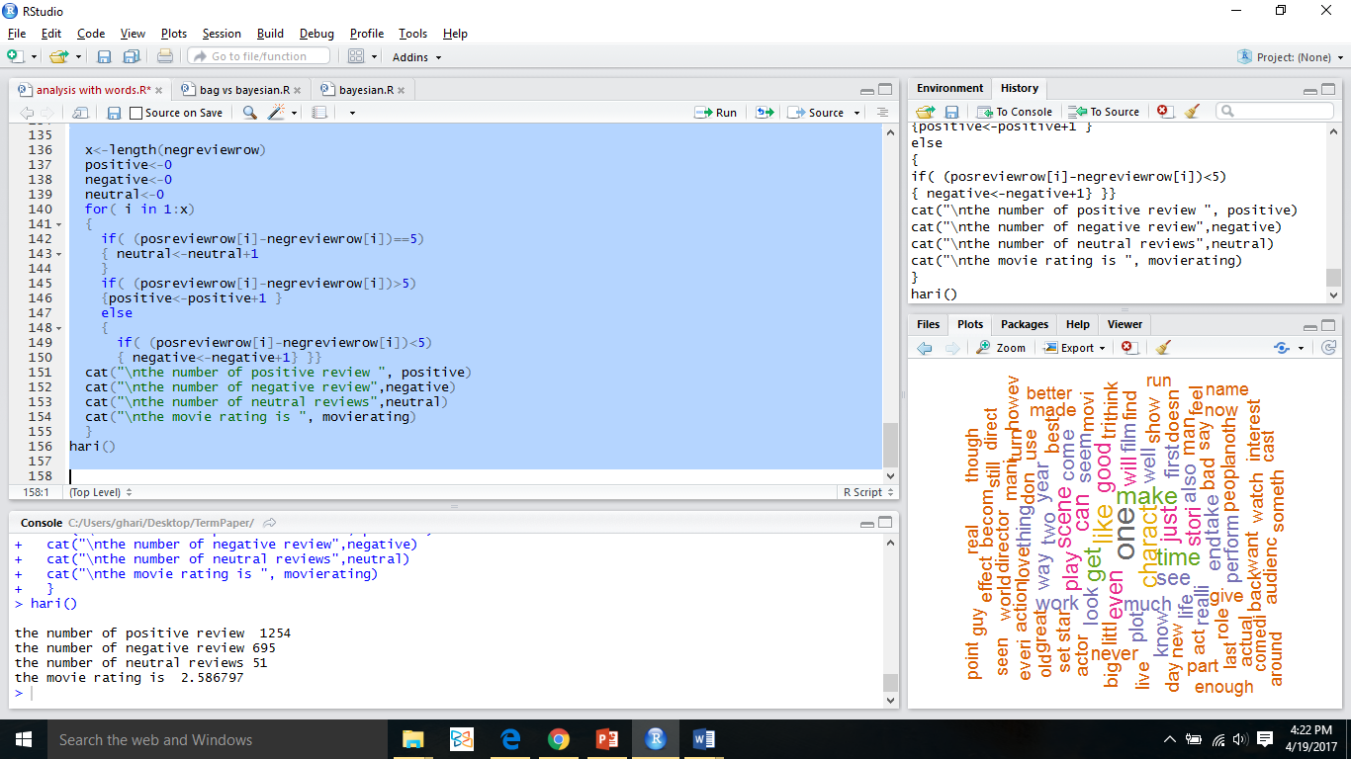
RESULT
Sentimental Analaysis with BAG of words achieved 69.5 percent of accuracy

Slide 23

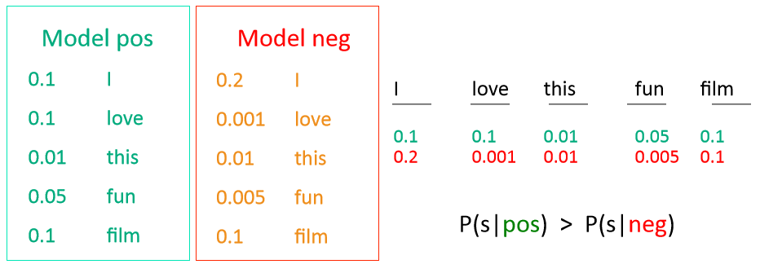
NAÏVE BAYESIAN
Naïve Bayes as a Language Model Illustration

Slide 24
NAÏVE BAYESIAN IMPLEMENTATION
## loading libraries
library(tm)
library(RTextTools)
library(e1071)
library(dplyr)
library(caret)
## reading the file
setwd("C:/Users/ghari/Desktop/TermPaper")
movie<-read.csv("movie.csv",header = T,stringsAsFactors = F)
summary(movie)
## randomizing the data set
set.seed(1)
movie<-movie[sample(nrow(movie)),]
movie<-movie[sample(nrow(movie)),]
movie$label=as.factor(movie$label)
##converting corpus
moviec<-Corpus(VectorSource(movie$review))
moviec
inspect(moviec[1:3])
length(moviec)

Slide 25
NAÏVE BAYESIAN IMPLEMENTATION CONT..
######cleaning the DATA
doc<-tm_map(moviec,removeNumbers)
doc<-tm_map(doc,removeWords,stopwords("english"))
doc<-tm_map(doc,removePunctuation)
doc<-tm_map(doc,stripWhitespace)
doc<-tm_map(doc,stemDocument,language="english")
doc<-tm_map(doc,tolower)
doc<-tm_map(doc,PlainTextDocument )
moviec.clean<-doc
##document term matrix
moviedtm<-DocumentTermMatrix(doc)
dim(moviedtm)
##Partitioning the Data
movie.train <- movie[1:1500,]
movie.test <- movie[1501:2000,]
moviedtm.train <- moviedtm[1:1500,]
moviedtm.test <- moviedtm[1501:2000,]
moviec.clean.train <- moviec.clean[1:1500]
moviec.clean.test <- moviec.clean[1501:2000]

Slide 26
NAÏVE BAYESIAN IMPLEMENTATION CONT..
## filtering the data set
dim(moviedtm.train)
fivefreq <- findFreqTerms(moviedtm.train, 95)
length((fivefreq))
## document term matrices of training and test data
dtm.train.fw <- DocumentTermMatrix(moviec.clean.train, control=list(dictionary = fivefreq))
dim(dtm.train.fw)
dtm.test.fw <- DocumentTermMatrix(moviec.clean.test, control=list(dictionary = fivefreq))
dim(dtm.test.fw)
convert_count <- function(x) {
y <- ifelse(x > 0, 1,0)
y <- factor(y, levels=c(0,1), labels=c("No", "Yes"))
y
}

Slide 27
Naïve bayesian implementation cont..
trainNB <- apply(dtm.train.fw, 2, convert_count)
testNB <- apply(dtm.test.fw, 2, convert_count)
## training naive bayesian classifier
system.time( classifier <- naiveBayes(trainNB, movie.train$label) )
##Prediction
system.time( pred <- predict(classifier, newdata=testNB) )
table("Predictions"= pred, "Actual" = movie.test$label )
confmatrix <- confusionMatrix(pred, movie.test$label)
confmatrix

Slide 28
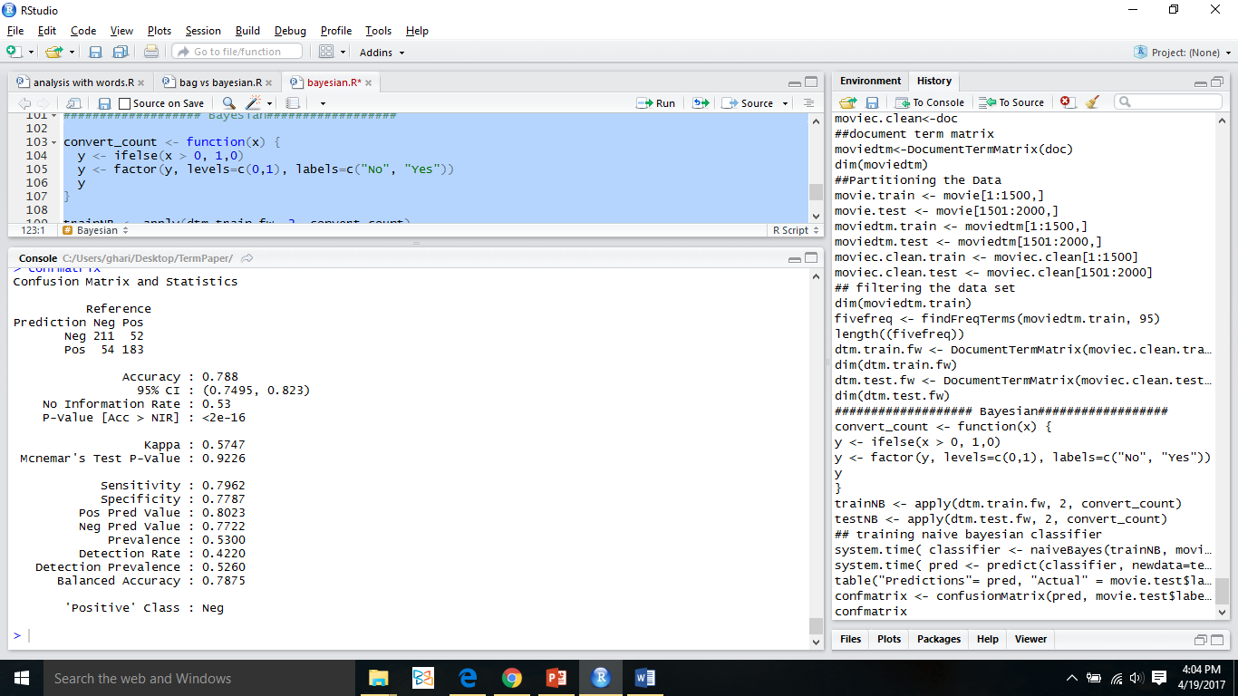
RESULT
Naïve Bayesian classifier achieved 78.8 percent accuracy

Slide 29
COMPARISON
Factor | Analysis with Bag of Words | Naïve bayesian
Accuracy | 69.5 | 78.8
Cost | 32.5 | 36
Training Data | No | YES
Reliability | No | YES
Implementation Difficulty | Easy | Hard

Slide 30
RESULT ANALYSIS
The data set which I was used contains 2000 tuples totally
It contains 1000 pos reviews and 1000 neg reviews
The bag of Words techniques achieves 69.5 accuracy
The Naïve Bayesian achieved 78.8 percent accuracy
Clearly naïve Bayesian is more reliable than ‘bag of words’

Slide 31
CONCLUSION
Naïve Bayesian achieved more accuracy than ‘bag of Words’,So it is recommended to prefer Naïve over bag of Words.
But if you don’t have training data to train the algorithm then go to Bag of Words approach.

Slide 32
THANK YOU

