Slide 1
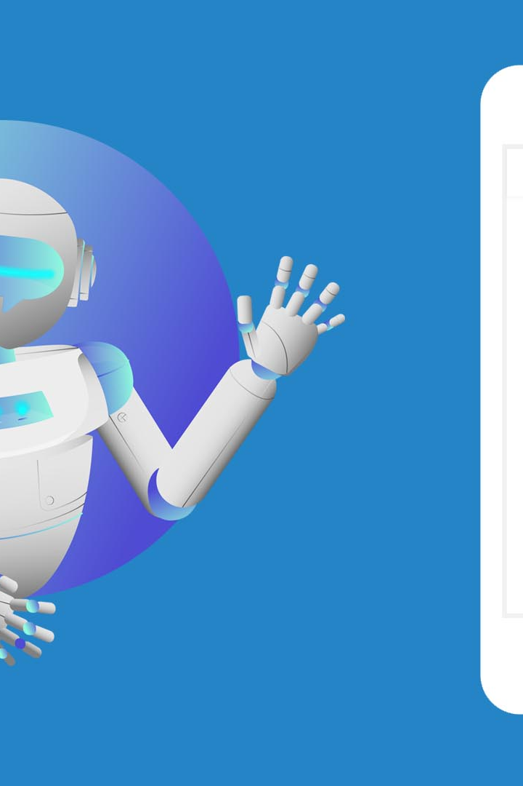
Overview of Chatbot using Python
A chatbot is an AI-powered software designed to interact with users in natural language. Learn how to build, test, and deploy chatbots using Python.
BJ

Slide 2

What is a Chatbot?
1
Definition
2
Purpose
A chatbot is a software program that uses artificial intelligence to simulate human conversation.
Chatbots are used to provide automated customer support, answer frequently asked questions, and perform tasks.

Slide 3

Components of a Chatbot
Natural Language Processing (NLP)
Machine Learning (ML)
Backend Architecture
The system that handles the processing and storage of data and manages the chatbot's functionalities.
Allows the chatbot to understand and generate human-like responses.
Enables the chatbot to learn and improve over time by analyzing data and user interactions.

Slide 4

Building a Chatbot using Python
1
Required Packages and Libraries
Use Python libraries like NLTK, SpaCy, and TensorFlow for natural language processing and machine learning.
Designing the Conversation Flow
2
Create dialogue scenarios and design the flow of interactions between the chatbot and users.
3
Implementing NLP and ML
Train NLP models and implement ML algorithms to enable the chatbot to understand and respond to user queries.

Slide 5
Testing and Training the Chatbot
1
Creating Test Cases
Develop test cases to evaluate the chatbot's performance, accuracy, and response quality.
2
Collecting Training Data
Gather relevant datasets and use them to train the chatbot to improve its understanding and responses.
3
Evaluating the Performance
Analyze the chatbot's performance metrics and make necessary adjustments for better user experience.

Slide 6
Deploying and Integrating the Chatbot
Hosting Options
Integration with Existing Systems
Choose between cloud platforms, dedicated servers, or on-premises hosting to deploy the chatbot.
Integrate the chatbot with CRM systems, databases, and other applications to enhance its capabilities.

