Slide 1
TELANGANA MOVEMENT
Presented By:-
AREPALLY SATISH
Department of history

Slide 2
INTRODUCTION
Telangana is a region of Andhra Pradesh state in India.
It has area of 1,14,840 km.
It's population is 3,06,96,520[2001 sensus].
The name means "land of Telugu people". It consits of the Telugu speaking parts of the erstwhile princely state of Hyderabad.

Slide 3
The region lies on the Deccan plateau to the west of the Eastern Ghats range, and includes the northwestern interior districts of Warangal, Adilabad, Khammam, Mahabubnagar, Nalgonda, Rangareddy, Karimnagar, Nizamabad, Medak, and the state capital of Andhra Pradesh of which telangana is a region is Hyderabad
The Krishna and Godavari rivers flow through the region from west to east.

Slide 4
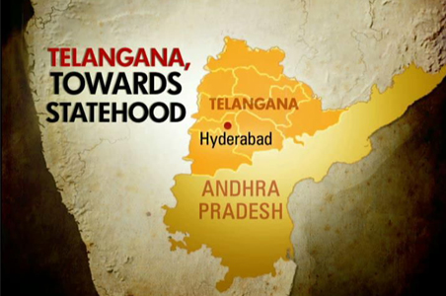
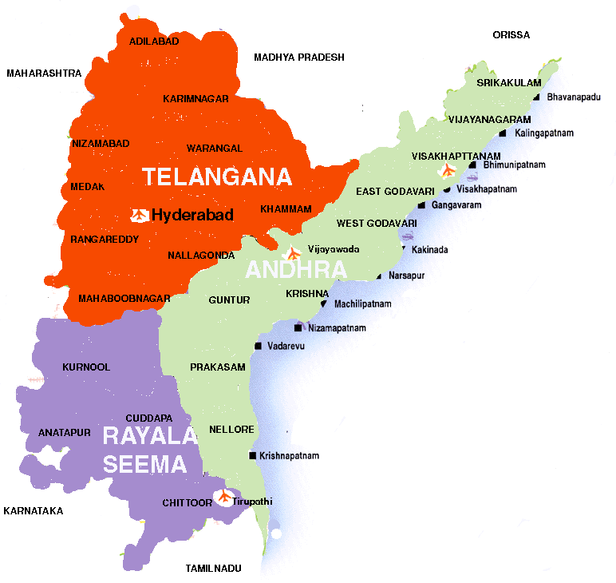
Map of Telangana

Slide 5
HISTORY
The Telangana region is believed to have been mentioned in the Mahabharata as the Telinga Kingdom.
When India became independent from the British Empire, the Nizam of Hyderabad wanted to retain his independence, but the Government of India amalgamated his state by force on September 17, 1948; after executing Operation Polo by the Indian Army.

Slide 6
Cont…
When India became independent, the Telugu-speaking people were distributed in about 22 districts; 9 of them in the Telangana region of Nizam's Dominions (Hyderabad State), 12 in the Madras Presidency (Andhra region) and one in French-controlled Yanam.
Telangana had tasted democracy for the first time when it participated in general elections and elected Dr.Burgula Ramakrishna Rao as the Chief minister of Hyderabad State

Slide 7
Merger of Telangana and Andhra
Between 1948 and 1956 Telangana was a separate state.
In December 1953, the States Reorganization Commission was appointed to prepare for the creation of states on linguistic lines.
The States Reorganization Commission (SRC) was not in favour of an immediate merger of Telangana region with Andhra state, despite the common language between the two.

Slide 8
Cont…
Prime minister Jawaharlal Nehru initially ridiculed the idea of merging Telangana with the Andhra State.
Telangana was merged with Andhra to form the new state of Andhra Pradesh on November 1,1956.

Slide 9
Separate Telangana state movement
When Jawaharlal Nehru announced the formation of a united Andhra Pradesh, he commented, "an innocent girl called Telangana is being married to a naughty boy called Andhra. It is their choice to continue or to get separated.“
Today the people of Telangana say that the innocent girl can no longer stay married to the naughty boy. Several proponents of the movement say that it is high time their 'state' is given back to them

Slide 10
1969 Movement
In the following years after the formation of Andhra Pradesh state, however, Telangana people had a number of complaints about how the agreements and guarantees were implemented.
Discontent with the 1956 Gentleman's agreement intensified in January 1969 when the guarantees that had been agreed on were supposed to lapse.

Slide 11
During the movement Government promised to correct the violation to Gentleman's agreement in jobs, budget allocations, educational facilities.

Slide 12
Movement in 1990-2004
The emotions and forces generated by the movement, in 1969, were not strong enough, however, for a continuing drive for a separate state until 1990s when Bharatiya Janata Party (BJP), promised a separate Telangana state if they came to power.
But the BJP could not create a separate Telangana state because of the opposition from its coalition partner, Telugu Desam Party

Slide 13
WHY SEPRATE TELANGANA STATE ?
Telangana is the largest single region of the three regions of Andhra Pradesh state,(Coastal Andhra, Rayalaseema regions (Andhra region) & Telangana).
Telangana covering 41.47% of its total area, is inhabited by 40.54% of the state’s population.

Slide 14
NAME OF STATE
The very first promise that was broken was regarding the name of the state.
The Union government had promised us that the state would be known as the Andhra Telangana state.
However overnight, the leaders from the Andhra and Rayalseema regions managed to convince the government to change the name to Andhra Pradesh

Slide 15
REVENUS
Telangana contributes about 76% to the state’s revenues.
From Central govt: 19.86% revenus
From Telangana: 61.47%(including 37.17% from capital).
From Andhra: 14.71%
From Rayalaseema: 3.90%%

Slide 16
Irrigation
Within the state of Andhra Pradesh,68.5% of catchment area of river Krishna and 69% of catchment area of river Godavari are in the Telangana region.
Telangana region barely gets 25 per cent of the river waters.
Since the formation of Andhra Pradesh in 1956, successive governments have spent Rs 190 billion on irrigation in coastal Andhra. In the same period, less than Rs 35 billion has been spent on Telangana.

Slide 17
Education
Educationally, Telangana lags behind the rest of Andhra Pradesh.
While the literacy rates in coastal Andhra and Rayalaseema are 46 and 45 per cent, respectively, it is only 37 per cent in Telangana.
Telangana has only one university. Coastal Andhra has three, and Rayalaseema, seven. Of the 91 polytechnics in the state, only 20 are in Telangana. Of the 72 government technical institutes, just 26 are in this region.

Slide 18
Budget Allocations
Expenditure incurred on this region has never been more than 25% to 30% of total expenditure of Andhra Pradesh. Most years, funds allocated to Telangana were never fully spent.

Slide 19
Jobs
Only 20% of total Government employees, less than 10% employees in secretariate, less than 5% of head of the departments in Andhra Pradesh are from Telangana.
In 1985, Chief Minister N T Rama Rao pledged 60,000 jobs for youth in the region. "But nothing happened.

Slide 20
Demography
9 out of 10 districts in the Telangana region of Andhra Pradesh are recognized by the Government of India as backward.
According to the Backword Regions Grant Fund 2009-10, 13 districts are located in Andhra Pradesh, 9 are from Telangana and the rest are from other region.

Slide 21
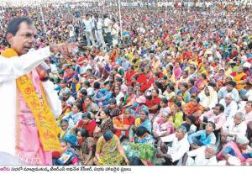
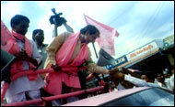
Telangana’ State: Dream come true?
The Telangana movement got the man and momentum under the leadership of K. Chandrashekar Rao (KCR).
The response Mr. Rao has obtained is indeed unique; and his credibility owes to his renouncing positions of power on many occasions.

Slide 22
Cont…
Telegu Desam Party and the Praja Rajyam Party had said that they would support the bill if it is introduced.

Slide 23
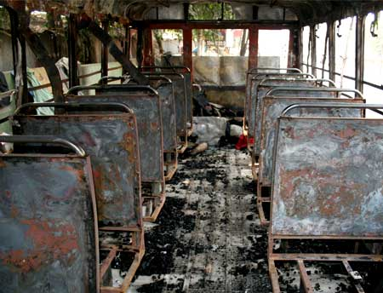
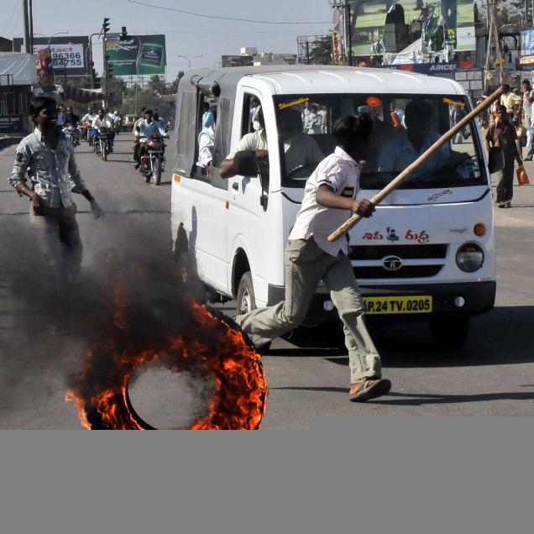
Terrible violence due to Telangana Movement
As Andhra Pradesh boils over the Telangana issue, public and private properties worth over Rs. 250 crore were destroyed by protesters in all the three regions of the state so.

Slide 24
Cont…
In the Telangana region, the Andhra Pradesh Road Transport Corporation faced a loss of Rs 7 crore due to the protests.
Whereas in Andhra and Rayalseema the losses were to the tune of Rs 70 crore and this was largely because buses were being burnt.
The Bharat Sanchar Nigam Limited too had said that at the Shrikrishna Devaraya University at Rayalseema, students had burnt its optic fibres which resulted in a loss of Rs 2 crore.

Slide 25
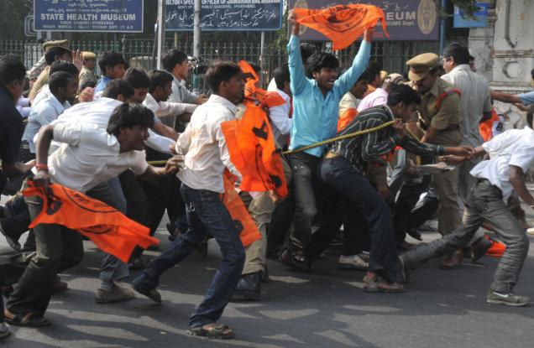
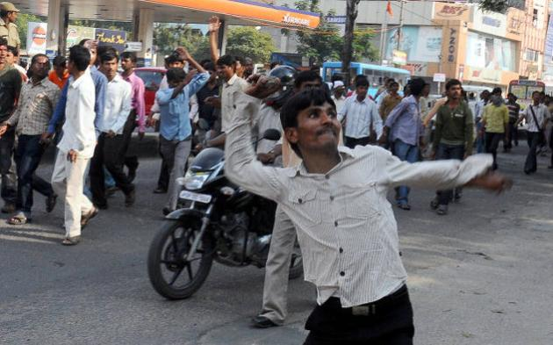
Cont…
There was also an incident in which supporters of J C Divakar Reddy in Rayalseema had bombed a railway station, causing a loss of Rs 10 crore.

Slide 26
Proposed Telangana State Formation Process
On December 9, 2009, at 11:30 PM, Mr. P. Chidambaram, Union Minister of Home Affairs announced that the Indian government will start the process of forming a separate Telangana state.
On December 23, the Government of India announced that no action on Telangana will be taken until a consensus is reached by all parties.

Slide 27
Conclusion
"Telangana is the best example of discrimination in the country," he continues, "because despite having elected two chief ministers and one prime minister, the region has been given a raw deal in education, irrigation, budget allocation and job opportunities."

Slide 28
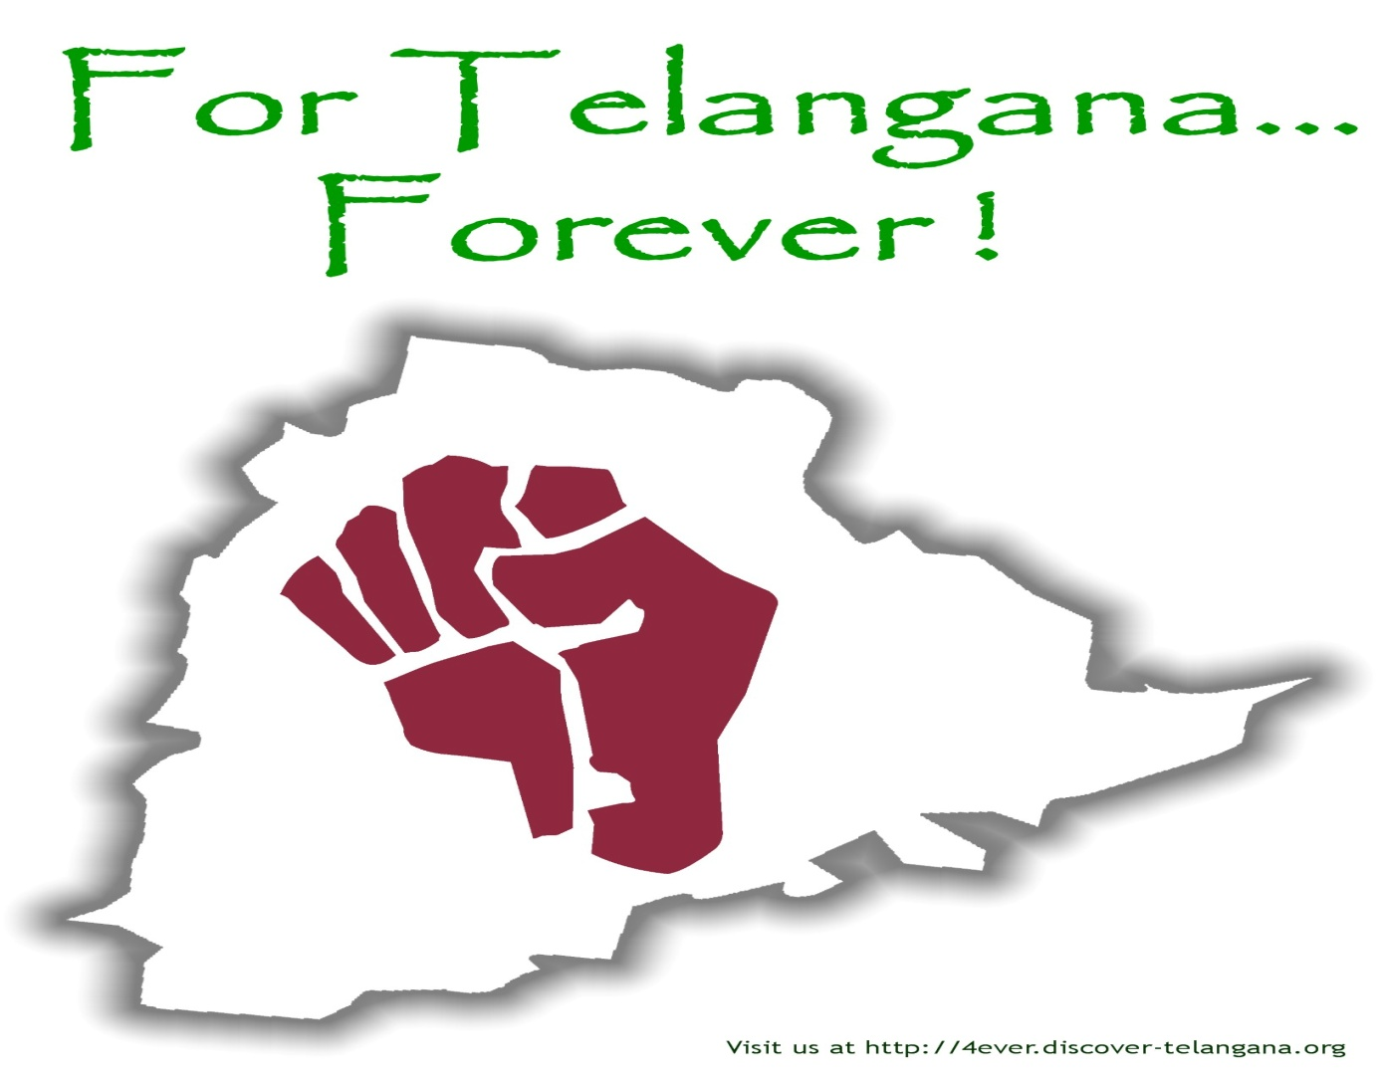
Telangana People Say’s

