Slide 1
Analyzing US Residential Mortgage Closing Disclosure Data: Identifying Error Trends and Financial Impact"
Sample Data dummy
Person | Origination Fee | Underwriting Fee | Appraisal Fee | Credit Report Fee | Total Fees | Corrected Fees | Percentage Change | Errors | Risk Score | Difference | Correction Type
Person 1 | 1453.55 | 976.84 | 1010.68 | 202.61 | 3643.68 | 7075.76 | 94.23% | 7 | 0.70 | 3432.08 | Excessive
Person 2 | 1979.39 | 948.47 | 811.88 | 1275.62 | 5015.35 | 2784.96 | -44.49% | 4 | 0.59 | -2230.39 | Excessive
Person 3 | 1676.70 | 1340.70 | 611.88 | 223.42 | 3852.70 | 5936.69 | 54.06% | 2 | 0.04 | 2083.99 | Excessive
Person 4 | 1947.15 | 1110.67 | 574.16 | 192.49 | 3824.47 | 4682.55 | 22.44% | 1 | 0.63 | 858.08 | Excessive
Person 5 | 1683.37 | 1252.96 | 935.30 | 227.64 | 4099.27 | 7458.18 | 81.97% | 5 | 0.84 | 3358.91 | Excessive
Person 6 | 1132.09 | 759.21 | 666.58 | 394.19 | 2952.07 | 3961.87 | 34.25% | 8 | 0.45 | 1009.80 | Excessive
Person 7 | 2836.67 | 1421.97 | 582.11 | 198.47 | 5039.22 | 4532.98 | -10.05% | 0 | 0.06 | -506.24 | Excessive
Person 8 | 2881.70 | 903.89 | 537.53 | 529.68 | 4852.80 | 4716.00 | -2.82% | 3 | 0.36 | -136.80 | Minor
Person 9 | 1146.04 | 788.75 | 1042.04 | 207.51 | 3184.34 | 5351.58 | 68.03% | 6 | 0.20 | 2167.24 | Excessive

Slide 2
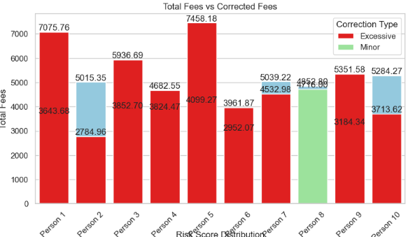

Slide 3
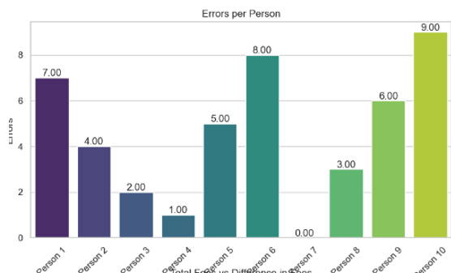

Slide 4
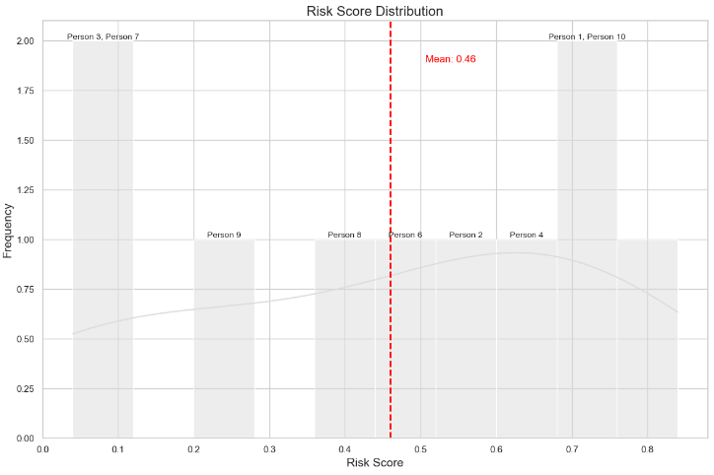
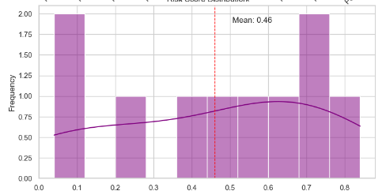
Each individual is assigned a risk score ranging from 0 to 1.
A risk score closer to 1 indicates a higher risk, while a score closer to 0 indicates a lower risk. Red Dashed Line: The red dashed line represents the mean risk score of the group. This line helps you understand the average risk level and compare individual scores against it.
Identify Outliers: The risk score distribution helps identify individuals with exceptionally high or low risk scores, which can be outliers

Slide 5
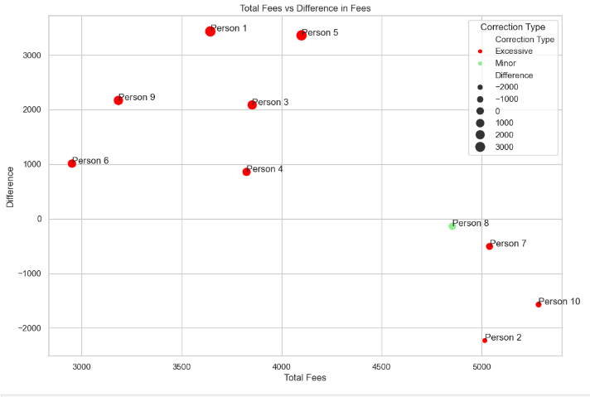

Slide 6
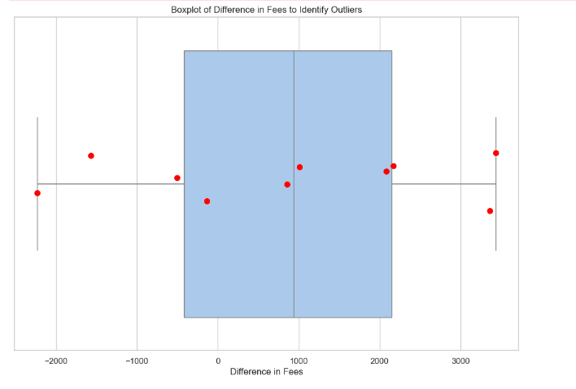
· Person 1 with a difference of 3432.08 · Person 2 with a difference of -2230.39 · Person 3 with a difference of 2083.99 · Person 5 with a difference of 3358.91 · Person 9 with a difference of 2167.24 · Person 10 with a difference of -1570.65

