Slide 1
MONEY MATTERS: A PERSONAL FINANCE MANAGEMENT APP
SUBHASHINI S
HARISHANKAR G R
ANTRIC K NAYAKAM
DHARINEESH J

Slide 2
DESCRIPTION
Money Matters is a user-friendly application designed to help individuals manage their finances effectively. With features like expense tracking, setting spending limits, and viewing expense records, the app empowers users to maintain financial discipline and achieve their savings goal.
Expense tracking: The Expense Tracking feature enables users to log their daily expenditures by entering details such as the amount, date, and optional notes for clarity. Users can view their expenses in a structured format with daily and monthly summaries, making it easier to monitor spending patterns over time. While the app focuses on simplicity, it ensures accurate and up-to-date records without offering categorization or modification options, keeping the process straightforward and user-friendly.
Set limit: The Set Limit feature allows users to define a monthly spending cap to manage their finances effectively. Users receive notifications when their expenses approach or exceed the limit, helping them stay aware of their spending habits. This feature promotes financial discipline by providing a clear boundary for monthly expenditures.
View records: he View Records feature provides users with a clear overview of their past expenses. It displays recorded transactions in an organized format, offering both daily and monthly summaries. This helps users track their spending patterns and review financial activity for better planning and decision-making.

Slide 3
Main Activity.kt:
package com.example.expensestracker
import android.annotation.SuppressLint
import android.content.Intent
import android.os.Bundle
import androidx.activity.ComponentActivity
import androidx.activity.compose.setContent
import androidx.compose.foundation.Image
import androidx.compose.foundation.layout.*
import androidx.compose.material.*
import androidx.compose.runtime.*
import androidx.compose.ui.Alignment
import androidx.compose.ui.Modifier
import androidx.compose.ui.graphics.Color
import androidx.compose.ui.res.painterResource
import androidx.compose.ui.text.font.FontWeight
import androidx.compose.ui.text.style.TextAlign
import androidx.compose.ui.tooling.preview.Preview
import androidx.compose.ui.unit.dp
import androidx.compose.ui.unit.sp
import com.example.expensestracker.ui.theme.ExpensesTrackerTheme

Slide 4
class MainActivity : ComponentActivity() {
@SuppressLint("UnusedMaterialScaffoldPaddingParameter")
override fun onCreate(savedInstanceState: Bundle?) {
super.onCreate(savedInstanceState)
setContent {
Scaffold(
// in scaffold we are specifying top bar.
bottomBar = {
// inside top bar we are specifying
// background color.
BottomAppBar(backgroundColor = Color(0xFFadbef4),
modifier = Modifier.height(80.dp),
// along with that we are specifying
// title for our top bar.
content = {
Spacer(modifier = Modifier.width(15.dp))
Button(
onClick = {startActivity(Intent(applicationContext,AddExpensesActivity::class.java))},
colors = ButtonDefaults.buttonColors(backgroundColor = Color.White),

Slide 5
modifier = Modifier.size(height = 55.dp, width = 110.dp)
)
{
Text(
text = "Add Expenses", color = Color.Black, fontSize = 14.sp,
textAlign = TextAlign.Center
)
}
Spacer(modifier = Modifier.width(15.dp))
Button(
onClick = {
startActivity(
Intent(
applicationContext,
SetLimitActivity::class.java
)
)
},
colors = ButtonDefaults.buttonColors(backgroundColor = Color.White),

Slide 6
modifier = Modifier.size(height = 55.dp, width = 110.dp)
)
{
Text(
text = "Set Limit", color = Color.Black, fontSize = 14.sp,
textAlign = TextAlign.Center
)
}
Spacer(modifier = Modifier.width(15.dp))
Button(
onClick = {
startActivity(
Intent(
applicationContext,
ViewRecordsActivity::class.java
)
)
},
colors = ButtonDefaults.buttonColors(backgroundColor = Color.White),
modifier = Modifier.size(height = 55.dp, width = 110.dp)

Slide 7
)
{
Text(
text = "View Records", color = Color.Black, fontSize = 14.sp,
textAlign = TextAlign.Center
)
}
}
)
}
) {
MainPage()
}
}
}
}
@Composable
fun MainPage() {
Column(
modifier = Modifier.padding(20.dp).fillMaxSize(),
verticalArrangement = Arrangement.Center,
horizontalAlignment = Alignment.CenterHorizontally

Slide 8
) {
Text(text = "Welcome To Expense Tracker", fontSize = 42.sp, fontWeight = FontWeight.Bold,
textAlign = TextAlign.Center)
Image(painterResource(id = R.drawable.img_1), contentDescription ="", modifier = Modifier.size(height = 500.dp, width = 500.dp))
}
}
RegisterActivity.kt:
package com.example.expensestracker
import android.content.Context
import android.content.Intent
import android.os.Bundle
import androidx.activity.ComponentActivity
import androidx.activity.compose.setContent
import androidx.compose.foundation.Image
import androidx.compose.foundation.layout.*
import androidx.compose.material.*

Slide 9
import androidx.compose.runtime.*
import androidx.compose.ui.Alignment
import androidx.compose.ui.Modifier
import androidx.compose.ui.graphics.Color
import androidx.compose.ui.layout.ContentScale
import androidx.compose.ui.res.painterResource
import androidx.compose.ui.text.font.FontFamily
import androidx.compose.ui.text.font.FontWeight
import androidx.compose.ui.text.input.PasswordVisualTransformation
import androidx.compose.ui.tooling.preview.Preview
import androidx.compose.ui.unit.dp
import androidx.compose.ui.unit.sp
import androidx.core.content.ContextCompat
import com.example.expensestracker.ui.theme.ExpensesTrackerTheme
class RegisterActivity : ComponentActivity() {
private lateinit var databaseHelper: UserDatabaseHelper
override fun onCreate(savedInstanceState: Bundle?) {
super.onCreate(savedInstanceState)
databaseHelper = UserDatabaseHelper(this)
setContent {
ExpensesTrackerTheme {
// A surface container using the 'background' color from the theme
Surface(

Slide 10
modifier = Modifier.fillMaxSize(),
color = MaterialTheme.colors.background
) {
RegistrationScreen(this,databaseHelper)
}
}
}
}
}
@Composable
fun RegistrationScreen(context: Context, databaseHelper: UserDatabaseHelper) {
Image(
painterResource(id = R.drawable.img_1), contentDescription = "",
alpha =0.3F,
contentScale = ContentScale.FillHeight,
)
var username by remember { mutableStateOf("") }
var password by remember { mutableStateOf("") }
var email by remember { mutableStateOf("") }
var error by remember { mutableStateOf("") }

Slide 11
Column(
modifier = Modifier.fillMaxSize(),
horizontalAlignment = Alignment.CenterHorizontally,
verticalArrangement = Arrangement.Center
) {
Text(
fontSize = 36.sp,
fontWeight = FontWeight.ExtraBold,
fontFamily = FontFamily.Cursive,
color = Color.White,
text = "Register"
)
Spacer(modifier = Modifier.height(10.dp))
TextField(
value = username,
onValueChange = { username = it },
label = { Text("Username") },
modifier = Modifier
.padding(10.dp)
.width(280.dp)
)

Slide 12
TextField(
value = email,
onValueChange = { email = it },
label = { Text("Email") },
modifier = Modifier
.padding(10.dp)
.width(280.dp)
)
TextField(
value = password,
onValueChange = { password = it },
label = { Text("Password") },
modifier = Modifier
.padding(10.dp)
.width(280.dp),
visualTransformation = PasswordVisualTransformation()
)
if (error.isNotEmpty()) {
Text(
text = error,
color = MaterialTheme.colors.error,

Slide 13
modifier = Modifier.padding(vertical = 16.dp)
)
}
Button(
onClick = {
if (username.isNotEmpty() && password.isNotEmpty() && email.isNotEmpty()) {
val user = User(
id = null,
firstName = username,
lastName = null,
email = email,
password = password
)
databaseHelper.insertUser(user)
error = "User registered successfully"
// Start LoginActivity using the current context
context.startActivity(
Intent(
context,
LoginActivity::class.java
)
)

Slide 14
} else {
error = "Please fill all fields"
}
},
modifier = Modifier.padding(top = 16.dp)
) {
Text(text = "Register") }
Spacer(modifier = Modifier.width(10.dp))
Spacer(modifier = Modifier.height(10.dp))
Row() {
Text(
modifier = Modifier.padding(top = 14.dp), text = "Have an account?")
TextButton(onClick = {
context.startActivity(
Intent(
context,
LoginActivity::class.java))}) {
Spacer(modifier = Modifier.width(10.dp))
Text(text = "Log in")}}}}
private fun startLoginActivity(context: Context) {
val intent = Intent(context, LoginActivity::class.java)
ContextCompat.startActivity(context, intent, null)
}

Slide 15
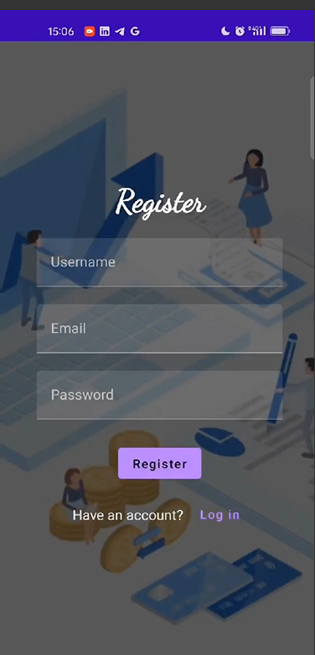
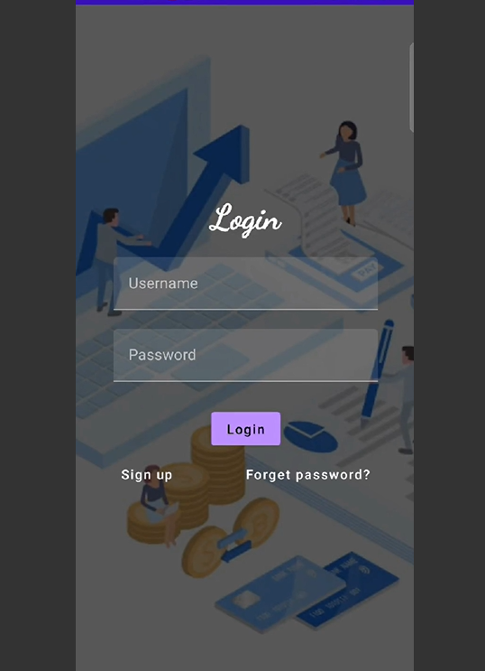
OUTPUT:

Slide 16
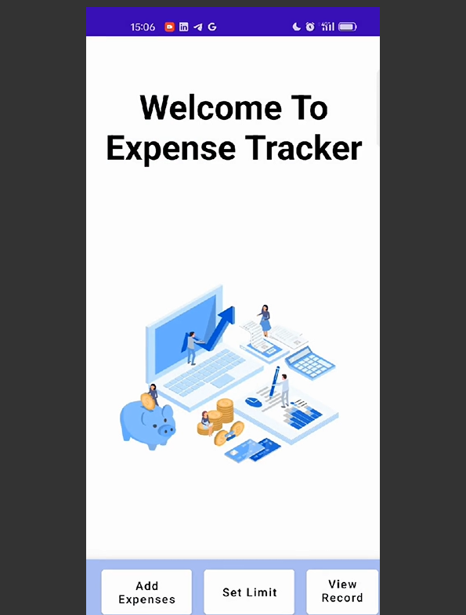
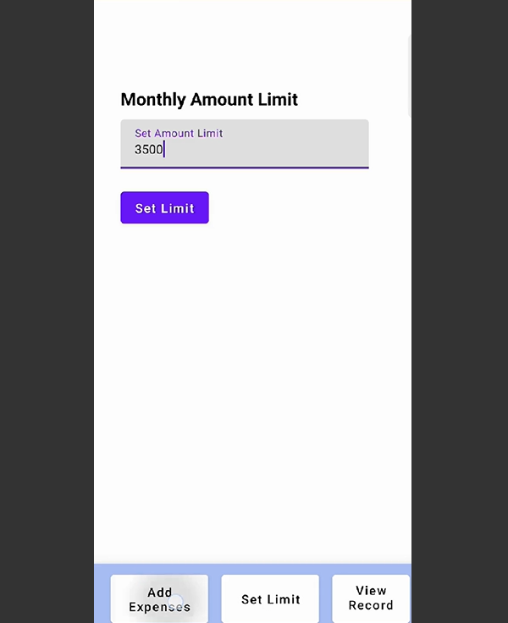

Slide 17
