Slide 1
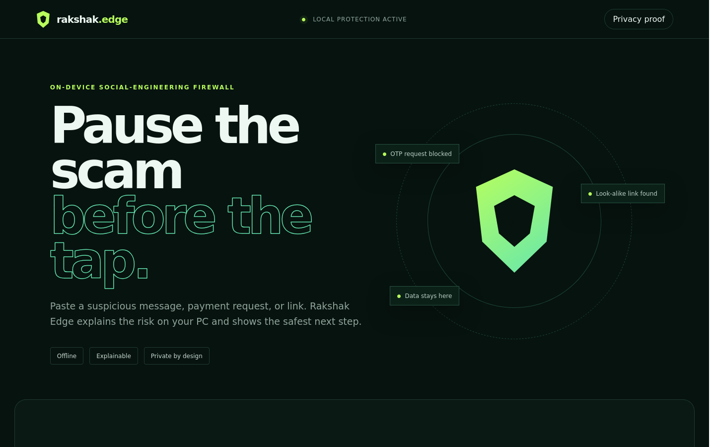
ON-DEVICE SOCIAL-ENGINEERING FIREWALL
Rakshak
Edge
A private safety check before the user clicks, pays, or shares a secret
SNAPDRAGON X SERIES
Hariharan C | 2026
Notes:
Product screenshot: Rakshak Edge local demo. Built for the Snapdragon AI Lab Build & Present Challenge.

Slide 2
RAKSHAK EDGE
01 / PROBLEM
The critical moment happens before the tap
A suspicious message exploits urgency and trust. Sending it to a cloud checker can expose the same private content the user is trying to protect.
01
02
03
Private content
Fast manipulation
Opaque verdicts
OTP messages, account alerts, payment handles, and personal context.
Threats and rewards push the user to act before checking another channel.
A score alone cannot teach the user what triggered the warning or what to do next.
Design question
Can a PC explain the risk locally, in the moment that matters?

Slide 3
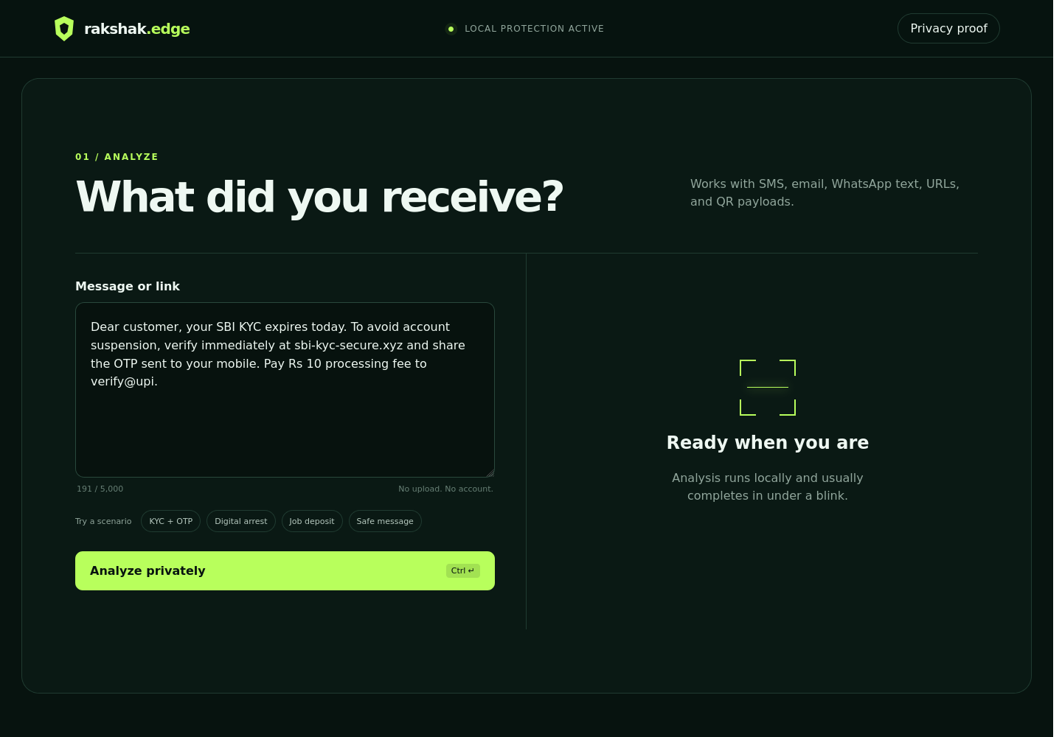
RAKSHAK EDGE
02 / PRODUCT
One local workflow from suspicion to safe action
Paste
Message, URL, UPI request, or QR payload
Understand
Risk score with visible evidence and extracted entities
Act safely
Independent verification path without another risky link
Notes:
Product screenshot from the running local app. The default build sends no content outside 127.0.0.1.

Slide 4
RAKSHAK EDGE
03 / CORE INNOVATION
Scams unfold across a conversation
Rakshak connects the stages that single-message classifiers lose.
01
IDENTITY SETUP
42
Hi, this is Arun from finance. Save my new number.
81
/100
02
ISOLATION
55
I am boarding a flight. Do not call. Keep this confidential.
COORDINATED SCAM
Identity setup
Isolation and pressure
Money or access request
03
EXTRACTION
72
Purchase five vouchers and send the codes before 4 PM.
The raw conversation is processed in memory and never appears in the exported report.
Notes:
Working conversation analyzer. Input contains three messages. Output: 81/100, three attack-chain stages, zero network calls, and no raw message persistence.

Slide 5
RAKSHAK EDGE
04 / TECHNICAL IMPLEMENTATION
Hybrid reasoning keeps security explainable
Transparent signals stay authoritative. A compact classifier adds context today; the production profile moves the encoder to the Hexagon NPU.
01
02
03
04
Input boundary
Evidence engines
Snapdragon profile
Decision layer
>
>
>
Loopback API
No persistence
URL + entity rules
Local semantic model
INT8 encoder
ONNX Runtime + QNN
Calibrated score
Reasons + safe action
Graceful fallback
QNN unavailable? ONNX Runtime uses CPU. Model absent? The deterministic engine still delivers a complete, testable product.
Notes:
Technical references: ONNX Runtime QNN Execution Provider, https://onnxruntime.ai/docs/execution-providers/QNN-ExecutionProvider.html; Qualcomm AI Hub, https://aihub.qualcomm.com/

Slide 6
RAKSHAK EDGE
05 / LIVE EVIDENCE
AI catches the scam
without a malicious link
72
Semantic scam pattern
99.8% high-risk confidence
AI
/100
Voucher purchase
Financial coercion
RULE
HIGH RISK
Stop and verify independently
No URL
Nothing for a link scanner
0
No OTP or UPI
Meaning comes from context
0
SAFEST NEXT STEP
Call the finance head using the number already in your contacts.
Notes:
Input: Finance head here. I cannot take calls. Purchase five vouchers and send the numbers before the client meeting. Output from the checked-in hybrid analyzer: high risk, 72/100; local semantic model high-risk confidence 99.77%. The score is a risk indicator, not proof of fraud.

Slide 7
RAKSHAK EDGE
06 / MEASURED EVIDENCE
A locked suite tests the complete product
97.78%
15 / 15
15 / 15
10 / 10
45-case system suite
high-risk cases
medium-risk cases
regression tests
ONE DISCLOSED ERROR
39
A safety reminder about OTP and PIN is conservatively rated medium instead of low.
The system suite is balanced, never used for training, and prints every error. The model-only holdout remains 94.44%.
Notes:
Reproduce with python benchmarks/evaluate_system.py. 44 of 45 balanced non-training cases correct. All 15 high-risk and 15 medium-risk cases correct. The evaluator prints the single false positive.

Slide 8
RAKSHAK EDGE
07 / SNAPDRAGON ADVANTAGE
Local protection is the product advantage
0
< 1 ms
INT8
45 TOPS
cloud calls by default
median reference CPU
production model target
Snapdragon X Elite NPU
Same private API, stronger production encoder
The reference model makes the complete demo reproducible today. On Snapdragon X Series, the production profile swaps in an INT8 encoder through ONNX Runtime QNN while keeping the evidence layer, conversation logic, and offline boundary unchanged.
Notes:
Qualcomm states Snapdragon X Elite includes a Hexagon NPU with up to 45 TOPS. Source: Snapdragon X Elite product brief, https://docs.qualcomm.com/bundle/publicresource/87-71417-1_REV_D_Snapdragon_X_Elite_Product_Brief.pdf. QNN source: https://onnxruntime.ai/docs/execution-providers/QNN-ExecutionProvider.html

Slide 9
RAKSHAK EDGE
08 / DEPLOYMENT & RESPONSIBILITY
A safety product needs honest failure behavior
01
Runs today
One command, standard library server, offline message and thread APIs
02
Private
No raw history; exported reports exclude the source conversation
03
Accessible
Keyboard flow, high contrast, reduced motion, plain-language actions
04
Deployable
QNN adapter, INT8 model contract, CPU fallback, acceptance checks
05
Bounded
Risk indicator, not a fraud verdict; one false positive disclosed
python app.py → localhost:8765

Slide 10
RAKSHAK EDGE
A safer pause
before the tap
Conversation-aware protection that stays on the PC
LIVE DEMO
python app.py
Working demo, locked evaluation, privacy threat model, Snapdragon profile
Hariharan C

