Slide 1
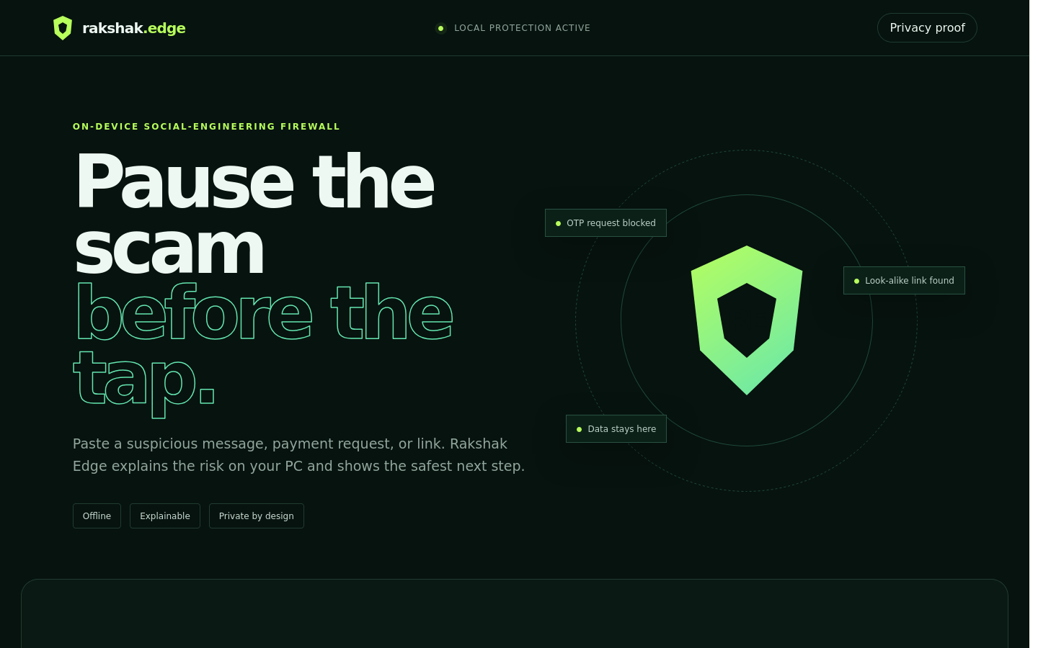
ON-DEVICE SOCIAL-ENGINEERING FIREWALL
Rakshak
Edge
A private safety check before the user clicks, pays, or shares a secret
SNAPDRAGON X SERIES
Hariharan C | 2026
Notes:
Product screenshot: Rakshak Edge local demo. Built for the Snapdragon AI Lab Build & Present Challenge.

Slide 2
RAKSHAK EDGE
01 / PROBLEM
The critical moment happens before the tap
A suspicious message exploits urgency and trust. Sending it to a cloud checker can expose the same private content the user is trying to protect.
01
02
03
Private content
Fast manipulation
Opaque verdicts
OTP messages, account alerts, payment handles, and personal context.
Threats and rewards push the user to act before checking another channel.
A score alone cannot teach the user what triggered the warning or what to do next.
Design question
Can a PC explain the risk locally, in the moment that matters?

Slide 3
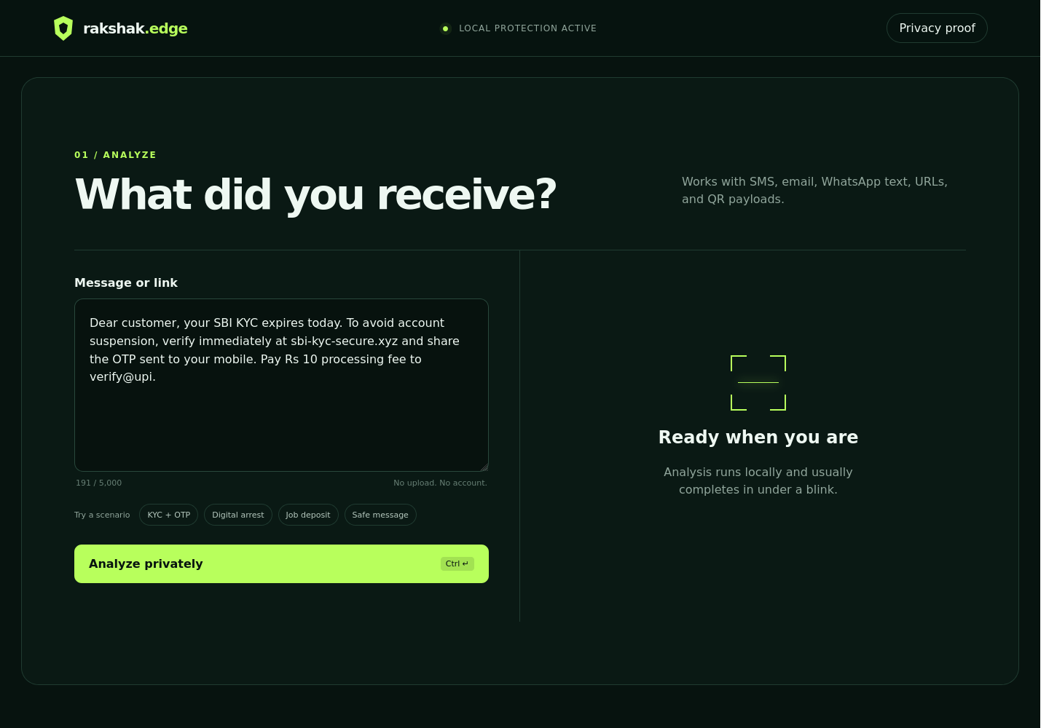
RAKSHAK EDGE
02 / PRODUCT
One local workflow from suspicion to safe action
Paste
Message, URL, UPI request, or QR payload
Understand
Risk score with visible evidence and extracted entities
Act safely
Independent verification path without another risky link
Notes:
Product screenshot from the running local app. The default build sends no content outside 127.0.0.1.

Slide 4
RAKSHAK EDGE
03 / TECHNICAL IMPLEMENTATION
Hybrid reasoning keeps security explainable
Transparent signals stay authoritative. A compact classifier adds semantic context and runs on the Hexagon NPU.
01
02
03
04
Input boundary
Evidence engines
Snapdragon path
Decision layer
>
>
>
Loopback API
No persistence
URL + entity rules
INT8 classifier
ONNX Runtime
QNN Execution Provider
Calibrated score
Reasons + safe action
Graceful fallback
QNN unavailable? ONNX Runtime uses CPU. Model absent? The deterministic engine still delivers a complete, testable product.
Notes:
Technical references: ONNX Runtime QNN Execution Provider, https://onnxruntime.ai/docs/execution-providers/QNN-ExecutionProvider.html; Qualcomm AI Hub, https://aihub.qualcomm.com/

Slide 5
RAKSHAK EDGE
04 / LIVE EVIDENCE
A KYC scam becomes a teachable decision
99
OTP request
Credential theft signal
+30
/100
Look-alike SBI domain
Identity mismatch
+26
HIGH RISK
Stop and verify independently
Expires today
Artificial urgency
+18
UPI + Rs 10
Financial ask
+18
SAFEST NEXT STEP
Do not reply, pay, share a code, or open the link yet.
Notes:
Evidence shown is the output of the included analyzer for the bundled KYC scenario. The score is a calibrated risk indicator, not proof of fraud.

Slide 6
RAKSHAK EDGE
05 / SNAPDRAGON ADVANTAGE
Privacy and responsiveness
from the same architecture
0
INT8
QNN
45 TOPS
cloud calls in the default build
target model precision
accelerator execution path
Snapdragon X Elite NPU
Why the NPU matters
The transformer encoder runs without occupying the CPU or sending personal content to a data center. The rules layer remains sub-millisecond and handles crisp security facts.
Target acceptance: warm analysis below 100 ms, no outbound connection, identical label contract on CPU fallback.
Notes:
Qualcomm states Snapdragon X Elite includes a Hexagon NPU with up to 45 TOPS. Source: Snapdragon X Elite product brief, https://docs.qualcomm.com/bundle/publicresource/87-71417-1_REV_D_Snapdragon_X_Elite_Product_Brief.pdf

Slide 7
RAKSHAK EDGE
06 / DEPLOYMENT & ACCESSIBILITY
A working submission, not a concept mockup
01
Runs today
One command, Python standard library, offline demo
02
Tested
Safety regression suite and reproducible latency harness
03
Accessible
Keyboard flow, high contrast, reduced motion, plain language
04
Deployable
QNN adapter, INT8 model contract, target acceptance checks
05
Responsible
Threat model, bounded claims, no server-side history
python app.py → localhost:8765

Slide 8
RAKSHAK EDGE
A safer pause
before the tap
Private by design. Explainable by default. Ready for Snapdragon.
LIVE DEMO
python app.py
GitHub-ready repository | Pitch deck | Brief | Demo script
Hariharan C

