Slide 1

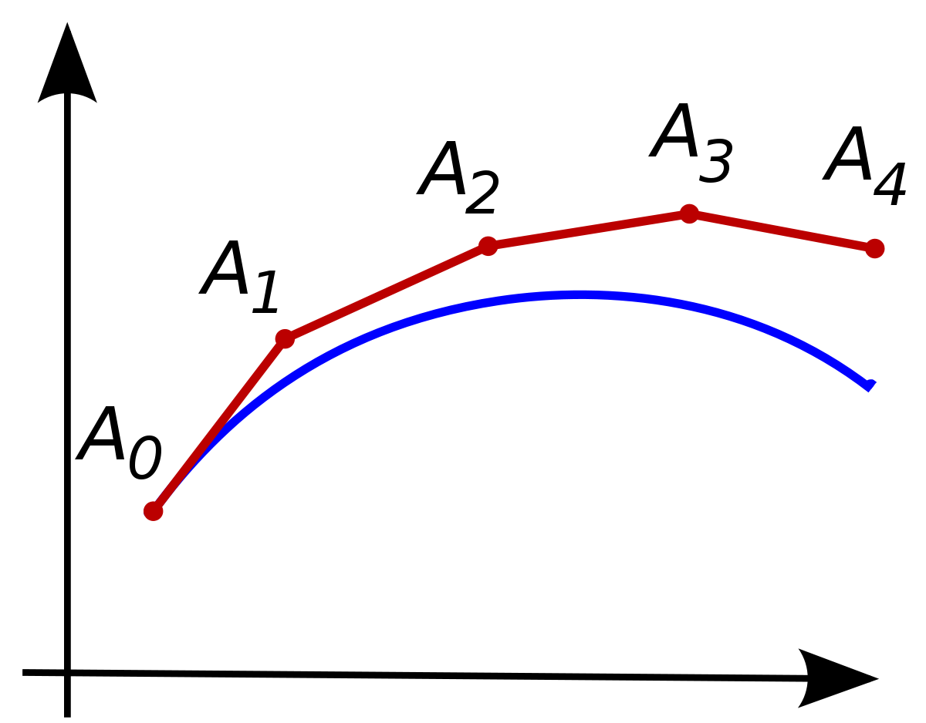
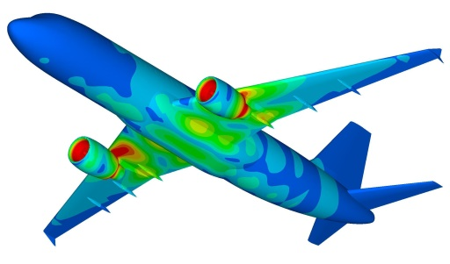
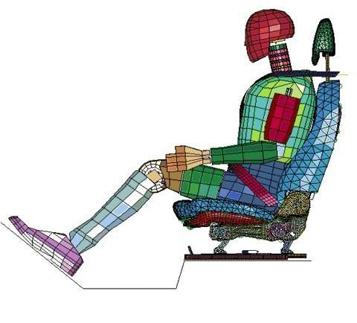
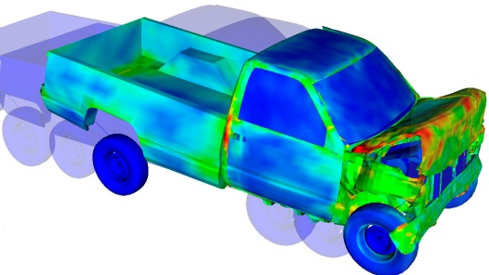
ODE
Dr. Himanshu Pathak
himanshu@iitmandi.ac.in

Slide 2
ODE vs PDE
ODE: One independent variable
PDE: Multiple independent variable
Heat Equation
Wave Equation
Laplace Equation
Notes:
2

Slide 3
Initial and boundary value problems
Boundary Value Problems:
Initial Value Problems:
Boundary and Initial Value Problems:
Eigen Value Problems:
3

Slide 4



Taylor Series
Taylor series are expansions of a function f(x) by some finite distance dx to f(x+dx).
In essence, the Taylor series provides a means to predict a function value at one point in terms of the function value and its derivatives at another point.
In particular, the theorem states that any smooth function can be approximated as a polynomial.
0th order Approximation
1st order Approximation
2nd order Approximation
N^{th} order Approximation
Remainder

Slide 5
Taylor Series
Solve the differential equation using Taylor series
Expand y(x) using Taylor series:

Slide 6
PICARD’S Method
Integration is applied to solve ODE.
Integrating:
Integral Equ^{n}
Approximations:

Slide 7
PICARD’S Method
Solve the differential equation using PICARD’S method:
Integral Equ^{n}
Approximations:

Slide 8
Euler’s Method / First Order Runge Kutta Method
Stepwise approximation is used to find numerical solution of differential equation.
Approximations:
Example: Solve the differential equation using Euler’s method:
Find step size:
n | x | y
₀ | x₀=0 | y₀=1
₁ | x₁=0.02 | y₁= y₀ + h × f(x₀, y₀) = 1+0.02×(0+1) = 1.02
₂ | x₂=0.04 | y₂= y₁ + h × f(x₁, y₁) = 1.02+0.02×(0.02+1.02) = 1.0408
₃ | x₃=0.06 | y₃= y₂ + h × f(x₂, y₂) = 1.0408+0.02×(0.04+1.0408) = 1.0624
₄ | x₄=0.08 | y₄= y₃ + h × f(x₃, y₃) = 1.0624+0.02×(0.06+1.0624) = 1.0848
₅ | x₅=0.10 | y₅= y₄ + h × f(x₄, y₄) = 1.0848+0.02×(0.08+1.0848) = 1.1081

Slide 9
Euler’s Modified Method
Stepwise approximation with predictor-corrector is used to find numerical solution of differential equation.
Two step Predictor-Corrector Approximation
Example: Solve the differential equation using modified Euler’s method:
step size:
n | x | y* | y
₀ | x₀=0 | y*₀=1 | y₀=1
₁ | x₁=0.02 | y*₁= y₀ + h × f(x₀, y₀) = 1+0.02×(0²+1) = 1.02 | y₁= y₀ + h/2 × [f(x₀, y₀)+ f(x₁, y*₁) = 1 + 0.02/2 × [(0²+1) + (0.02²+1.02)] = 1.0202
₂ | x₂=0.04 | y*₂= y₁ + h × f(x₁, y₁) = 1.0202+0.02×(0.02²+1.0202) = 1.0406 | y₂= y₁ + h/2 × [f(x₁, y₁)+ f(x₂, y*₂) = 1.0202 + 0.02/2 × [(0.02²+1.0202) + (0.04²+1.0406)] = 1.0408

Slide 10
Runge Kutta Method
The method achieve accuracy of a Taylor series approach without requiring the calculation of higher order derivatives.
R-K Method
Incremental function
Incremental slope factor

Slide 11
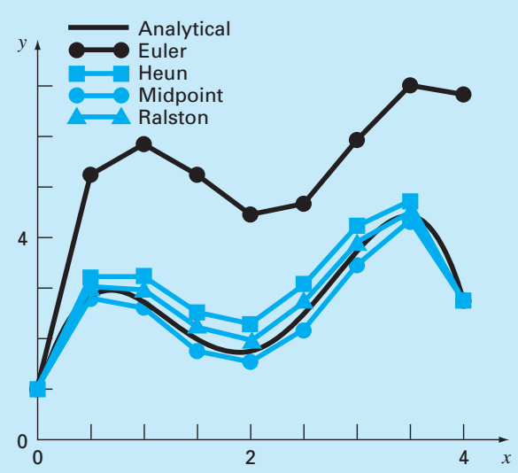
Second-Order Runge Kutta Method
R-K Method
Constant values:
Heun method
Midpoint method
Ralston’s method

Slide 12
Runge Kutta Method
Third Order R-K Method
Fourth Order R-K Method
Fifth Order R-K method (Butcher’s Method)

Slide 13
MATLAB© Script
MATLAB Program for 4th Order R-K Method
% Plot data with in-built function
tspan = [0,100];
y0 = 0.5;
[tx, yx] = ode45(F_xy, tspan, y0);
plot(x, y, 'o-', tx, yx, '--')
clear all
close all
clc
h=0.5; % step size
x = 0:h:100;
Y = zeros(1,length(x));
y(1) = 0.5; % initial condition
F_xy = @(t,r) 2.*exp(-0.5*t)-r; % the function
for i=1:(length(x)-1)
k_1 = F_xy( x(i), y(i) );
k_2 = F_xy( x(i)+0.5*h, y(i)+0.5*h*k_1);
k_3 = F_xy( (x(i)+0.5*h), (y(i)+0.5*h*k_2));
k_4 = F_xy( (x(i)+h), (y(i)+k_3*h));
y(i+1) = y(i) + (1/6)*(k_1+2*k_2+2*k_3+k_4)*h;
end

Slide 14
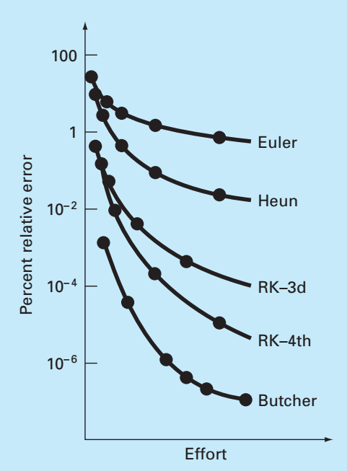
Runge Kutta Method
Accuracy of R-K Method

Slide 15


THANK YOU
Questions??

