Slide 1

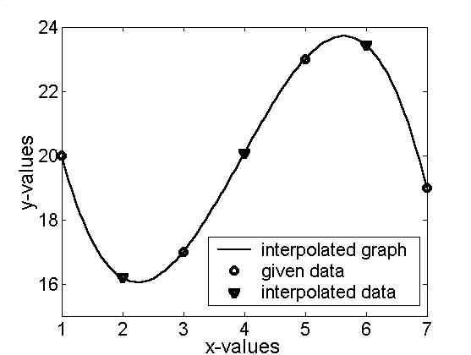
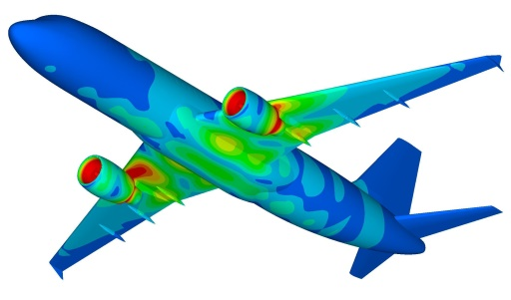

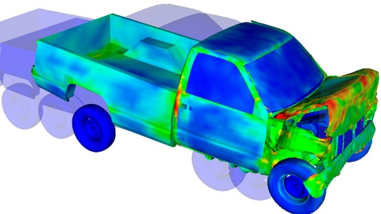
Finite Difference and Interpolation
Dr. Himanshu Pathak
himanshu@iitmandi.ac.in

Slide 2



Taylor Series
Taylor series are expansions of a function f(x) by some finite distance dx to f(x+dx).
In essence, the Taylor series provides a means to predict a function value at one point in terms of the function value and its derivatives at another point.
In particular, the theorem states that any smooth function can be approximated as a polynomial.
0th order Approximation
1st order Approximation
2nd order Approximation
N^{th} order Approximation
Remainder

Slide 3
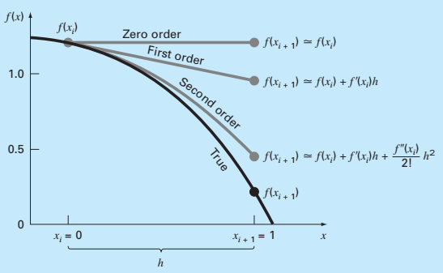


Taylor Series
Example: Use zero- through fourth-order Taylor series expansions to approximate the function.
$f\left(x\right)=−0.1x4−0.15x3−$0.5 $x2$-0.25$x+1.2$
x_{i} = 0 with h = 1. That is, predict the function’s value at x_{i+1} = 1
By Taylor Series
0th order Approximation
1st order Approximation
2nd order Approximation

Slide 4
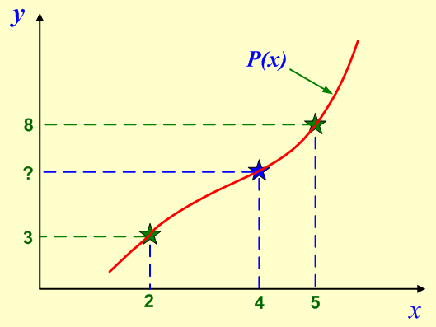
Interpolation
Interpolation produces a function that matches the given data exactly.
The function then can be utilized to approximate the data values at intermediate points.
Given data points: at x₀ = 2, y₀ = 3 and at x₁ = 5, y₁ = 8
Find the following: at x = 4, y = ?

Slide 5
Introduction
If interpolation method provides a polynomial function with appropriate degree to exactly match a given set of data, polynomial interpolation is employed.
Lagrange Interpolation
Newton Interpolation
Hermite interpolation method interpolate function as well as first derivative of function values.

Slide 6
Lagrange Interpolation
Given data points: at x₀ = 2, y₀ = 3 and at x₁ = 5, y₁ = 8
Find the following: at x = 4, y = ? Using Lagrange interpolation technique.
P(x) should satisfy the following conditions:
P(x = 2) = 3 and P(x = 5) = 8. Assume Function
P(x) can satisfy the above conditions if
at x = x₀ = 2, L₀(x) = 1 and L₁(x) = 0 and
at x = x₁= 5, L₀(x) = 0 and L₁(x) = 1
The conditions can be satisfied if L₀(x) and L₁(x) are defined in the following way:

Slide 7
Lagrange Interpolation Contd…
Lagrange Interpolating Polynomial
P(x = 4) can be obtained by:

Slide 8
Lagrange Interpolation Contd…
Lagrange Interpolating Polynomial for three points:
L_{k}(x) can be defined by:
Numerator
Denominator

Slide 9
MATLAB© Script
Simplest MATLAB Program for Coefficient of Lagrange Polynomial
clear all
clc
x = input(‘Define x vector = ‘);
y = input(‘Define y vector = ‘);
n=length(x);
for k = 1:n
d(k) = 1;
for i = 1: n
if i ~= k
d(k) = d(k) * (x(k) – x(i));
end
c(k) = y (k) / d(k);
end
end

Slide 10
MATLAB© Script
Simplest MATLAB Program for Lagrange Polynomial
t=input('Enter point x at which polynomial get evaluated = ');
for i = 1:length(t)
p(i) = 0;
for j = 1:n
N(j) = 1;
for k = 1:n
if j ~= k
N(j) = N(j) * (t(i) - x(k));
end
end
p(i) = p(i) + N(j) * c(j);
end
end
p=interp1([x], [y], [t])

Slide 11
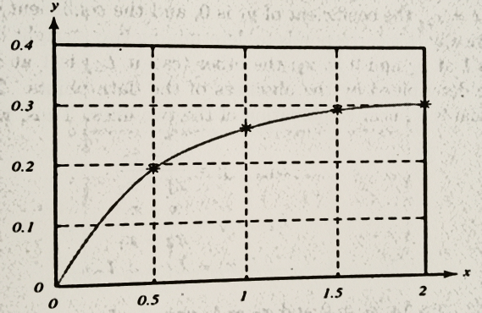
MATLAB© Script
Comparision of result obtained by developed and in-built function
p=interp1([x], [y], [t])
p=interp1([0 0.5 1 1.5 2],[0 0.19 0.26 0.29 0.31],[0.75 1.25])

Slide 12
Why Newton Interpolation
The Lagrange formula is popular because it is well known and is easy to code.
Also, the data are not required to be specified with x in ascending or descending order.
If we decide to add a point to the set of nodes, we have to completely re-compute all of the polynomial functions.
Here we introduce an alternative form of the polynomial: the Newton form (Divided-Difference Interpolating Polynomials).

Slide 13
Introduction
Newton interpolation assume a complete polynomial starts from lower degree to higher degree :
For two point Interpolation
For three point Interpolation
For n-point Interpolation

Slide 14
Newton Interpolation
Given data points:
Find the coefficient of polynomial.
P(x) for 3 data set:
At x = x₁ and y = y₁
At x = x₂ and y = y₂
At x = x₃ and y = y₃

Slide 15
Newton Interpolation Example
For given data points:
Find the Newton interpolation polynomial and value at x =1 .
For 3-data set:
Coefficients of polynomial:
Put these value in polynomial
Impose co-ordinate in polynomial

Slide 16
MATLAB© Script
MATLAB Program for Coefficient of Newton Polynomial
clear all
clc
x = input(‘Define x vector = ‘);
y = input(‘Define y vector = ‘);
n=length(x);
a(1) = y(1);
for k = 1 : n - 1
d(k, 1) = (y(k+1) - y(k))/(x(k+1) - x(k));
end
for j = 2 : n - 1
for k = 1 : n - j
d(k, j) = (d(k+1, j - 1) - d(k, j - 1))/(x(k+j) - x(k));
end
end
for j = 2 : n
a(j) = d(1, j-1);
end

Slide 17
MATLAB© Script
MATLAB Program for Newton Interpolation
t=input('Enter point x at which polynomial get evaluated = ');
for i = 1:length(t)
d(1) = 1;
N = a(1);
for j = 2:n
d(j) = (t(i) – x(j-1)) * d(j-1);
N(i) = N(i) + a(j) * d(j);
end
end

Slide 18
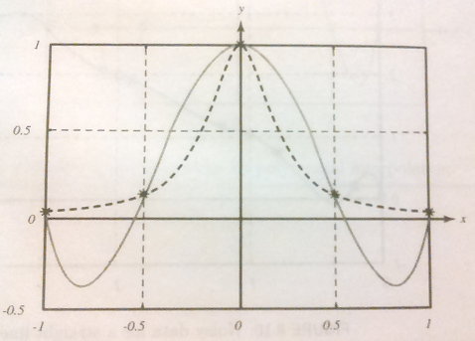
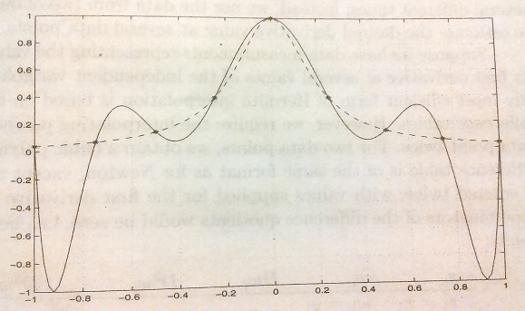
Piecewise Interpolation
Runge Function

Slide 19
Piecewise Interpolation
Picewise linear interpolation for four data points:
Provided
Sub-domain

Slide 20
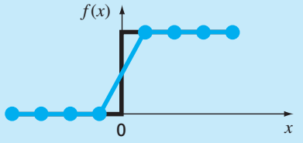
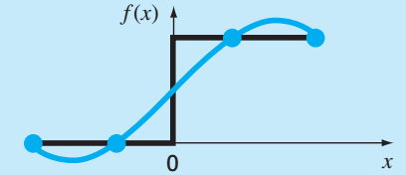
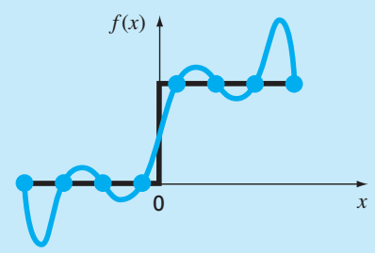
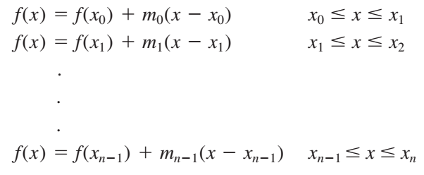
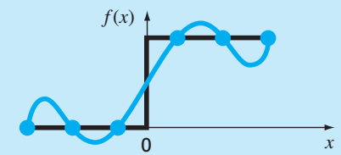

Spline Interpolation
A spline is a special function defined piecewise by polynomials.
In essence, spline interpolation is a special type of polynomial interpolation where each section/range is interpolated by different polynomial functions.
Linear Spline Interpolation
Polynomial Interpolation

Slide 21

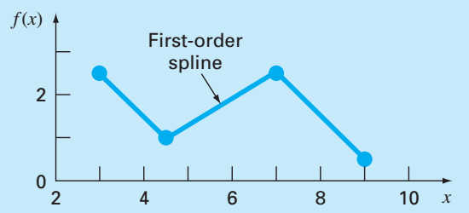
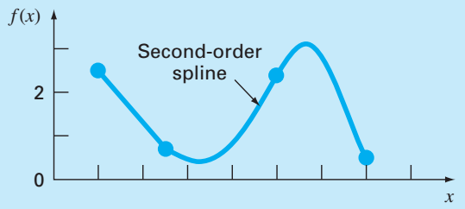
Quadratic Spline Interpolation
A spline interpolation using second-order polynomials.
In essence, quadratic splines have continuous first derivatives at the knots.
Linear Spline Interpolation
Quadratic Spline Interpolation

Slide 22

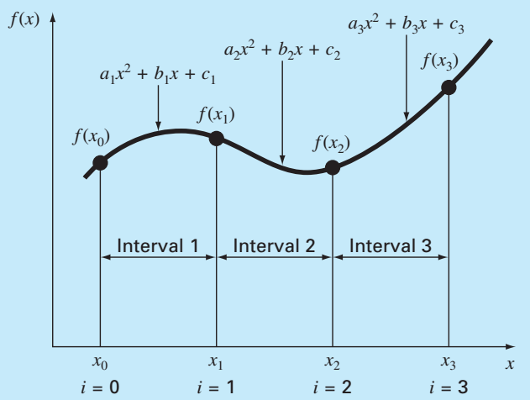


Quadratic Spline Interpolation
Quadratic Spline interpolation for four data points:
Polynomial for each interval:
For n+1data points, there are n intervals and, 3n unknown constants to be find for interpolation functions.
Interpolation conditions (3n):
01. The function values of adjacent polynomials must be equal at the interior knots.
02. The first and last functions must pass through the end points.
Quadratic Spline Interpolation

Slide 23



Quadratic Spline Interpolation
For n+1data points, there are n intervals and, 3n unknown constants to be find for interpolation functions.
Interpolation conditions continue…
03. The first derivatives at the interior knots must be equal.
04. Assume that the second derivative is zero at the first point.
Quadratic Spline Interpolation

Slide 24
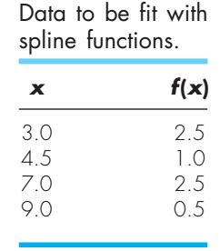
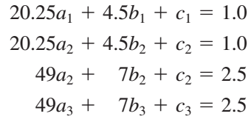




Quadratic Spline Interpolation
Given data points:
.
We have four data points and n = 3 intervals. Therefore, 3×3=9 unknowns must be determined.
Quadratic Spline Interpolation

Slide 25
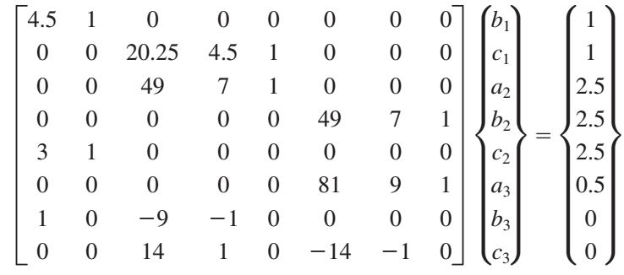
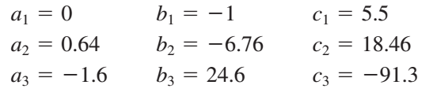
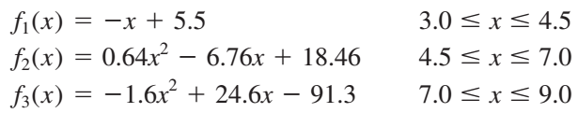
Quadratic Spline Interpolation
Obtained Equations:
Quadratic Spline Interpolation

Slide 26

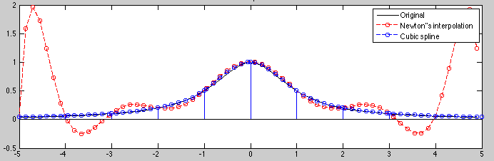
Cubic Spline Interpolation
To define third-order polynomial for each interval between knots:
Polynomial for each interval:
For n+1data points, there are n intervals and, 4n unknown constants to be find for interpolation functions.
Interpolation conditions (4n):
Cubic Spline Interpolation
The function values of adjacent polynomials must be equal at the interior knots.
The first and last functions must pass through the end points.
The first derivatives at the interior knots must be equal.
The second derivatives at the interior knots must be equal.
The second derivatives at the end knots are zero (natural spline).

Slide 27

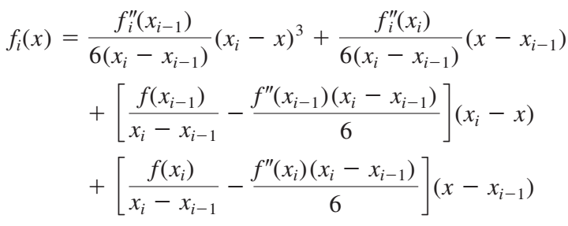
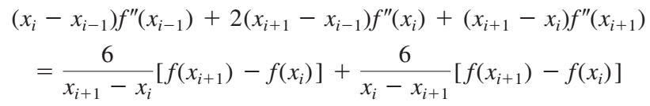
Cubic Spline Interpolation
Interpolation equations:
To find f’’(x)

Slide 28
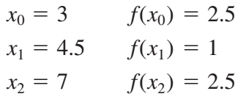
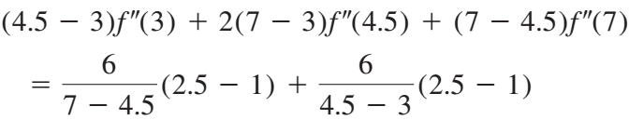



Cubic Spline Interpolation
Given data points:
.
We have four data points and n = 3 intervals. Therefore, 4×3=12 unknowns must be determined.
To find f’’(x)

Slide 29
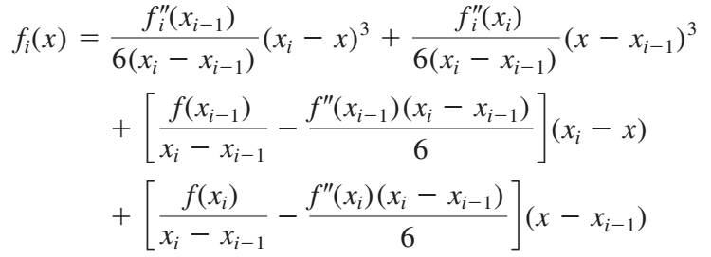
Cubic Spline Interpolation
To find f_{i} (x)

Slide 30


Finite Divided Difference Method
Divided differences is a recursive division process. The method can be used to calculate the coefficients in the interpolation polynomial in the Newton form.
The Taylor series used to approximate divided differences.
Taylor Series
First Forward Difference
Δf_{i} is referred to as the first forward difference and h is called the step size

Slide 31
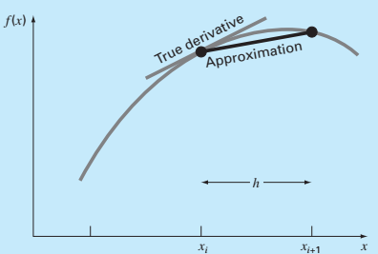
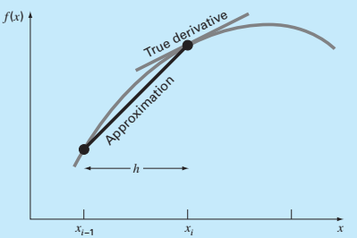
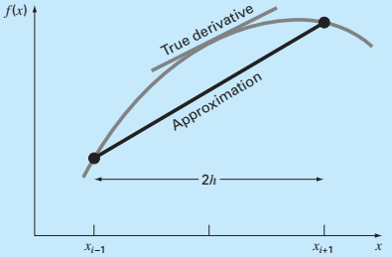
Finite Divided Difference Method
forward difference
It utilizes data at i and i ₁₊₁ to estimate the derivative.
backward difference
To calculate a previous value on the basis of a present value
centered difference
It utilizes data at i ₁₋₁ and i ₁₊₁ to estimate the derivative.

Slide 32
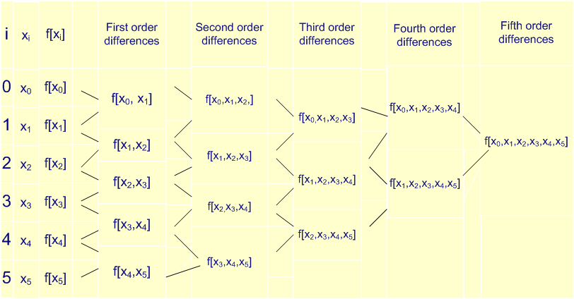
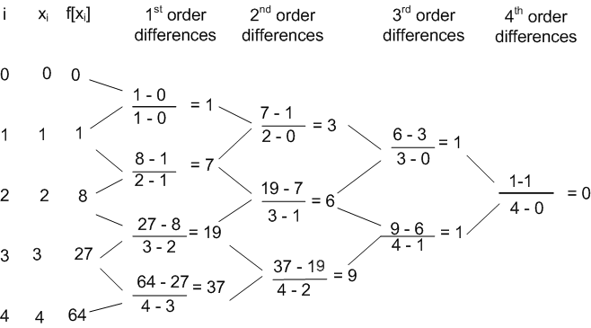
Finite Divided Difference Table

Slide 33
Finite Divided Difference Table
Example: Compute f(0.3) for the data using Newton's divided difference formula.
x | 0 | 1 | 3 | 4 | 7
f | 1 | 3 | 49 | 129 | 813
Divided difference table
f(x) = f [x₀] + (x - x₀) f [x₀, x₁] + (x - x₀) (x - x₁) f [x₀, x₁, x₂] +
(x - x₀) (x - x₁) (x - x₂)f [x₀, x₁, x₂, x₃]
x_{i} | f_{i}
0 | 1
 |  | 2
1 | 3 |  | 7
 |  | 23 |  | 3
3 | 49 |  | 19
 |  | 80 |  | 3
4 | 129 |  | 37
 |  | 228
7 | 813
f(0.3) = 1 + (0.3 - 0) 2 + (0.3)(0.3 - 1) 7 +
(0.3) (0.3 - 1) (0.3 - 3) 3
=1.831

Slide 34


THANK YOU
Questions??

