Slide 1
Fair Clustering under misinterpreted data
HARIKESH (2019CS10355)
DEEPANSHU YADAV (2019CS10343)
https://github.com/Deepanshu-Yadav-2001/K-Clustering.git

Slide 2
K-Means Clustering
Partition given unlabeled dataset into k disjoint subsets
Minimize the squared Euclidean distance to the closest center
Heuristic Algorithms such as Lloyd’s Algorithm
Start by Randomly allocating k centers
Assign each point to the nearest center
Reassign centers by taking mean of its points
Repeat till convergence

Slide 3
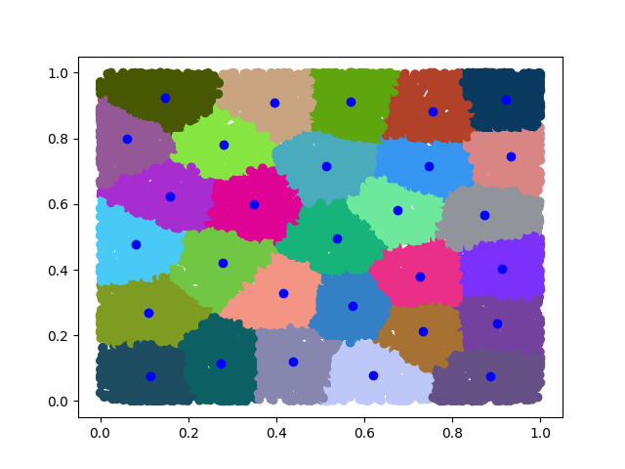
Description
A given block is divided in D x D square shaped blocks of equal size
Each block may have points(population) of type 1 or 2
Type 1 block has n1 people whereas Type 2 block has n2 people
Need to generate k centers (facilities)
Aim: To minimize total squared distance to reach the nearest center
Parameters: D, n1, n2, k

Slide 4
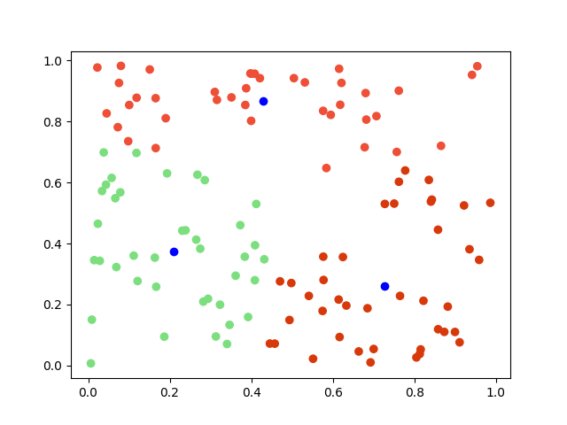
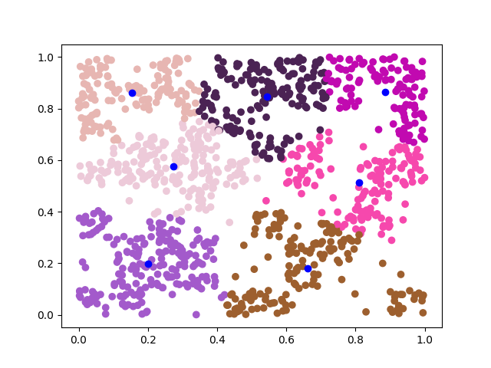
Better view (Small values)

Slide 5
Under-Reporting
Type 1 population may be under-reported by some percentage (Let’s say alpha)
May lead to shifting of cluster points away from type 1 points (thus unprivileged group)
Favourable to type 2 population (thus privileged group)
Cost v/s alpha for different total points (population)
Effect on privileged cost, unprivileged cost & Total cost.

Slide 6
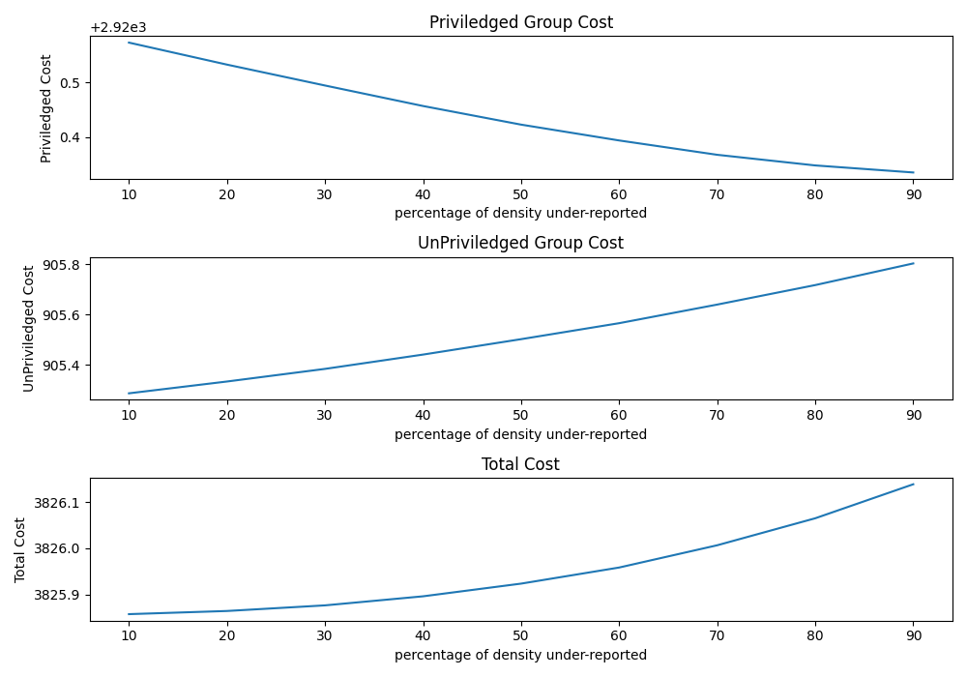
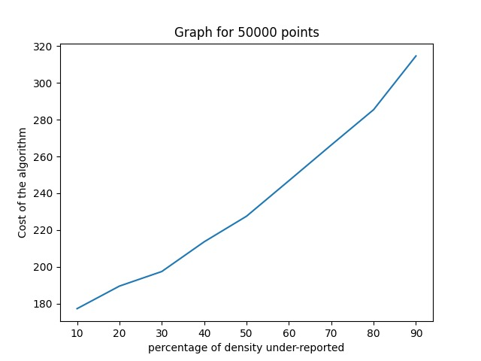
Results and Plots

Slide 7
Observations
Unprivileged Cost demonstrates almost linear increase.
Privileged cost on the contrary shows linear decrement.
Total cost shows linear increment with less slope.
Randomness of square types has no special effect on the plots.
Another implementation with n = n1 = n2 but number of squares of one type more than other.

Slide 8
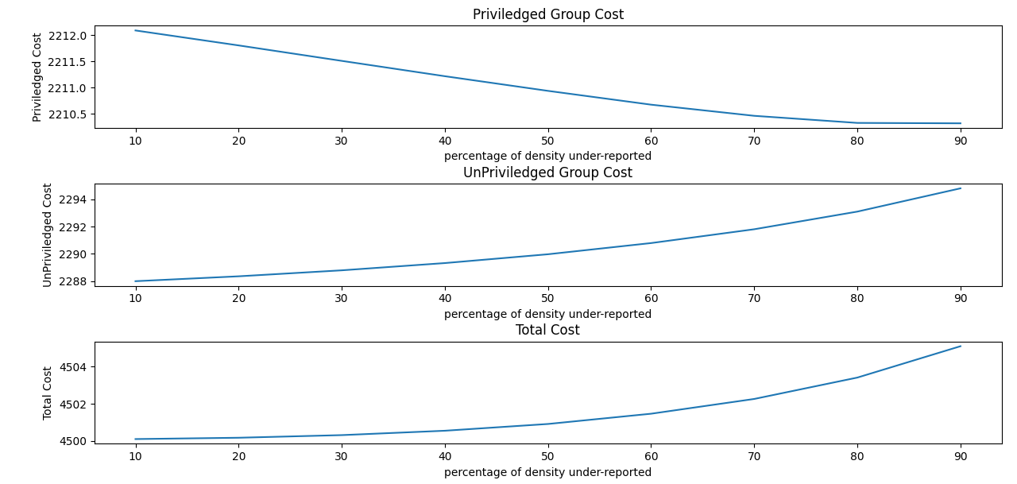
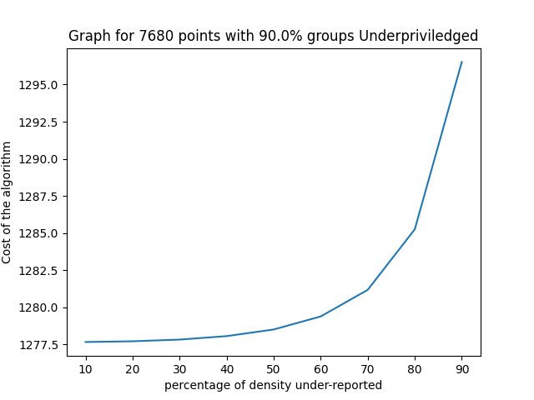
Results and Plots (Similar Algorithms)

Slide 9
Ensure Fairness in resource allocation
Unfair/Disadvantage for unprivileged population
Cover more distance to reach nearest centre.
Centres over-crowded by privileged population
Implement a solution independent of alpha.
Limit the percentage of both type population to any cluster.
Currently reading papers for this new algorithm.

Slide 10
References
https://dl.acm.org/doi/10.1145/3442188.3445906
https://arxiv.org/abs/2006.10085#:~:text=Mehrdad%20Ghadiri%2C%20Samira%20Samadi%2C%20Santosh,(e.g.%2C%20demographic%20groups).
https://github.com/Deepanshu-Yadav-2001/K-Clustering.git

