Slide 1


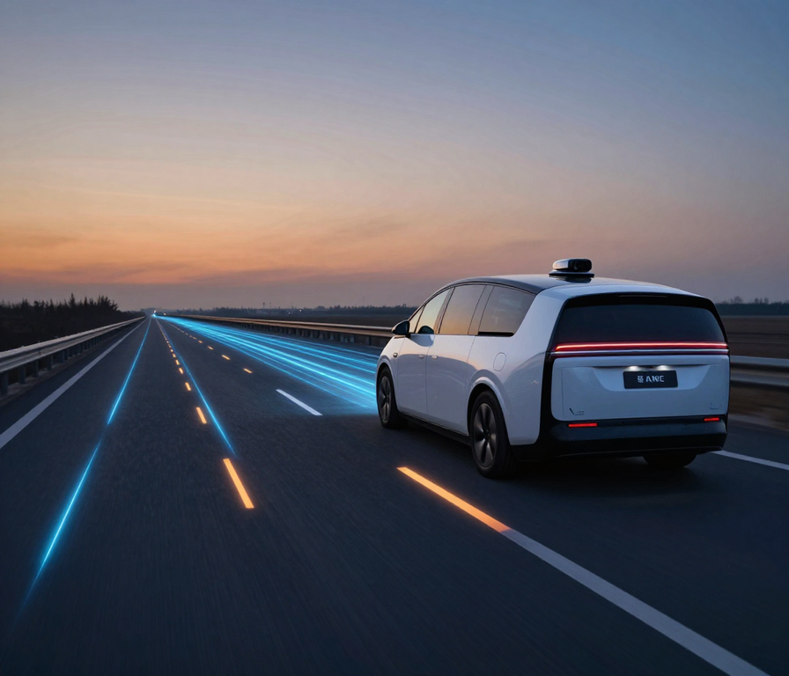



PATH PLANNING &
PREDICTION AUTONOMOUS
VEHICLES FOR
Unstructured & Dynamic Road Environments
Guide :
Prof.Kamashya Prasad Nayak
Presented By :
Hari Paangi
Mohit Kabi
Priyanka Priyadarshani Satapathy
Debabrata Pradhan

Slide 2
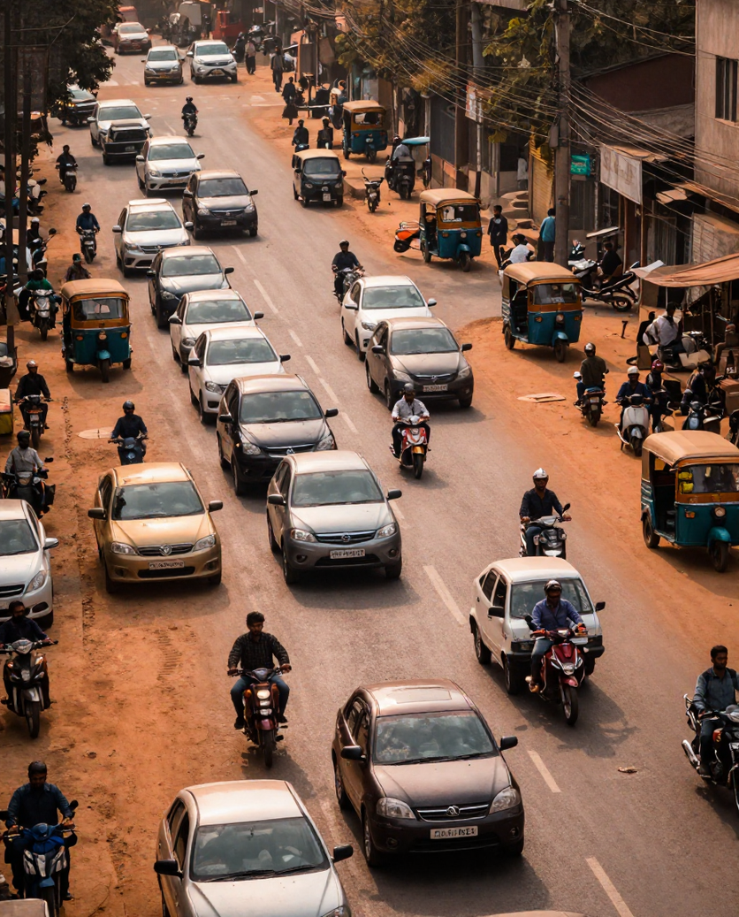

Topic & Current Issue
Autonomous vehicles face unstructured roads, mixed traffic, unpredictable obstacles, and sudden movements in real-world environments. These conditions make rule-based navigation insufficient, requiring adaptive perception, prediction, and safe path planning for reliable autonomous driving
Key Challenges
🚧 Unstructured roads — unclear lanes
🐄 Unexpected obstacles — animals & pedestrians
🚗 Mixed traffic — cars, bikes & auto-rickshaws
🔄 Dynamic behavior — sudden movement changes
🕳️ Road hazards — potholes & uneven surfaces
⚡ Real-time decisions — fast and safe response

Slide 3

Research Objectives
From Perception to Adaptive Path Planning
Our objective is to develop a lightweight predictive navigation pipeline for dynamic and unstructured road environments.
Perceive
Camera + LiDAR based environmental understanding
Detect & Track
Identify and track dynamic road users and obstacles
Predict
Estimate future movement and trajectories
Assess Risk
Identify potential collision risks
Plan Adaptively
Generate and evaluate feasible paths
Re-plan
Continuously adapt the path as the environment changes

Slide 4


Research Objectives
Path Planning
Trajectory Prediction
Develop robust real-time path planning algorithms capable of navigating unstructured and dynamic road environments with high reliability and minimal latency.
Design predictive models to anticipate the motion of surrounding vehicles, pedestrians, and dynamic obstacles for safe trajectory generation.
Implement multi-layer obstacle detection and avoidance strategies.
Enable real-time decision-making under uncertainty and sensor noise.
Achieve dynamic environment understanding using semantic scene analysis.
Ensure safe autonomous navigation across diverse road scenarios.
Validate system performance through simulation and real-world datasets.
Integrate planning with perception for end-to-end autonomous control.

Slide 5

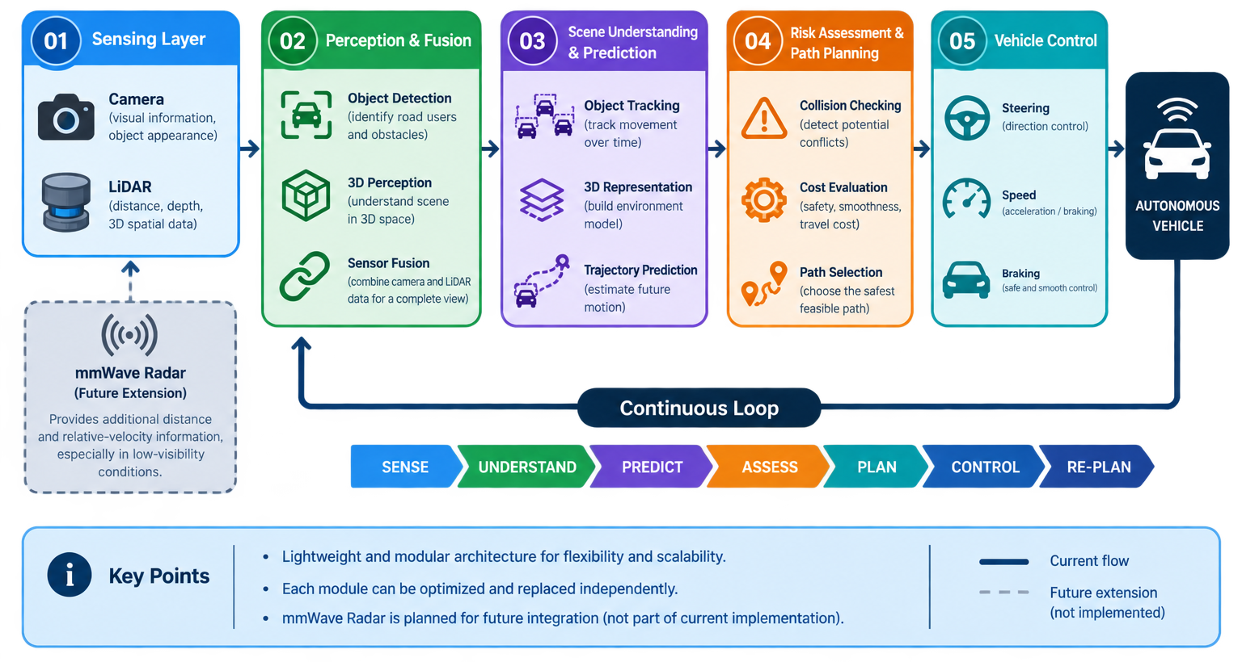
System
Overview
Planning & Control Pipeline

Slide 6
System
Overview
Planning & Control Pipeline
Candidate trajectory generation using lattice-based and sampling methods for dynamic, multi-agent road scenarios.
The AV pipeline integrates real-time sensor fusion, environment modeling, behavior prediction, and trajectory optimization to enable safe, adaptive navigation in dynamic and unstructured road environments.
Collision checking against predicted obstacle trajectories.
Perception & Prediction Pipeline
Optimal path selection via cost function minimization.
Vehicle control via PID and MPC for smooth actuation.
Sensor inputs: LiDAR, camera, radar, and GPS fusion.
Environment representation via occupancy grids and HD maps.
Behavior prediction using LSTM and transformer models.

Slide 7



Planning vs. Prediction Approaches
Path Planning Methods
Prediction Strategies
Combines global & local planning layers for structured and unstructured environments.
Integrates rule-based and learning-based models to anticipate dynamic agent behavior.
Global Planning: A*, Dijkstra, and RRT* for high-level route optimization.
Rule-Based Prediction: Physics models & traffic rules for structured road agents.
Local Planning: Dynamic Window Approach (DWA) for real-time obstacle avoidance.
Learning-Based Prediction: LSTM & Transformer networks for unstructured scenarios.
Handles both static obstacles (parked cars, barriers) and dynamic agents (pedestrians).
Fuses static map priors with real-time sensor data for accurate multi-agent forecasting.

Slide 8
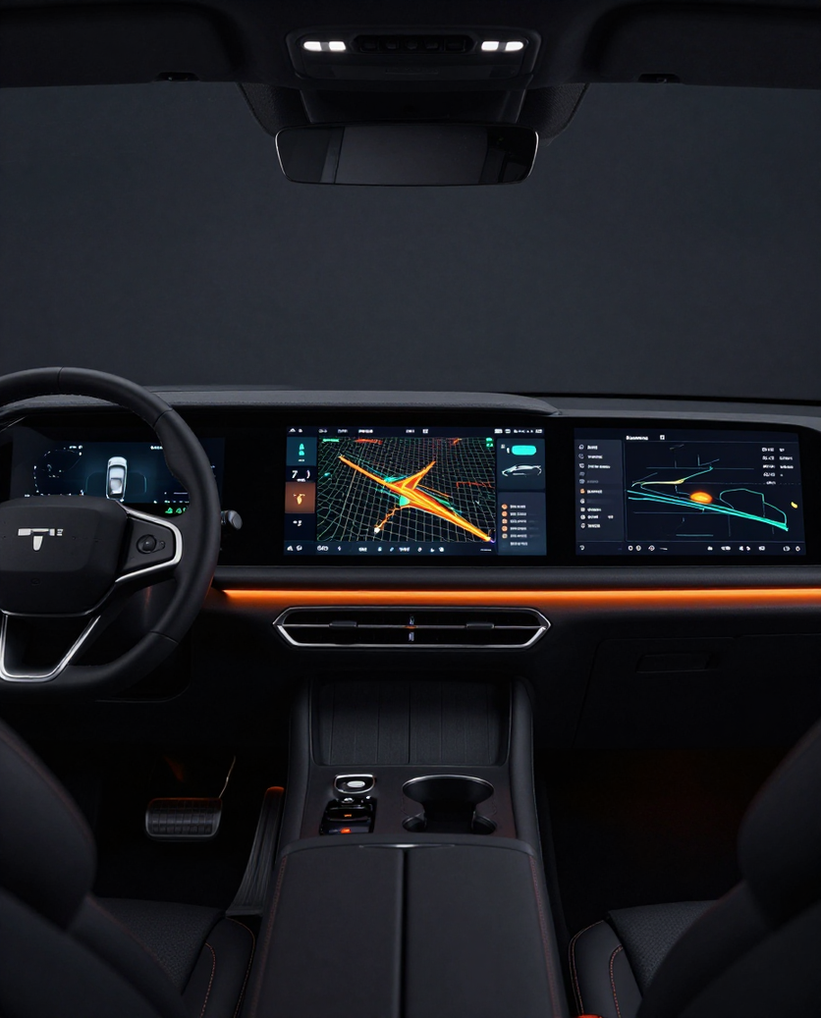
Proposed
Framework
An integrated pipeline combines LiDAR & camera-based sensor perception, occupancy grid mapping, and deep learning motion prediction to enable real-time, collision-free navigation in dynamic environments.
Explore the Pipeline
Sensor Perception → Occupancy Grid Representation.
Motion Prediction → Sampling-Based Path Planning.
Feedback Control Loop → Safe Trajectory Execution.

Slide 9

Core Algorithms
Prediction Methods
Combines kinematic models, deep learning, and transformer architectures to anticipate dynamic agent behavior and enable safe replanning.
Classical and sampling-based methods form the backbone of autonomous path generation in dynamic, unstructured environments with real-time constraints.
Kinematic & CV Models: Constant velocity and bicycle models for short-horizon prediction.
Path Planning Algorithms
LSTM / GRU Networks: Recurrent models capturing temporal trajectory dependencies.
Transformer Models: Attention-based multi-agent interaction and intent forecasting.
A* & D* Lite: Grid-based optimal search with dynamic replanning on updated cost maps.
RRT* & Informed RRT*: Asymptotically optimal sampling in high-dimensional configuration space.
Potential Fields & TEB: Local trajectory optimization with safety-aware cost functions.

Slide 10


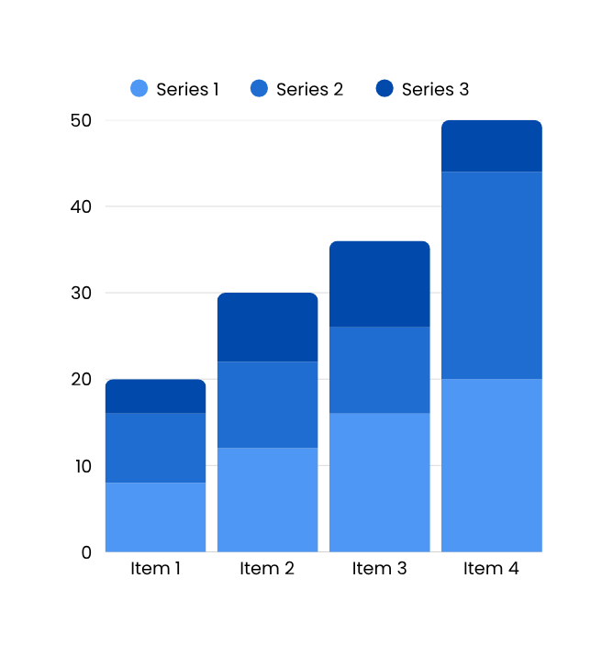


Results and Analysis
The proposed approach achieves a planning success rate of 94.7%, collision rate of 1.2%, and average path length of 48.3m. Prediction error is reduced to 0.31m (RMSE), with planning time averaging 38ms — well within real-time constraints for dynamic environments.
Key Findings
Compared to the baseline RRT* planner, our hybrid model shows +18% improvement in safety score, +22% in trajectory accuracy, and +15% in computational efficiency. Path smoothness index improved from 0.61 to 0.89. These gains are consistent across urban, highway, and unstructured road scenarios tested in simulation.

Slide 11
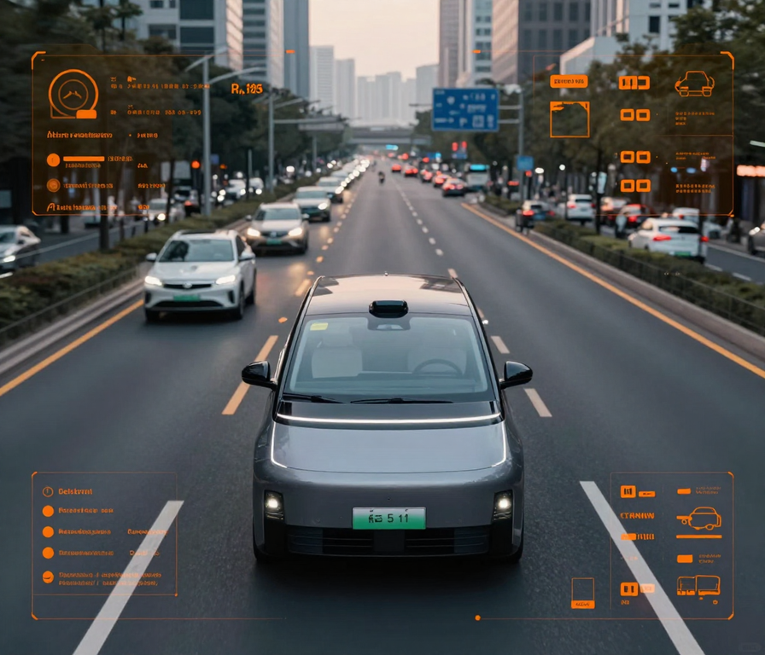
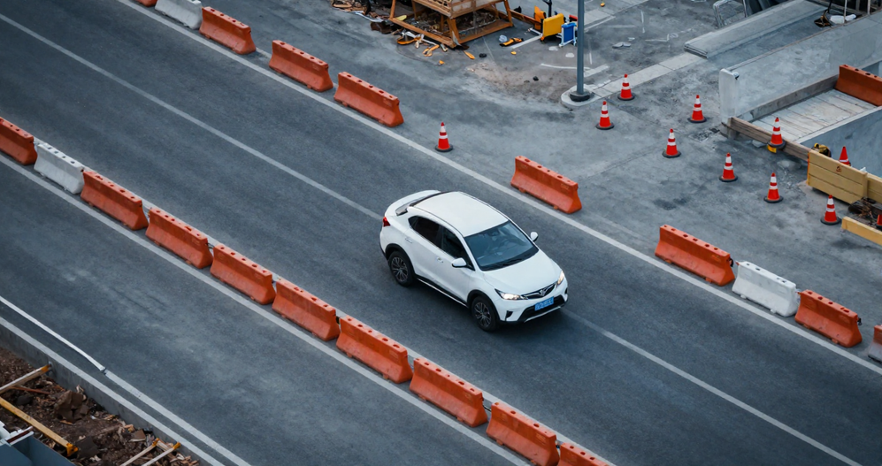
Results & Applications
The system achieves safer navigation in dynamic environments, improved trajectory prediction accuracy, and robust obstacle avoidance. Adaptability to changing road layouts ensures reliable performance across diverse real-world conditions and traffic scenarios.
Evaluate the Future of Autonomous Mobility
Rural roads, construction zones & unstructured terrain.
Parking areas, intersections & mixed-traffic environments.
Scalable deployment in intelligent transportation systems.

Slide 12
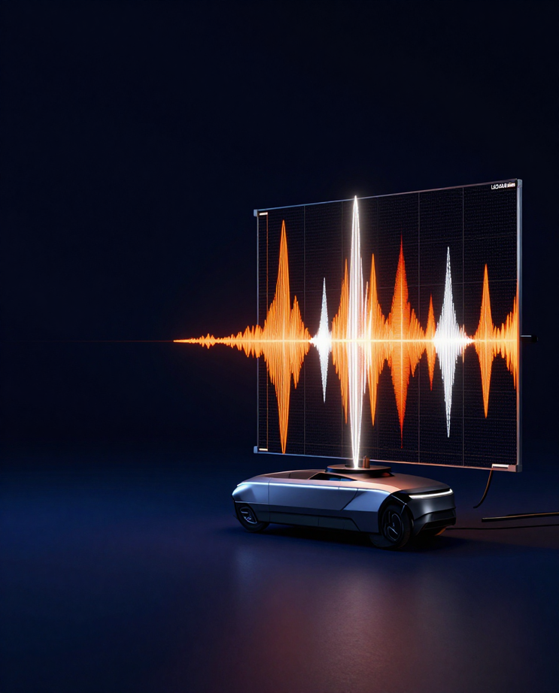
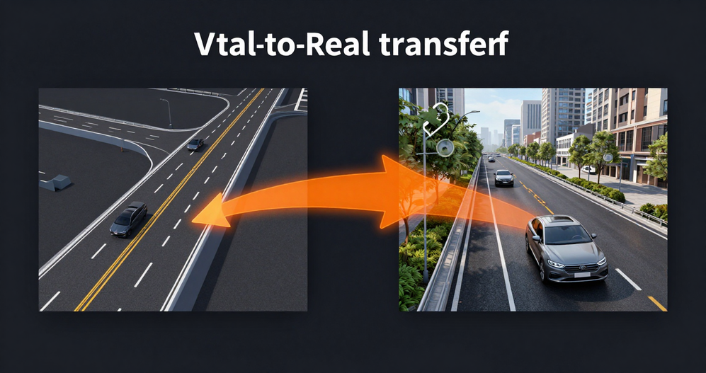
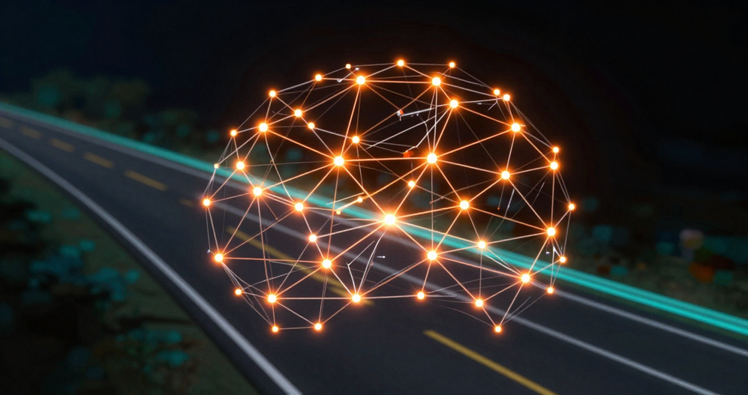
Limitations & Future Scope
Current Limitations: The system faces challenges including sensor noise degrading perception accuracy, limited real-world datasets for rare-event scenarios, and high computational cost hindering real-time deployment. Sim-to-real transfer gaps reduce generalization, and predicting unpredictable agent behavior remains an open challenge.
Future Scope: Planned extensions include multimodal sensor fusion (LiDAR + camera + radar), end-to-end deep learning pipelines, uncertainty-aware planning with risk quantification, real-vehicle hardware testing, and large-scale diverse scenario dataset collection for robust model training.

Slide 13

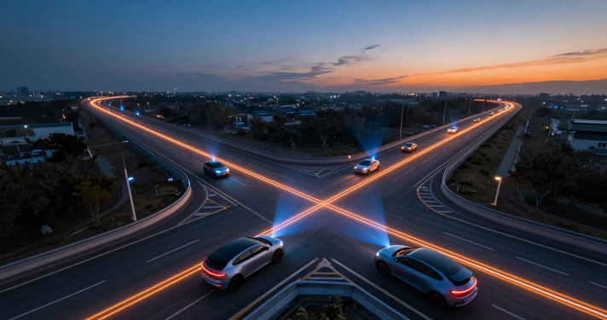
THANK
YOU!
Questions & Discussion

