Slide 1





Agricultural Raw Material Analysis
Student Details
Name: Srihari S
NM Id: au2021111087
College Name: College of Engineering Guindy, Anna University

Slide 2

Project Outline
Abstract
Problem Statement
Aims & Proposed Solution
EDA & Results
Future Scope
Conclusion
Reference

Slide 3

Abstract
The agricultural sector presents a complex decision-making landscape for farmers and agribusinesses. Numerous intricate factors influence these choices, with accurate yield estimation being a cornerstone of effective agricultural planning. Data mining techniques offer a powerful approach to tackle this challenge and provide practical solutions. The abundance of data in agriculture, encompassing environmental conditions, soil variability, input levels, combinations, and commodity prices, makes it a prime candidate for big data applications. This information empowers farmers to make critical decisions and optimize their operations. This paper delves into the analysis of agricultural raw material prices, specifically focusing on price fluctuations between 1990 and 2020. This analysis provides valuable insights for stakeholders involved in utilizing or selling these materials. By understanding price trends, they can make informed decisions to maximize their revenue (for producers) or return on investment (for buyers).

Slide 4

Problem Statement
This project aims to conduct an Exploratory Data Analysis (EDA) on a dataset containing historical agricultural raw material prices. Our primary objectives are to:
Identify high-priced and low-priced raw materials: We shall find the range of the prices of the given raw materials from the dataset to figure out the high range and low range raw material over the given time frame (1990-2020).
Discover materials with significant price fluctuations: We will pinpoint raw materials that exhibit extreme percentage changes in price over time, highlighting those experiencing dramatic price increases or decreases.
Analyze price range variations: We will investigate the overall range of price fluctuations for each raw material across the years covered in the dataset. Visualize price correlations:
Finally, we will employ a heatmap to depict the correlation matrix, visually representing the strength and direction of the relationships between the prices of different agricultural raw materials.

Slide 5

Aim
Aim: To go through the given data analyze the features and return the required insights as per the problem statement.

Slide 6

Proposed Solution
Our approach to analyzing the agricultural raw material prices dataset involves several steps.
First, we'll import necessary libraries and load the data. After cleaning and preprocessing our data we shall try to understand the various features present in the data as well as what is required for us to find using EDA.
After preprocessing the data we shall do year over year analysis of the data and figure out insights such as price ranges, prices rate changes and rate of change of price over a long period i.e. the whole duration of data availability.
Finally, we'll create a correlation matrix and visualize it as a heatmap to understand the strength and direction of relationships between the prices of different agricultural raw materials. By interpreting the results from each step, we can gain valuable insights into historical pricing, trends, identify consistently expensive or volatile materials, and explore potential price correlations within the agricultural raw material market.

Slide 7





Tools & Softwares Used

Slide 8
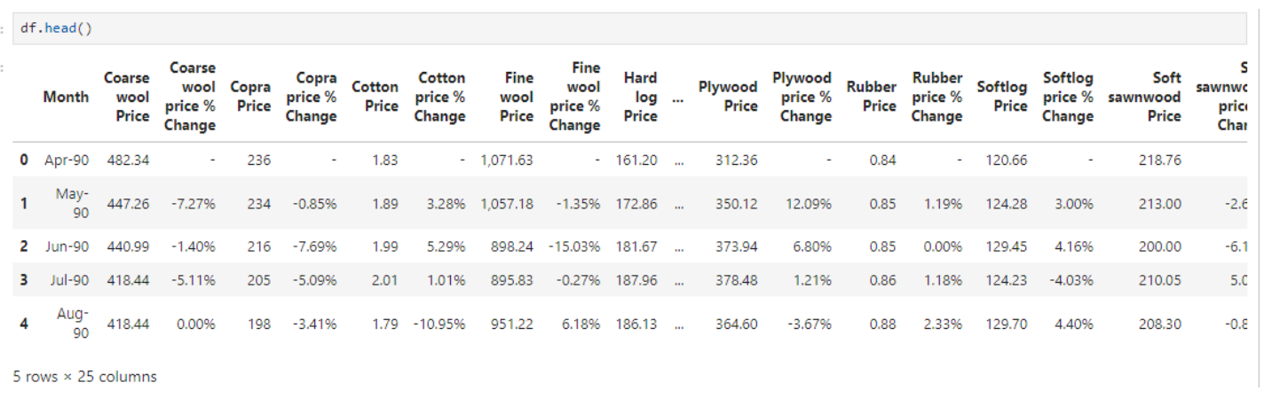
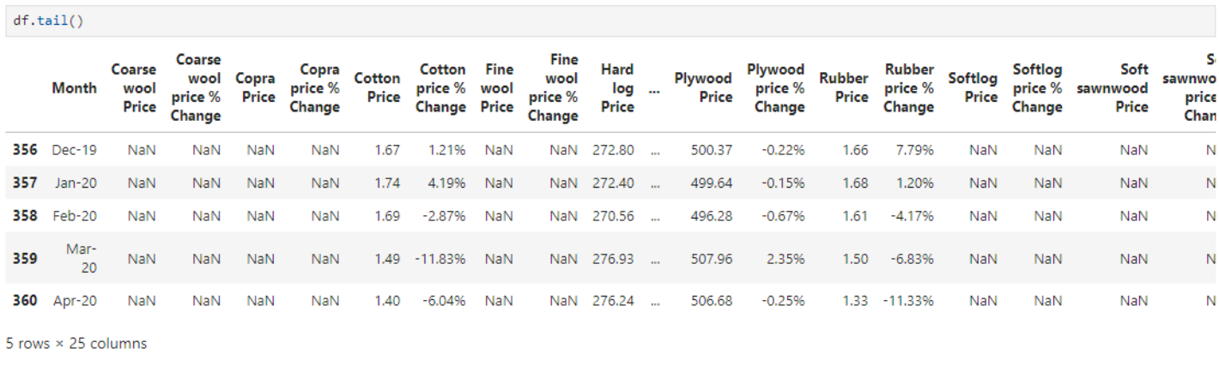
EDA
Data Snapshot:

Slide 9
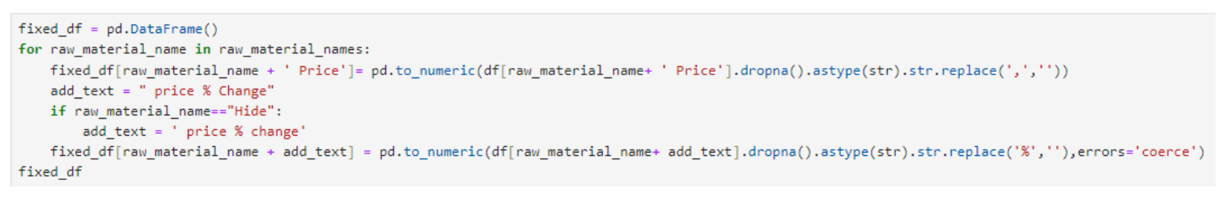
Using the following lines of code we show a small part of our preprocessing to convert all columns into required
Format while avoiding the NaN values.

Slide 10
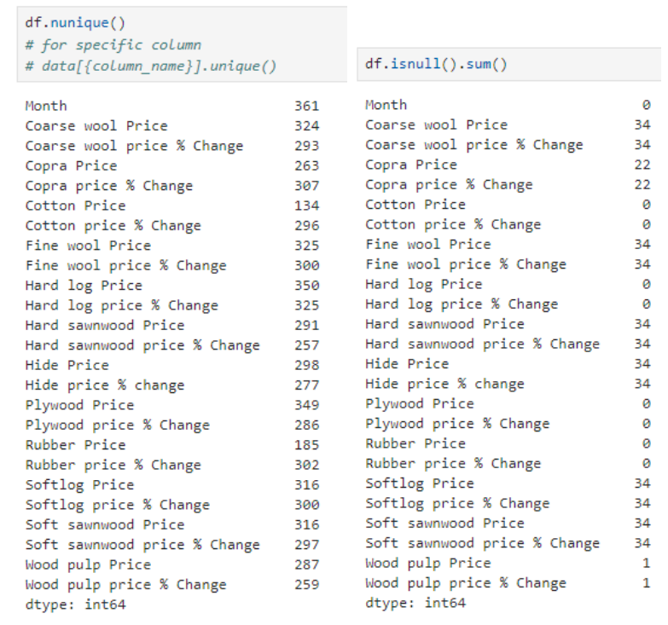
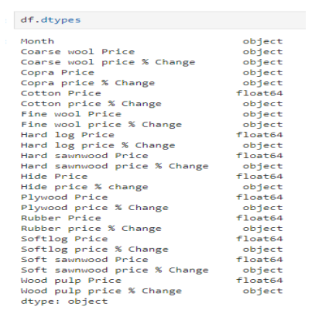
The previous code snippet takes care a small part of the following issues shown in the images below.
[for full code use the project_code from GITHUB]

Slide 11
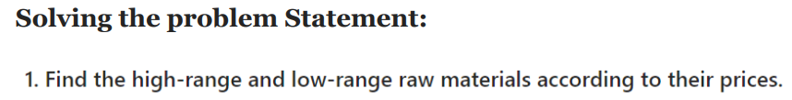
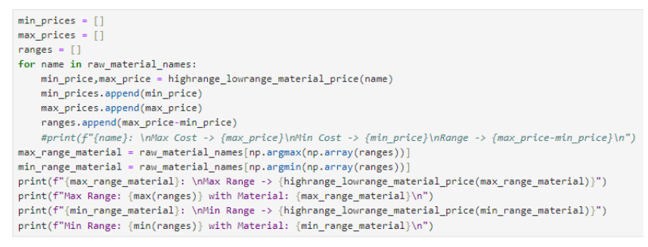
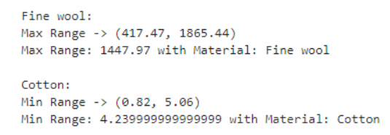
CODE SNIPPET
OUTPUT:

Slide 12
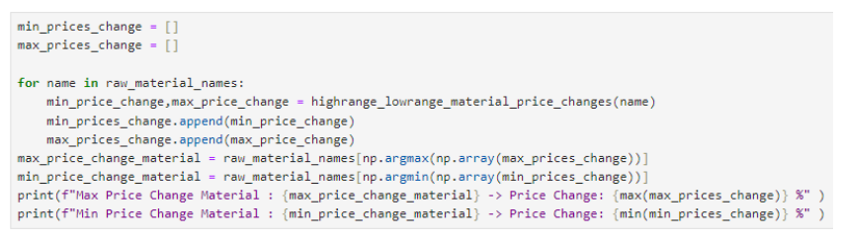
CODE SNIPPET
OUTPUT:

Slide 13
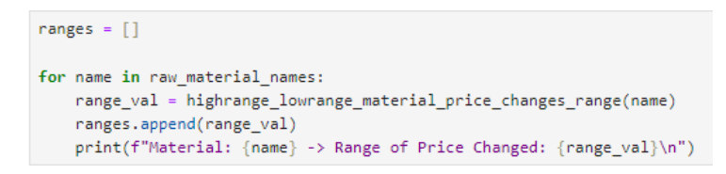
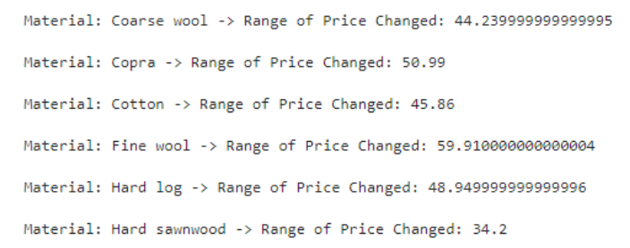
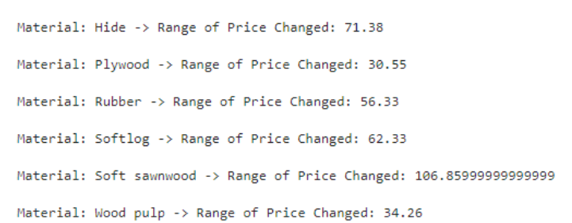
CODE SNIPPET
OUTPUT:

Slide 14
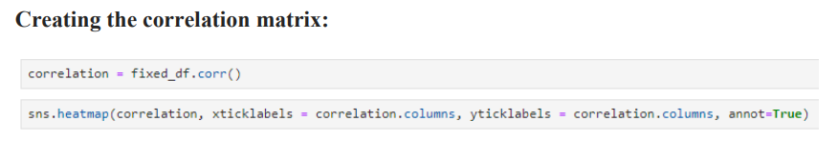
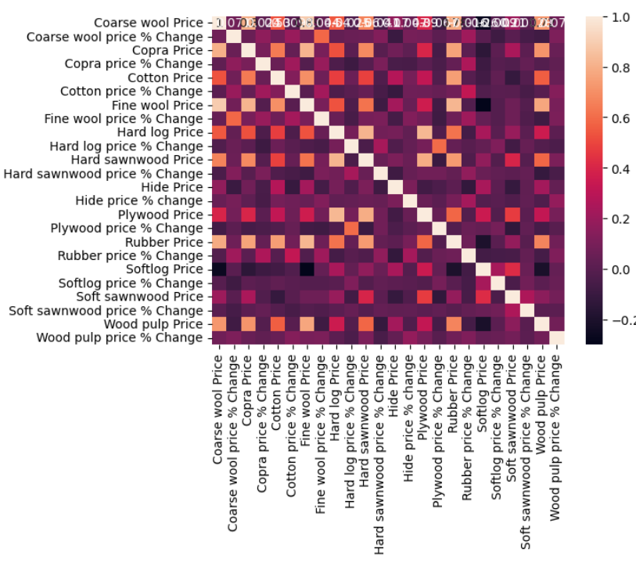


Slide 15

Future Scope
Real-time price data integration: This allows for a more dynamic understanding of market fluctuations, enabling stakeholders to make informed decisions in a rapidly changing environment.
Machine learning for price prediction: Techniques like regression or time series forecasting could potentially predict future price trends, providing valuable insights for strategic planning and risk mitigation.
Incorporating external factors: Analyzing external factors like weather patterns, global economic trends, and government policies could lead to a more holistic understanding of how these elements influence agricultural raw material prices.
Global market data exploration: Expanding the analysis to encompass global price data would offer insights into international market dynamics and potential diversification opportunities.

Slide 16

Conclusion
This project has gone through the given data and performed the required transformations on it as such as provided results as accurate as possible.
Overall this project has:
Analyzed historical agricultural raw material prices.
Gained comprehensive understanding of historical price behavior.
Identified consistently high and low-priced materials.
Pinpointed materials with significant price fluctuations.
Uncovered potential correlations between material prices (visualized with a heatmap).

Slide 17
Reference
https://github.com/HariCane193
https://github.com/ramar92/TNSDC-NM-Engineering-Colleges/tree/main
https://www.researchgate.net/publication/308007227_Exploratory_Data_Analysis
Project Link:
https://github.com/HariCane193/EDA_AgriculturalRawMaterialAnalysis

Slide 18
Thank you!

