Slide 1

Hari Chandana Datla
Lakshmi Chandana Shaik
Guided by Prof. Chaojie Wang

Slide 2


Introduction
Health occupies utmost priority in everyone’s life.
Falling prey of Chronic diseases.
Unhealthy behaviors and eating habits.
Looks into prevention.
How many are taking actions based on their health outcomes

Slide 3

Data Source
The source for this data is CDC(Centers for Disease Control and Prevention)., Division of Population Health, Epidemiology and Surveillance Branch and this project of making this dataset was funded by the Robert Wood Johnson Foundation (RWJF) in conjunction with the CDC Foundation.
Size of dataset is 224.276 MB.
The dataset has 810k rows and 24 columns.

Slide 4
Dataset
Contains health metrics for over 28,000 different census tracts within the 500 largest cities in America. It’s an awesome data-set because of the sheer quantity of locations included and also because of the amount of detailed structured data it contains for each of those very specific locations.
It includes columns such as State, city, population count, health measures, categories that the health measures fall into, Measure id, Category id and so on.

Slide 5
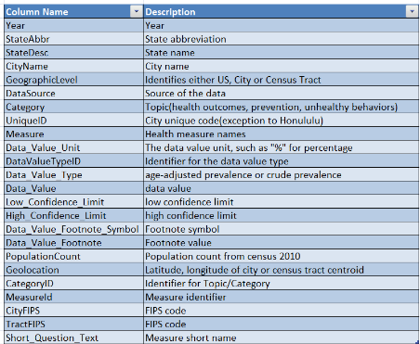
Dataset Columns
hgbugv

Slide 6
Aim & Purpose of Project
Helps in bring out the states that stand tall in their occurrence with respect to all the categories like Unhealthy behaviors, Prevention and Health outcomes.
The analytics could be helpful for Govt or private organizations in planning health care initiatives specific to a city or a region.

Slide 7
Literature Review
Pandas
Matplotlib
Machine learning libraries
Spark
Linear Regression
Lasso Regression
Ridge Regression
Decision Tree Classifier
Random Forest Classifier
Accuracy
Standard Deviation

Slide 8

Research Questions
The main objective is to analyze the unhealthy behaviors, health outcomes and prevention (3 variables) in the dataset and their relation with various health measures
Which cities are more into prevention?
Identifying which machine learning model gives the best accuracy score for our analysis.

Slide 9
Research Process
Data collection
Data cleaning
EDA
Data Visualization
ML models
Results

Slide 10
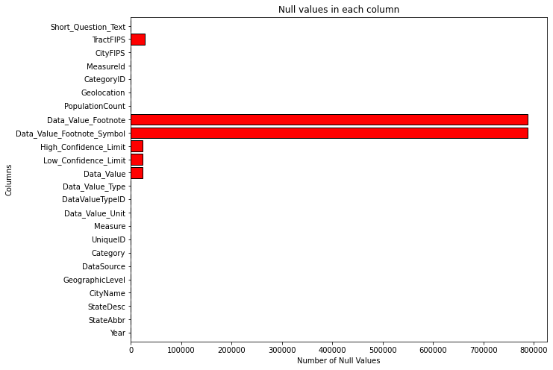
Data Preparation
Null values

Slide 11

Exploratory Data Analysis

Slide 12
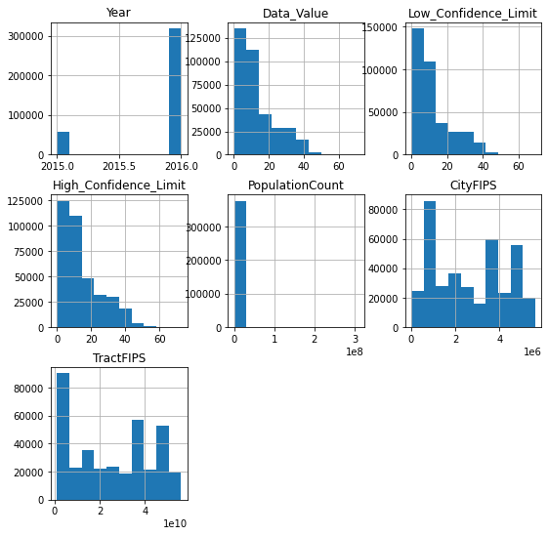
Grouping the features by target feature “CategoryID”
fv

Slide 13
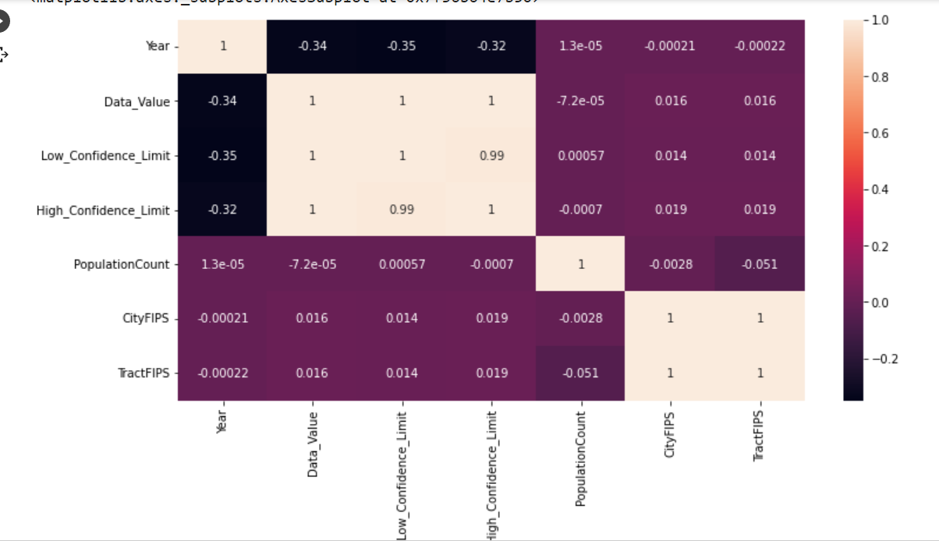
Correlation Matrix

Slide 14
abc
Data Visualization of New York data
file:///C:/Users/91951/Documents/MASTERS/DATA%20606/Downloaded%20Files/NY_info.html
Comparison after dividing the New York data into test and train datasets
file:///C:/Users/91951/Documents/MASTERS/DATA%20606/Downloaded%20Files/Compare.html

Slide 15
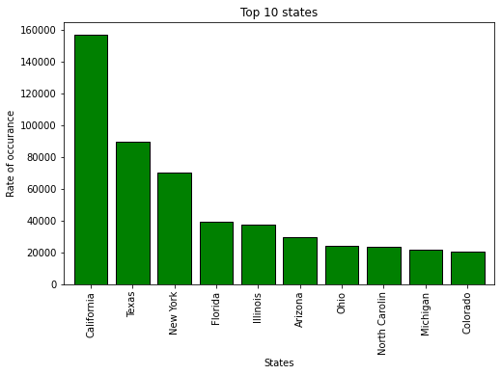
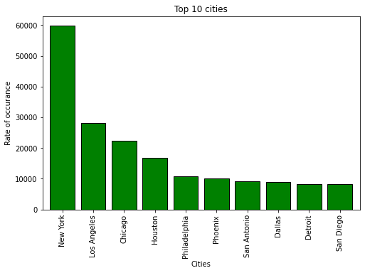
abc
Below are the States and Cities that ranked top 10 in our analysis.

Slide 16
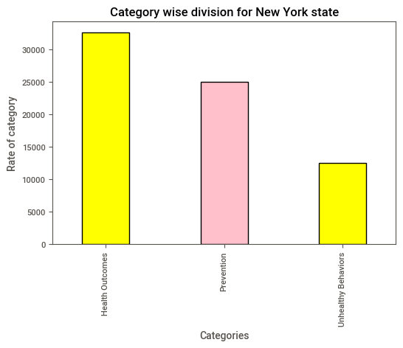
abc
Analysing New York Records

Slide 17
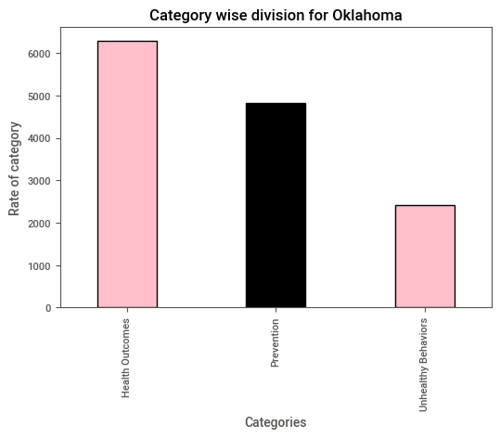
abc
Analysing Oklahoma Records

Slide 18
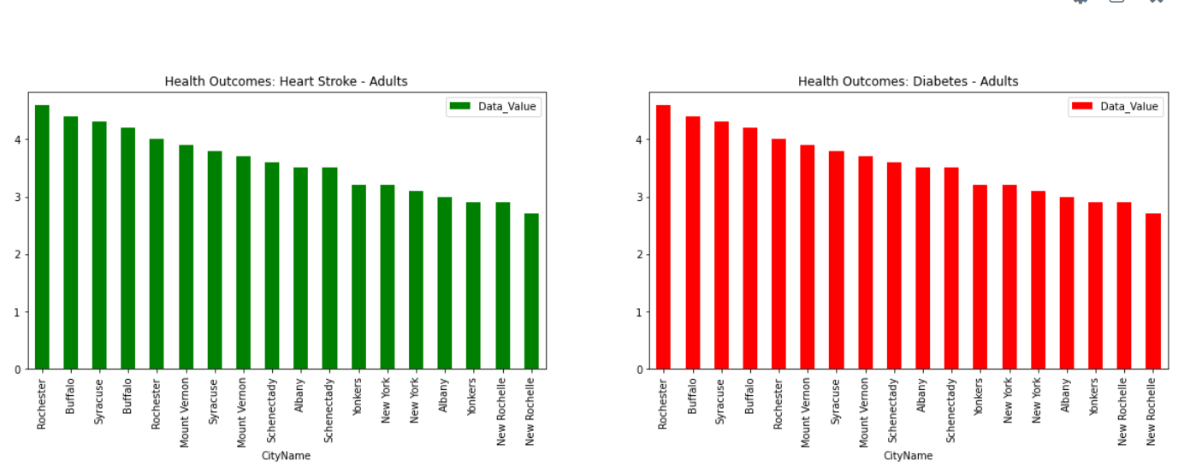
EDA for New york state
Heart Stroke and Diabetes prevalence.

Slide 19
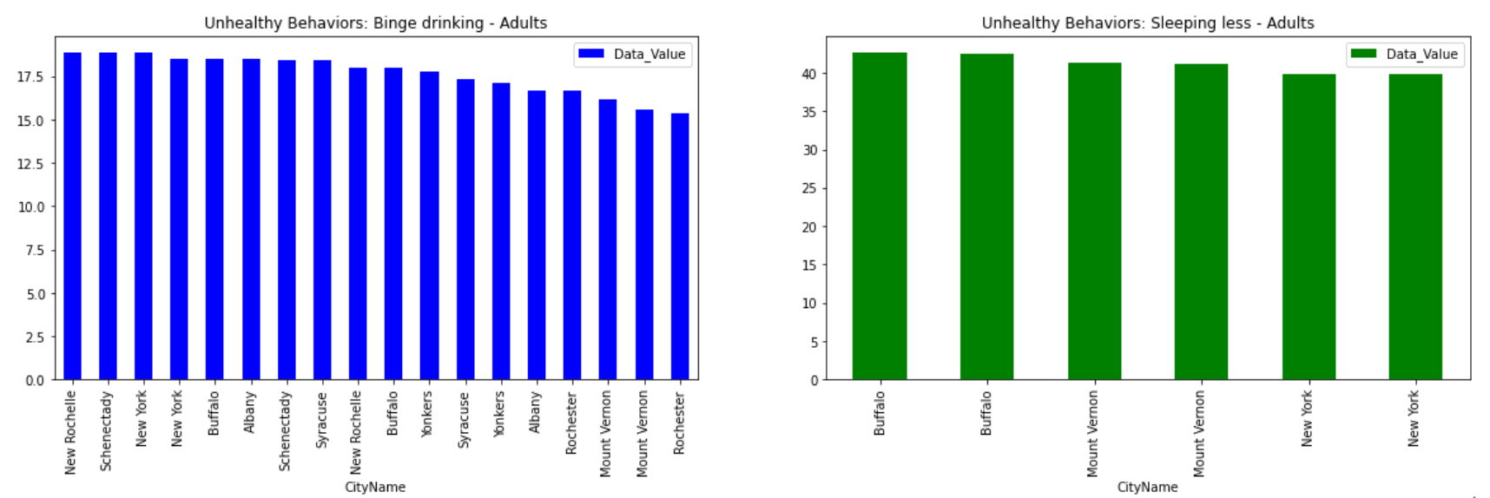
New york state- Prevalent unhealthy behaviors
Binge Drinking and sleep deprivation in adults.

Slide 20
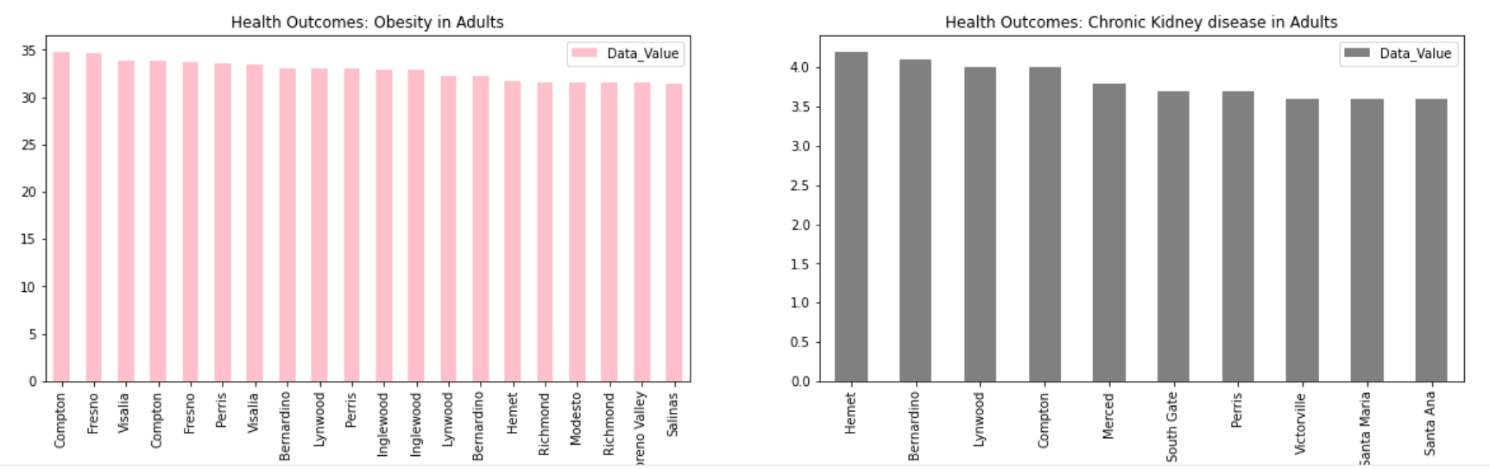
California State
Obesity and chronic kidney disease in adults.

Slide 21
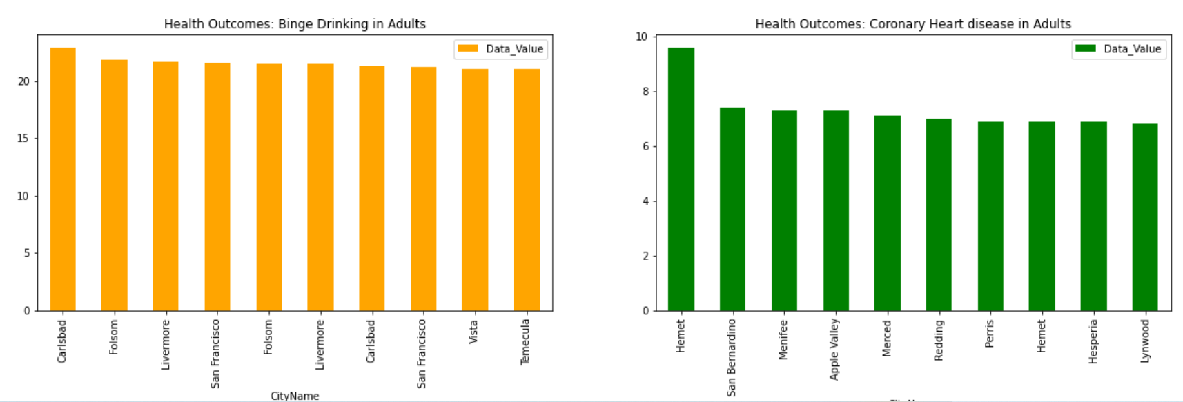
California State
Binge drinking and coronary heart disease in Adults.

Slide 22
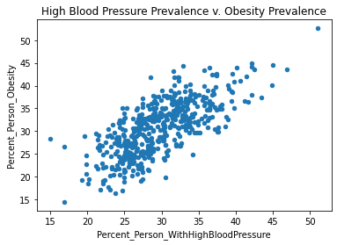
Relationship between high BP and obesity
cbd

Slide 23

Machine Learning
vgb

Slide 24
Machine Learning
Resampling the data
Data splitting
Training the models
Features used for training and encoding
Results

Slide 25
Dealing with Imbalanced Data
Matching the target classes is required because the model should give equal importance or weight to all the classes rather than being biased in detecting the majority class.
It is observed that the target class has an imbalance.

Slide 26
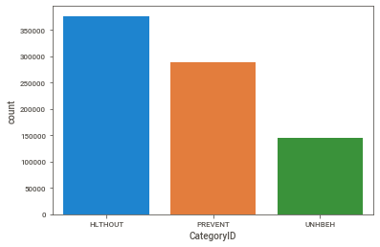
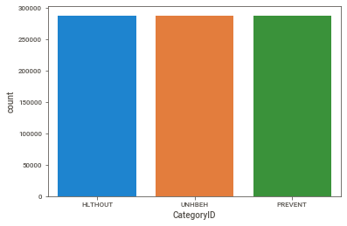
Resampling the Imbalanced Data
Before resampling After resampling

Slide 27
Linear Regression Vs Ridge Regression Vs Lasso Regression
Linear Regression Train Score: 0.8455
Linear Regression Test Score: 0.8268
Ridge Regression train score: 0.84553
Ridge Regression test score: 0.82689
Lasso Regression train score: 0.7957
Lasso Regression test score: 0.8041

Slide 28
DecisionTree
Scores : [0.982 0.982 0.9855 0.982 0.98 ]
Accuracy : 0.9823000000000001
Standard Deviation : 0.0017776388834631395

Slide 29
RandomForest classifier
Scores : [1. 1. 0.9995 1. 0.999 ]
Accuracy : 0.9997
Standard Deviation : 0.0003999999999999948

Slide 30
Conclusions
Decision Tree classifier worked at its best.
Generally, health outcomes topped up.
People are less into prevention.
Many people are into medications.

Slide 31
References
https://github.com/HariChandana1116/harichandana_data606
500 CIties link
https://towardsdatascience.com/whats-the-difference-between-linear-regression-lasso-ridge-and-elasticnet-8f997c60cf29

Slide 32

nh

