Slide 1
Secure Mobile-Cloud Storage with Location Based File Transfer System
Vaks
Sribhagat
Rachita
Chandana

Slide 2
Group project Description
TASK 1: Storing the file onto the cloud server
TASK 2: Request and transfer of the file from mobile device
TASK 3: Request and transfer of file from cloud
TASK 4: Implementing encryption and decryption while transferring data(alterative to RSA and digital signatures).

Slide 3
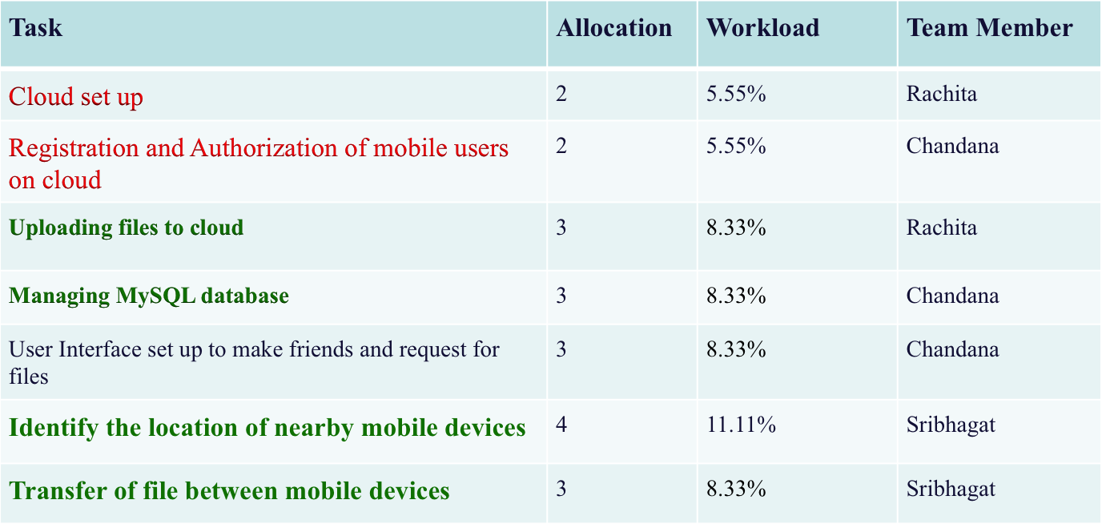
Project Description (cont.)
Tasks allocation

Slide 4
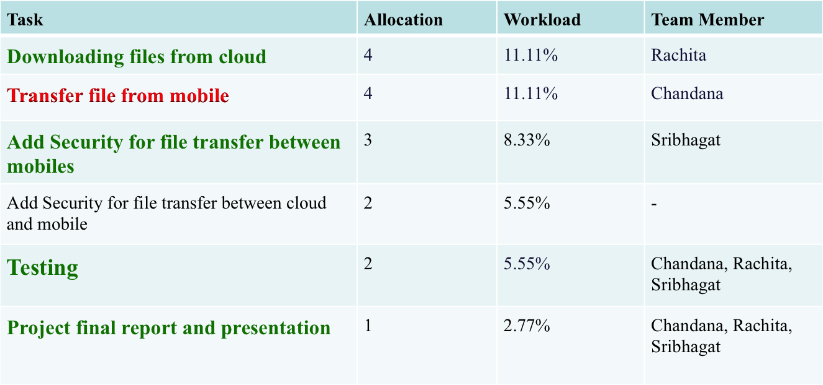
Project Description (cont.)
Tasks allocation

Slide 5
Technical Details
Software Used:
- Operating system: Android
- Cloud environment: Open Stack
- Language of implementation- Java
- Database: SQL server
Hardware Used:
- 8GB RAM
- 512GB HardDisk
- Intel RCore i5

Slide 6
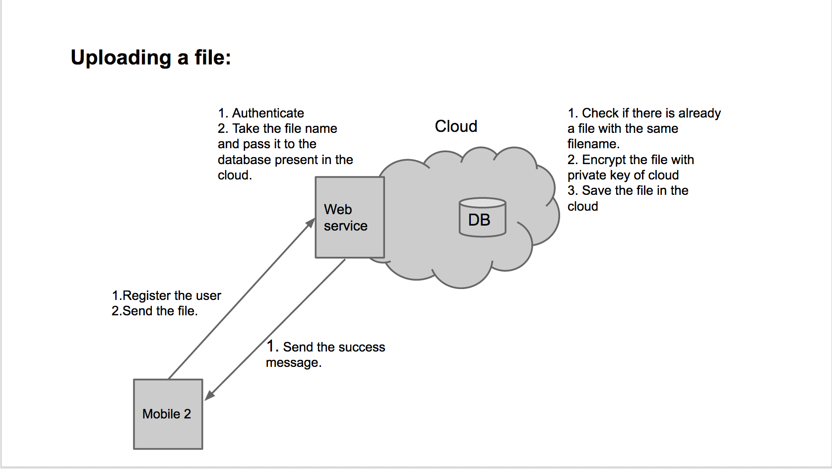
Technical Details

Slide 7
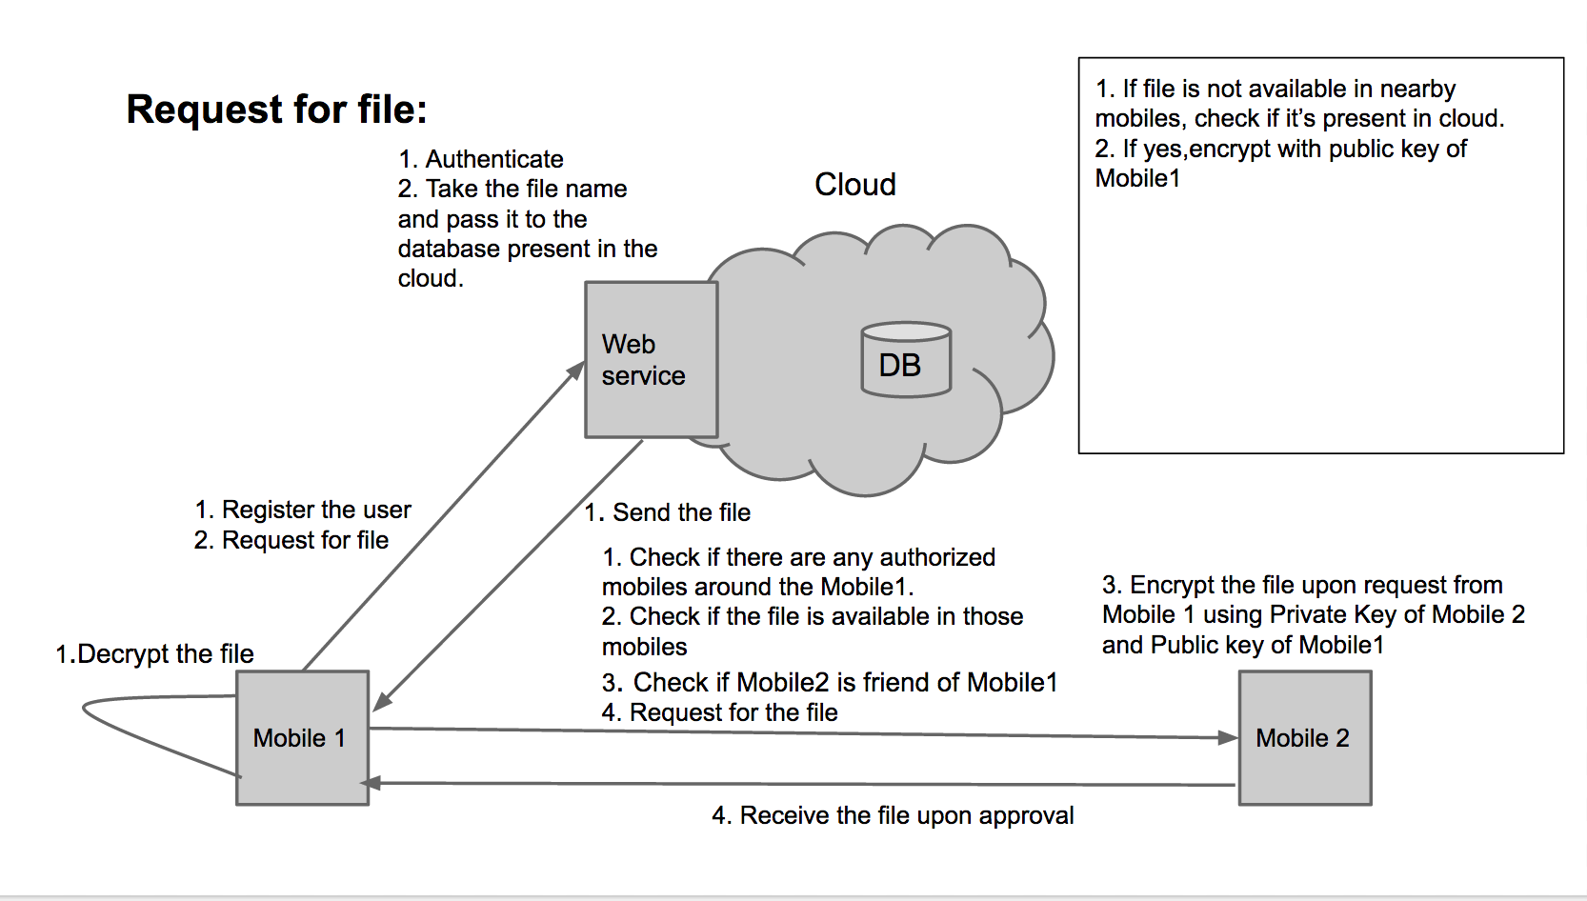
Technical Details

Slide 8
Technical Details
Mid-term goal of the project is as following:
- Upload file onto the cloud server.
- Request a file for download.
- Set up a cloud server that can handle the request and transfer the file either from the cloud storage or facilitate a mobile device nearby to transfer it.

Slide 9
Technical Details
Final goal of the project is the following:
- Build a secure file transfer system either from the mobile or cloud using encryption techniques
- Communication between mobile devices using sockets (transfer location information and requested file)
- A system that allows file transfer only between authorized users (friends of users)

Slide 10
Risks and Benefits
Novel aspects of this project:
  Location based file transfer enforces quick transfer of data from nearby mobile devices
  Uses the Base64 encryption techniques which is a simple encryption library provided in Android to imposing secure data transmission
  Reliable transfers files between trusted devices
  Secure data transmitted between mobile devices
Risks/challenges:
  Imposing very high level of security can be a challenge considering the given time for implementation
  RSA implementation : Challenging
  Alternative: Android.Util.Base64 library to impose encryption and decryption
  Concept of file transfer only between mutually accepted friends of the application

Slide 11
Risks and Benefits
Potential applications & benefits:
  This project can be extended to provide broadcasting feature where a professor can share files to a set of students who are registered to a specific course under him.
  A repository of small group project developer codes can be maintained which can be transferred between the members of the group
  Implementation of file transfer can be extended to custom made mobile applications which can be communicated to trusted users.

Slide 12
Tasks Accomplished
- Set up the cloud with XAMPP which is a cross platform web server solution supporting MySQL database and interpreter scripts in PHP
- Registration of members followed by their login
- Uploading of filenames and filepaths
- Discovery of mobiles and their IP to initiate transfer of files between them
Managing MySQL database
Display the user’s files present on the cloud on the mobile phone.
Communication between mobile devices using Sockets.
Transfer of files between the near by mobile devices

Slide 13
Tasks Accomplished ..contd
File download from the FTP if the mobile is not nearby or if the nearby mobile does not contain the required file
Tried implementing RSA encryption: Challenges faced
Impose encryption in message passing and file transfer between mobile devices using Android.util.Base64 library

Slide 14
Conclusion
Space problems faced by traditional mobile devices can be solved by storing the file content on cloud.
Download time is reduced as the file is transferred using the location based services
Burden on the cloud is reduced because the system first checks for nearby mobile devices and only then communicates with the cloud

Slide 15
Future Enhancements
Proximity of the mobile devices in our project is a static number. It can be made flexible by calculating the dynamic threshold for proximity.
This can be done by comparing file transfer rate and the time taken for file to be transferred between the mobile devices and that between the mobile device and the cloud.

Slide 16
Demo (if have)

