Slide 1







Snake Game
Prepared by:- Name: Harikrishna Rajeshbhai Gajjar Roll No: 252 Enrollment no: 2021002171210037 Batch: 10 Branch: CSE

Slide 2
Project Outline:-
Introduction
System design diagram (flow-chart / Algorithm….)
Functionality

Slide 3
Introduction

Slide 4
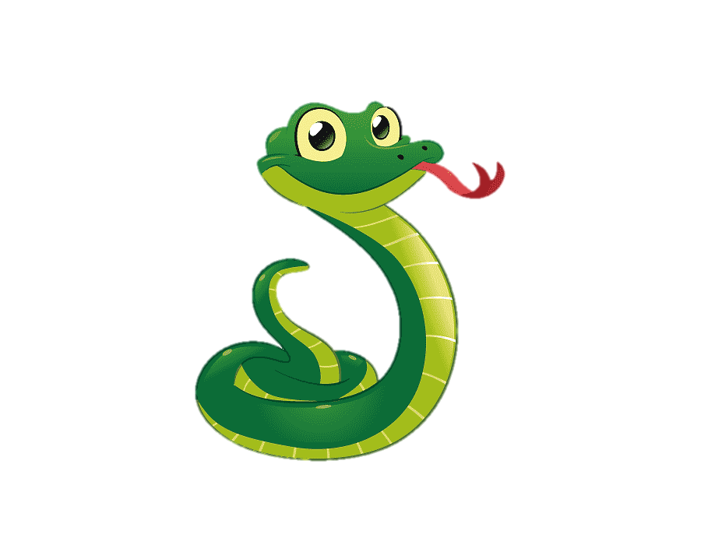
Snake is a video game that originated during the late 1970s in arcades becoming something of a classic.
It became the standard pre-loaded game on Nokia phones in 1998.
The player controls a long, thin creature, resembling a snake, which roams around on a bordered plane, picking up food (or some other item), trying to avoid hitting its own tail or the edges of the playing area.
Each time the snake eats a piece of food, its tail grows longer, making the game increasingly difficult.
The user controls the direction of the snake's head (up, down, left, or right), and the snake's body follows.

Slide 5
FLOWCHART

Slide 6
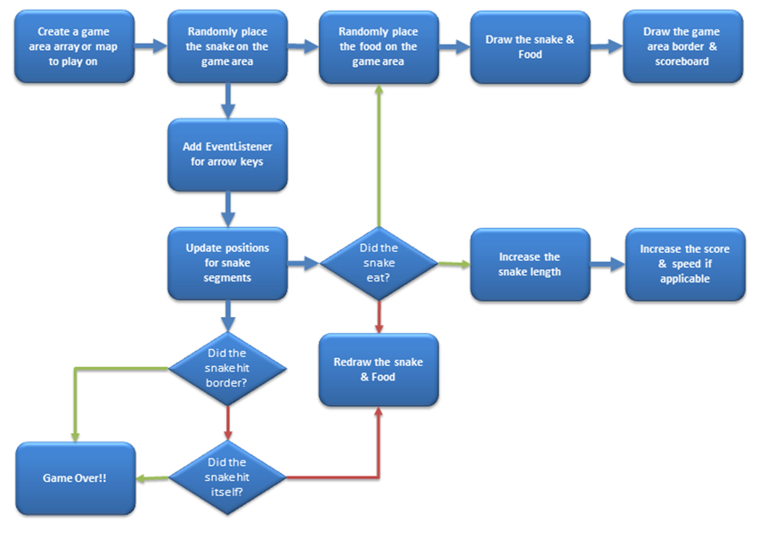

Slide 7
Functionality

Slide 8
BASIC INFORMATION OF SNAKE GAME
The snake is represented with a *(astreisk) symbol.
The fruit is represented with a F symbol.
The snake can move in any direction according to the user with the help of the keyboard (up,down,left,right keys).
When the snake eats a fruit the score will increase by 10 points.
The fruit will generate automatically within the boundaries.
Whenever the snake will touch the boundary the game is over.

Slide 9
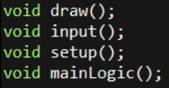
STEPS TO CREATE THIS GAME:-
There will be four user-defined functions.
Build a boundary within which the game will be played.
The fruits are generated randomly.
Then increase the score whenever the snake eats a fruit.
The user-defined functions created in this program are given below:
Draw(): This function creates the boundary in which the game will be played.
Setup(): This function will set the position of the fruit within the boundary.
Input(): This function will take the input from the keyboard.
Logic(): This function will set the movement of the snake.

Slide 10
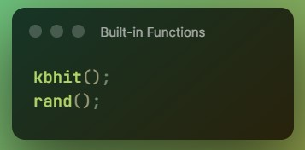
Built-in functions used:
kbhit(): This function in C is used to determine if a key has been pressed or not. To use this function in a program include the header file conio.h. If a key has been pressed, then it returns a non-zero value otherwise it returns zero.
rand(): The rand() function is declared in stdlib.h. It returns a random integer value every time it is called.

Slide 11
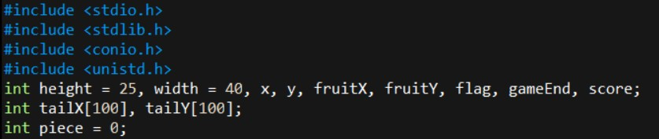
Header Files And Variables
The header files and variables used in this program are:
Here include the <unistd.h> header file for the sleep() function.
Draw(): This function is responsible to build the boundary within which the game will be played.

Slide 12
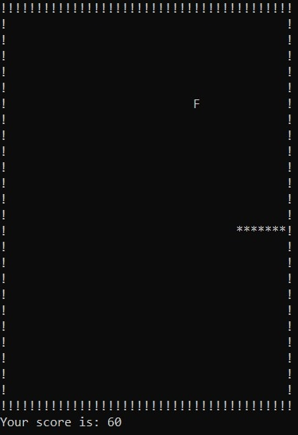
OUTPUT

Slide 13
THANK YOU!!

