Slide 1
PSCS147 – GAMING BUILT AROUND BUSINESS SIMULATION
PIP2001 Capstone Project
Review-3
Batch Number:26
Under the Supervision of,
Dr. Ramesh Sengodan
Professor
School of Computer Science and Engineering
Presidency University
Roll Number | Student Name
20211CSE0306 20211CSE0341 20211CSE0265 20211CSE0076 | AMAN SRIVASTAVA LIKHITH S DHEERAJ KUMAR B HARIHANTH M
Name of the Program: CSE
Name of the HoD: Dr.Asif Mohammed
Name of the Program Project Coordinator: Mr. Amarnath J.L & Dr. Jayanthi. K.
Name of the School Project Coordinators: Dr. Abdul Khadar A

Slide 2
Introduction
What is Business Simulation? Business simulation involves creating a virtual environment where individuals can engage in realistic business scenarios. This approach allows participants to make decisions, manage resources, and experience the consequences of their choices in a risk-free setting.
Importance of Gaming in Business Simulations
Engagement: Incorporating gaming elements increases participant engagement and motivation, making learning enjoyable and interactive.
Real-World Application: Simulations replicate real-world challenges, providing valuable insights into business operations and strategies.

Slide 3
Literature Review
According to Gentry, J. W. (1990), simulations offer an active learning environment where students can practice decision-making skills in a simulated business context.
Kriz, W. C., & Hense, J. (2006) discuss how business simulation games facilitate soft skill development, including communication, leadership, and team collaboration.
Mayer, I. S., & Veeneman, W. W. (2002) demonstrate how simulation games can be applied to policy-making and organizational studies, providing insights into decision-making under uncertainty.

Slide 4
Existing method Drawback
Limited Engagement: Traditional methods often rely on lectures and static case studies, which can lead to low participant engagement.
Insufficient Feedback: Traditional methods often provide limited feedback on decision-making, hindering the opportunity for participants to learn from their mistakes.
Lack of Collaboration: Conventional methods may not foster teamwork or collaborative problem-solving, which are essential skills in the business world.

Slide 5
Proposed Method
Interactive Gaming Elements: Incorporate gamification techniques, such as points, levels, and challenges, to enhance engagement and motivation among participants.
Real-Time Feedback Mechanisms: Implement systems that provide immediate feedback on decisions, allowing participants to reflect on their choices and learn from mistakes in real-time.
Collaborative Learning Environments: Design simulations that require teamwork and communication, enabling participants to work together to solve problems and make decisions, thereby fostering collaboration.

Slide 6
Objectives
Enhance Learning Engagement: Utilize gaming elements to create an interactive and enjoyable learning experience that keeps participants motivated.
Provide Real-Time Feedback: Develop a system that offers immediate feedback on decisions, facilitating reflective learning and continuous improvement.
Foster Collaboration: Design simulations that encourage teamwork and communication, essential skills for success in the business environment.

Slide 7
Methodology/Modules
1. Research and Analysis
Conduct a literature review of existing business simulation methods and educational practices.
Gather feedback from potential users to identify needs and preferences.
2. Game Design
Develop game mechanics that incorporate engagement, feedback, and collaboration.
Create storylines and scenarios that reflect real-world business challenges.
3. Prototype Development
Build an initial prototype of the gaming platform to test key features and functionality.
Use agile development practices to iteratively refine the game based on user feedback.

Slide 8
Methodology/Modules
4. Implementation of Feedback Systems
Integrate real-time feedback mechanisms to provide participants with insights on their decisions.
Include analytics to track performance and learning progress.
5. Collaboration Features
Design modules that facilitate teamwork, such as group tasks and competitive elements.
Ensure communication tools are available for participants to interact effectively.

Slide 9
Architecture
User Interface Layer
Dashboards
Decision Panels
Game Mechanics Interface
Game Logic Layer
Decision Processing
Economic Models
Business Operations Models
Simulation Engine
Time Progression Module
Random Event Generator
AI-Driven Competitors
Database Layer
User Data
Game Data
Historical Data
Analytics & Reporting Module
Reports and Graphs
Comparative Analysis
Optional Layers: AI, Multiplayer, External Data
AI & Machine Learning Layer
Multiplayer & Networking Layer
External Data Integration

Slide 10
Hardware/software components
Hardware Components
A powerful system with a multi-core processor (Intel i5/i7/i9 or AMD Ryzen 5/7/9), at least 8GB of RAM, integrated graphics for 2D simulations.
A mid-range to high-end Android device (with different screen sizes) for testing the game
Software Components
Android Studio for app development.
SQLite for storing in-game data, player progress, and game state locally.
LibGDX an open-source game development framework.

Slide 11
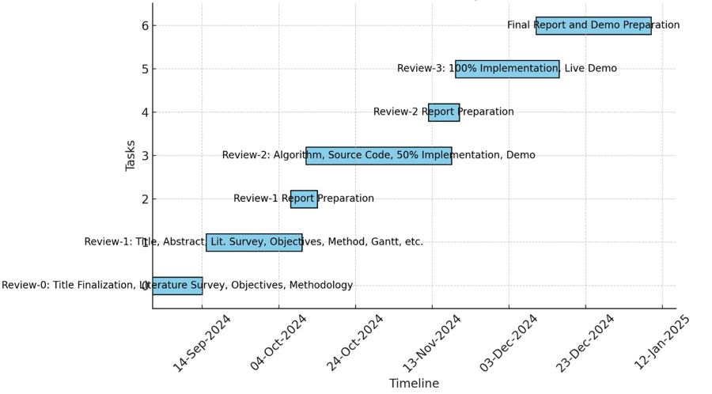
Timeline of Project

Slide 12
Expected Outcomes
Enhanced Engagement: Participants will show increased motivation and active involvement due to interactive gaming elements.
Improved Decision-Making Skills: Users will develop stronger abilities to analyze situations and make informed decisions in complex business scenarios.
Collaboration and Teamwork: Participants will enhance their collaboration skills by working together on tasks and solving problems in multiplayer settings.

Slide 13
Conclusion
Our project focuses on enhancing business education through an interactive gaming platform.
We aim to overcome drawbacks of traditional methods, such as low engagement and insufficient feedback.
Participants will develop critical decision-making and teamwork skills, bridging the gap between theory and practice.

Slide 14
Github Link
GitHub Link :
https://github.com/HariHanth96/projectid26.git

Slide 15
References
Gentry, J. W. (1990). "What is Experiential Learning?". Guide to Business Gaming and Experiential Learning.
Anderson, P. H., & Lawton, L. (2009). "Business Simulations and Cognitive Learning". Journal of Management Education

Slide 16
Thank You

Slide 17

Project work mapping with SDG

