Slide 1


EVIDENCE MANAGEMENT USING BLOCKCHAIN
Team members
717822F218 HARIHARAN.M
717822F232 MUKESH.R
717822F254 SIVASAKTHI.P
,
Assistant Professor,
Department of Information Technology,
Karpagam college of Engineering, Coimbatore

Slide 2
Abstract
Evidence management is crucial for law enforcement and legal processes, but traditional systems face issues like tampering and lack of transparency. Blockchain technology offers a solution by providing a decentralized, immutable ledger that secures the integrity and traceability of evidence. Our project explores how blockchain enhances evidence management through cryptographic hashing, timestamping, and improved chain-of-custody tracking, ensuring authenticity and reducing human error. Case studies highlight blockchain’s potential to improve security, efficiency, and trust in managing digital evidence across legal and forensic settings. Positioned to redefine communication training, it heralds a transformative learning experience poised for widespread adoption.
Snaptok: Revolutionizing Communication Education
Platform: AI-driven
Features: Real-time feedback
Focus: Individual growth
Impact: Societal benefits
Future: VR integration

Slide 3
Objective
To implement blockchain for securing and enhancing evidence management.
To provide a system that ensures:
Integrity of evidence records.
Proper chain of custody with transparent tracking.
Automation of workflows for access and transfer of evidence.
To address key challenges such as scalability and legal compliance.

Slide 4
Problem Statement
Problem Statement Id : 1326
Ideate and implement a system to enhance the quality of communication

Slide 5
Key features of SNAPTOK
Decentralized Ledger:
No central authority—data is stored across multiple nodes.
Immutability:
Once recorded, evidence data cannot be altered.
Smart Contracts:
Automated rules for access control and evidence management.
Chain of Custody:
Clear, transparent record of who accessed and handled evidence at all times.
Encryption & Security:
Cryptographic techniques to secure data and prevent unauthorized access.

Slide 6
Competitive Advantage of SNAPTOK
Tamper-Proof Records:
Immutable logs of evidence transactions.
Enhanced Transparency:
All stakeholders can verify the integrity and history of evidence.
Automated Workflow:
Smart contracts ensure smooth and secure access control.
Decentralization:
No single point of failure; the system remains operational under cyberattacks or server failure.
Increased Trust:
Strengthens the credibility of evidence in legal proceedings.

Slide 7
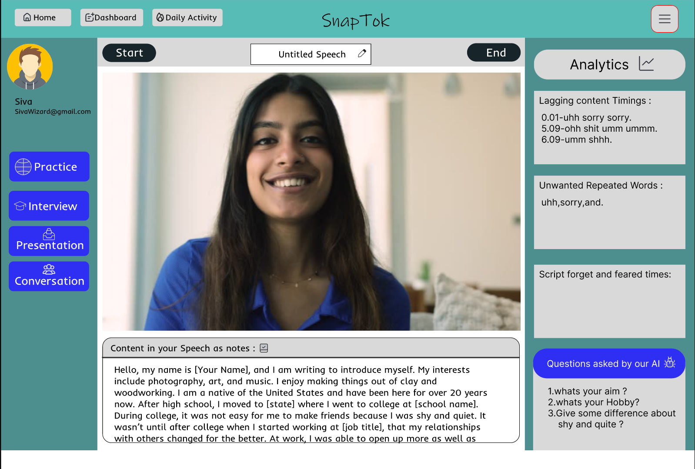
Proposed Model

Slide 8
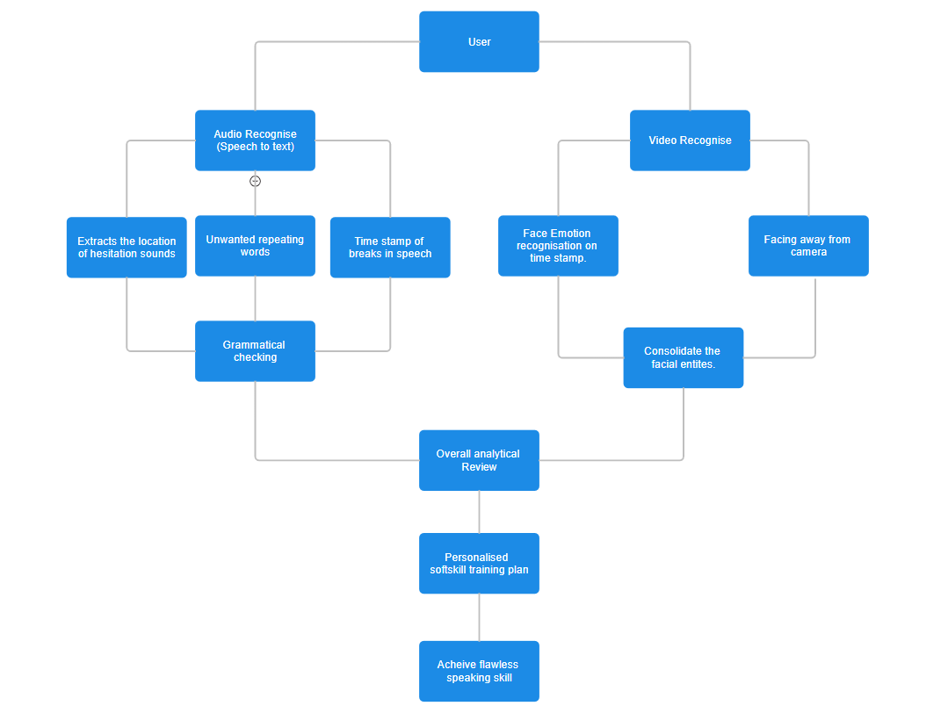
Block Diagram

Slide 9
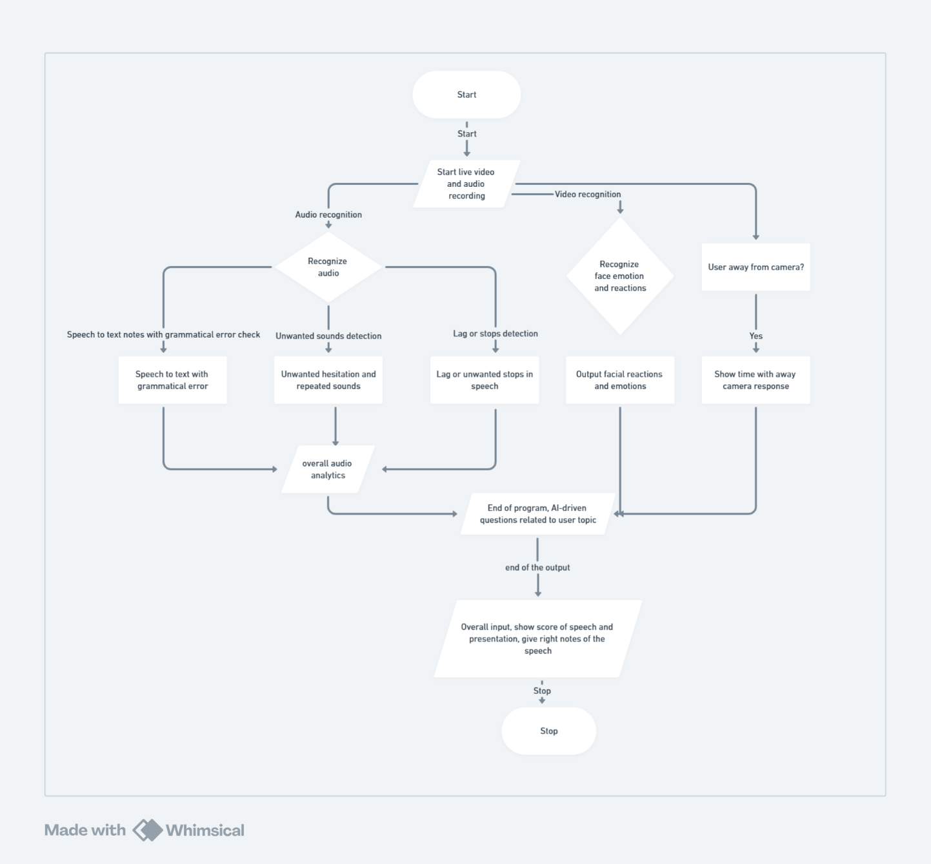
Flowchart

Slide 10
Algorithms Used
Consensus Algorithms:
Proof of Work (PoW): Ensures decentralized agreement on evidence transactions.
Proof of Stake (PoS): Used for energy-efficient consensus.
Hashing Algorithms:
SHA-256 or similar cryptographic hashing algorithms to ensure data integrity.

Slide 11
Collect and Annotate Data
Goal: Create a dataset that includes hesitation sounds explicitly labeled.
Steps:
1. Gather Data:
i.Collect audio recordings from various sources where hesitation sounds are naturally present. This could include interviews, casual conversations, podcasts, etc.
ii.Ensure diversity in accents, speaking styles, and environments to make the model robust.
2,Annotate the Data:
i. Use tools like ELAN or Praat to manually annotate the audio files.
ii..Label hesitation sounds explicitly. For example, transcriptions should include "uh", "umm", "hmm" as part of the text.

Slide 12
Preprocess the Data
Goal: Prepare the data for training by ensuring hesitation sounds are treated as distinct tokens.
Steps:
1. Tokenization:
i. Use a tokenizer that can handle hesitation sounds as separate tokens.
ii. If using a library like Hugging Face's transformers, customize the tokenizer to include hesitation sounds.
2. Data Augmentation (Optional):
i. If the dataset is small, create synthetic samples by adding hesitation sounds to existing clean speech data.

Slide 13
Fine-Tune the Model
Goal: Train a pre-trained speech-to-text model to recognize and transcribe hesitation sounds.
Steps:
1. Choose a Pre-trained Model:
i. Use a model like Wav2Vec 2.0 by Facebook AI, which is well-suited for speech recognition tasks.
2. Fine-Tuning Process:
i. Load the pre-trained model and tokenizer from Hugging Face's transformers library.
ii. Prepare the dataset, ensuring it is tokenized correctly.
iii. Fine-tune the model with the dataset that includes hesitation sounds.

Slide 14
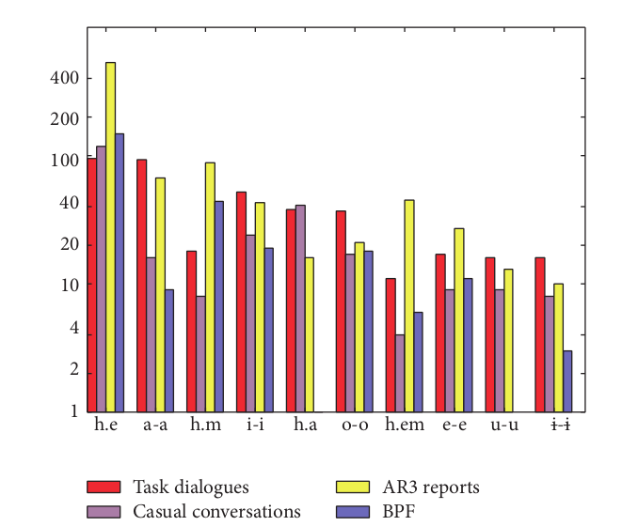
Report
Distribution (in log scale) of the top ten frequent hesitations across the parts of joint corpus, where h.e, h.m, h.a and h.em are filled pauses, and others are lengthenings of certain vowels (/a/, /i/, /o/, /e/, /u/ ).

Slide 15
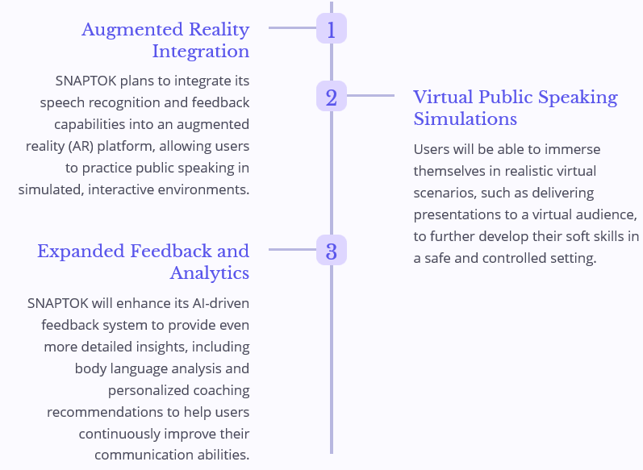
Future Scopes

Slide 16
References
Speech Module:
Research on Speech Separation and Recognition Algorithm Based on Deep Learning :
Author(s): Sarah Wan
Published in: 2021 IEEE International Conference on Power, Intelligent Computing and Systems (ICPICS)
Publisher: IEEE
DOI: 10.1109/ICPICS52425.2021.9524204
Effective speech emotion recognition using deep learning approaches for Algerian dialect :
Author(s): Raoudha Yahia Cherif, Abdelouahab Moussaoui, Nabila Frahta, Mohamed Berrimi.
Published in: 2021 International Conference of Women in Data Science at Taif University (WiDSTaif )
Publisher: IEEE
DOI: 10.1109/WiDSTaif52235.2021.9430224
Face Module:
Real-Time Emotion Recognition from Facial Expressions using Artificial Intelligence:
Author(s): Prashant Dhope, Mahesh B. Neelagar.
Published in: 2022 2nd International Conference on Artificial Intelligence and Signal Processing (AISP)
Publisher: IEEE
DOI: 10.1109/AISP53593.2022.9760654
Facial Expression Recognition Using CNN:
Author(s): Fahreddin M. Sadikoğlu, Mohamed Idle Mohamed.
Published in: 2022 International Conference on Artificial Intelligence in Everything (AIE)
Publisher: IEEE
DOI: 10.1109/AIE57029.2022.00025

Slide 17
Conclusion
Snaptok leverages advanced AI technologies to help users improve their public speaking and interview skills. By detecting hesitation sounds, assessing confidence levels, and providing real-time feedback, it offers a comprehensive solution to enhance soft skills crucial for personal and professional success.

Slide 18
THANK YOU!

