Slide 1




Track AI
Finding Missing Person
Team ID - 6916
OMKAR CHILLORE
HARI JHA
SHUBHAM GOHIL
SANKET BELEKAR

Slide 2

Project Objectives
Problem Statement
Project Overview – Introduction
End Users
Wow Factor in Project
Modelling/Block Diagram/Flow of Project
Result/outcomes
Conclusion
Future Perspective

Slide 3
Problem Statement
The efficient and timely location of missing individuals is a critical challenge faced by law enforcement agencies and communities worldwide. Current methods often rely heavily on manual processes, leading to delays and reduced success rates.
Problem: Develop a comprehensive and scalable solution to expedite the search and recovery of missing persons by leveraging advanced technologies to analyze and correlate vast amounts of data, improve information sharing, and enhance investigative capabilities.

Slide 4
Project overview - Introduction
In this world, a countless number of kids, mentally ill or mentally disabled people are missing sometimes. This project proposes a method that would help the administration for searching the missing people. Missing person cases are a growing concern, worldwide, with thousands of people going missing every year.
The traditional methods of finding missing persons have been limited to missing person posters, physical search parties, and relying on tips from the public. These methods are time-consuming, costly, and not always successful in locating the missing person. The use of technology has the potential to provide more efficient and effective means of finding missing persons.
In this project, we propose an application built using Python that utilizes facial recognition technology and machine learning algorithms to help locate missing persons. In this application we, there will be the feature of saving all the data of the missing person so that system can detect that image data and trace the missing person.

Slide 5
End User
End Users of the Missing Person Finder Application:-
1. Law Enforcement Agencies
Police departments can use the app to quickly scan and match missing persons’ faces.
Helps in real-time tracking and locating individuals efficiently.
2. NGOs & Human Rights Organizations
Groups working on human trafficking, child abduction, and missing persons cases can use it for better tracking.
Helps in collaborating with authorities for rapid response.
3. Hospitals & Mental Health Centers
Helps identify unknown patients (like unconscious accident victims or people with amnesia).
Useful for mentally ill or disabled individuals who might be unable to communicate.

Slide 6
Wow Factor in Solution
A Unified Global Network! One Connected System – Governments, NGOs, and the public can access a shared global database of missing persons.
Self-Learning System– The system improves over time by learning from real-world success cases.
Decentralized Missing Persons Registry – Prevents data tampering & unauthorized access.
Anonymous Tip-Offs – People can submit leads without revealing their identity.
Verified Reports Only – filters fake/misleading reports to reduce false alarms.
Multi-Language Support – Helps across different countries and languages.

Slide 7
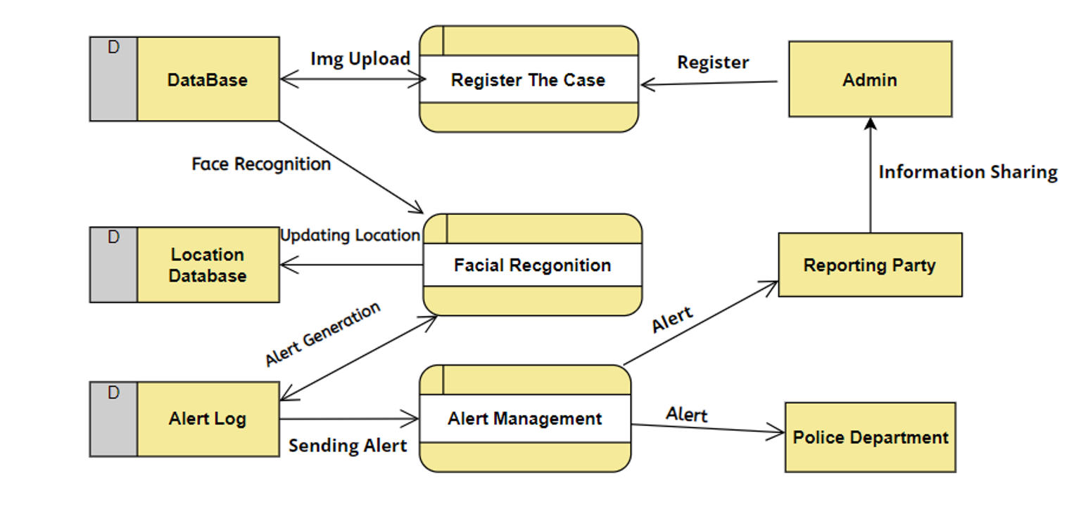
Modelling
Teams can add block diagram, Circuit diagram, wireframe etc​

Slide 8
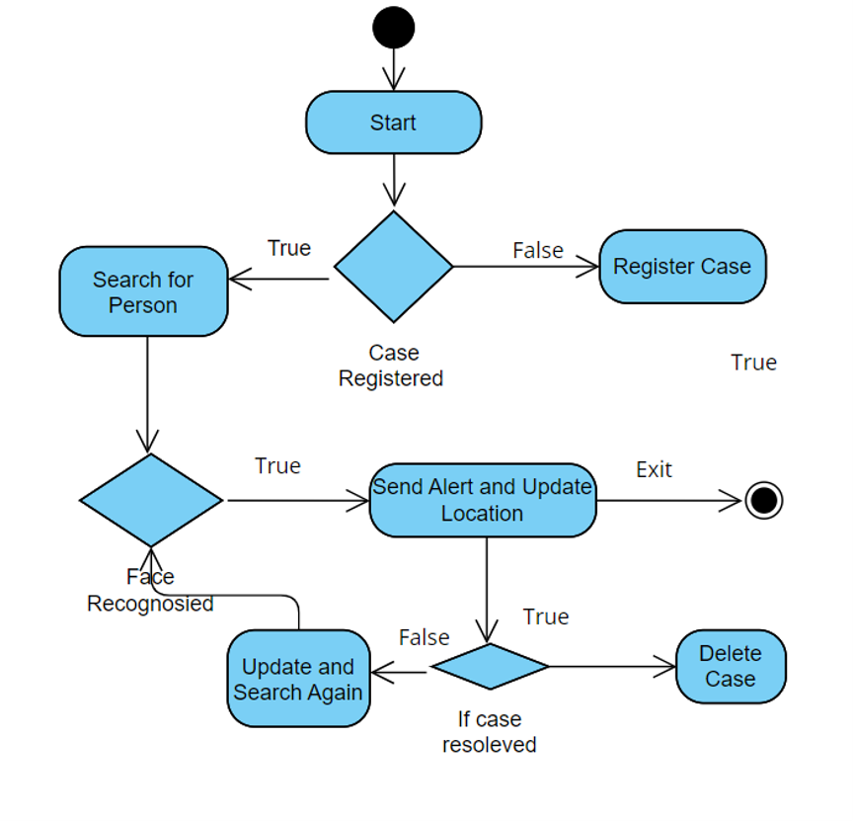

Slide 9

Result / Outcomes

Slide 10
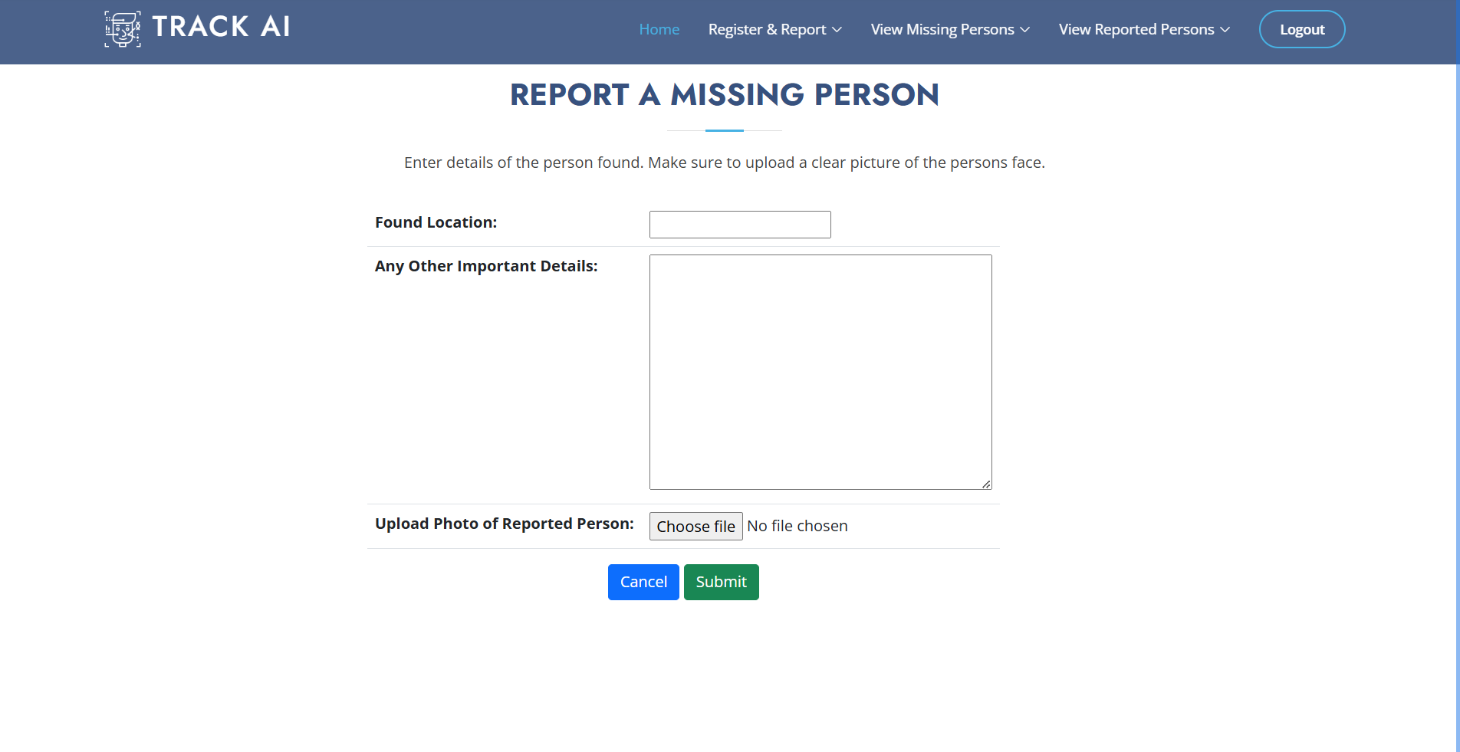

Slide 11
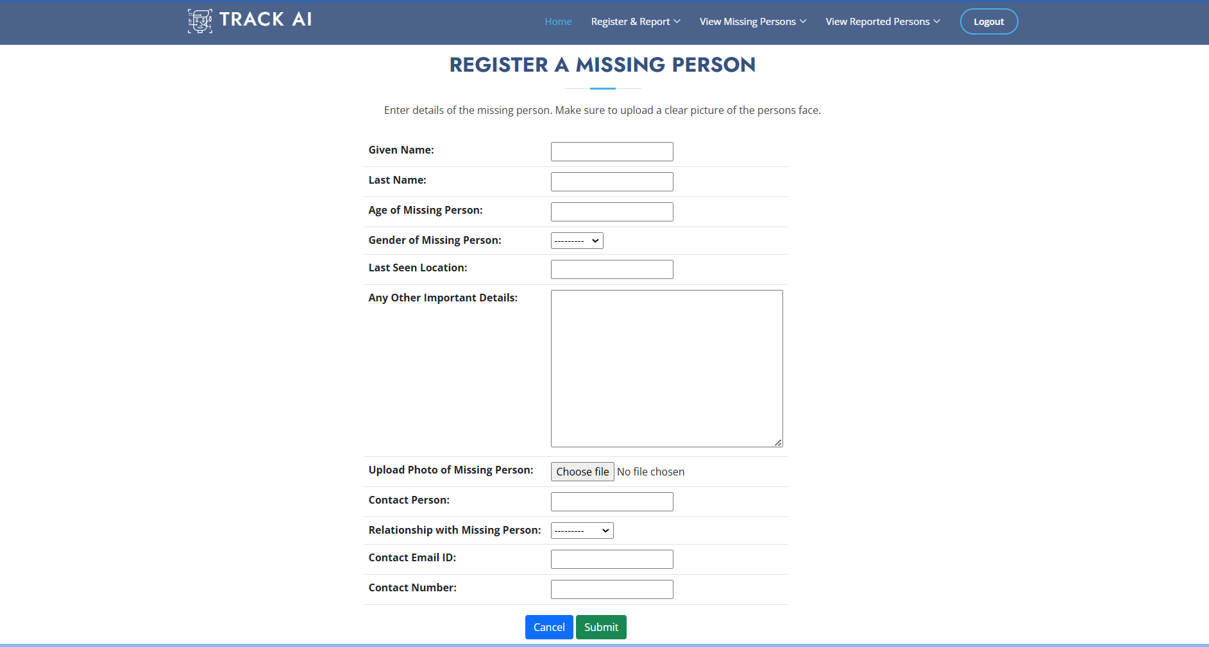

Slide 12
Conclusion
This technology, when put into good use, can be beneficial. Process of identifying the missing people is fastened. Our system replaces the manual scanning process through the databases for each picture to check the match, by an efficient Face recognition method which finishes the work in no time.
The application was tested using a dataset of missing person cases. The dataset contained information on missing persons, including their age, gender, and location. The Facial recognition algorithm was tested using a subset of the data set, and, it was found to accurately identify the missing Person In real-time.
The proposed missing person application built using Python has the potential to provide a more efficient and Effective means of locating missing persons. The use of facial recognition technology and machine learning algorithms can help identify missing persons in real-time.

Slide 13
Future Perspective
The future scope of finding a missing person project would include:
Real-Time Video Analysis Integration.
Mobile Application Development.
Collaboration with Law Enforcement Agencies,
Integration with Social Media Platforms.
Integration with Public Services.
Implementing encryption protocols and data privacy.
Incorporating geolocation services and camera metadata.
Deploying the system on cloud services like AWS, Azure, or Google Cloud.

Slide 14
Thank you...!

