Slide 1

Major Project – MCA491P
IoT Based Smart Irrigation in Arecanut Farms
1RV23MC039
HARI KETAN T
Under the Guidance
Of
Dr. Renuka Prasad B
Associate Professor
Department of MCA

Slide 2
Introduction
Arecanut is a vital commercial crop in India, especially in states like Karnataka, Kerala, and Tamil Nadu, where it supports thousands of small and medium-scale farmers.
Traditional irrigation methods for arecanut farms are mostly manual, leading to water wastage, inconsistent irrigation, and higher labor dependency.
This project aims to build a smart irrigation system that automates and optimizes water usage based on real-time soil and environmental conditions.
The system is designed to promote precision agriculture, improving crop yield while conserving water and reducing human effort.

Slide 3
Objectives
To develop an IoT-based smart irrigation system
To automate irrigation in arecanut farms using IoT devices to reduce manual work.
To monitor soil moisture and water flow using sensors to ensure proper watering.
To control water flow with a motorized valve based on real-time sensor readings.
To display live data on a web interface to help farmers monitor conditions remotely.

Slide 4
Design Methodology
Hardware Requirements
Sl No | Components | Purpose
1 | ESP32 | Collects data from sensors; sends via MQTT
2 | Soil Moisture Sensor (Capacitive V2.0) | Monitors real-time moisture near root zone
3 | Water Flow Sensor (e.g., YF-S201) | Measures volume of water supplied
4 | Motorized Valve | Controls irrigation based on command
5 | Wi-Fi Relay Module | Activates valve based on control logic
6 | Raspberry Pi (Gateway) | Receives MQTT data; handles control logic
Software Requirements
Sl No | Components | Purpose
1 | Next.js (Frontend) | Web dashboard for farmers
2 | MQTT Broker (Mosquitto) | Lightweight messaging protocol
3 | PostgreSQL | Database to store sensor readings
4 | Node.js + Express | API backend for sensor data
5 | MicroPython / Arduino IDE | Programming ESP32 sensor logic

Slide 5
Functional Requirements Specification
Module Name: Soil Moisture Monitoring
Purpose: To continuously measure soil moisture and determine irrigation need.
Input: Analog signal from capacitive soil moisture sensor.
Function: Converts sensor data to digital, compares against threshold, sends to backend.
Output: Moisture percentage, timestamp, and section ID pushed via MQTT.
Module Name: Water Requirement Calculation
Purpose: To fetch the ideal water requirement for a section based on crop age, month, and soil.
Input: Soil type, current month, plant age (from planting date).
Function: Fetches required value from Water_Requirement table.
Output: Ideal liters/day/palm value used by decision logic.
Module Name: Irrigation Control (Auto/Manual)
Purpose: To control the valve state based on logic or manual command.
Input: Mode (AUTO/MANUAL), moisture value, required water, user input.
Function: If AUTO: checks if moisture < threshold; triggers relay via Raspberry Pi. If MANUAL: user control overrides logic.
Output: Valve ON/OFF signal, recorded in control log.
Module Name: Water Flow Monitoring
Purpose: To measure actual water delivered during irrigation.
Input: Digital pulses from flow sensor (YF-S201).
Function: Converts pulses to L/min, multiplies by duration to get volume.
Output: Water volume in liters; logs for accuracy tracking.

Slide 6
Non-Functional Requirements Specification
Sl No | Components | Purpose
1 | Performance | The system shall respond to sensor updates and take control actions within 10 seconds.
2 | Scalability | The system shall support up to 4 farm sections and 20 sensors without performance degradation.
3 | Accuracy | Moisture readings should have an accuracy of ±5%, and flow readings ±10%.
4 | Reliability | System actions (irrigation ON/OFF) must execute correctly 100% of the time based on logic.
5 | Data Logging | All sensor and control actions shall be logged and retrievable for a minimum of 30 days.
<number>

Slide 7
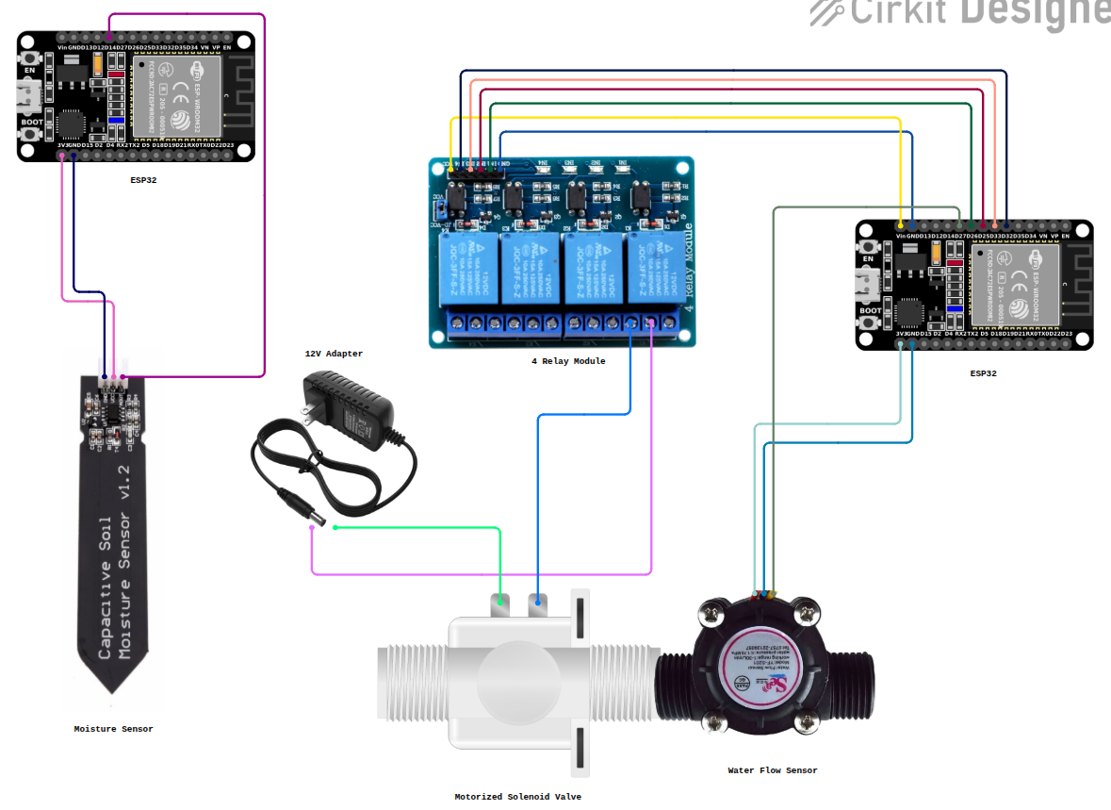
Fritzing Diagram

Slide 8
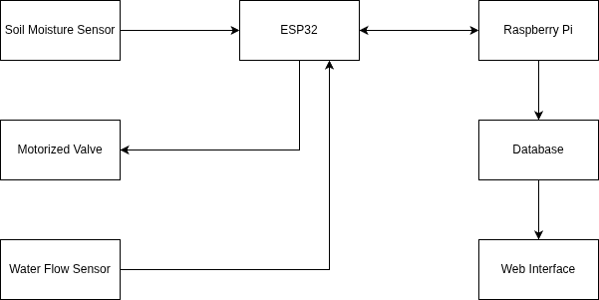
System Design
Block Diagram

Slide 9
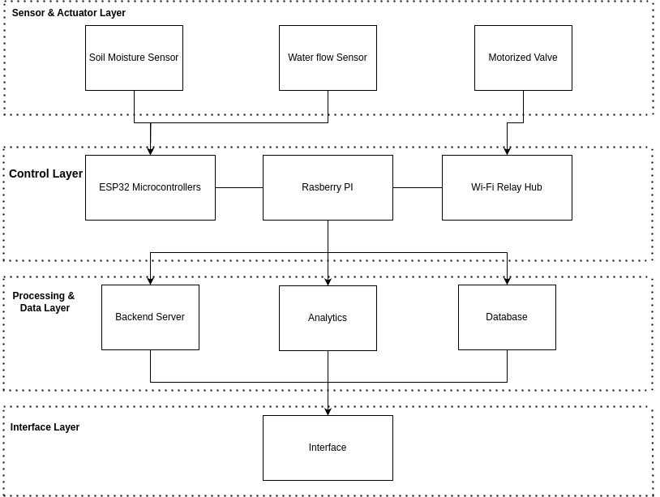
System Design
Architecture Diagram

Slide 10
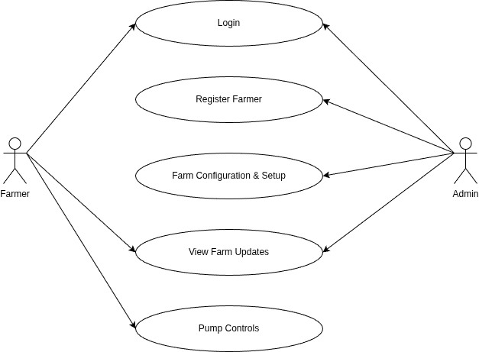
Detailed Design
Use Case Diagram

Slide 11
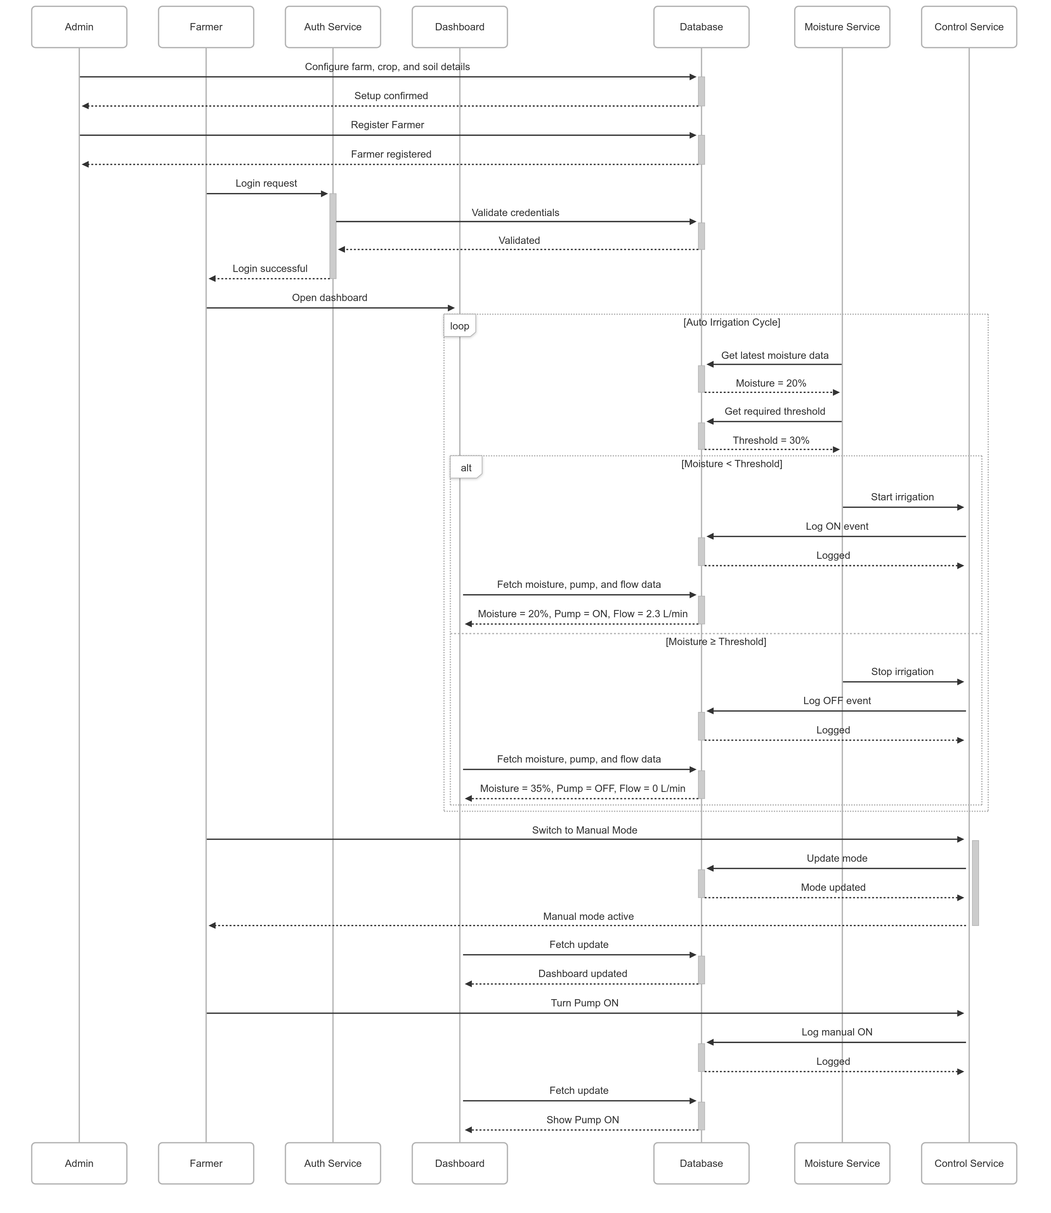
Sequence Diagram

Slide 12
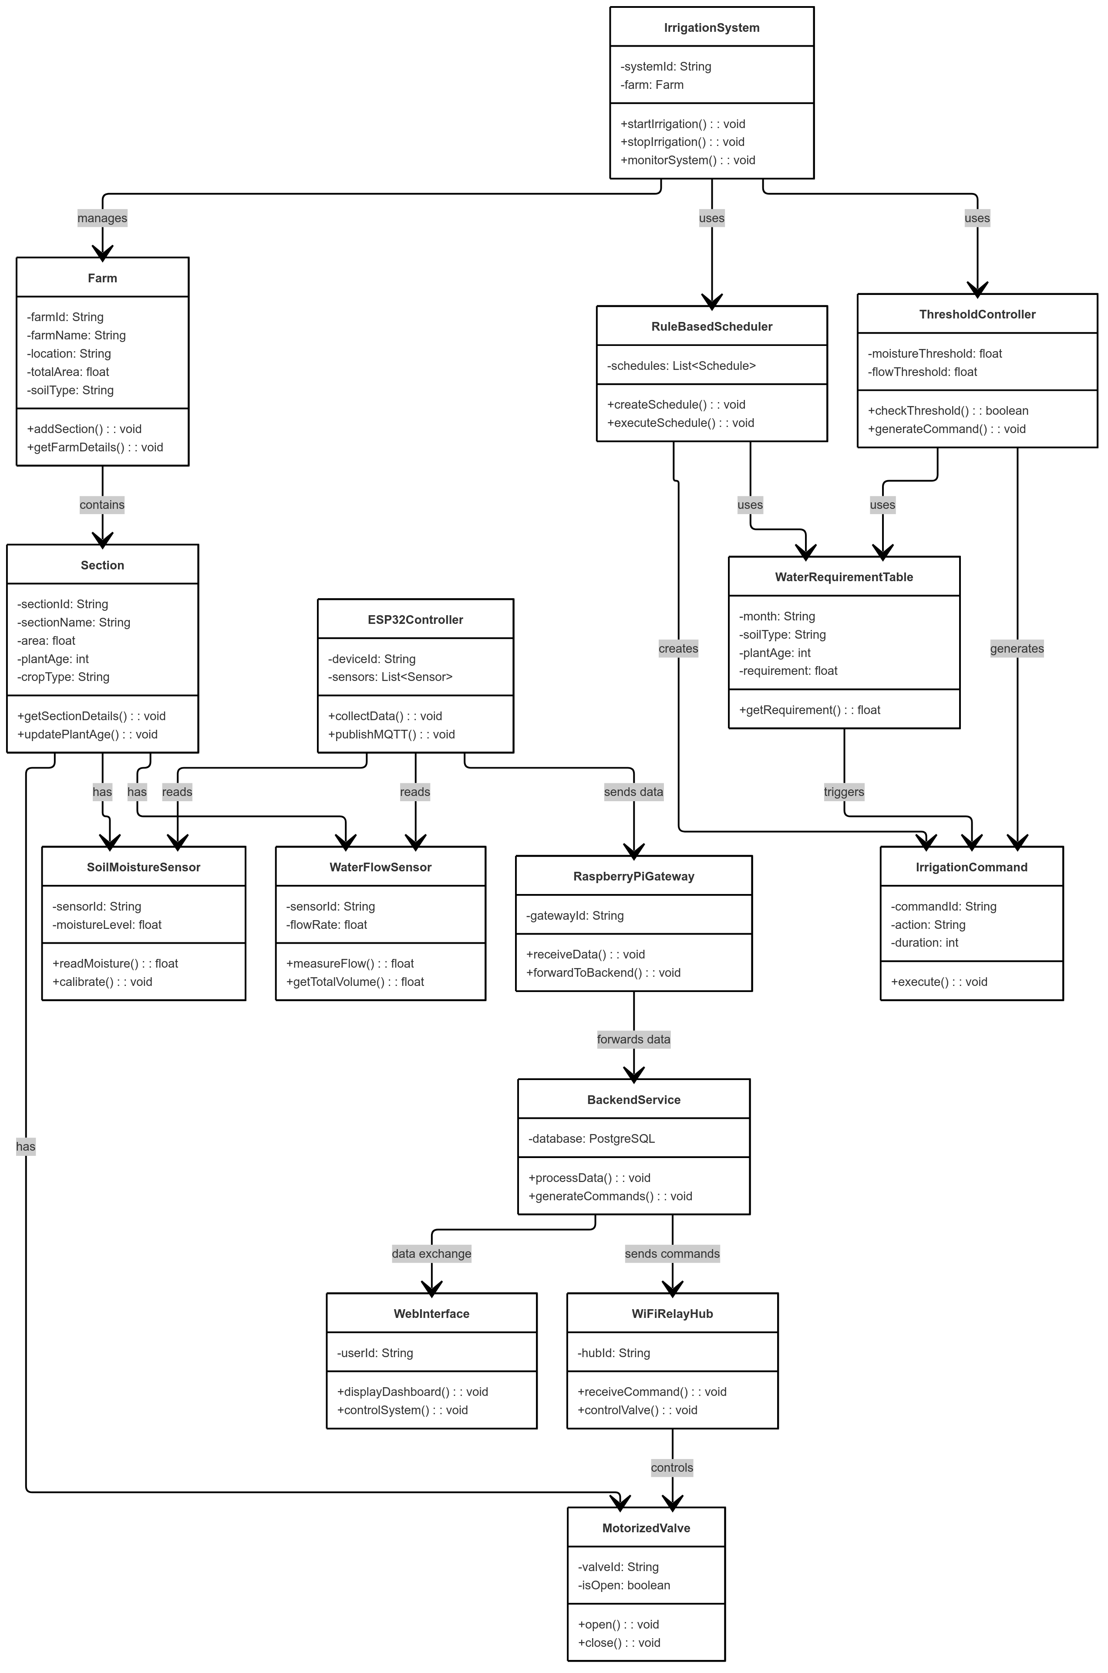
Class Diagram

Slide 13
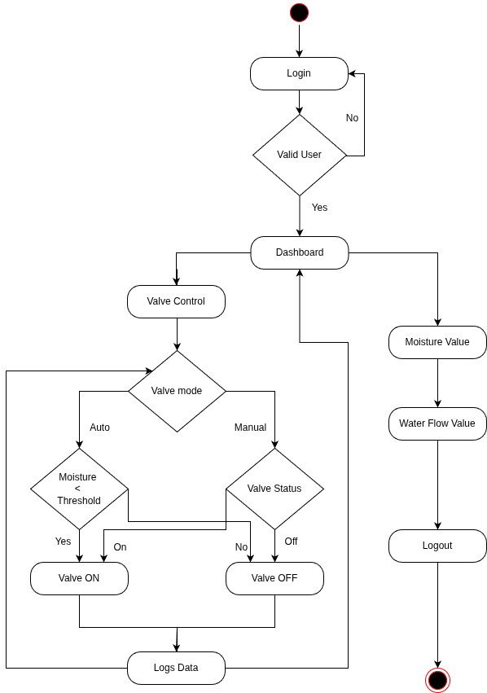
Detailed Design
Activity Diagram

Slide 14
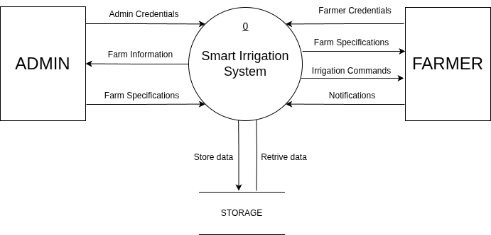
Detailed Design
Level 0 DFD

Slide 15
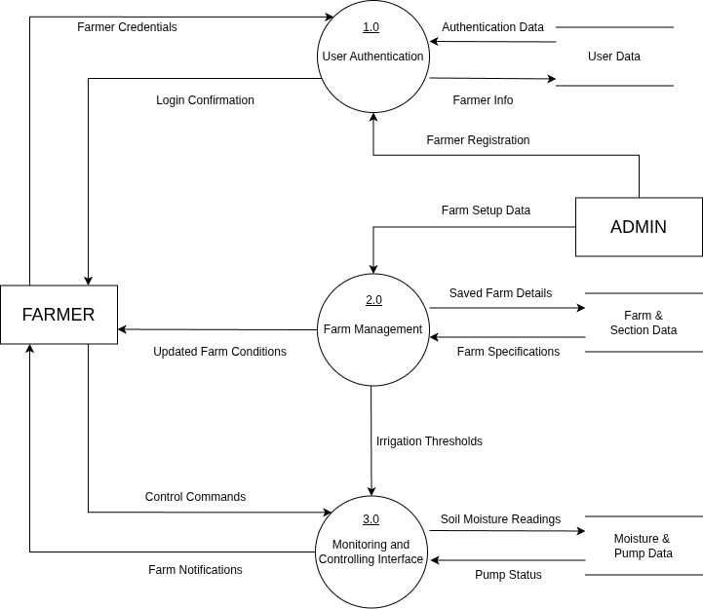
Detailed Design
Level 1 DFD

Slide 16
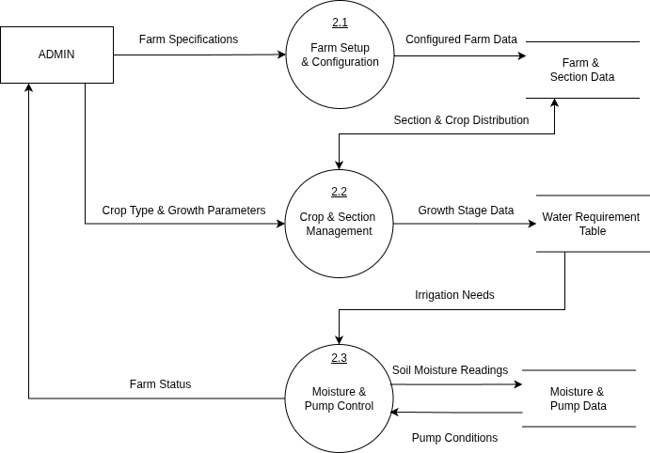
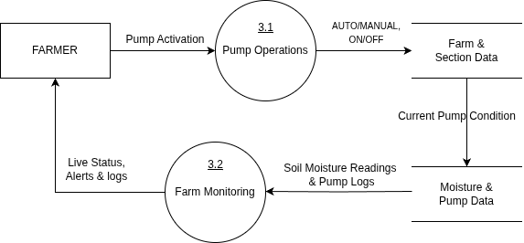
Detailed Design
Level 2 DFD

Slide 17
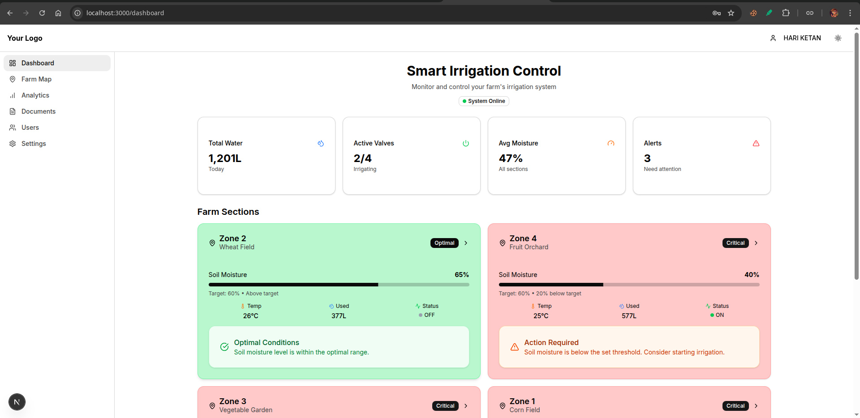
Screen shots of Results

Slide 18
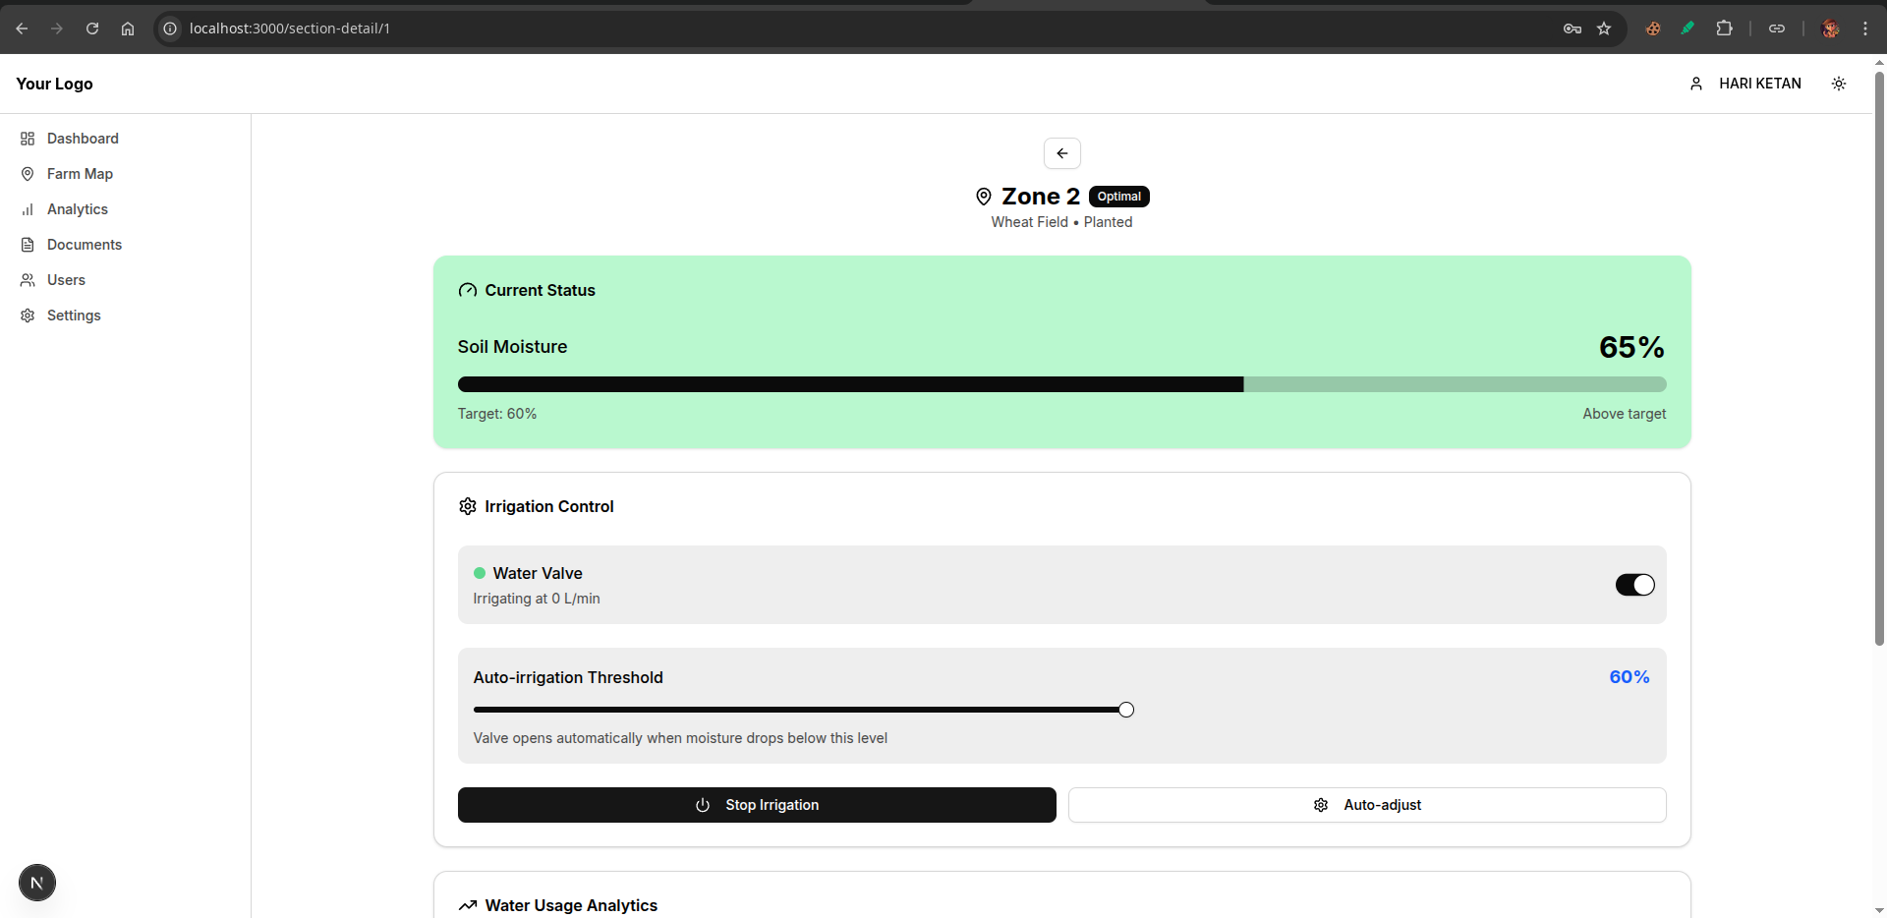
Screenshots of Results

Slide 19
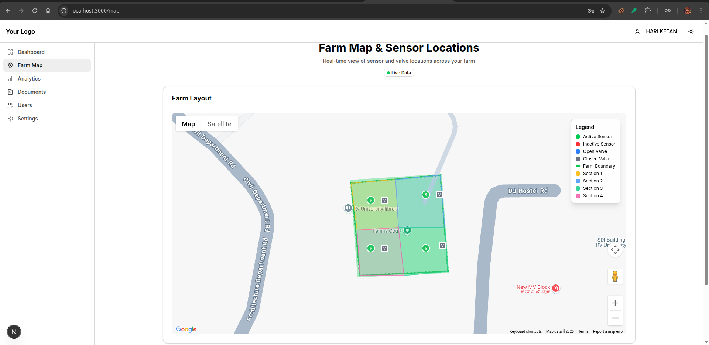
Screenshots of Results

Slide 20
Conclusion
The proposed system successfully automates irrigation for arecanut farms using IoT-based monitoring and control.
By integrating soil moisture sensors, flow sensors, and motorized valves, the system ensures accurate and efficient water usage.
The system achieves water conservation, reducing wastage by supplying water only when soil moisture is below the threshold.
Farmers benefit from reduced manual labor, as the system provides both automatic and manual control modes.
The dashboard interface enhances usability by offering real-time monitoring of moisture, flow rate, and pump status.

Slide 21
Future Enhancements
1. Advanced Intelligence and Predictive Analytics
Weather Forecast Integration
Machine Learning for Predictive Irrigation
2. Integrated Farm Management Features
Smart Fertigation System
Expanded Environmental Sensing
3. Sustainability and Robustness
Solar Power Integration
<number>

Slide 22
References
[1] SharathKumar KR, Mohan K, and Nirisha, “Arecanut Crop Disease Prediction using IoT and Machine Learning”, Journal of Science; Technology , vol. 5, no. 3, pp. 160–165, May 2020.
[2] Jyothi R, Rachana S, Ranjitha R, Krishna Prasad R, “Smart Irrigation System Based on Iot”, IJAST, vol. 29, no. 3, pp. 5730 - 5737, Mar. 2020.
[3] A. J. Rao, C. Bekal, Y. R. Manoj, R. Rakshitha, N. Poornima, “Automatic Detection of Crop Diseases and Smart Irrigation Using IoT and Image Processing,” in Advances in Communication and Computational Technology, Springer, pp. 343–353, 2021.
[4] S. Ramya, A. M. Swetha, M. Doraipandian, “IoT Framework for Smart Irrigation Using Machine Learning Technique,” Journal of Computer Science, vol. 16, no. 3, pp. 355–363, Mar. 2020.
[5] Raja Muthuramalingam, Reshnuvi Rathnam Velu, Harshini Baskar, Merun Hrithik Vellan Saminathan, “An IoT-Based Smart Irrigation System,” Engineering Proceedings, vol. 66, no. 1, pp. 13, July 2024.
[6] I. Ravi, G. Prabhu, P. S. Shelake, R. Selvarajan, and V. B. Patel, “IoT enabled soil moisture sensor based irrigation in banana”, Ind. Horticulture, vol. 69, no. 6, pp. 17–21, Jan. 2025
[7] Hema Losini Jayashanker, Nurmiza Othman, “IoT Based Irrigation and Fertigation System for Smart Smallholder Farming Application,” Emerging Advances in Integrated Technology, vol. 5, no. 1, pp. 16–25, July 2024.
[8] Eddala Chandu, M. K. Shukla, “IoT-Based Smart Irrigation System for Mango Orchard,” in Artificial Intelligence and Machine Learning in Satellite Data Processing and Services, Springer, pp. 61–69, Jan. 2023.
[9] D. Thakur, Y. Kumar, S. Vijendra, “Smart Irrigation and Intrusions Detection in Agricultural Fields Using IoT,” Procedia Computer Science, vol. 167, pp. 154–162, 2020.
[10] Manish Vasant Gurao and U. B. Vaidya, “IOT based Smart Irrigation System,” International Journal of Engineering Research & Technology (IJERT), vol. 11, no. 11, Nov. 2022.

Slide 23
THANK YOU

