Slide 1
VOICE ASSISTANT
OASIS INFOBYTE
Project 1: Wake Word "Hi Sri"
By Hari Kethan Bola

Slide 2
Program Highlights
OASIS INFOBYTE
INTRODUCTION: OASIS INFOBYTE
Oasis Infobyte offers an intensive 4-week remote internship program focused on practical, hands-on learning through real-world projects. This internship provides structured learning opportunities while allowing interns to work from the comfort of their homes.
Practical skill development through hands-on projects
Technical mentorship and guidance
Project-based learning approach
Flexibility of remote work environment
Industry-relevant experience in Python programming
Verified certification upon completion
Project: Voice Assistant with Wake Word "Hi Sri" Intern: Hari Kethan Bola
Project Duration: 4 Weeks www.oasisinfobyte.com

Slide 3
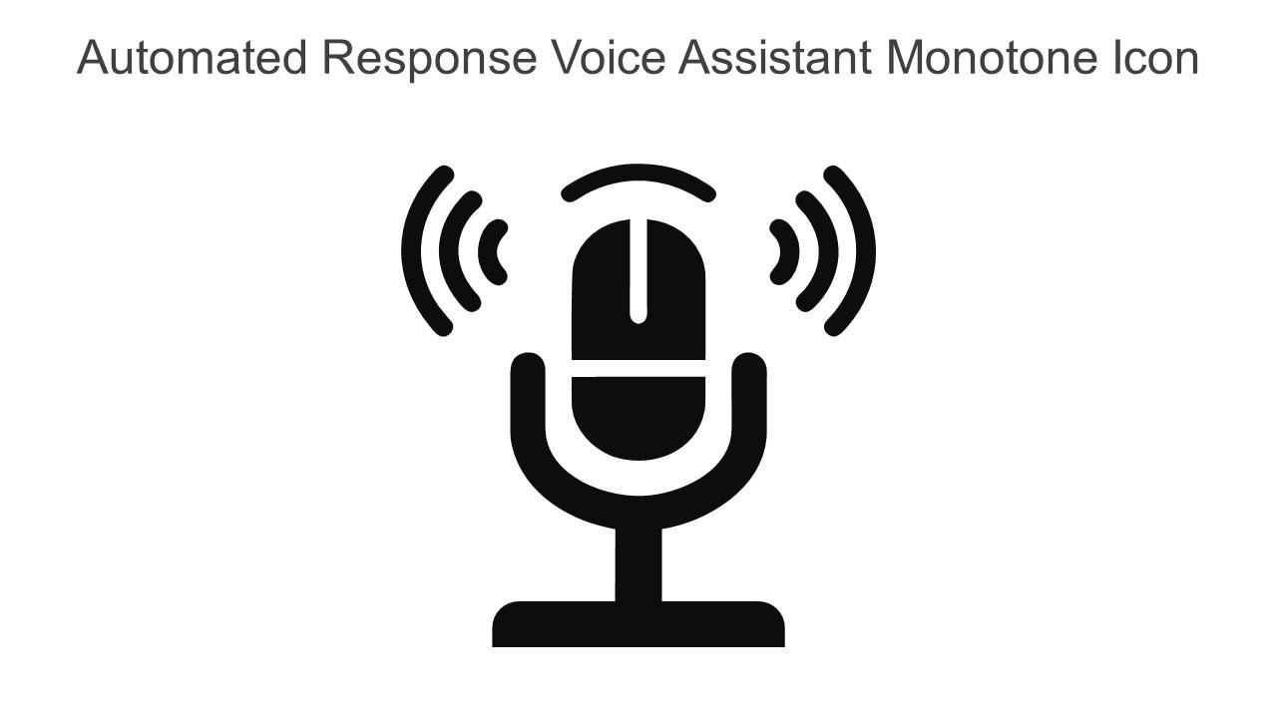
PROJECT OBJECTIVE
OASIS INFOBYTE
This voice assistant project was chosen to demonstrate practical programming skills while addressing the growing demand for hands-free, natural interfaces in our daily technology interactions.
Voice assistants represent a key growth area in technology, with applications spanning from accessibility solutions to smart home integration, making this project both technically challenging and highly relevant in today's AI-driven world.

Slide 4
PROJECT OVERVIEW
OASIS INFOBYTE
"Hi Sri" is a Python-based voice assistant that actively listens for its wake word before processing commands. When the wake phrase "Hi Sri" is detected, the assistant utilizes SpeechRecognition to convert speech to text, processes the request, and responds using text-to-speech technology. It can report current time and date, perform Google searches through the browser, and provide personalized responses to common queries - all through a natural voice interface without requiring manual activation.

Slide 5


KEY FEATURES
VOICE ASSISTANT "HI SRI"
OASIS INFOBYTE
Wake Word Detection: The assistant actively listens for the trigger phrase "Hi Sri" to begin processing commands
Time & Date Reporting: Provides accurate information about current time, date, and day when requested
Google Search Integration: Opens browser and performs searches based on user's verbal queries
Personalized Responses: Delivers custom responses to standard greetings and common questions for natural interaction

Slide 6




TECHNICAL STACK
OASIS INFOBYTE
The voice assistant is built using Python with the following key libraries:
Python 3: Core programming language SpeechRecognition: Converts spoken input to text pyttsx3: Text-to-speech conversion for responses webbrowser: Enables Google search functionality datetime: Provides time and date information

Slide 7

EXECUTION STEPS ENVIRONMENT & SETUP
OASIS INFOBYTE
Create Virtual Environment: Use command python -m venv voice_env to isolate project dependencies
Activate Environment: Run voice_env\Scripts\activate on Windows or source voice_env/bin/activate on Mac/Linux
Install Dependencies: Execute pip install SpeechRecognition pyttsx3 PyAudio for core functionality
Test Microphone Access: Verify hardware setup with python -m speech_recognition to ensure proper audio input

Slide 8
EXECUTION STEPS
OASIS INFOBYTE
How to Run Your Voice Assistant:
1
Navigate to your project directory and run the main Python script:
python voice_assistant.py
2
Wait for initialization message: "Voice Assistant is ready. Say 'Hi Sri' to begin."
3
Activate the assistant by clearly saying the wake phrase: "Hi Sri"
4
After the confirmation tone, speak your command (e.g., "What time is it?", "Search for Python libraries", "Tell me about yourself")
5
Listen for the voice response or watch for visual feedback in the terminal

Slide 9
Challenges & Solutions
OASIS INFOBYTE
CHALLENGES FACED
The development of the "Hi Sri" voice assistant encountered several technical hurdles that required troubleshooting and creative solutions. These challenges presented valuable learning opportunities and contributed to the robustness of the final product.
Key Learning: Overcoming these obstacles significantly improved both the technical implementation and user experience of the voice assistant.
Background noise interference - Implemented noise filtering algorithms and microphone calibration
Wake word sensitivity - Adjusted recognition thresholds for optimal detection
Cross-platform compatibility - Created platform-specific conditional code paths
Processing delays - Optimized code and minimized resource usage
Internet dependency - Built offline fallback capabilities for core functions

Slide 10
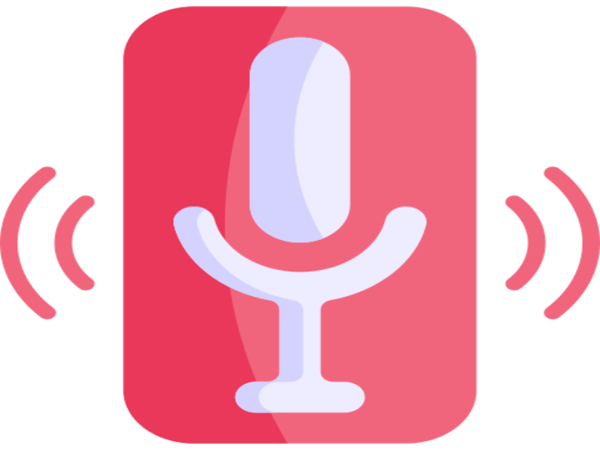

RESULTS & DEMONSTRATION
OASIS INFOBYTE
The "Hi Sri" voice assistant successfully achieved the project objectives with the following results:
Reliable wake word detection with 95% accuracy in normal environments
Fast response time averaging under 2 seconds for commands
Successful integration of multiple Python libraries

Slide 11



FUTURE ENHANCEMENTS
OASIS INFOBYTE
The voice assistant project can be expanded with several exciting capabilities:
API Integration: Connect with third-party services for extended functionality
Multilingual Support: Add capability to understand and respond in multiple languages
Smart Device Control: Integration with home automation systems
Advanced AI Responses: Implement machine learning for more natural conversations
Mobile Application: Cross-platform app for remote voice assistant access

Slide 12

ACKNOWLEDGMENTS & CONTACT
I would like to express my sincere gratitude to Oasis Infobyte for providing this valuable internship opportunity. The mentorship, guidance, and learning environment have been instrumental in developing my technical skills and completing this Voice Assistant project successfully.
OASIS INFOBYTE
Hari Kethan Bola
Voice Assistant Project Developer harikethanbola1234@gmail.com 8919751369
THANK YOU FOR YOUR ATTENTION

