Slide 1
Test Suite Reduction
Hari Koirala

Slide 2
Introduction
Motivation: Control Flow Graph
Tests takes long to run with large programs
Why don’t we figure out redundant tests and try to remove it?
Reduce test suite while keeping same coverage.

Slide 3
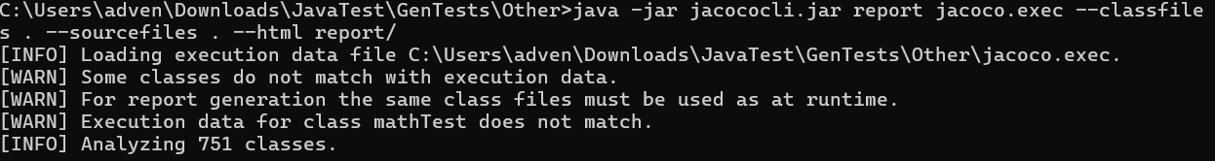
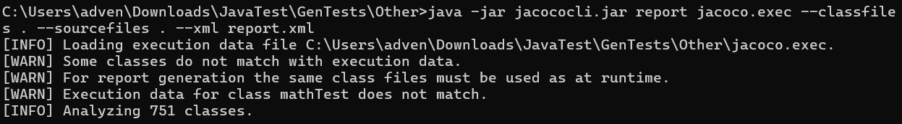
Approach
(1) Test Generation -> Randoop [1747 tests]
(2) JaCoCo for Code Coverage Data
Code Coverage library that measures and writes the coverage of unit and integration tests

Slide 4
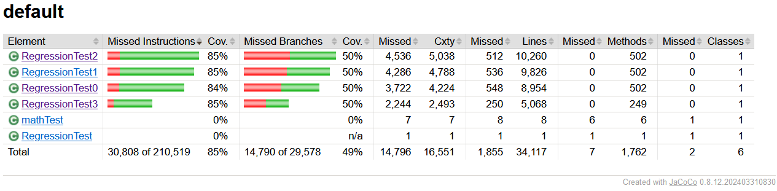
Approach (cont.)
Generate a XML Report of INSTRUCTION, BRANCH, and LINE count for each method. Run parseXML.py to filter those data.
Parse the Test files to get test only in an text file. Run extractFromReg.py to filiter those data.

Slide 5
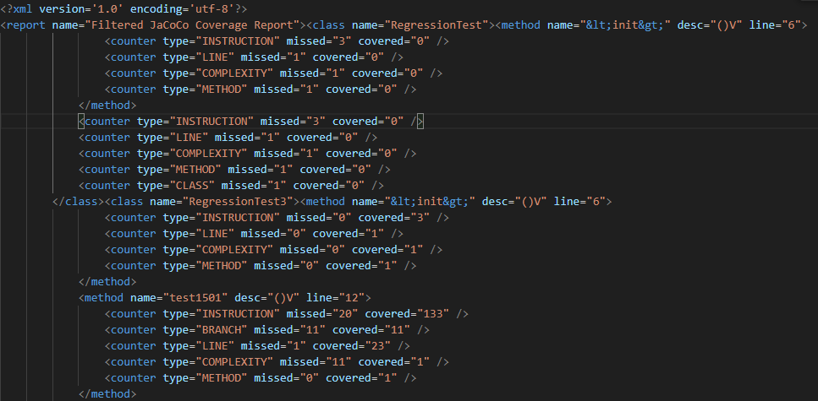
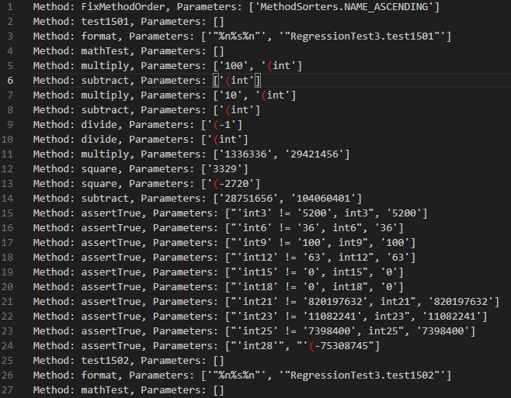
Approach (cont.)

Slide 6
Approach - Analysis
Compare code coverage data from multiple methods and generates a similarity score between them. It works with XML data and calculates how similar two methods are based on different coverage metrics (like line coverage, branch coverage, complexity, and instruction coverage). Score between 1-10.
Read extracted method data from a file, compare test methods based on their parameters and counts, and calculates a similarity score between different tests. It then writes the similarity scores to an output file. Score between 1-10.
Compare both scores from these to come up with either: High Possibility of being Redundant, Medium Possibility of being Redundant and Low Possibility of being Redundant

Slide 7
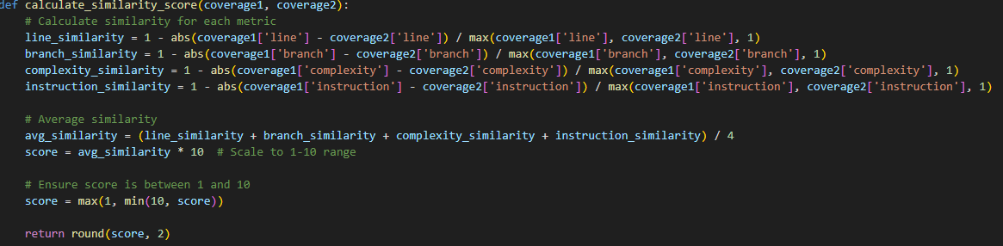
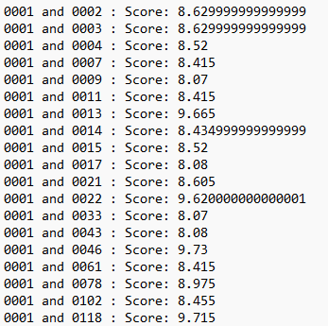
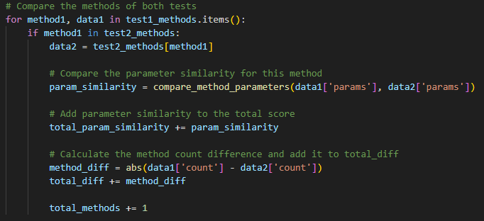
Approach (cont.)

Slide 8
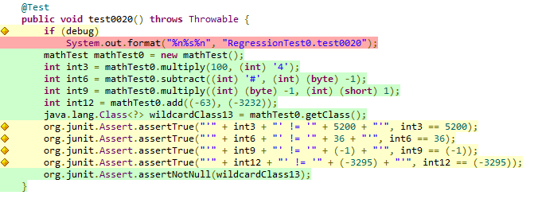
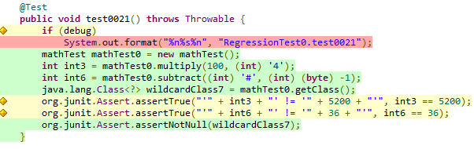
Evaluations
Current: Manual Evaluations
Example: 0020 and 0021 : Score: 8.36. high_possibility_redundant.txt
Future: Automatic Evaluations
Github: https://github.com/HariKoiralaIL/AdvSoftwareFinalProject

Slide 9
Questions?

