Slide 1
GRASP LOCALIZATION BASED ON VISION BASED DEEP LEARNING
Mentor : Dr. R. Senthilnathan
Department : Mechatronics - Robotics
Team Members:
Harikrishnan S
Habeeb Aga
Gautham Rajesh

Slide 2
OBJECTIVE
The objective is to simulate in an environment how a manipulator would pick up an object ( based on relative transformations between different frames ).
Where the inferencing part i.e., detecting the pose of the object of interest is provided by the deep learning model.

Slide 3
RELEVANT LITERATURE
Review of Deep Learning Methods in Robotic Grasp
Detection - Shehan Caldera, Alexander Rassau, Douglas Chai
Robotic Grasp Detection using Deep Convolutional Neural Networks - Sulabh Kumra and Christopher Kanan
Berk Calli, Aaron Walsman, Arjun Singh, Siddhartha Srinivasa, Pieter Abbeel, and Aaron M. Dollar, Benchmarking in Manipulation Research: The YCB Object and Model Set and Benchmarking Protocols, IEEE Robotics and Automation Magazine, pp. 36 – 52, Sept. 2015.

Slide 4
WORKFLOW OF PROJECT
FILTER CUSTOM OBJECTS FROM DATASET
FIX THE FRAMES FOR MANIPULATOR AND CAMERA
IMPORT POINT CLOUD MODEL INTO SIMULATION PLATFROM
FIND FRAME RELATION BETWEEN ROBOT AND OBJECT
DEEP LEARNING INFERENCE TO PICK THE OBJECT IN THE BEST POSSIBLE WAY WITH TRAJECTORY PLANNING .

Slide 5
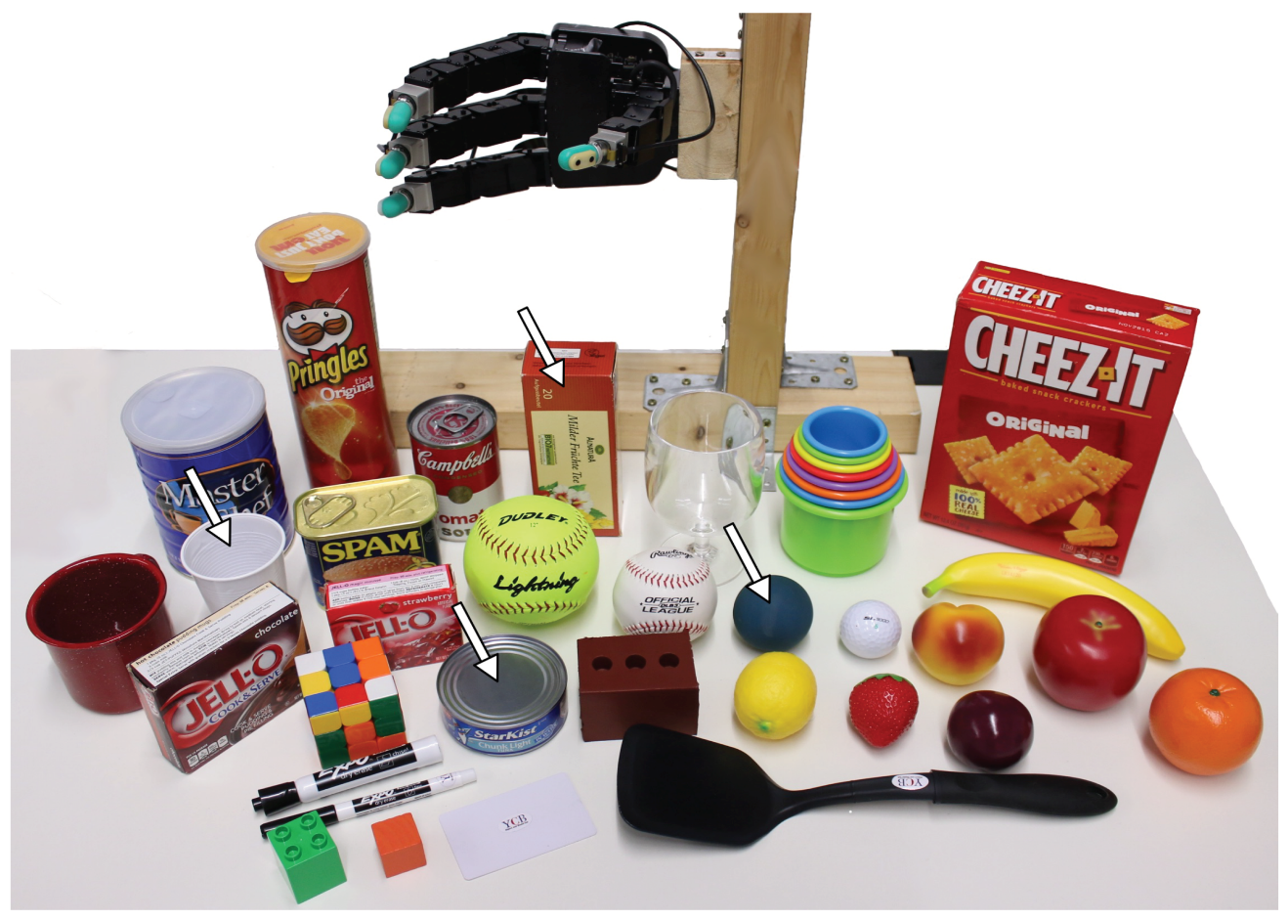
THE YCB BENCHMARK DATASET FOR GRASP LOCALIZATION

Slide 6
What is present in the Dataset ?
The data are ordered by object ID, followed by the name of the objects. For each object four compressed files are supplied as follows.
The ‘berkeley_processed’ file contains the following:
a point cloud in .ply extension obtained by merging the data acquired from all the viewpoints;
Poisson meshes;
TSDF meshes.
The ‘berkeley_rgb_highres’ file contains the following:
600 images with 12.2 megapixel resolution in
The pose of the RGB camera for each image in Hierarchical Data Format (HDF5; The HDF Group, 2016) with ‘.h5’ extension
Camera intrinsic parameters in HDF5 and JSON formats;
Segmentation masks in ‘.pbm’ format.
The ‘berkeley_rgbd’ file contains the following:
1) 600 RGB-D images in HDF5 format;
2) The pose of the RGB-D camera in HDF5 and JSON format for each image;
camera intrinsic parameters in HDF5 and JSON formats;
3) Segmentation masks in ‘.pbm’ format.

Slide 7
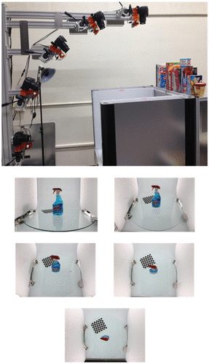
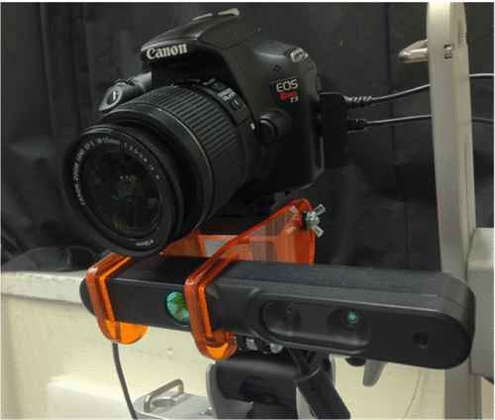
A Canon Rebel T3 RGB camera and PrimeSense Carmine 1.08 RGB-D sensor pair mounted together.
BigBIRD Scanning Rig and viewpoints of the five cameras.

Slide 8
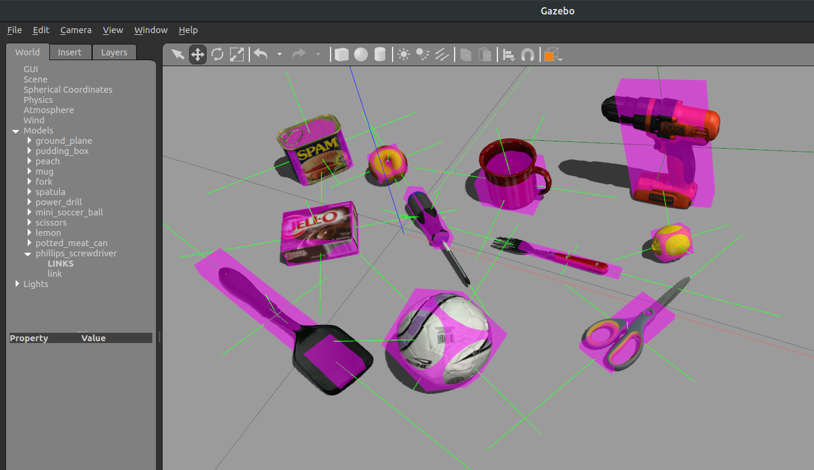

Slide 9
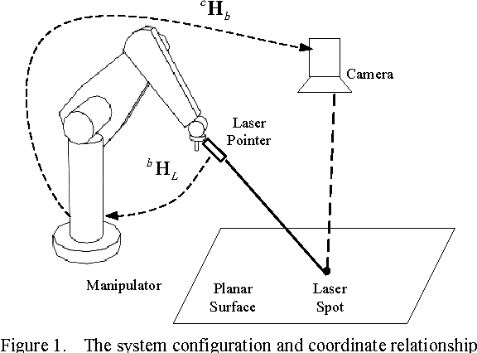
MANIPULATOR , CAMERA , OBJECT COORDINATE RELATIONSHIP
{ M } – Gripper frame of reference
{ C } – Camera frame of reference
{ B } – Base frame of manipulator
{ O } – Object frame of reference
C
M
B
O

Slide 10
Deep Learning model
In this model Convolutional Neural Networks was used.
First cnn will process a RGB image
Second cnn will process a RGB-D image.
The output obtained by the first two layers is merged which would then provide the grasp point and the particular pose.

Slide 11
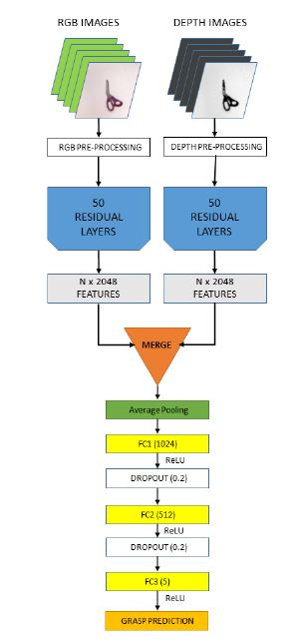

Slide 12
THANK YOU

