Slide 2
AWS & Impetus GenAI Hackathon

Slide 3
An AI-Aided Targeted Ad Generation
AD-APT
Hariharakrishnan M
Note: All submissions remain the intellectual property of the individuals or organizations that developed them, and go on to describe a non-exclusive, royalty-free license granted to the sponsor, rather than a full transfer of ownership.

Slide 4
Introduction
Hariharakrishnan M : Solo harisamy@gmail.com

Slide 5
Problem ​statement​
To reach out to people with the ad content dressed to each one's liking thro' social media or bill-boards based on their demography, nay, psychography and serve them the content that can even change its Avtaar everyday, all with the power of Generative AI informed by such knowledge and ever opportunistically 'looking for' the happenings in the 'world around', self-motivatedly, with a spirit of true AI agent
Now this is an ‘app’ where advertisers can use its user-interface. It has to develop into an agentic AI that picks up peoples’ interest and the topics of interest automatically, autonomously through the social media and News APIs and feed the users with relevant ads in the forms of their taste

Slide 6
Tech-stack selection​
Frontend: Streamlit (Python)
Backend: AWS Lambda, FastAPI
AI Models: Amazon Bedrock (Claude 3 Sonnet, Stable Diffusion XL)
Storage: Amazon S3
Infrastructure: CloudFormation, Docker
Deployment: Streamlit Cloud, AWS EC2
<Give reasons for your tech stack selections​>

Slide 7
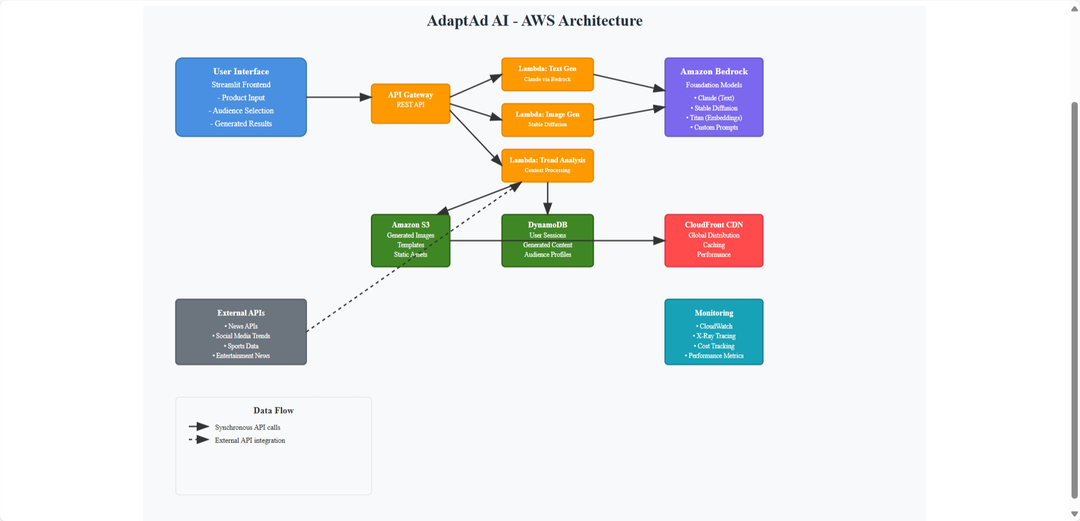
Architecture design/diagram

Slide 8
Impact potential & limitations​
Potential impact:
Ability to reach huge no. of social media users with targeted ads
Benefits:​ Ability to engage audience, remember the brand value uniquely and conversion to customers//buyers
Dependencies (like on third party libraries or software)
Limitations of the current solution​​​:
Now, it is a stand-alone solution with a Front-end for advertisement generator

Slide 9
Ethical & security considerations​
The AI generated Ad may end up occasionally offending sentiments of certain segments of people,, in spite of instructions to AI not to do so. Another AI agent that scrutinizes the ad generated to censor content or block ads can be added.

Slide 10
Project URL, video pitch & demo
Hosted URL of the working project:
https://adaptad-ai-yqybmrgudsehbfw7h2usxh.streamlit.app/
Demo video:
https://youtu.be/91Yzgi3GVN0

