Slide 1
Parking Management System
BY: HARI OM NARAYAN

Slide 2



Applications used
Tkinter Is The Most Commonly Used
Library For Developing Gui (graphical
User Interface) In Python. It Is A
Standard Python Interface To The
Tk Gui Toolkit Shipped With Python.
DB Browser for SQLite (DB4S) is a
high quality, visual, open source
tool to create, design, and edit
database files compatible with SQLite.
SQLite is a RDBMS contained in a
C library. In contrast to many other
database management systems, SQLite
is not a client–server database engine.
Rather, it is embedded into the end
program

Slide 3
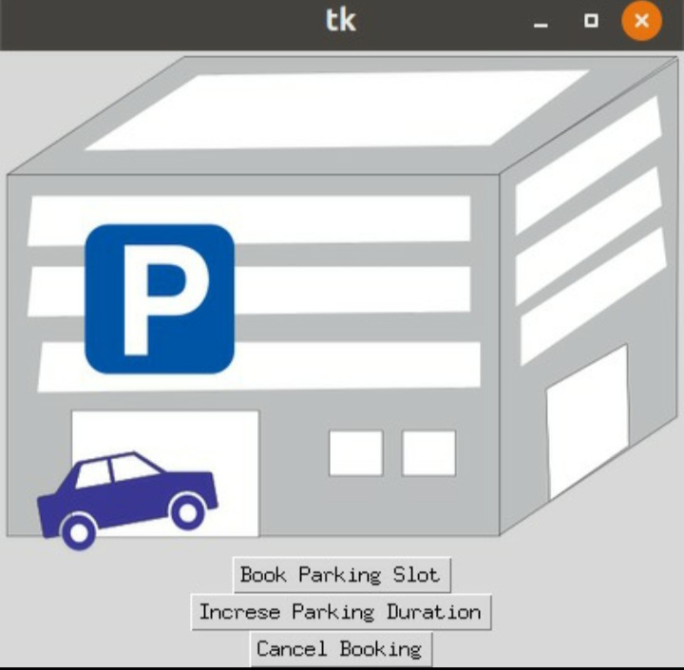
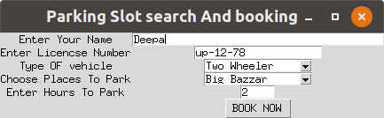
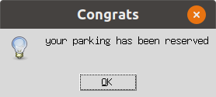
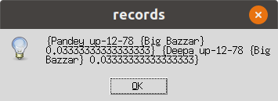

Slide 4
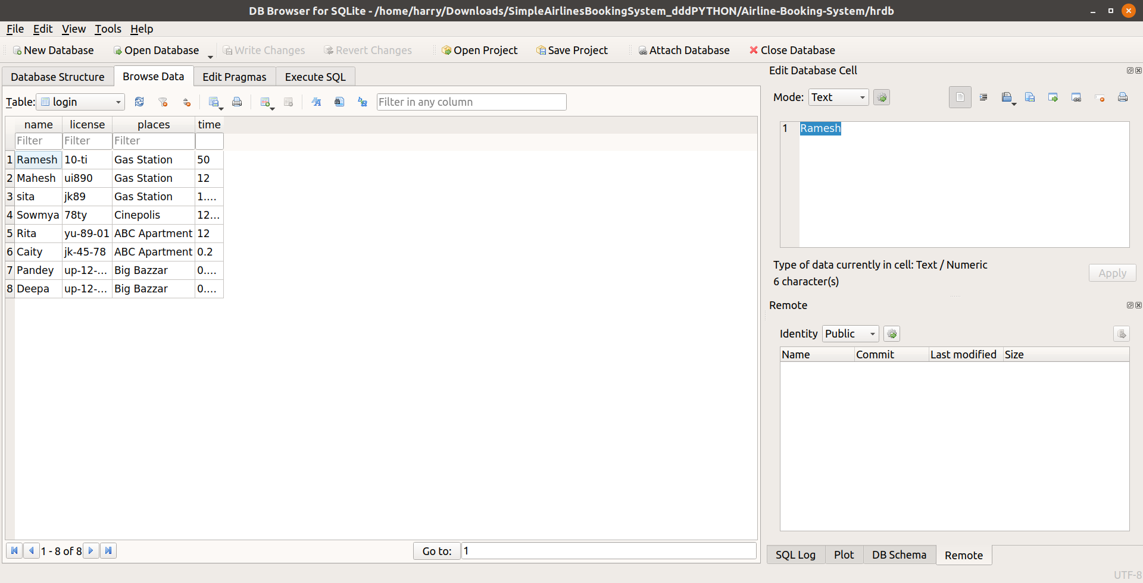
The sqlite stores the data in database

