Slide 1
SCORE THE COIN
BY: HARI OM NARAYAN

Slide 2
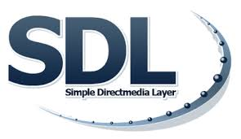
WHAT IS SDL
Simple DirectMedia Layer is a cross-platform development library designed to provide low level access to audio, keyboard, mouse, joystick, and graphics hardware via OpenGL and Direct3D.
It is used by video playback software, emulators, and popular games including Valve's award winning catalog and many Humble Bundle games.
SDL officially supports Windows, Mac OS X, Linux, iOS, and Android. Support for other platforms may be found in the source code.
SDL is written in C, works natively with C++, and there are bindings available for several other languages, including C# and Python.
This is the SDL wiki; SDL's main website is https://libsdl.org/.

Slide 3
WHAT SDL CAN BE – USED FOR
Video
3D graphics:
SDL can be used in combination with the opengl API or direct3d API for 3D graphics
Accelerated 2D render API:
Supports easy rotation, scaling and alpha blending, all accelerated using modern 3D apis
Input events
Events and API functions provided for:
Application and window state changes
Mouse input/Keyboard input/Multi touch gestures
Joystick and game controller input
Audio
Set audio playback of 8-bit and 16-bit audio, mono stereo or 5.1 surround sound, with optional conversion if the format is not supported by the hardware

Slide 4
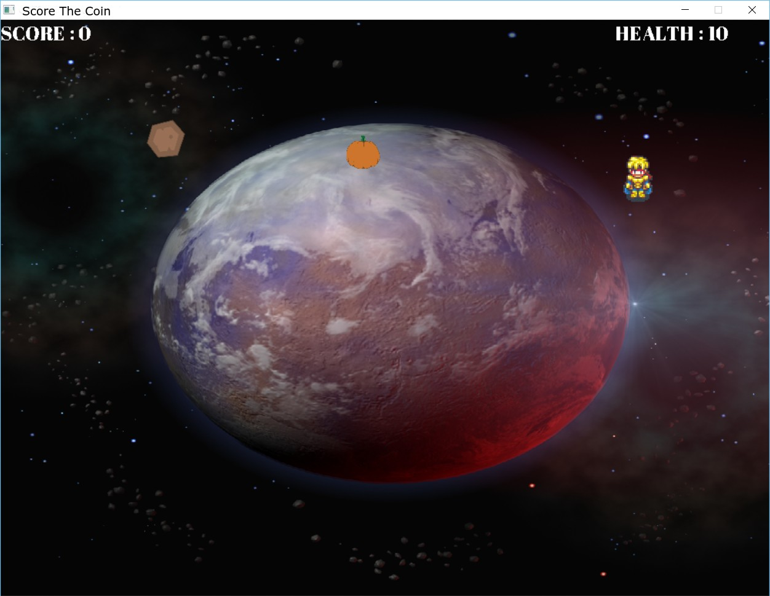

Slide 5
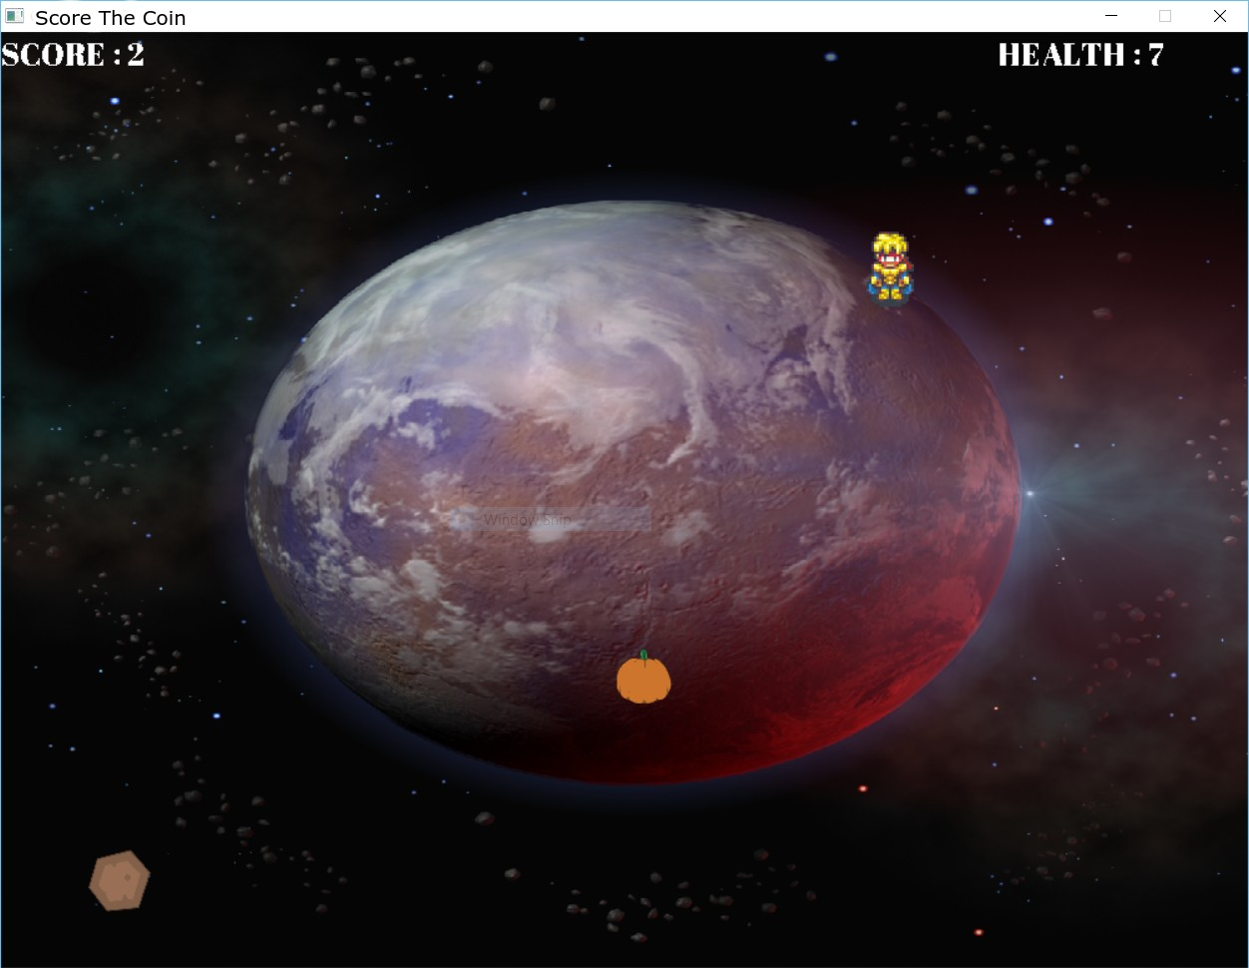

GETTING HIT BY ROCK WILL DECREASE THE HEALTH BY 3

Slide 6
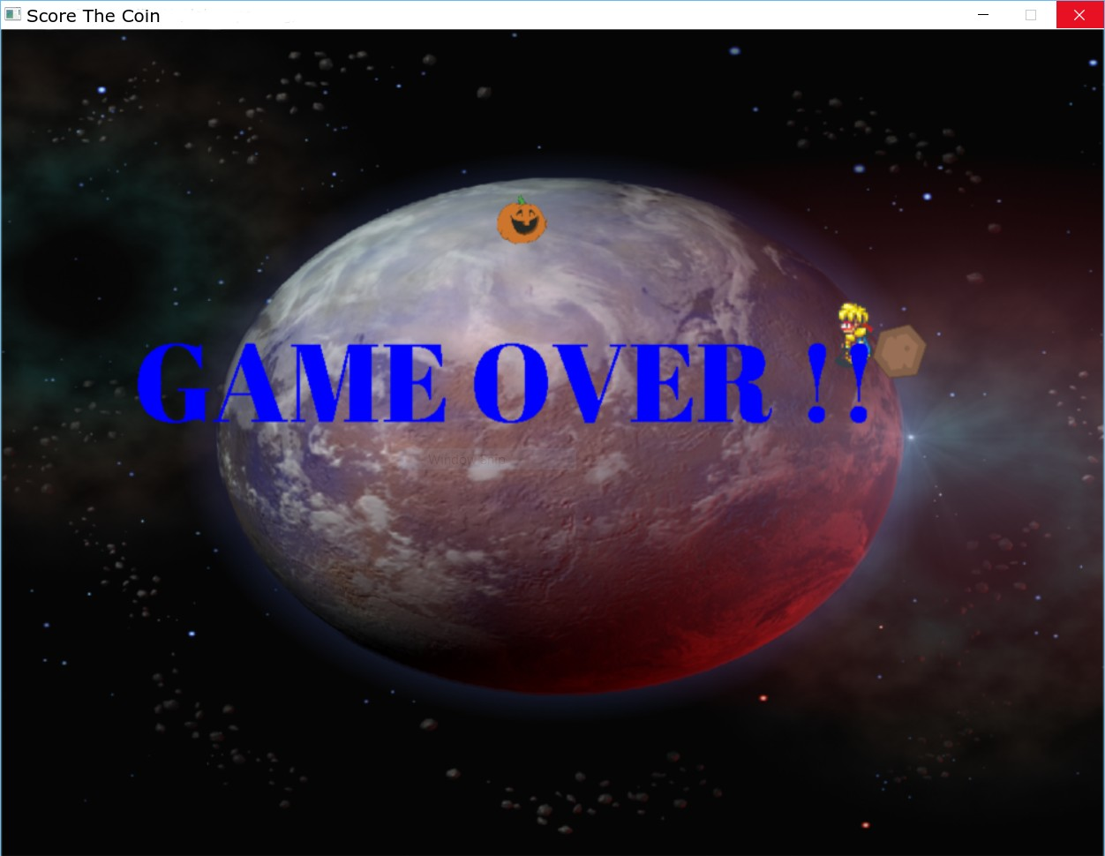
IF HEALTH GOES TO 0 PLAYER IS DEAD AND GAME WILL BE OVER

