Slide 1
Analysis of Environmental Changes and Global Impacts
BY : Hari Pad Bharti

Slide 2
Economic and the Environment
World Bank Datasets http://data.worldbank.org/topic/environment#tp_prop
Carbon Emission – increased at an alarming rate during past decades.
Research on the current trend of carbon emission : Past and the Present.
Co-relation between Carbon Emission & Economy of the region.
©Hari Pad Bharti

Slide 3
ANALYSIS
World Environment Data
World Economy Data
Carbon Emitting Regions
Trend of Emission
©Hari Pad Bharti

Slide 4
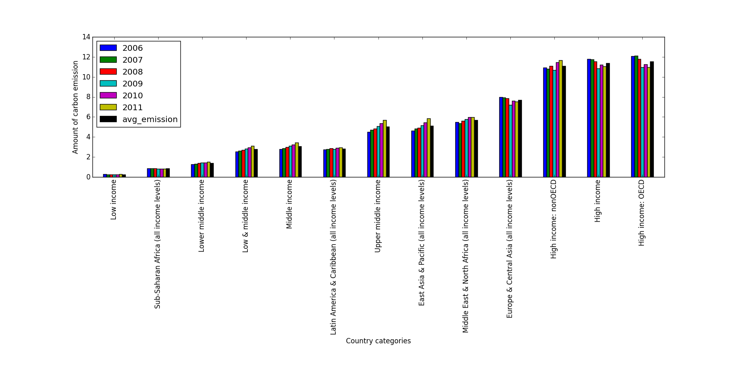
A COMPARISON : ECONOMY & ENVIRONMENT
©Hari Pad Bharti

Slide 5
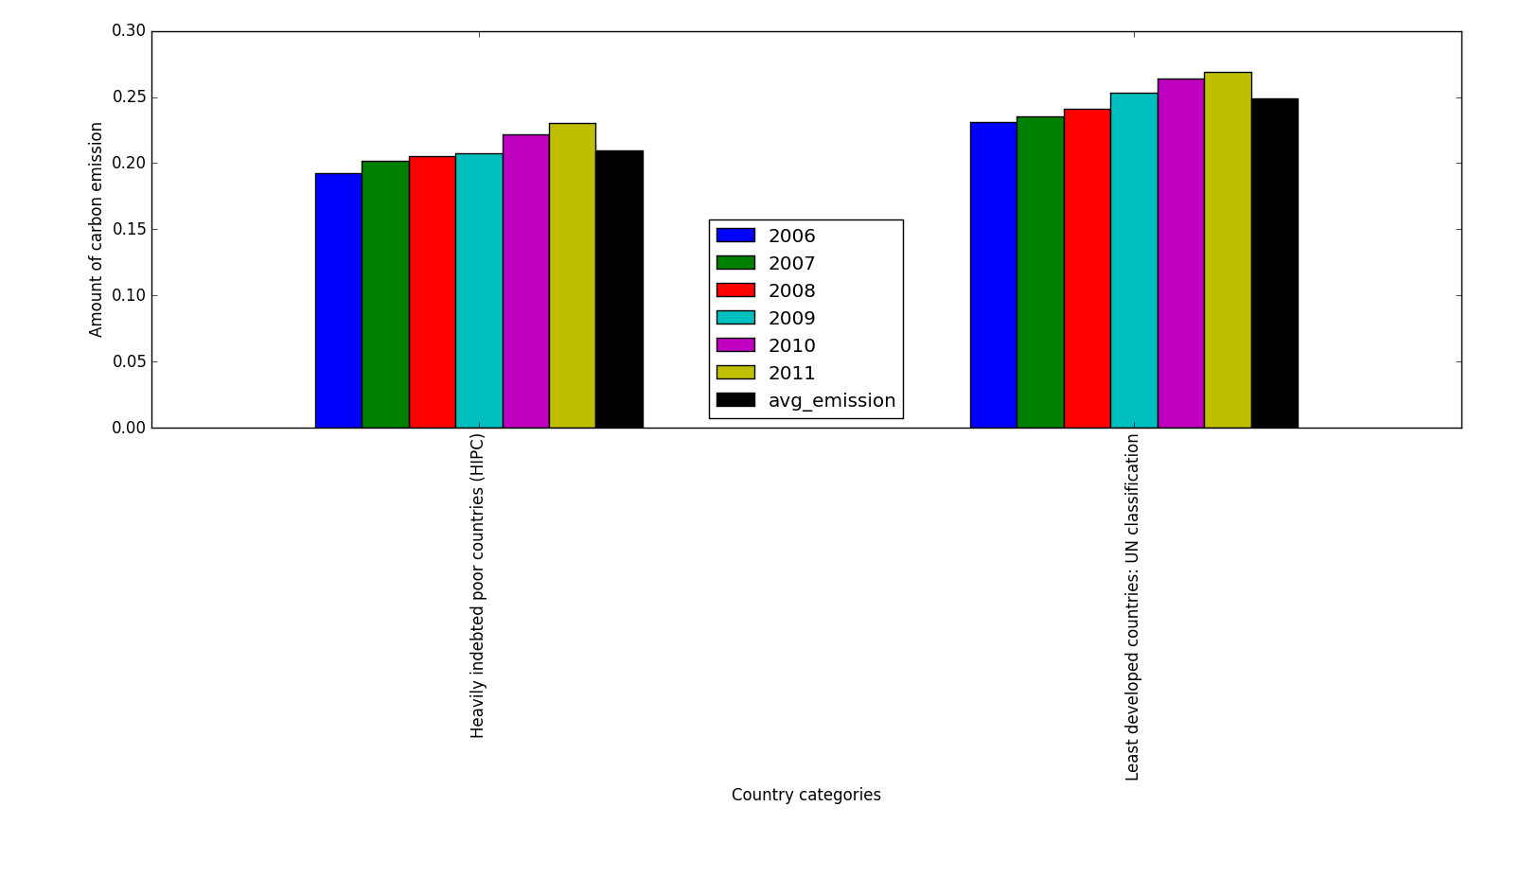
©Hari Pad Bharti

Slide 6
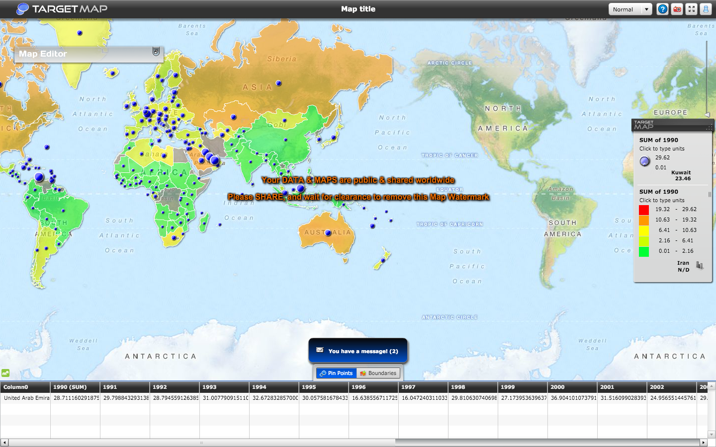
©Hari Pad Bharti

Slide 7
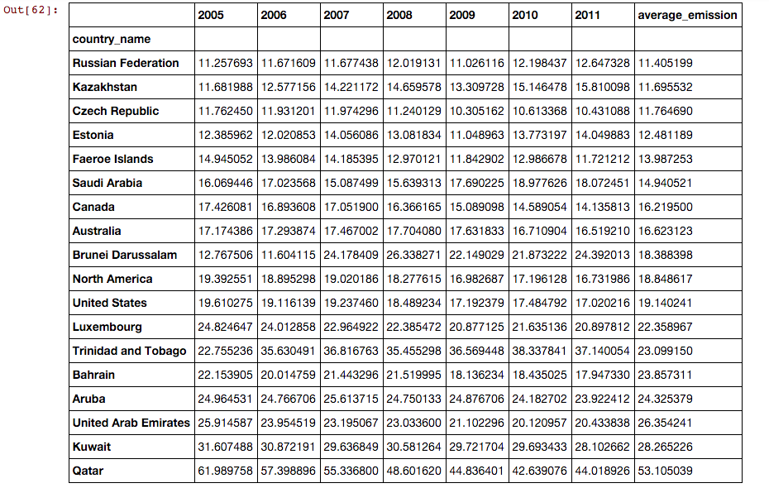
©Hari Pad Bharti

Slide 8
Results
Household requirements produces maximum Carbon Emission (~70%)
There exists direct proportional relation between Economy of the region and its Carbon Emission.
Carbon Emission significantly reduced in past 2-3 years
Forest cover reduced with increase in Carbon Emission.
Developed Countries emitted maximum carbon.
There is a rise in Carbon Emission by Developing Countries like India and China .
Trend Shows overall carbon emission will increase in next coming years ( ct. developing nations)
United States stands at 8th position in Carbon Emission with significant reduction in emission during past 5 years
©Hari Pad Bharti

Slide 9
How this project can help ?
Help us understand the path of SUSTAINABLE DEVELOPMENT
Helps to establish and find effects of environmental factors on Economy.
Predict the future based on past trends.
Environmental exploitation is not a right way to grow Economy.
©Hari Pad Bharti

